Slide 1

<anglular.io/>
Training Sessions

Slide 2

Agenda
JavaScript Ecosystem
Paradigm Shift
Angular Introduction
What is Angular
Architecture
Associated Frameworks
TypeScript
Angular Components

Slide 3

JavaScript Eco System -*
Build & Package Tool
MVC Framework
Server Side Framework
Grunt
Gulp
JSPM
WebPack
NPM
Bower
Lite-Server
Mock-server
Layout Framework
JS Libraries
CSS Preprocessors
JS Languages (ECMA V5/6)
AngularJS
Angular.io
EmberJS
BackBone
ReactJS
Express
MongoDB
CommonJS
Hapi
UI Components
jQuery
Kendo UI
ExtJS
DOJO
SASS
Stylus
LESS
TypeScript
CofeeScript
DartLang
BootStrap
INK
Mueller
Skeleton
Google-MD
Testing Framework
Polymer
SkateJS
Stencil
BoSonic
Karma
Jasmine
Protactor
NodeJS / IO.JS
Browser
JS Runtime
Nashorn
Google V8
Spider Monkey
Chakra
JVM
Host Machine
</JavaScript>
* → indicates only the popular & widely used tools and frameworks
Mature Eco System with enterprise grade tools and framework
Cohesive & Self Contained Feature set
Relatively Light weight Solution & eases various deployment level issues

Slide 4
The As-IS State Implementation
Deployed as WAR/EAR, and contains both Presentation and Business logic components, unless distributed into different nodes.
The Presentation layer would get processed in the Server Side, and rendered on the user browser.
Upon rendering, the browser gets a chunk of payload containing HTML elements such as HTML Code, JS, CSS, and Data.
The predominant communication between Browser and the Server is over HTTP(S), and GET and POST used.
Uses HTTP’s Session store for persisting user context data.
The Browser is responsible for DOM manipulation, UI validations, AJAX Calls only.
The Page Navigation, Execution is being done on the Server Side.
Pros
    Uni Technology Architecture
    Easier to Maintain & Develop
    Needs only Java Team
Cons
    Multi Channel/layout Capability. ?
    Responsiveness ?
    Not harnessing the Browser Capability. ?
    Relatively Heavy Weight Solution. ?
    Limited Scalability. ?

Slide 5
The Angular Implementation
Based on SPA Concept, and entire UI layer is developed using Angular Stack
Module Design – the functionality of the applications can be grouped as modules, and managed separately
Angular itself architected as a collection of modules such as FormsModule, CoreModue, ServerSIdeModule etc
Has native integration with RWD tools such as BootStrap, MediaQueries etc
The UI Application gets downloaded for the first time, and gets executed on the browser for all its need. Ex For Routing, Validation, Rendering, DOM Manipulation, Server Side Calls, Data Binding etc.
REST Protocol over HTTPS being used to communicate between Browser and the Server layer.
JSON is the format of data being used.
Uses REST Verbs such as GET,POST,UPDATE,DELETE for all its actions.
Pros
  Java Script based JS Framework backed by Google.
  Faster to Develop
  Multi Layout/Channel Capability
  Mobile enablement is faster & easier
  High Scalability with the user of Promise & Observable.
  Easier to Maintain & Develop
Cons
  New Technology to be learnt
  One more technology in landscape

Slide 6
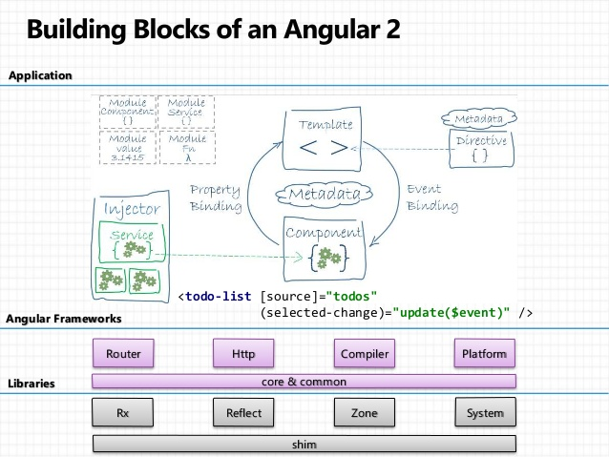
Angular Introduction
Angular JS is an open source framework built over JavaScript. This framework was used to overcome obstacles encountered while working with Single Page applications. Also, testing was considered as a key aspect while building the framework. It was ensured that the framework could be easily tested.
TypeScript based open-source front-end web application platform
Angular 2 uses a hierarchy of components as its main architectural concept
The desktop development is much easier when mobile performance issues are handled first
Works well in modern browsers
Improved dependency injection – bindings make it possible for dependencies to be named
Reactive programming support using RxJS
Modularity – much core functionality has moved to modules, producing a lighter, faster core
Angular also includes the benefits of ES6:Lambdas
  Iterators
  For/Of loops
  Python-style generators
  Reflection
TypeScrips is recommended one, optionally its supports DART,JavaScript

Slide 7
Angular Benefits
Angular2/4 is 5x faster than AngularJS 1.x
Loose Coupling
Support for Web Components
Ease in Templating, Form Field Management, Routing
Server Side UI rendering
Modular approach
Native Mobile Support
Rich Tool Set Support
  IDE
  Build Management
  Development Support
  Debugging Tools (browser based)
Strong Static Typing
ECMA 5/6 Compatibility
Multi Language Support
  TypeScript (Recommended)
  Dart
  JavaScript

Slide 8
Angular Building Blocks
Data Binding
Template
Service
Dependency Injection
Module
Component
Metadata
Directive

Slide 9
Micro Services
Pause for TypeScript

Slide 10
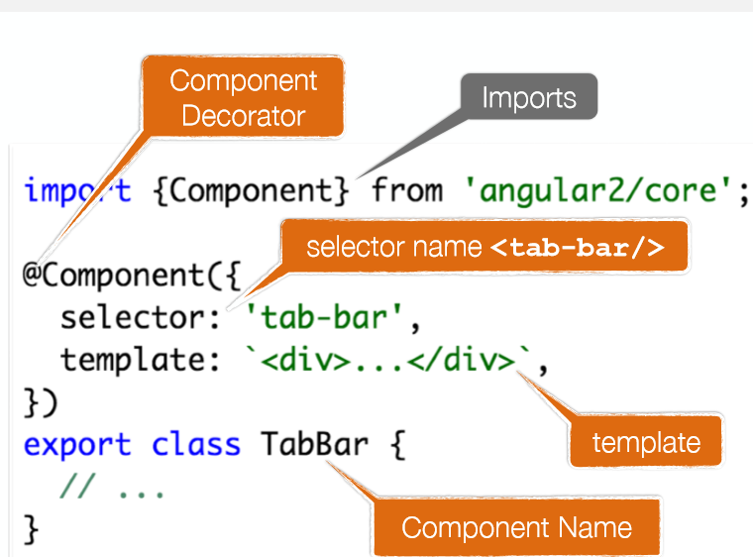
Angular 6 Components
Angular.io

Slide 11
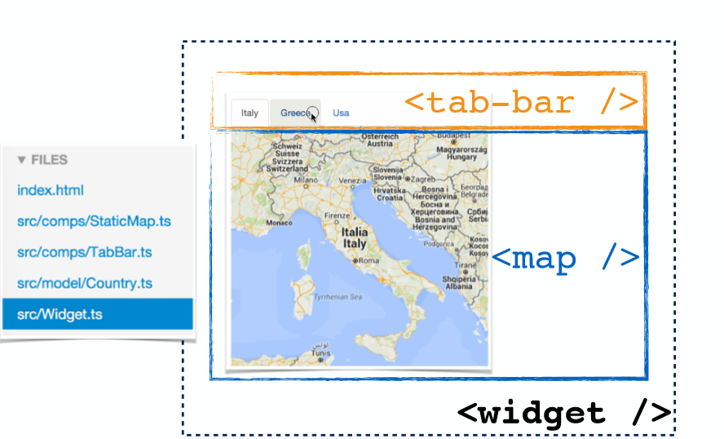
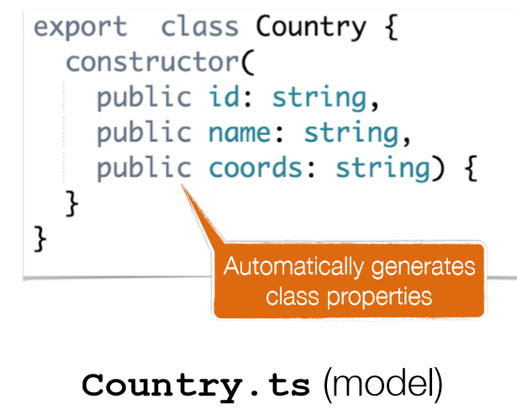
Angular 6 Components
Angular.io
http://plnkr.co/edit/vllrTYuOo6VJE7vMPEfQ?p=preview

Slide 12
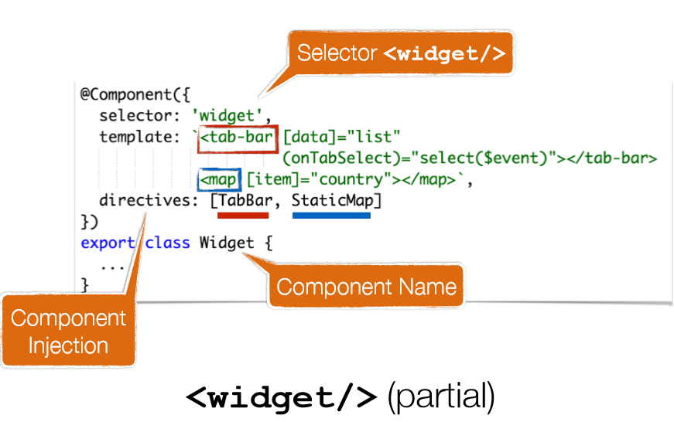
Angular 6 Components
Angular.io

Slide 13
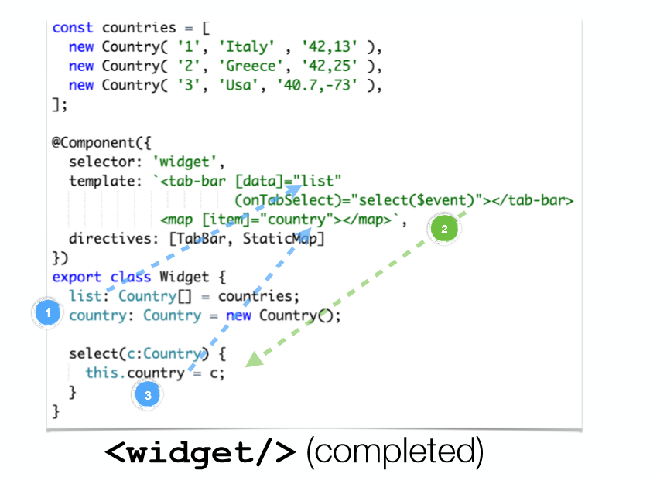
Angular 6 Components
Angular.io

Slide 14
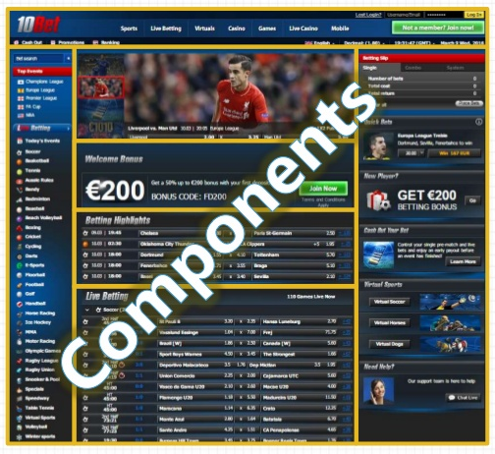
Angular 2 Components
Modules − This is used to break up the application into logical pieces of code. Each piece of code or module is designed to perform a single task.
Component − This can be used to bring the modules together.
Templates − This is used to define the views of an Angular JS application.
Metadata − This can be used to add more data to an Angular JS class.
Service − This is used to create components which can be shared across the entire application.
RS
Angular.io

Slide 15

Angular 2 Environment Setup
Install Node.js® and npm if they are not already on your machine.
Install AngularJS
Create a new project
Start the application
Angular.io
Verify that you are running at least node 6.9.x and npm 3.x.x by running node -v and npm -v in a terminal/console window. Older versions produce errors, but newer versions are fine.
$ npm install –g @angular/cli
$ ng new my-app
$ cd my-app
$ ng serve --open
Output in the Default
Browser:-

Slide 16
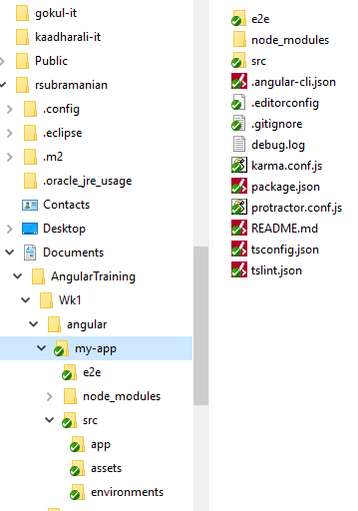
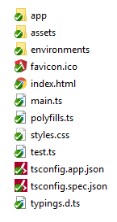
Angular 2 Project Folder Setup
Angular.io
Project Structure create by ng package
Project is compatable with IDE such as NodePad++, Atom, Sublime etc
Points to Note:-
Package.json → Has details about 3rd Party Packasges, and Custom Scripts
tsconfig.json → TypeScript compiler configuration for your IDE
tslint.json → Linting configuration for TSLint together with Codelyzer (when ng lint)
karma.conf.js → Unit test configuration for the Karma test runner, used when running ng test
E2e/ → which has e2e test cases.
node_modules → place where all dependent packages are stored in a recursive fashion.
environments/* → For maintaining env specific configurations.
assets/* → A folder where you can put images and anything else to be copied wholesale when you build your application.
index.html → main html file where all js/css files are linked (at runtime)
main.ts → entry point for the application

Slide 17
Angular 2 Sample Code Base
app.module.ts
app.component.ts
Angular.io
@NgModule({
declarations: [
AppComponent
],
imports: [
BrowserModule
],
providers: [],
bootstrap: [AppComponent]
})
import { Component } from '@angular/core';
@Component({
selector: 'app-root',
templateUrl: './app.component.html',
styleUrls: ['./app.component.css']
})
export class AppComponent {
title = 'app';
}
c
a
index.html
<!doctype html>
<html lang="en"><head>
<title>MyApp</title>
<base href="/">
<meta name="viewport" content="width=device-width, initial-scale=1"> <link rel="icon" type="image/x-icon" href="favicon.ico">
</head>
<body>
<app-root></app-root>
</body>
</html>
app.component.html
<h1> Welcome to {{title}}!! </h1>
<h2>Here are some links to help you start: </h2>
b

Slide 18
Micro Services
Data Binding

Slide 19
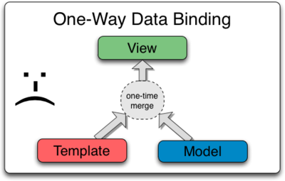
Data Binding / interpolation – One Way

Slide 20
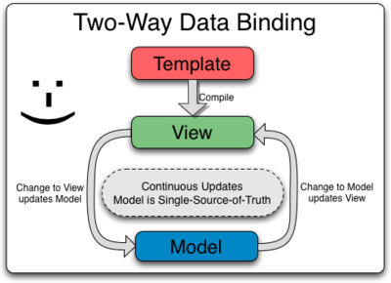
Data Binding / interpolation – 2 Way Binding

Slide 21
Data Binding / interpolation
….the insertion of something of a different nature into something else.

Slide 22
Data Binding / interpolation
import { Component } from '@angular/core';
@Component({
selector: 'app-root',
template: `
<h1>{{title}}</h1>
<h2>My favorite hero is: {{myHero}}</h2>
`
})
export class AppComponent {
title = 'Tour of Heroes';
myHero = 'Windstorm';
}

Slide 23
Data Binding / interpolation – via Constructor
export class AppCtorComponent {
title: string;
myHero: string;
constructor() {
this.title = 'Tour of Heroes';
this.myHero = 'Windstorm';
}
}

Slide 24
Data Binding / interpolation – 2 Way Binding
<input [(ngModel)]="username">
<p>Hello {{username}}!</p>
OR
<input [value]="username" (input)="username = $event.target.value">
<p>Hello {{username}}!</p>
[value]=”username” - Binds the expression username to the input element’s value property
(input)=”expression” - Is a declarative way of binding an expression to the input element’s input event (yes there’s such event)
username = $event.target.value - The expression that gets executed when the input event is fired
$event - Is an expression exposed in event bindings by Angular, which has the value of the event’s payload

Slide 25
Data Binding / interpolation – 2 Way Binding
<input [ngModel]="username" (ngModelChange)="username = $event">
<p>Hello {{username}}!</p>
The property binding [ngModel] takes care of updating the underlying input DOM element.
The event binding (ngModelChange) notifies the outside world when there was a change in the DOM.
ngModelChange takes care of extracting target.value from the inner $event payload

Slide 26
Data Binding / interpolation – Custom 2 Way Binding
app/counter.component.ts
export class CounterComponent {
@Input() count = 0;
@Output() countChange = EventEmitter<number>();
increment() {
this.count++;
this.countChange.emit(this.count);
}
}
app/counter.component.html
<div>
<p>
Count: {{ count }} -
<button (click)="increment()">Increment</button>
</p>
</div>

Slide 27
Data Binding / interpolation – NGFor*
export class AppComponent {
title = 'Tour of Heroes';
heroes = ['Windstorm', 'Bombasto', 'Magneta', 'Tornado'];
myHero = this.heroes[0];
}
template: `
<h1>{{title}}</h1>
<h2>My favorite hero is: {{myHero}}</h2>
<p>Heroes:</p>
<ul>
<li *ngFor="let hero of heroes">
{{ hero }}
</li>
</ul>
`

Slide 28
Data Binding / interpolation – NgIf*
<p *ngIf="heroes.length > 3">There are many heroes!</p>

Slide 29

Micro Services

Slide 30
Micro Services
Event Handling

Slide 31
Event handling
Clickmessage(){}
Form Control(s)
Event:On Click
Event:On Select
onChange(){}
event
<button (click)="onClickMe()">Click me!</button>
{{clickMessage}}
export class ClickMeComponent {
clickMessage = '';
onClickMe() {
this.clickMessage = 'You are my hero!';
}
}

Slide 32
Event handling
<input (keyup)="onKey($event)">
<p>{{values}}</p>
export class KeyUpComponent_v1 {
values = '';
onKey(event: any) { // without type info
this.values += event.target.value + ' | ';
}
}
The properties of an $event object vary depending on the type of DOM event. For example, a mouse event includes different information than an input box editing event.

Slide 33
Event handling – with Proper Data Type
<input (keyup)="onKey($event)">
<p>{{values}}</p>
export class KeyUpComponent_v1 {
values = '';
onKey(event: KeyboardEvent) { // with type info
this.values += (<HTMLInputElement>event.target).value + ' | ';
}
}
The $event is now a specific KeyboardEvent.

Slide 34
Event handling – with “Template Reference Variable”
@Component({
selector: 'app-key-up2',
template: `
<input #box (keyup)="onKey(box.value)">
<p>{{values}}</p>
`
})
export class KeyUpComponent_v2 {
values = '';
onKey(value: string) {
this.values += value + ' | ';
}
}
The template reference variable named box, declared on the <input> element, refers to the <input> element itself. The code uses the box variable to get the input element's value and display it with interpolation between <p> tags.

Slide 35
Event handling – with “Template Reference Variable” (Key Event Filter)
@Component({
selector: 'app-key-up3',
template: `
<input #box (keyup.enter)="onEnter(box.value)">
<p>{{value}}</p>
`
})
export class KeyUpComponent_v3 {
value = '';
onEnter(value: string) { this.value = value; }
}

Slide 36
Event handling – with “Template Reference Variable” (Multi Event Handling)
@Component({
selector: 'app-key-up4',
template: `
<input #box
(keyup.enter)="update(box.value)"
(blur)="update(box.value)">
<p>{{value}}</p>
`
})
export class KeyUpComponent_v4 {
value = '';
update(value: string) { this.value = value; }
}

Slide 37
Event handling – with “Template Reference Variable” - Observations
Use template variables to refer to elements
Pass values, not elements
Keep template statements simple

Slide 38
Micro Services

Slide 39
Micro Services
LifeCycle Hooks

Slide 40
Life Cycle Hooks
Angular creates it, renders it, creates and renders its children, checks it when its data-bound properties change, and destroys it before removing it from the DOM.
Angular offers lifecycle hooks that provide visibility into these key life moments and the ability to act when they occur.

Slide 41
Life Cycle Hooks
export class PeekABoo implements OnInit {
constructor(private logger: LoggerService) { }
// implement OnInit's `ngOnInit` method
ngOnInit() { this.logIt(`OnInit`); }
logIt(msg: string) {
this.logger.log(`#${nextId++} ${msg}`);
}
}
No directive or component will implement all of the lifecycle hooks.
Angular only calls a directive/component hook method if it is defined.

Slide 42
Life Cycle Hooks
ngOnChanges() | Respond when Angular (re)sets data-bound input properties.
ngOnInit() | Initialize the directive/component after Angular first displays the data-bound properties and sets the directive/component's input properties.
ngDoCheck() | Detect and act upon changes that Angular can't or won't detect on its own. Called during every change detection run, immediately after ngOnChanges() and ngOnInit().
ngOnDestroy() | Cleanup just before Angular destroys the directive/component. Unsubscribe Observables and detach event handlers to avoid memory leaks. Called just before Angular destroys the directive/component.
Other Hooks :- ngAfterContentInit() ngAfterContentChecked() ngAfterViewInit() ngAfterViewChecked()

Slide 43
Micro Services

Slide 44
Micro Services
Services and Dependency Injection

Slide 45
Services and DI
Service is a broad category encompassing any value, function, or feature that an app needs.
DI framework provides declared dependencies to a class when that class is instantiated.

Slide 46

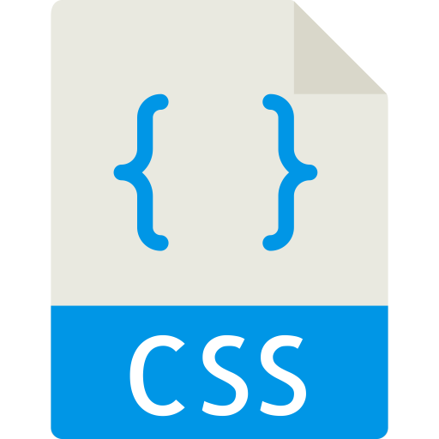
Services and DI
Dependency
Injection
@Injectable
LoggerService
@Component
Component
constructor(loggerService,heroService)
@Injectable ExceptionService
Dependency
Injection
@Injectable HeroService
Dependency
Injection
`
[Declarations]
[providers]
[providers]
[providers]
@NGModule

Slide 47
Services and DI
A service is typically a class with a narrow, well-defined purpose. For example LoggerService, HttpClientService, DataTransformationService
Angular creates a single, shared instance of LoggerService and injects it into any class that asks for it
Makes the component layer more leaner and improved manageability.
Supports Contract based Implementation using Interfaces.

Slide 48
Services and DI – Service Definition
src/app/logger.service.ts
@Injectable()
export class Logger {
log(msg: any) { console.log(msg); }
error(msg: any) { console.error(msg); }
warn(msg: any) { console.warn(msg); }
}

Slide 49
Services and DI – Service Injection –Option 1
src/app/hero-list.component.ts
@Component({
selector: 'app-hero-list',
templateUrl: './hero-list.component.html',
providers: [ LoggerService ]
})

Slide 50
Services and DI – Service Injection –Option 2
src/app/hero-list.component.ts
constructor(private service: LoggerService) { }

Slide 51
Services and DI – Service Injection – to a given Module
src/app/app-module.ts
@NgModule({
providers: [
  BackendService,
  LoggerService
],
...
})}

Slide 52
Services and DI – Service Injection – Injectable Decorator
import { Injectable } from '@angular/core'; @Injectable({ providedIn: 'root', }) export class UserService {} | 'root’ → injectable will be registered as a singleton in the application, & not required to add it to the providers of the root module.
import { Injectable } from '@angular/core'; import { UserModule } from './user.module'; @Injectable({ providedIn: UserModule, }) export class UserService {} | The Service is available only the module “UserModule”
import { NgModule } from '@angular/core'; import { UserService } from './user.service'; @NgModule({ providers: [UserService], }) export class UserModule {} | The Service is available only the module “UserModule”

Slide 53
Micro Services
NGModule

Slide 54
NgModules
@NgModule
NgModules are containers for a cohesive block of code dedicated to an application domain, a workflow, or a closely related set of capabilities

Slide 55
NgModules –Meta Data →Sample Code Snippet
@NgModule({
declarations: [
AppComponent,
ItemDirective
],
imports: [
BrowserModule,
FormsModule,
HttpClientModule
],
export:[],
providers: [],
bootstrap: [AppComponent]
})
export class AppModule { }

Slide 56
NgModules –Meta Data →Declarations
The components, directives, and pipes that belong to this NgModule.

Slide 57
NgModules –Meta Data →exports
The subset of declarations that should be visible and usable in the component templates of other NgModules.

Slide 58
NgModules –Meta Data →imports
Other modules whose exported classes are needed by component templates declared in this NgModule.

Slide 59
NgModules –Meta Data →Providers
Creators of services that this NgModule contributes to the global collection of services; they become accessible in all parts of the app. (You can also specify providers at the component level, which is often preferred.)

Slide 60
NgModules –Meta Data →bootstrap
The main application view, called the root component, which hosts all other app views. Only the root NgModule should set the bootstrap property.

Slide 61
NgModules – Hierarchy
NGModule
Component 1
Component 2
Service
Directive
Pipe
Embed Component
Embed Component
Embed Component

Slide 62
NgModules – Importing other Modules (Feature Modules)
@NgModule({
declarations: [
AppComponent
],
imports: [
BrowserModule,
FormsModule,
HttpClientModule,
CustomerDashboardModule
],
providers: [],
bootstrap: [AppComponent]
})
export class AppModule { }
NGModule
Core Modules
Feature Modules
Browser Module
Forms Module
HTTP Client Module
Dashboard Module
Funds Transfer Module
User Profile Module

Slide 63
NgModules – Importing other Modules (Feature Modules)
$> ng generate module CustomerDashboard

Slide 64

Micro Services

