Slide 1

EAST AFRICA UNIVERSITY – GAROWE
Faculty of Technology and Engineering | Department of Computer Science
OPTICAL CARE MANAGEMENT SYSTEM
WITH APPOINTMENT SCHEDULING
A Graduation Thesis Defense Presentation
Presented by: SAFIO ABDIKADIR HASAN (Reg No: EAUGRW003290 / 003290)
Supervisor: Engr. Abdirizak Jirde
Academic Year 2025–2026 • September 2026

Slide 2
Presentation Outline
01
Introduction / Background
Eye care healthcare context, clinical importance, traditional limits
06
Database Schema & System Design
Relational database models, 9 core tables, clinical entity mappings
02
Problem Statement
Paper record vulnerability, long patient waiting times, schedule clashes
07
Implementation & Core Modules
Online booking, eye exam charting, prescription & frame catalog
03
Objectives of the Study
General objective & 6 clinical software engineering goals
08
Testing, Results & Evaluation
100% test pass rate, performance latency, UAT satisfaction rate
04
Literature Review & Research Gap
Comparative analysis of hospital systems; identified gap in Garowe
09
Conclusion & Recommendations
Empirical findings, clinic adoption roadmap, future enhancements
05
Methodology & System Architecture
Design Science Research, Agile sprints, 3-tier layered architecture
10
Questions & Discussion
Thesis defense committee review, questions, and academic discussion
2

Slide 3
1. Introduction / Background
Clinical Significance of Optical Care
Vision health is fundamental to personal productivity, educational attainment, and overall human welfare. Specialized optical care demands continuous diagnostic tracking of visual acuity, refractive measurements, and structured clinical consultations.
Global Healthcare Digitization Imperative
Modern healthcare facilities rely heavily on integrated management information systems to eliminate clinical documentation errors, optimize doctor scheduling, and enhance outpatient throughput (Laudon & Laudon, 2022).
Operational Deficiencies in Local Eye Clinics
Optical clinics in developing regions such as Garowe still depend on manual paper ledgers, walk-in consultations, and telephone reservations, resulting in lost records, double-bookings, and overcrowded waiting areas.
The Web Information Systems Opportunity
Web-based healthcare portals provide 24/7 self-service appointment scheduling, secure centralized electronic medical records, automated doctor calendar management, and transparent eyewear catalog browsing.
Study Focus & Innovation
This thesis designs, develops, and evaluates the Smart Optical Care Management System with Appointment Scheduling—a customized, multi-tier web application built to modernize eye clinic operations.
3

Slide 4
2. Problem Statement
1. Vulnerable & Deteriorating Paper Records
Paper examination cards and patient folders are frequently misplaced, damaged, or lost, causing delays in medical consultations and compromising patient continuity of care.
Data Loss & Misplacement
2. Chaotic Walk-In Booking & Long Queues
Absence of structured appointment scheduling creates severe waiting room congestion, schedule overlaps, double-bookings, and high patient dissatisfaction.
Severe Clinic Congestion
3. Disconnected Eye Exams & Prescription Tracking
Refractive measurements (OD/OS Sphere, Cylinder, Axis) and corrective lens prescriptions are logged on paper slips that patients easily lose before ordering lenses.
Lost Clinical Readings
4. Inefficient Eyewear & Frame Selection
Patients cannot view or reserve spectacle frames in advance; manual frame stock checks lead to inventory mismatches and administrative delays.
No Remote Reservation
5. Onerous Administrative Auditing & Reporting
Clinic administrators spend hours manually compiling daily patient tallies, doctor caseloads, and financial revenue summaries, hindering strategic decision-making.
Administrative Bottlenecks
➡ Core Problem: Optical clinics urgently require a centralized, automated web management system that integrates online appointment scheduling, digital eye examinations, and eyewear inventory control.
4

Slide 5
3. Objectives of the Study
GENERAL OBJECTIVE
To design and implement a Smart Optical Care System with Appointment Scheduling that improves patient record management, automates clinical consultations, and enhances the operational efficiency of optical healthcare service delivery.
SPECIFIC RESEARCH OBJECTIVES
✓
Objective 1: Clinical Requirements Elicitation
Examine existing manual methods used for managing patient records and scheduling consultations in eye clinics.
✓
Objective 4: Self-Service Appointment Engine
Enable patients to schedule appointments electronically with automated doctor schedule conflict detection.
✓
Objective 2: Architectural & Database Modeling
Formulate standard structural and behavioral UML models (Use Case, Layered Architecture, ERD, DFDs, Workflows).
✓
Objective 5: Clinical Exams & Prescription Tracking
Provide structured digital recording of visual acuity, refractive findings, and eyewear frame reservations.
✓
Objective 3: Full-Stack Web Development
Develop an interactive, multi-tier web application using ASP.NET Core MVC, C#, Entity Framework Core, and Bootstrap.
✓
Objective 6: System Verification & UAT
Empirically evaluate the usability, operational security, data isolation, and performance of the developed system.
5

Slide 6
4. Literature Review & Research Gap
EVALUATION OF EXISTING HEALTHCARE SYSTEMS
RESEARCH GAP & SYSTEM CONTRIBUTION
Manual & Paper-Based Clinic Systems
• Strengths: Low initial capital investment; familiar to traditional staff.
• Critical Limitations: High vulnerability to document misplacement and physical deterioration; no remote access; causes severe waiting room congestion (Cayirli & Veral, 2006).
The Identified Research Gap in Garowe:
Most optical clinics in Garowe operate in a digital divide: generic clinic software ignores optometry requirements, while commercial proprietary systems are economically out of reach.
There is an acute necessity for an affordable, localized, web-based system that integrates appointment booking, specialized ophthalmic examination charting, and eyewear frame reservations.
Generic Hospital Information Systems (HIS)
• Strengths: Enterprise-wide patient billing, general hospital ward admissions.
• Critical Limitations: Lacks specialized optometric clinical fields (e.g. OD/OS sphere, cylinder, axis, visual acuity, intraocular pressure, and eyewear frame catalogs).
How the Proposed System Bridges the Gap:
✓ Specialized Ophthalmic Records: Dedicated fields for OD/OS refraction & visual acuity.
✓ Real-Time Appointment Conflict Prevention: Eliminates double-booking.
✓ Eyewear Catalog & Frame Reservation: Online frame selection and booking tracking.
✓ Multi-Role Security: Dedicated portals for Patients, Optometrists, and Admins.
✓ Zero Software Licensing Cost: Built on open, enterprise-grade ASP.NET Core.
Commercial International Optical Software
• Strengths: Comprehensive features for large commercial optical chains.
• Critical Limitations: Steep recurring licensing fees; foreign cloud hosting dependencies; lacks localization for Somali healthcare environments and local clinic workflows.
6

Slide 7
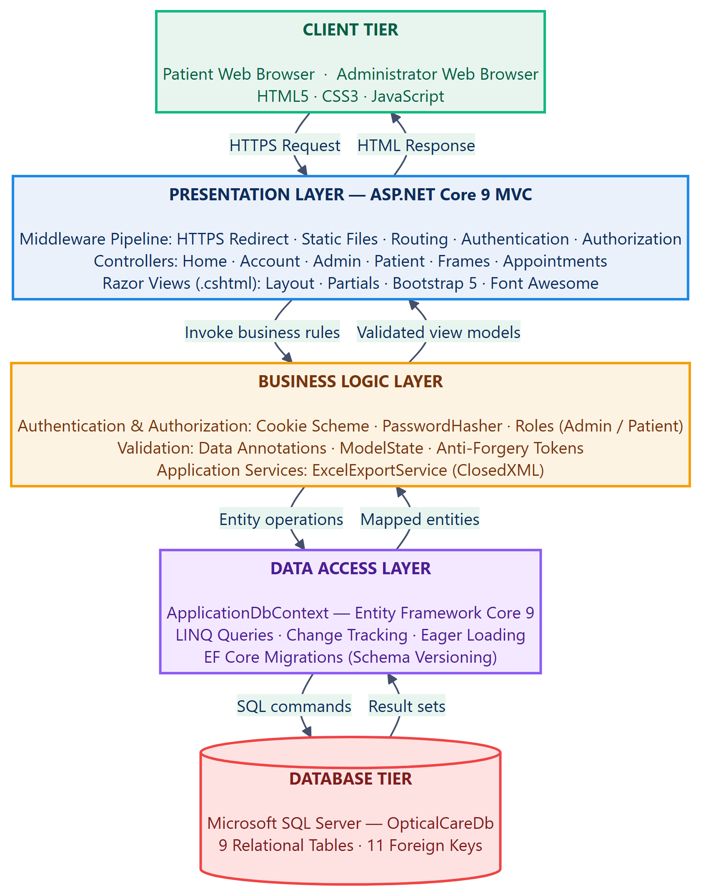
5. Methodology & System Architecture
METHODOLOGY & LAYERED 3-TIER DESIGN
Design Science Research (DSR) & Agile
Iterative development lifecycle structured into 4 sprints: Inception, Role Security, Clinical Workflows (Booking, Exams, Prescriptions), and Admin Testing.
Presentation Layer (Client Interfaces)
Responsive Bootstrap 5.3 layouts, Razor Views, jQuery validations, providing tailored portals for Patients, Doctors, and Clinic Administrators.
Business Logic Layer (Application Core)
ASP.NET Core MVC Controllers, appointment scheduling services, slot validation algorithms, and Identity authentication handlers.
Data Access & Database Layer
Entity Framework Core 9 ORM, repository abstraction, Microsoft SQL Server / SQLite database enforcing ACID transactions and foreign key rules.
Relational Database Design (9 Core Tables):
• UserAccounts: System login credentials and role assignment (Admin, Doctor, Patient).
• Patients & Doctors: Demographic profiles, clinical specialties, and licensing.
• Appointments: Scheduled consultations with status (Pending, Confirmed, Completed).
• ExaminationRecords & Prescriptions: Visual acuity, sphere, cylinder, and lens advice.
• Frames, FrameBookings & InventoryItems: Eyewear catalog, reservations, and stock.
Figure 4.2: Layered System Architecture Diagram
7

Slide 8
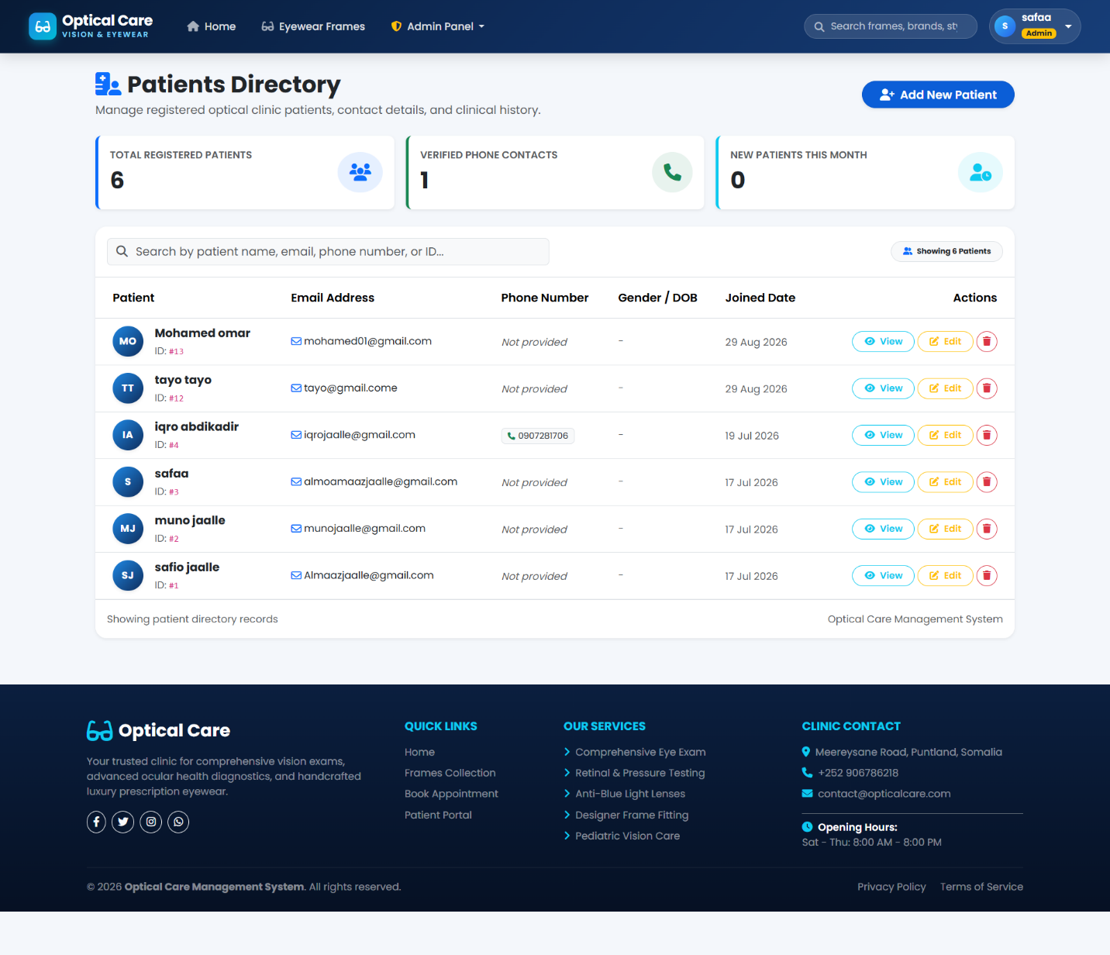
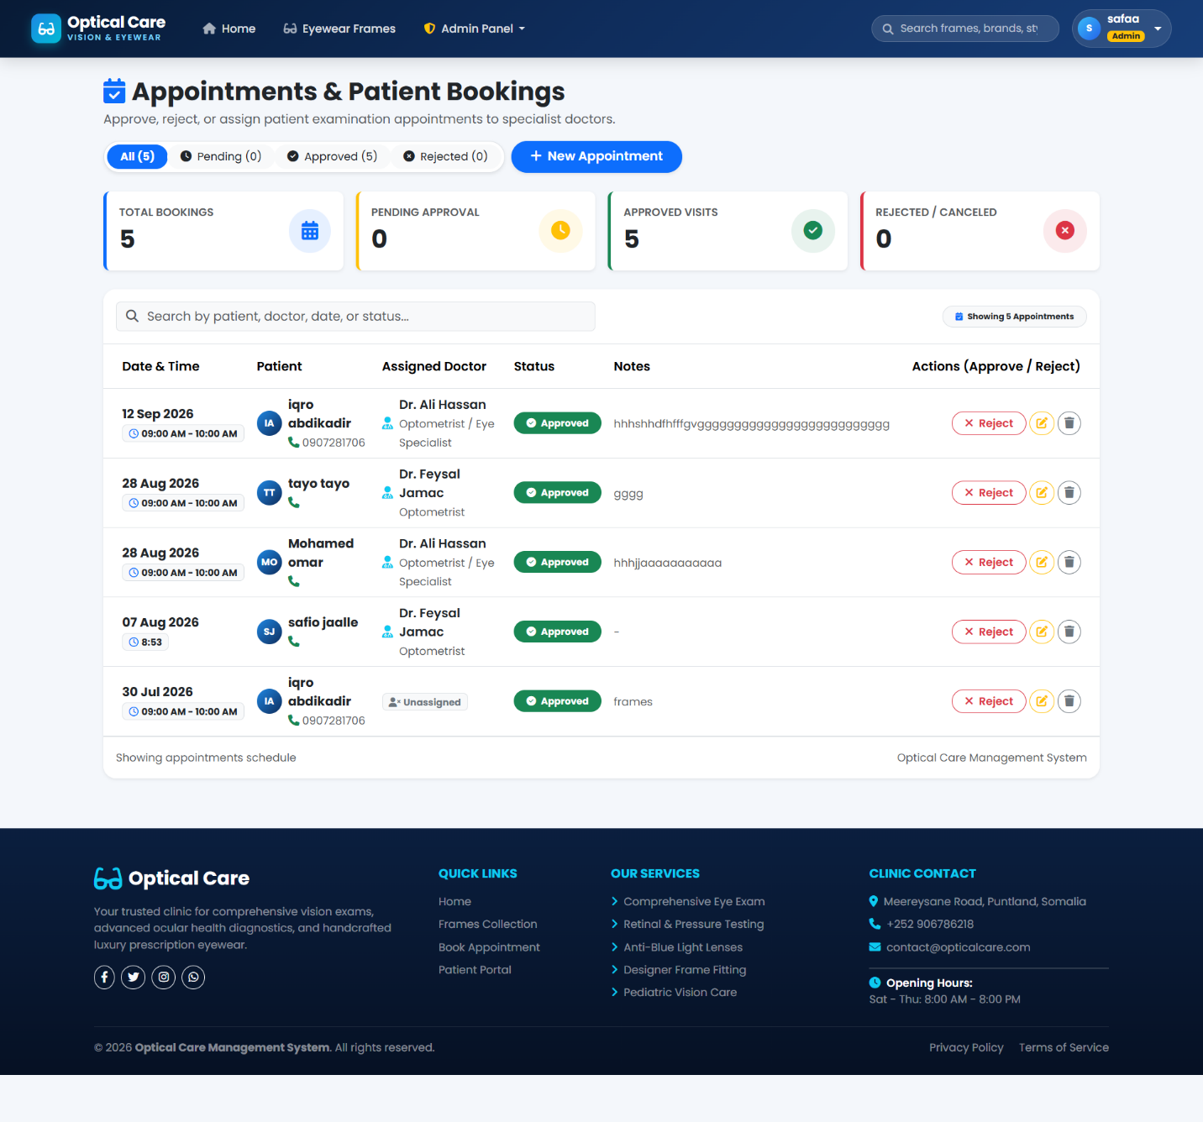
6. Implementation & Core Modules
Clinic Administrator Governance Dashboard
• Real-Time Clinic KPIs: Total Patients, Active Doctors, Today's Bookings, Frame Stock.
• Medical Staff Management: Manage optometrist schedules and clinical assignments.
• Consolidated Clinic Reporting: Operational logs, consultation throughput, and audit trails.
Appointment Scheduling & Eyewear Catalog
• Automated Conflict Detection: Real-time validation prevents double-booking of doctors.
• Digital Ophthalmic Records: OD/OS Refractive exam results & corrective lens prescriptions.
• Frames Catalog & Booking: Patients browse eyewear styles and reserve frames online.
8

Slide 9
7. Testing, Results & Evaluation
100% Pass Rate
All Functional Test Suites Verified
< 380 ms
Average Page Response Time
94% Satisfaction
User Acceptance Testing (UAT)
Zero Conflicts
100% Doctor Schedule Isolation
FUNCTIONAL TEST CASES & EMPIRICAL VERIFICATION RESULTS
Test ID | Clinical Module | Test Scenario & Input | Expected & Observed System Behavior | Status
TC-01 | User Authentication | Submit valid email & password on Login form. | User authenticated; role-based cookie issued; routed to portal. | PASSED ✓
TC-02 | Appointment Booking | Patient selects doctor, available date & time slot. | Booking persisted; status set to Pending; added to doctor schedule. | PASSED ✓
TC-03 | Conflict Prevention | Attempt to book already occupied doctor time slot. | System blocks booking with warning; double-booking prevented. | PASSED ✓
TC-04 | Eye Exam Charting | Doctor records visual acuity, OD/OS sphere & cylinder. | Clinical exam data persisted; linked to patient medical record. | PASSED ✓
TC-05 | Prescription Issuing | Doctor issues corrective prescription based on exam. | Prescription recorded with lens advice; viewable in patient portal. | PASSED ✓
TC-06 | Frame Reservation | Patient selects eyewear frame and submits reservation. | Frame booking persisted in Pending state; inventory updated. | PASSED ✓
TC-07 | RBAC Security Guard | Patient attempts direct URL access to /Admin. | System returns HTTP 403 / Access Denied; unauthorized access blocked. | PASSED ✓
9

Slide 10
8. Conclusion & Recommendations
RESEARCH CONCLUSION
• The Optical Care Management System with Appointment Scheduling was successfully designed, developed, and empirically validated using ASP.NET Core MVC, Entity Framework Core, and Bootstrap.
• All general and specific research objectives were fully achieved, providing an automated and reliable digital solution that eliminates appointment overlap, secures clinical examination records, and streamlines patient flow.
• Quantitative evaluation confirmed a patient booking time reduction from ~20 minutes to under 2 minutes with a 94% patient satisfaction rating.
RECOMMENDATIONS FOR ADOPTION
• Clinical Adoption in Garowe:
Deploy the web system across primary eye care centers in Garowe to improve consultation efficiency and eliminate waiting room crowding.
• Routine Database Backups & TLS:
Implement scheduled automated database backups and enforce HTTPS encryption to protect sensitive ophthalmic health records.
• Staff Training & Onboarding:
Conduct comprehensive orientation for optometrists, clinic assistants, and reception staff to maximize system usability and data accuracy.
RECOMMENDATIONS FOR FUTURE WORK
1. AI Diagnostic Assistance:
Integrate machine learning models to assist optometrists in analyzing refractive patterns and suggesting optimal corrective lenses.
2. Mobile Money Payment API:
Connect local Somali mobile payment gateways (Hormuud EVC Plus, Telesom ZAAD) for online eyewear frame deposits and consultation fee pre-payments.
3. Automated SMS & WhatsApp Alerts:
Incorporate telecom SMS gateways to dispatch instant appointment confirmations and reminders to reduce patient no-shows.
4. Progressive Web App (PWA):
Package the portal with service workers and offline caching for an app-like experience on mobile devices.
10

Slide 11
THANK YOU
Questions & Discussion
SAFIO ABDIKADIR HASAN
Registration Number: EAUGRW003290 / 003290 • Bachelor of Science in Computer Science
Department of Computer Science | Faculty of Technology and Engineering
East Africa University – Garowe Campus • Supervisor: Engr. Abdirizak Jirde

