Slide 1
Clustering Case Study

Slide 2
Clustering by 4 Groups
I ran clusters of sized 4-11
By computing the Absolute (negative values made positive) Maximum Z-Scores – having a K-means clustering of 4 gives the greatest average value, which means that the differentiating factors are most for this value

Slide 3
1st Calculate the Z-Score
Then take the Absolute value.
Order them by descending order by Cluster
Take the average of the top most element

Slide 4
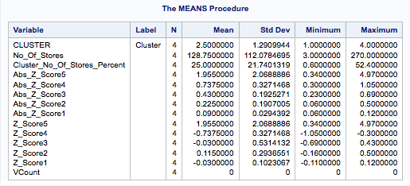
Here are the calculations for the various Cluster levels
Level 4:
Abs_Z_Score5 contains the highest Absolute Z-Score for the cluster followed by Abs_Z_Score4, 3, 2 & 1. So a high Mean value of Abs_Z_Score5 will indicate a higher degree of separation. Also the standard Deviation is large as well.

Slide 5
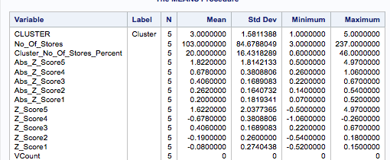
Level 5

Slide 6
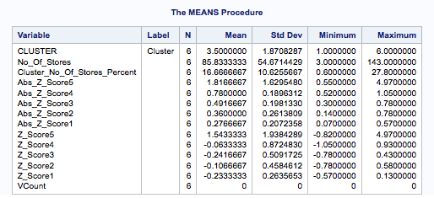
Level 6

Slide 7
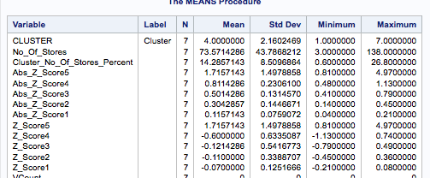
Level 7

Slide 8
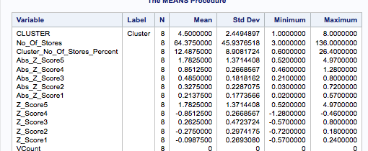
Level 8

Slide 9
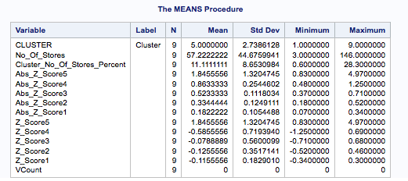
Level 9

Slide 10
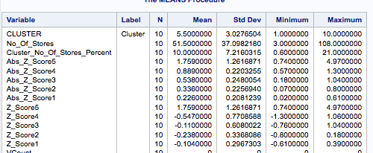
Level 10

Slide 11
Hence the decision to choose Level 4

Slide 12
Profiling Cluster 1
Obs | Variable | No_Of_Stores | Cluster_No_Of_Stores_Percent | Cluster_Mean | Population_Mean | Population_StdDev | Z_Score | Abs_Z_Score
1 | Average Sale per Square Feet | 91 | 17.7 | 291.092 | 210.364 | 52.5738 | 1.54 | 1.54
2 | Tobacco and Alcohol Category | 91 | 17.7 | 19.617 | 22.88 | 4.7099 | -0.69 | 0.69
3 | Frozen Foods Category | 91 | 17.7 | 27.951 | 24.934 | 8.2562 | 0.37 | 0.37
4 | Health and Beauty Category | 91 | 17.7 | 12.987 | 13.767 | 4.8775 | -0.16 | 0.16
5 | Fresh Foods Category | 91 | 17.7 | 39.445 | 38.42 | 8.7953 | 0.12 | 0.12

Slide 13
Profiling Cluster 1 (Continued)
High Sales per Square feet
These Stores Average Rs 291K compared to Population Average of 210K.
Tobacco Sales lower than average
Frozen Foods Higher than Average
Account for 91 stores – roughly 18%

Slide 14
Profiling Cluster 2
Obs | Variable | No_Of_Stores | Cluster_No_Of_Stores_Percent | Cluster_Mean | Population_Mean | Population_StdDev | Z_Score | Abs_Z_Score
6 | Tobacco and Alcohol Category | 151 | 29.3 | 27.456 | 22.88 | 4.7099 | 0.97 | 0.97
7 | Average Sale per Square Feet | 151 | 29.3 | 162.59 | 210.364 | 52.5738 | -0.91 | 0.91
8 | Fresh Foods Category | 151 | 29.3 | 32.33 | 38.42 | 8.7953 | -0.69 | 0.69
9 | Health and Beauty Category | 151 | 29.3 | 16.226 | 13.767 | 4.8775 | 0.5 | 0.5
10 | Frozen Foods Category | 151 | 29.3 | 23.988 | 24.934 | 8.2562 | -0.11 | 0.11

Slide 15
Profiling Cluster 2 (Continued)
High Sales of Tobacco and Alcohol – Key Differentiator
151 stores – 29%
Lower than Population Average sale per square feet
Fresh food sales (32%) significantly lower than the population average (38%)

Slide 16
Profiling Cluster 3
Obs | Variable | No_Of_Stores | Cluster_No_Of_Stores_Percent | Cluster_Mean | Population_Mean | Population_StdDev | Z_Score | Abs_Z_Score
11 | Average Sale per Square Feet | 3 | 0.6 | 471.52 | 210.364 | 52.5738 | 4.97 | 4.97
12 | Tobacco and Alcohol Category | 3 | 0.6 | 17.951 | 22.88 | 4.7099 | -1.05 | 1.05
13 | Fresh Foods Category | 3 | 0.6 | 42.175 | 38.42 | 8.7953 | 0.43 | 0.43
14 | Frozen Foods Category | 3 | 0.6 | 26.429 | 24.934 | 8.2562 | 0.18 | 0.18
15 | Health and Beauty Category | 3 | 0.6 | 13.446 | 13.767 | 4.8775 | -0.07 | 0.07

Slide 17
Profiling Cluster 3 (continued)
Cluster of Outliers – Only 3
Highest Sale per Sq feed – significantly higher than Population Mean!
Tobacco sale is lower than population average
Fresh foods higher sales than population average

Slide 18
Profiling Cluster 4
Obs | Variable | No_Of_Stores | Cluster_No_Of_Stores_Percent | Cluster_Mean | Population_Mean | Population_StdDev | Z_Score | Abs_Z_Score
16 | Fresh Foods Category | 270 | 52.4 | 41.438 | 38.42 | 8.7953 | 0.34 | 0.34
17 | Tobacco and Alcohol Category | 270 | 52.4 | 21.474 | 22.88 | 4.7099 | -0.3 | 0.3
18 | Health and Beauty Category | 270 | 52.4 | 12.658 | 13.767 | 4.8775 | -0.23 | 0.23
19 | Frozen Foods Category | 270 | 52.4 | 24.43 | 24.934 | 8.2562 | -0.06 | 0.06
20 | Average Sale per Square Feet | 270 | 52.4 | 206.972 | 210.364 | 52.5738 | -0.06 | 0.06

Slide 19
Profiling Cluster 4 (Continued)
270 stores – 52.4% - May need to be explored further
Biggest Differentiator – high sales of Fresh foods as compared to population mean
Lower sale of Tobacco and Alcohol

Slide 20
Recommendations
Break up the Cluster 4 further into smaller clusters

