Slide 1
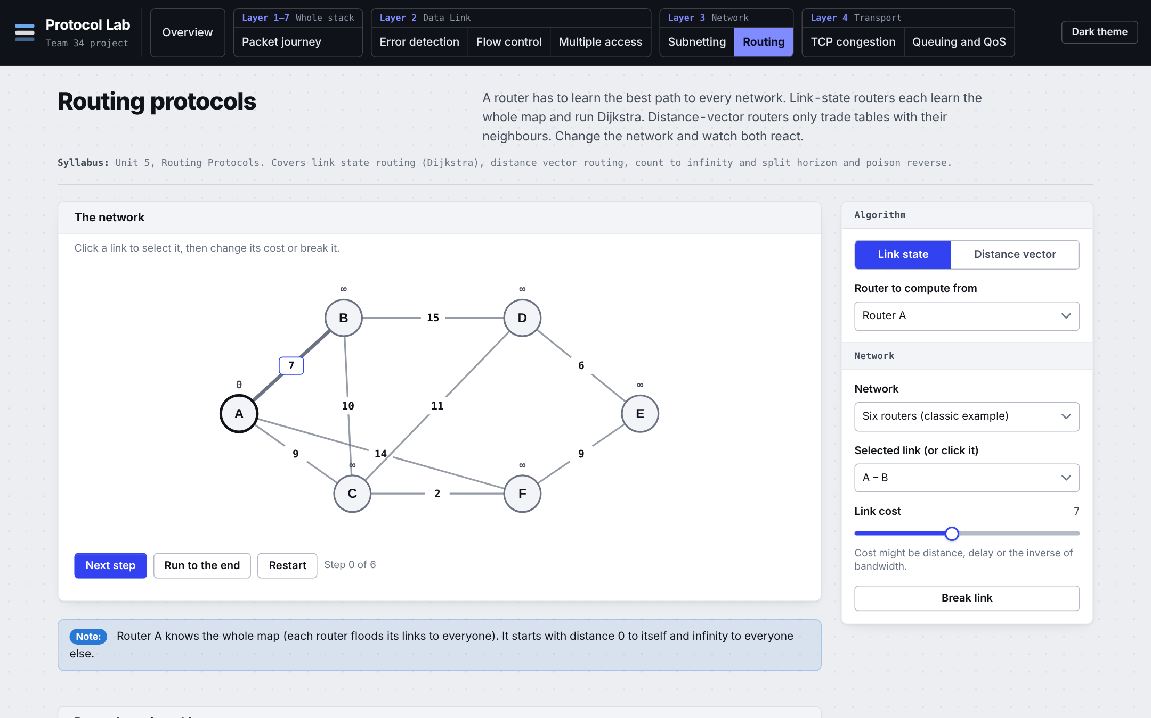
Protocol Lab: An Interactive Computer Networks Simulator
Watch network protocols work, then break them.
Savir Ghai · 24BCT0309
Team F1_Team34 · BCSE308P Computer Networks Lab
Faculty: Prof. Sreethar S
Notes:
Introduce yourself and the project: a browser simulator with eight labs that follow the syllabus. Everything shown today runs from one HTML file, offline.

Slide 2
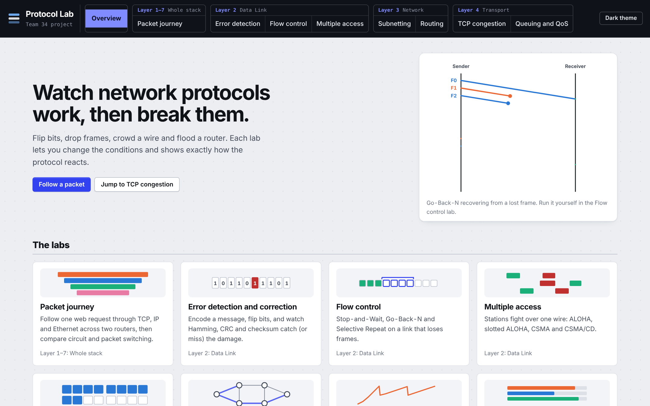
Protocols are taught as pictures
A diagram shows one case
What happens to Go-Back-N when loss goes from 2% to 20%? A textbook figure cannot say.
Real simulators are heavy
ns-3 and Mininet need installation, scripting and time before a first result.
Packet Tracer was not usable here
And it hides protocol internals such as the sender window.
Notes:
Problem and motivation. The students need to see protocol behaviour change with conditions. The tools that can do that are either heavy or not available. So the goal was a lightweight, correct, repeatable simulator.

Slide 3
Existing approaches and the gap they leave
Approach | Strength | Gap
Textbooks and slides | Reliable explanations | Fixed examples; cannot be re-run with other parameters
ns-3 (Henderson 2008) | Accurate, standard in research | Install, C++ or Python scripting, slow to try one idea
Mininet (Lantz 2010) | Runs real network software | Linux and command line; not a view of protocol state
Cisco Packet Tracer | Topology and CLI practice | Not usable in this project; internals hidden
The gap
Nothing lightweight shows the baseline and the improved mechanism side by side, on identical input, with results you can trust and repeat.
Notes:
Existing approach and its gap. Be fair: ns-3 and Mininet are better for research accuracy. This project does not compete on accuracy, it competes on time-to-first-result and on showing both mechanisms next to each other.

Slide 4
The novelty is the combination, not a new protocol
Zero install
Side by side
One HTML page. No framework, no build, no server, works offline.
Baseline and improvement run on identical seeded input.
Verified
Reproducible
78 automated tests, including four known-answer checks.
Fixed seeds and a 30-seed runner give mean ± SD tables.
The mechanisms themselves (Selective Repeat, Reno, WFQ, split horizon) are classical. The report says so plainly.
Notes:
Proposed novelty. Be honest: no new protocol. The contribution is the integrated, verified, reproducible tool that shows baseline against improvement. Expect a question on this and answer it directly.

Slide 5
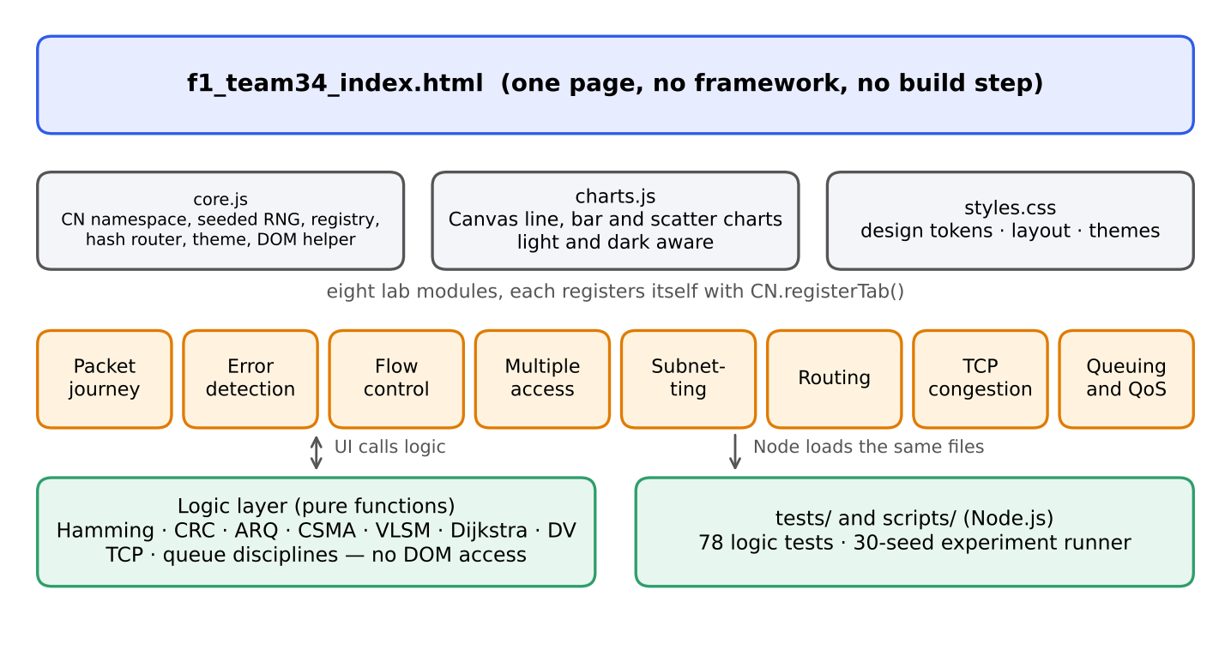
Architecture: logic apart from the screen
One page, eight modules
Each lab registers itself with a tab registry; a hash router shows it.
Pure logic functions
A guard exits before any DOM code when run in Node, so tests and experiments load the same files.
Seeded random numbers
Same seed, same result, every time.
Notes:
Architecture. The key design choice is that calculations never touch the DOM. That is what makes the 78 tests and the 30-seed experiment runner possible with the same code that runs in the browser.

Slide 6
Implementation setup
≈5,900
0
8
lines of JavaScript, CSS and tests
dependencies, frameworks or build steps
labs covering Units 1 to 6
Item | Detail
Languages | HTML5, CSS3, JavaScript (ES2020)
Run time | Any modern browser; Node.js v22 for tests and experiments
Screenshots | Chromium 153 headless (Playwright)
Machine for runs | Linux, 2 cores, 7 GB; all 30-seed runs finish in about 0.5 s
Repository | github.com/savir18/CN, files named f1_team34_*
Notes:
Implementation setup: tools and versions. Mention that anyone can clone the repository, open one file and run the same experiments.

Slide 7
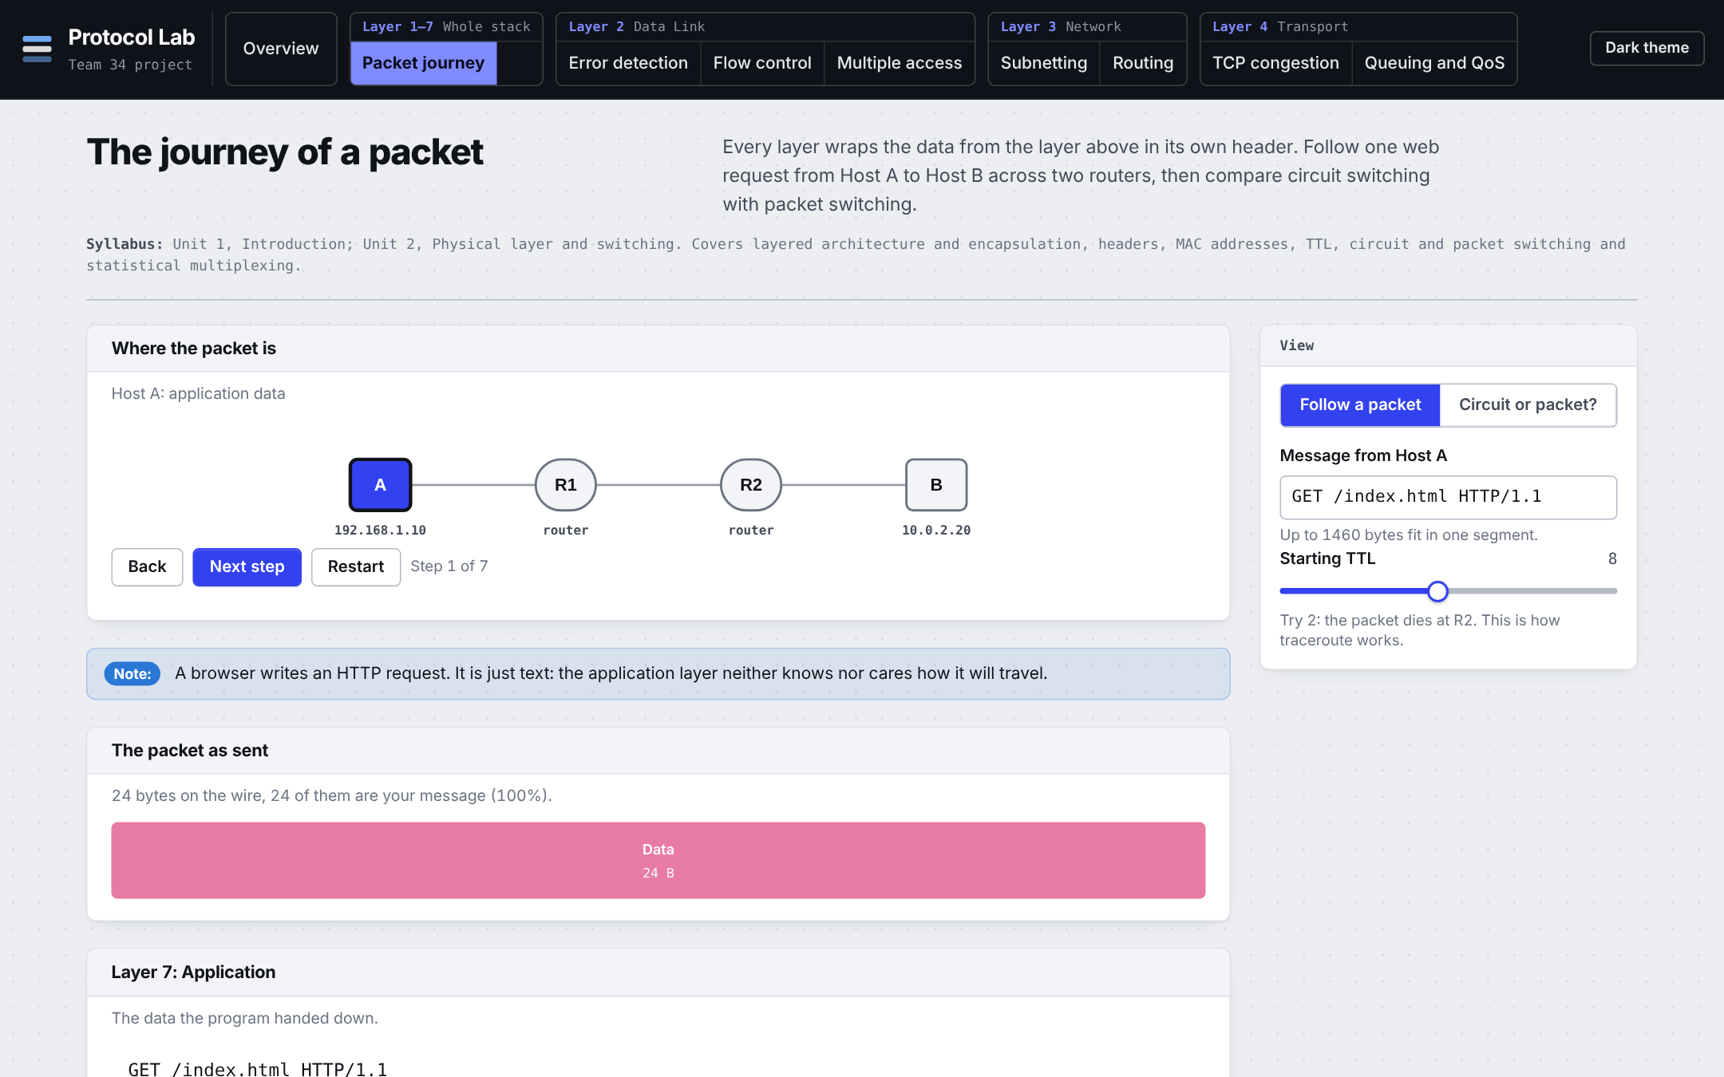
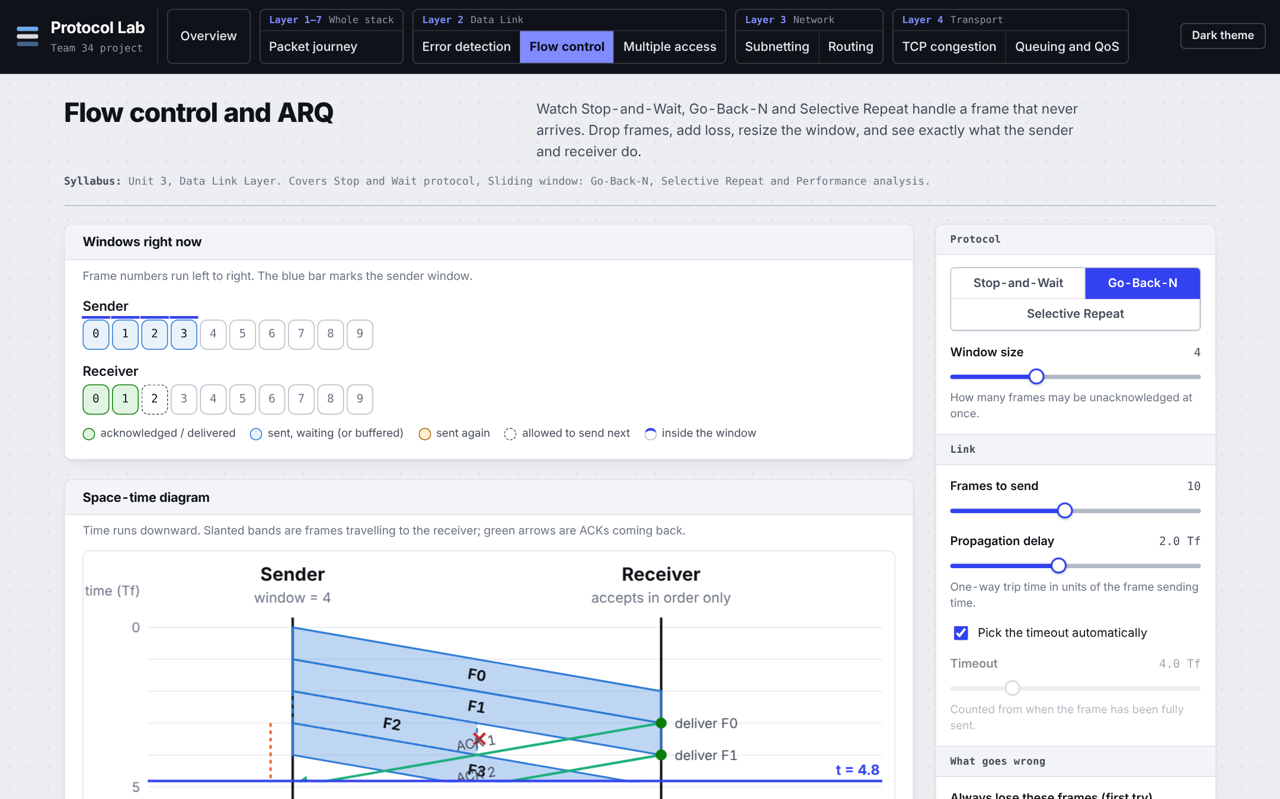
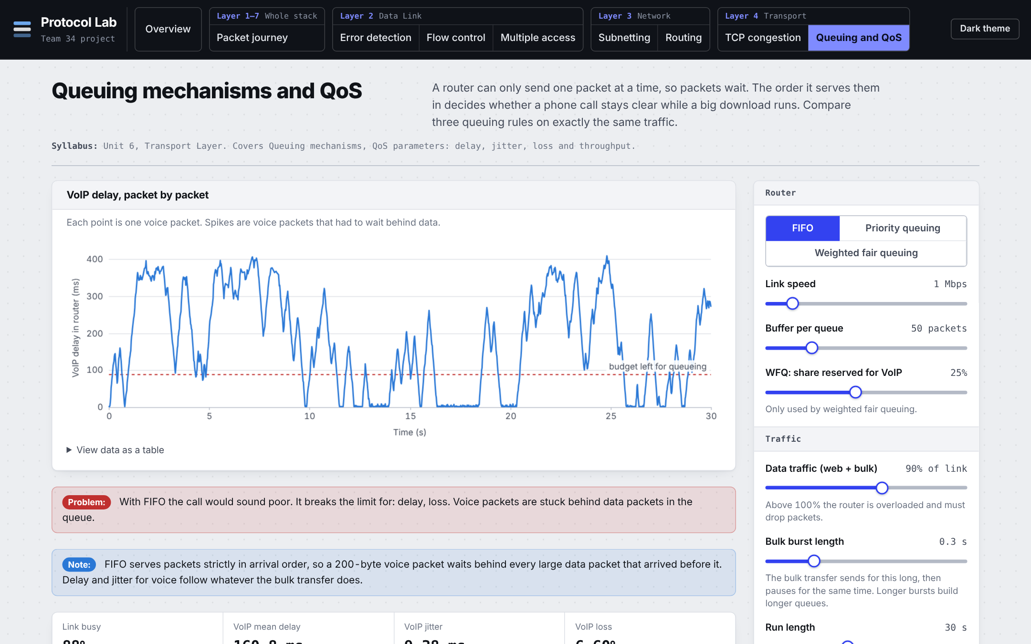
Eight labs, one per part of the syllabus
Packet journey (Units 1–2)
Flow control (Unit 3)
Routing (Unit 5)
Queuing and QoS (Unit 6)
Notes:
A quick tour. The other four labs are error detection, multiple access, subnetting and TCP congestion. Offer to open any of them.

Slide 8
Four comparisons, three scenarios each, 30 seeds
Lab | Baseline → proposed | Scenarios S1, S2, S3 | Metrics
Routing | Plain distance vector → split horizon, poison reverse | Chains of 3 to 8 routers | Rounds until stable
Flow control | Go-Back-N → Selective Repeat | Frame loss 2%, 10%, 20% | Link efficiency; retransmissions per frame
TCP | Tahoe → Reno | Loss per round 2%, 5%, 10% | Segments sent in 100 RTTs
Queuing | FIFO → priority, WFQ | Data load 50%, 80%, 95% | Voice p95 delay; voice loss
Identical conditions for both mechanisms in every run. Mean ± sample SD of 30 seeds. Routing is deterministic, so one run per cell.
Notes:
Scenarios and metrics. Every comparison gives both mechanisms the same loss events, traffic or topology. The runner is scripts/f1_team34_experiments.js and reproduces every number in the report.

Slide 9
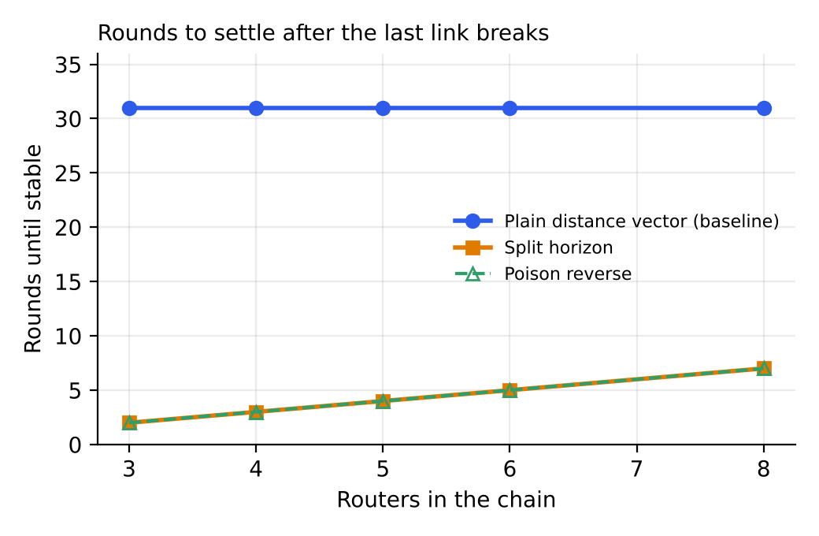
Routing: split horizon ends the 31-round loop
31
rounds with plain distance vector, in every chain
2 to 7
rounds with split horizon or poison reverse
Last link of a chain breaks. News of the loss travels one hop per round with split horizon; without it, two routers keep feeding each other the dead route until cost reaches infinity (32).
Notes:
Open the Routing lab, choose Three in a line, break the link B to C and run until stable. Then switch the fix to split horizon. Caveat to say out loud: split horizon only stops two-router loops. It does not fix loops in a general mesh, and the chain does not test that.

Slide 10
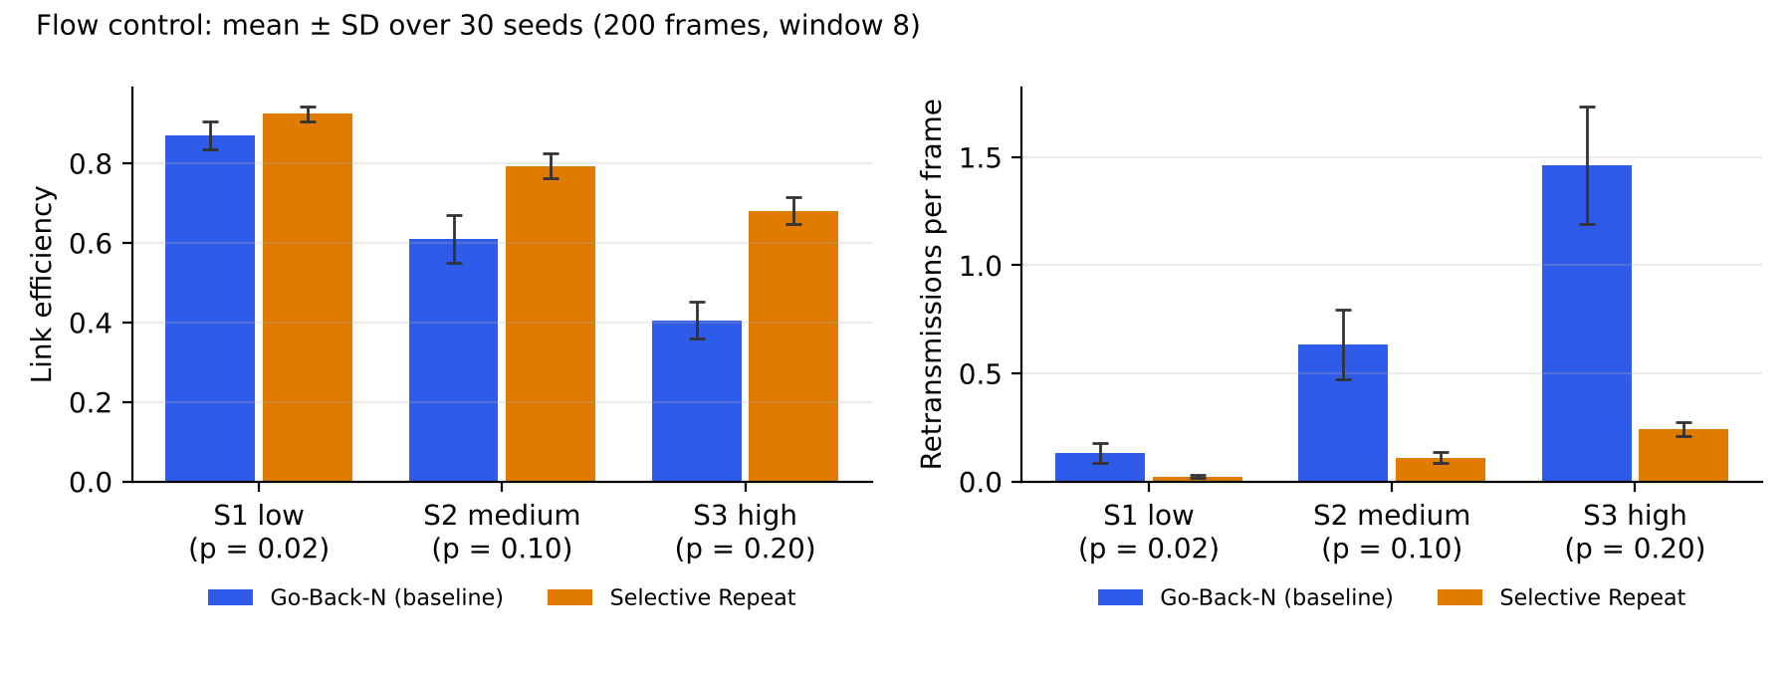
Flow control: Selective Repeat wins as loss grows
0.405 → 0.681
1.46 → 0.25
+6% → +68%
efficiency at 20% loss (GBN → SR)
retransmissions per frame at 20% loss
efficiency gain from S1 to S3
Notes:
Go-Back-N repeats the whole window after a loss, so its waste grows with loss. SR retransmits close to the loss probability. Setup: 200 frames, window 8, Tp = 2 frame times, ACKs not lost. Standard deviations do not overlap in S2 and S3.

Slide 11
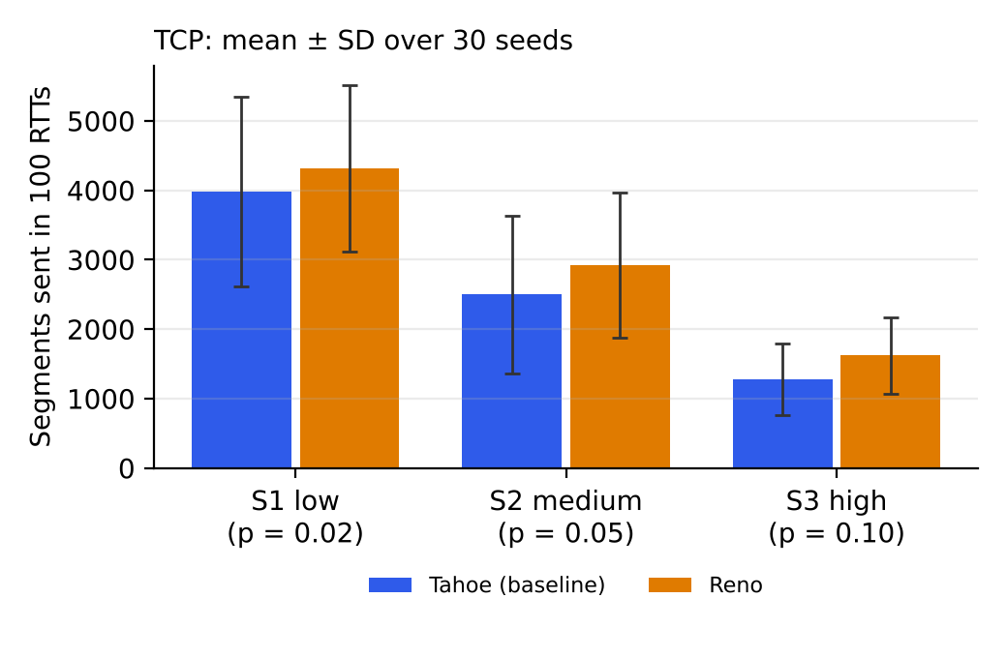
TCP: Reno halves its window, Tahoe restarts
+8% to +27%
more segments for Reno than Tahoe
On three duplicate ACKs Reno halves its window; Tahoe falls back to 1. On a timeout both restart from 1.
Read with care
The model draws one loss event per round, whatever the window. The size of the gain is a property of the model. The SD is wide, for example 3987 ± 1366 for Tahoe in S1.
Notes:
Live demo: TCP congestion, Window lab, default scenario. Tahoe 245 segments, Reno 304 (+24%). The 30-seed table is in the report. Be upfront that the direction is consistent but the percentage is model-dependent.

Slide 12
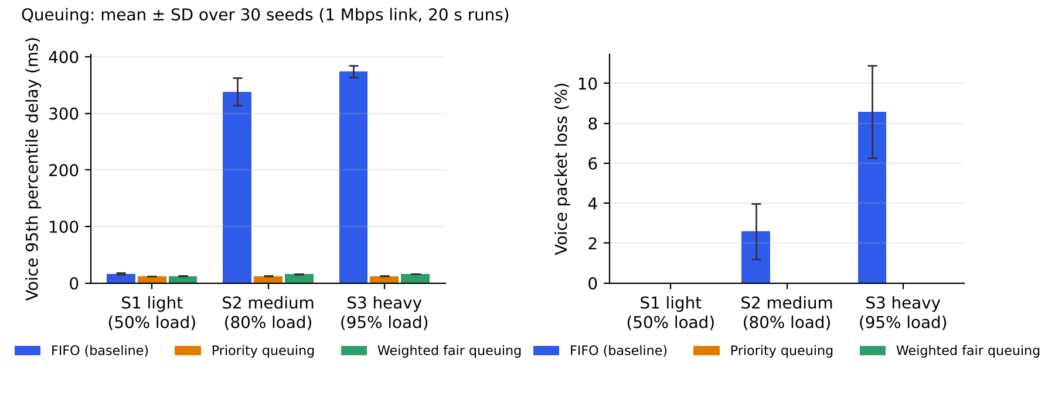
Queuing: weighted fair queuing protects the phone call
374 → 16 ms
8.57% → 0%
12.6 vs 16.2
voice p95 delay at 95% data load (FIFO → WFQ)
voice packet loss at 95% data load
ms, priority vs WFQ: WFQ pays about 4 ms for fairness
Notes:
Open Queuing and QoS. FIFO is the default: voice spikes appear because they wait behind 1500 byte data packets. Click Priority, then WFQ. WFQ is preferred in practice because bulk traffic cannot be starved. A call counts as good with p95 delay under 150 ms, jitter under 30 ms, loss under 1 percent.

Slide 13
78 tests check the labs against known answers
0xCBF43926
0xB861
0.184
Same costs
CRC-32 of the text 123456789, the standard check value
IPv4 header checksum from the textbook example
Peak throughput of pure ALOHA, at G = 0.5
Dijkstra and distance vector agree for every router pair
The other tests check invariants: every frame delivered exactly once and in order under random loss, WFQ never starves bulk traffic, and the same seed repeats exactly.
$ node tests/f1_team34_tests.js
78 passed, 0 failed
Notes:
How do we know the simulations are right? Four known results the code must reproduce, plus invariants. Run the test command live if asked.

Slide 14
Analysis and limitations
What the results show
What it does not show
Every improvement helps, and helps more under stress.
Selective Repeat and WFQ differences are many SDs wide in S2 and S3.
Protecting voice did not raise loss for bulk traffic.
Priority is slightly faster for voice; WFQ avoids starvation.
Simplified models: per-RTT TCP, fluid shared link, one queue port.
Split horizon is tested on chains only, not meshes.
No significance tests and no user study.
Unit 7 (DNS, HTTP, FTP) and 802.11 CSMA/CA have no lab.
Notes:
Analysis and limitations. Say the limits yourself before you are asked. The TCP percentages are model-dependent. No learning study was done, so the tool is not claimed to improve learning.

Slide 15
Conclusion and future work
Eight working labs in one zero-install page, four baseline-versus-improvement comparisons measured over 30 seeds, and 78 passing tests. The numbers can be reproduced with one command.
DNS lab
TCP handshake and UDP
Recursive and iterative lookups with caching, to cover Unit 7
Connection set-up and a comparison with UDP
CSMA/CA
Meshes and a classroom trial
IEEE 802.11 medium access
Loops that split horizon cannot stop; measure learning with students
Notes:
Conclusion: summarise in one breath, then name the one real gap: Unit 7 has no lab, and a DNS lab is the next build.

Slide 16
Thank you. Try it yourself
git clone https://github.com/savir18/CN.git
open f1_team34_index.html
node tests/f1_team34_tests.js
node scripts/f1_team34_experiments.js
Key references
Kurose and Ross, Computer Networking, 8th ed., 2021
Jacobson, Congestion avoidance and control, SIGCOMM CCR, 1988
Fall and Floyd, Tahoe, Reno and SACK TCP, SIGCOMM CCR, 1996
Demers, Keshav, Shenker, Fair queueing, SIGCOMM, 1989
Henderson, Lacage, Riley, ns-3, 2008; Lantz et al., Mininet, 2010
Notes:
Close and invite questions. Offer to open any lab that was not demoed, for example Error detection, which shows Hamming, CRC and checksum step by step. Full reference list is in the report.

