Slide 1
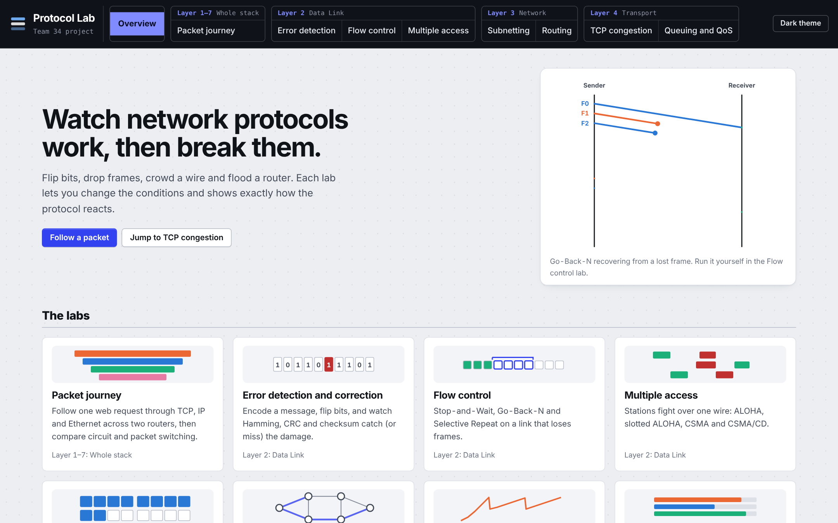
Protocol Lab: how it works, lab by lab
A tour of eight interactive labs that show how computer networks behave.
Savir Ghai · 24BCT0309
Team F1_Team34 · BCSE308P Computer Networks Lab
Faculty: Prof. Sreethar S
Notes:
Welcome. This is a short tour of Protocol Lab: what it is, how it is built, and how each of the eight labs works. I will keep it in plain words.

Slide 2
What it is, and why I built it
The problem
Networking is taught with pictures. A picture shows one case and cannot answer “what if the link gets worse?”
The idea
Eight small labs where you change the conditions, press play and watch what the protocol does. Then break something on purpose.
The promise
Open one file and it works. The results are checked by 78 tests, and the same settings always give the same answer.
Notes:
Networking courses explain protocols with diagrams, and a diagram shows only one situation. I wanted to be able to ask what happens if the link gets worse, or if a router fails, and see the answer. So I built eight labs that follow the syllabus. You change the conditions, press play, and watch.

Slide 3
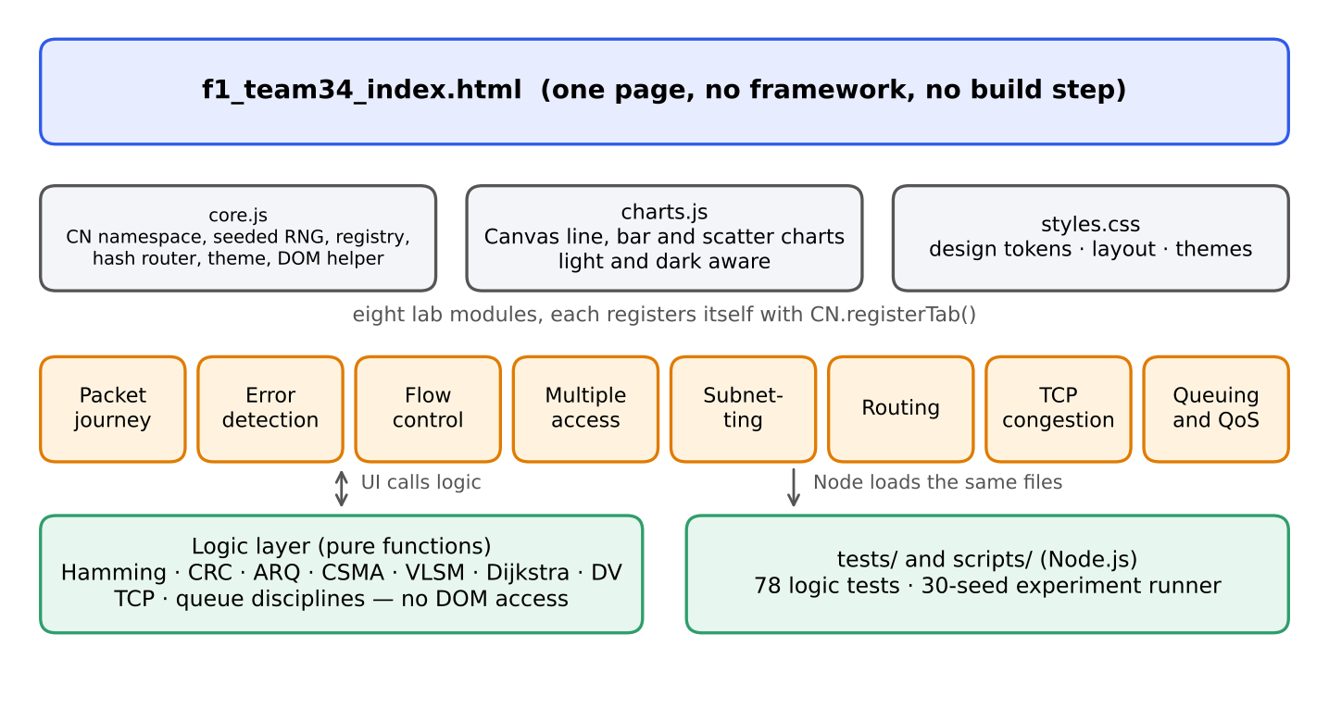
How it is built, in plain words
Plain web code
HTML, CSS and JavaScript. No framework, no install, no server.
Logic kept apart from the screen
The calculations are plain functions, so the same code runs in Node for testing.
Tested and repeatable
78 tests check known answers. Seeded random numbers give the same result every time.
Notes:
Technically it is as simple as possible. One HTML page loads a small shared core and one file per lab. Each lab keeps its calculations in plain functions separate from the screen code, which means the same code can be tested in Node with 78 automated tests. Random events use a seeded generator, so the same seed always gives the same result.

Slide 4
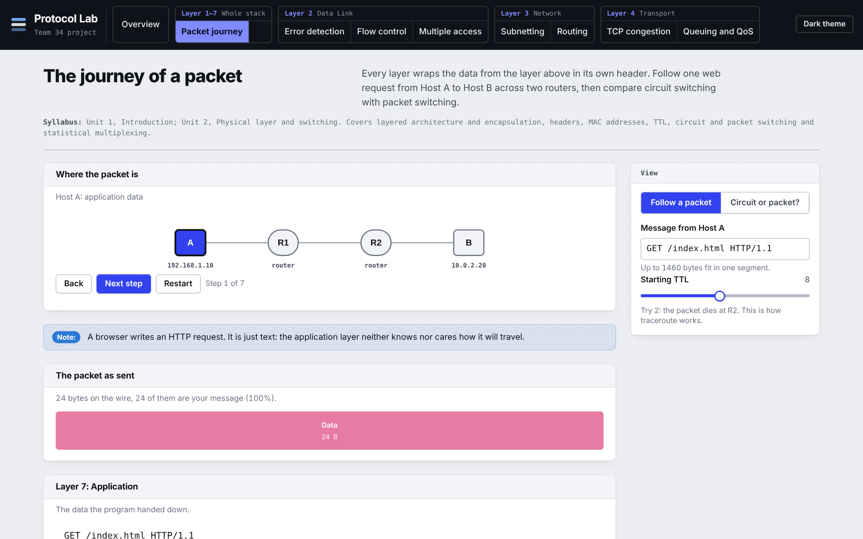
1. Packet journey: follow one request
What it shows
One web request travelling from Host A to Host B across two routers. You see TCP, IP and Ethernet headers wrapped around the data, one layer at a time.
Try this
Click Next step through all 7 steps. Then set the starting TTL to 2 and watch the packet die at router R2.
The takeaway
Headers go on going down and come off going up. Routers rebuild the frame with new MAC addresses, but the IP addresses never change.
Layers 1–7 · Units 1 and 2
The second view, Circuit or packet?, compares the two ways of sending a message: 188 ms against 93.7 ms in the default example.
Notes:
This lab is about encapsulation. Click Next step and point out that the application data is just text. Then TCP adds a header, then IP, then Ethernet. At each router the frame is stripped and rebuilt with new MAC addresses, while the IP addresses stay the same and the TTL drops by one. Set the TTL to 2 and the packet is dropped at R2, which is exactly how traceroute finds each router on a path. If there is time, open Circuit or packet: circuit switching takes 188 ms because of its set-up, packet switching 93.7 ms.

Slide 5
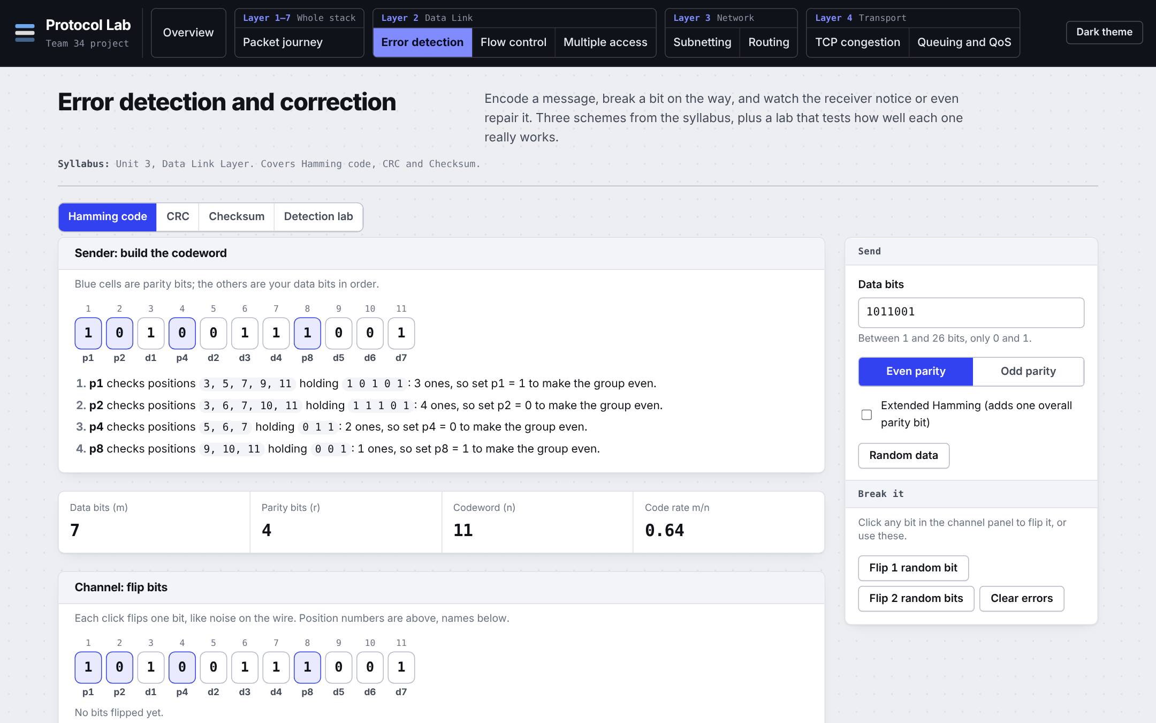
2. Error detection and correction
What it shows
How a sender adds extra bits so the receiver can notice, or even repair, damage on the wire. It has Hamming code, CRC and checksum, plus a lab that tests all three.
Try this
On the Hamming tab, click Flip 1 random bit and watch it get corrected. Then click Flip 2 random bits.
The takeaway
Extra bits cost space but buy safety. Hamming can fix one flipped bit; with two, plain Hamming gets it wrong, so the extended version detects them.
Layer 2 · Data link · Unit 3
Default message: 7 data bits become an 11-bit codeword with 4 parity bits.
Notes:
Here you can break a message on purpose. Hamming code adds parity bits at positions that are powers of two. Seven data bits need four parity bits, so the codeword is eleven bits. Flip one bit and the receiver works out which position is wrong and fixes it. Flip two and plain Hamming makes a wrong correction, which is why there is an extended version that can at least detect it. CRC and the checksum tabs show the other two schemes used in real networks.

Slide 6
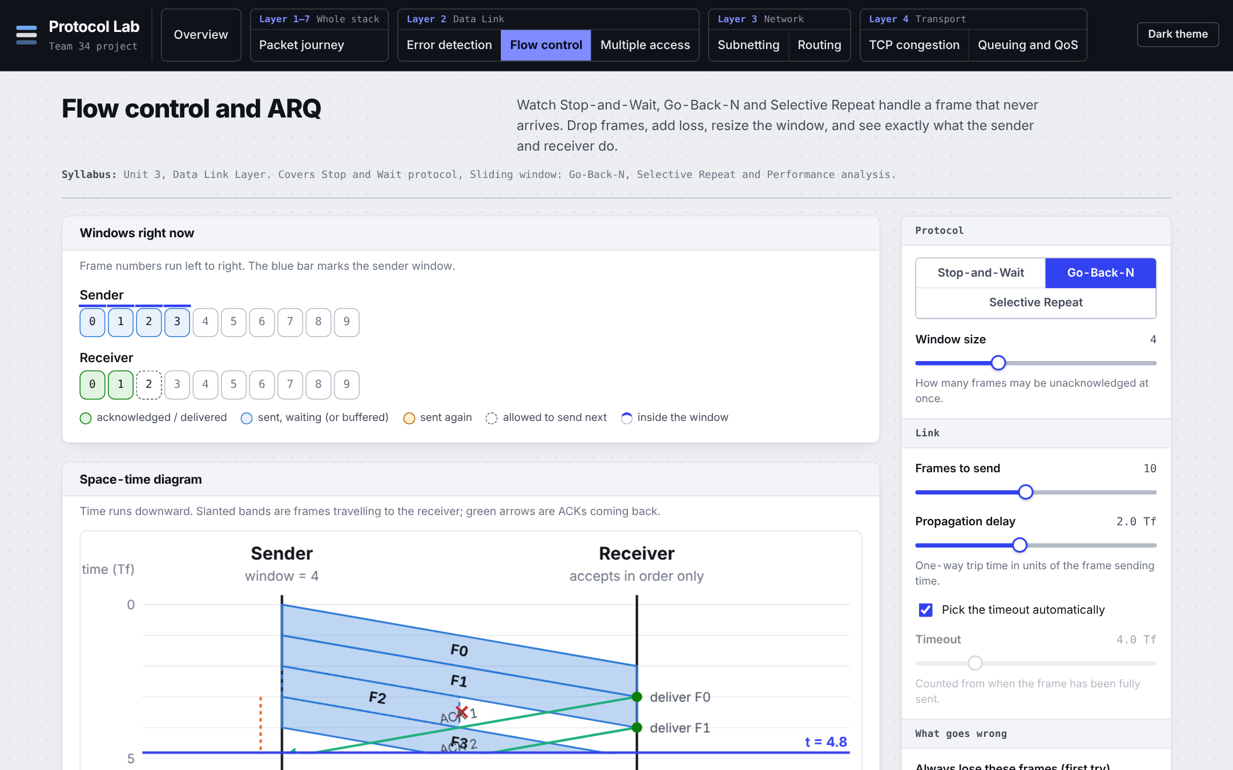
3. Flow control: keep the sender busy
What it shows
A sender and a receiver on a link that can lose frames. A time diagram shows every frame and every acknowledgement. You pick Stop-and-Wait, Go-Back-N or Selective Repeat.
Try this
With the defaults (frame 2 is lost), click Go-Back-N, then Show everything. Then do the same with Selective Repeat.
The takeaway
A window lets the sender keep sending. Go-Back-N resends the whole window after a loss (4 frames here); Selective Repeat resends only the lost one.
Layer 2 · Data link · Unit 3
Stop-and-Wait finishes in 55.1 time units, the two sliding-window schemes in 20.1.
Notes:
This is the lab I spend the most time on. The diagram runs from top to bottom: time. Blue bands are frames going to the receiver, green arrows are acknowledgements coming back. Frame 2 is lost. Go-Back-N cannot keep frames that arrive after a gap, so the sender repeats the whole window, four frames. Selective Repeat keeps the early frames and repeats only frame 2. Stop-and-Wait is the slow baseline because it sends one frame per round trip. The Efficiency vs frame loss chart shows the gap getting bigger as the link gets worse.

Slide 7
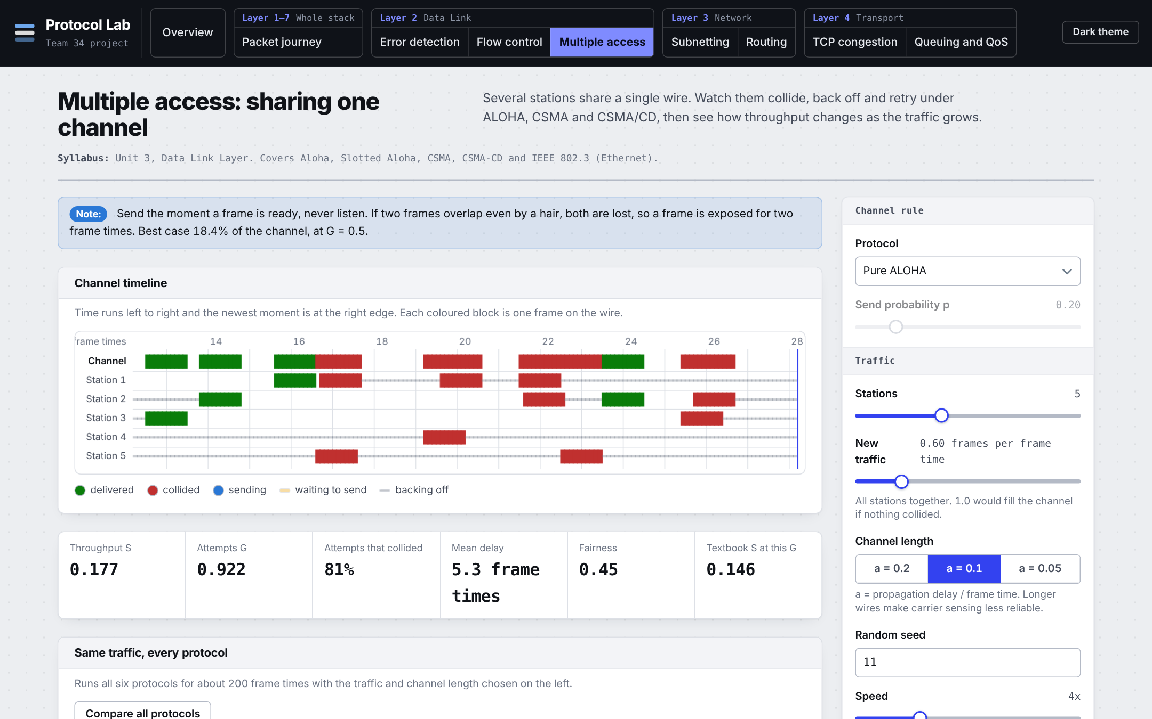
4. Multiple access: sharing one wire
What it shows
Many stations that all want to use the same wire. When two talk at once their frames collide. The lab runs pure ALOHA, slotted ALOHA, two kinds of CSMA, and CSMA/CD.
Try this
Click Compare all protocols to see throughput against how busy the network is.
The takeaway
Waiting for your turn beats talking at random. Pure ALOHA tops out around 0.184 of the link, slotted ALOHA around 0.368, and listening first (CSMA) does better still.
Layer 2 · Data link · Unit 3
The a value (0.2, 0.1, 0.05) is how long the wire is compared with a frame. A short wire helps carrier sensing.
Notes:
Think of a room where everyone wants to speak. In pure ALOHA, you just talk and hope nobody else does. Slotted ALOHA makes people start only at fixed moments, which halves the collisions. CSMA says listen first, and CSMA/CD also stops quickly when a collision happens, which is what classic Ethernet does. The compare chart shows the peaks: about 0.184 for pure ALOHA and 0.368 for slotted ALOHA, matching the textbook formulas. Wireless CSMA/CA is not simulated.

Slide 8
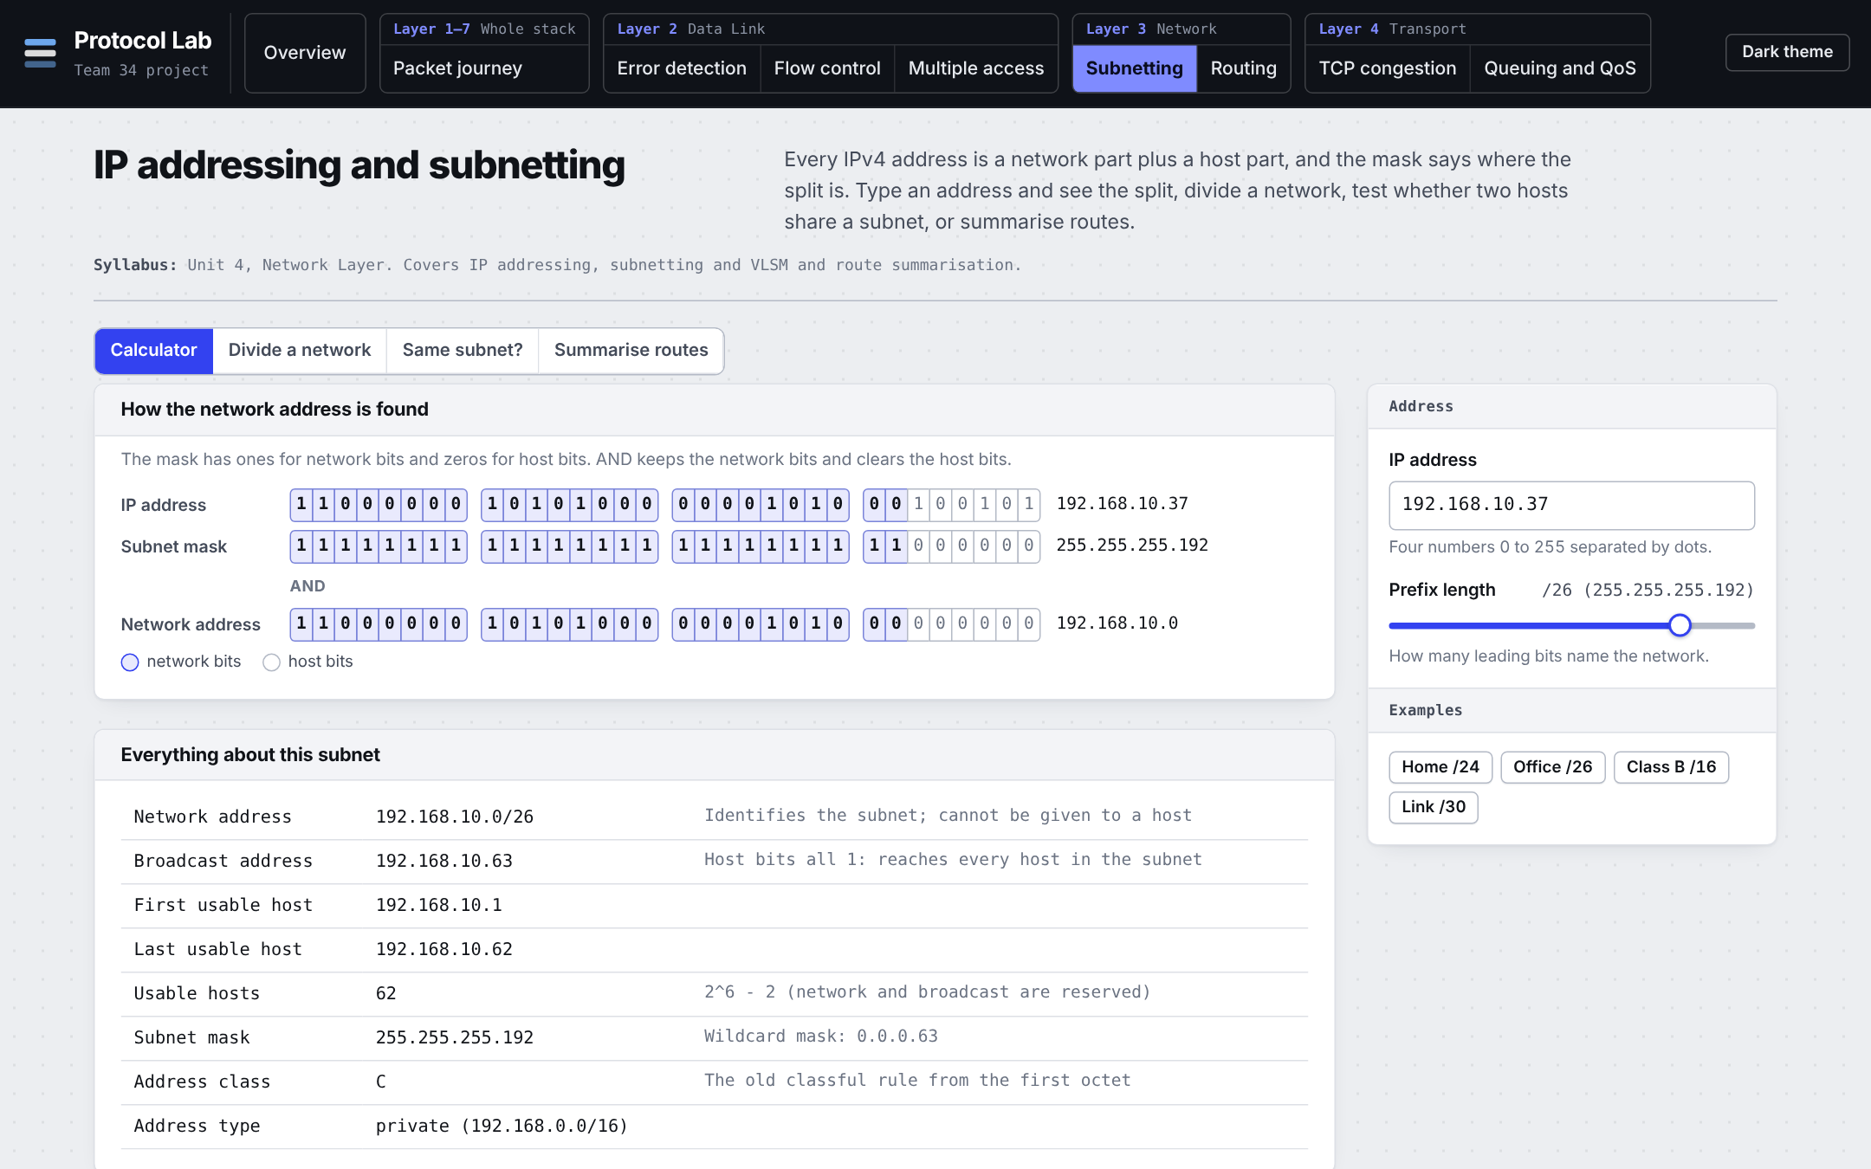
5. Subnetting: cutting up an address space
What it shows
An IP address is a network part plus a host part, and the mask says where the split is. The lab has a calculator, a tool to divide a network, a same-subnet test and route summarisation.
Try this
Type 192.168.10.37 with /26. Then divide 192.168.10.0/24 for 100, 50, 20 and 2 hosts.
The takeaway
The mask is just ones for the network bits and zeros for the host bits. For /26: network 192.168.10.0, broadcast 192.168.10.63, 62 usable hosts.
Layer 3 · Network · Unit 4
Dividing for 100, 50, 20 and 2 hosts gives a /25, /26, /27 and /30, using 228 of the 256 addresses.
Notes:
Everything here is bit arithmetic. The calculator shows the address in binary so you can see the mask keep the network bits and clear the host bits. For 192.168.10.37 slash 26, the network is .0, the broadcast is .63 and there are 62 usable hosts. The Divide a network tab does variable-length subnetting: biggest requirement first, each rounded up to a power of two, placed on aligned boundaries. The summarise tab combines routes, for example four /24s into one /22, and warns if there is a gap.

Slide 9
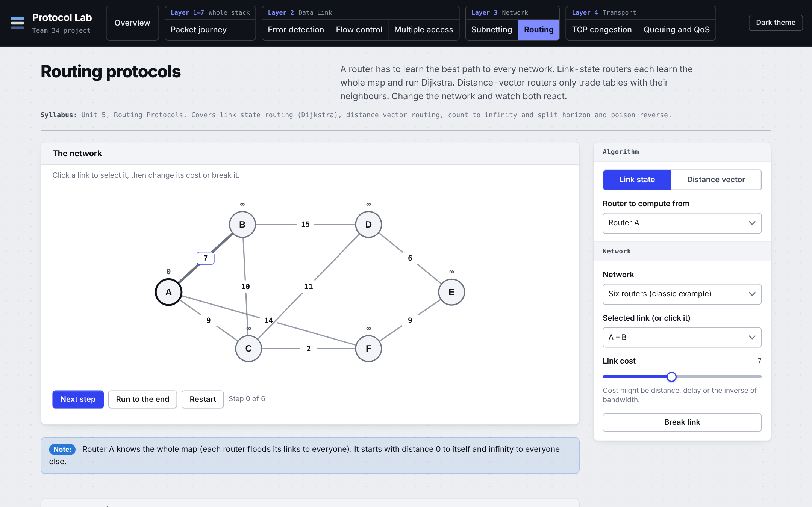
6. Routing: how routers find the way
What it shows
Two ways routers learn the map. Link state: each router knows everything and runs Dijkstra. Distance vector: routers only trade tables with their neighbours.
Try this
Distance vector, Three in a line, run until stable. Select link B – C, Break link, run again. Then switch to Split horizon and repeat.
The takeaway
After a break, plain distance vector counts up to infinity (32 here, Round 32 on screen). Split horizon stops routers telling each other a route they learned from each other.
Layer 3 · Network · Unit 5
In Link state mode, Next step shows Dijkstra from A: B 7, C 9, F 11, D and E 20.
Notes:
Start in Link state and press Next step: Dijkstra picks the closest router each time, so from A you get B at 7, C at 9, F at 11 and D and E at 20. Then switch to Distance vector on the three-in-a-line network. Break the link between B and C. A and B keep telling each other they can reach C through the other, and the cost creeps up round by round until it hits infinity, which is 32 in this lab. Change the fix to Split horizon and it settles in a few rounds. Be clear that split horizon only fixes loops between two neighbours.

Slide 10
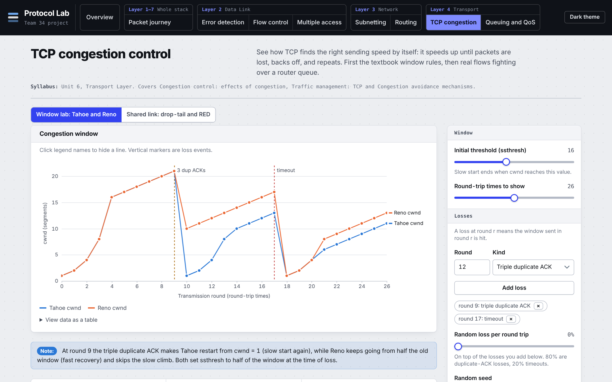
7. TCP congestion: how much to send
What it shows
How TCP decides its sending speed. The window doubles in slow start, then grows by one per round, and drops when a loss is detected. Tahoe and Reno react differently.
Try this
Open the Window lab with the defaults: a triple duplicate ACK at round 9 and a timeout at round 17. Read the totals under the chart.
The takeaway
On three duplicate ACKs Reno halves its window and Tahoe restarts from 1, so Reno gets more through: 304 segments against 245. On a timeout both restart from 1.
Layer 4 · Transport · Unit 6
The other tab, Shared link, has several flows sharing one router with drop-tail or RED queues.
Notes:
The chart has one point per round trip. The window starts at 1 and doubles until a threshold, then adds one each round. At round 9 there are three duplicate ACKs: the blue Tahoe line falls to 1, the orange Reno line only halves. At round 17 there is a timeout, and both go to 1. The readout says Tahoe 245 segments and Reno 304, about 24 percent ahead. This is a simplified model: one step is one round-trip time.

Slide 11
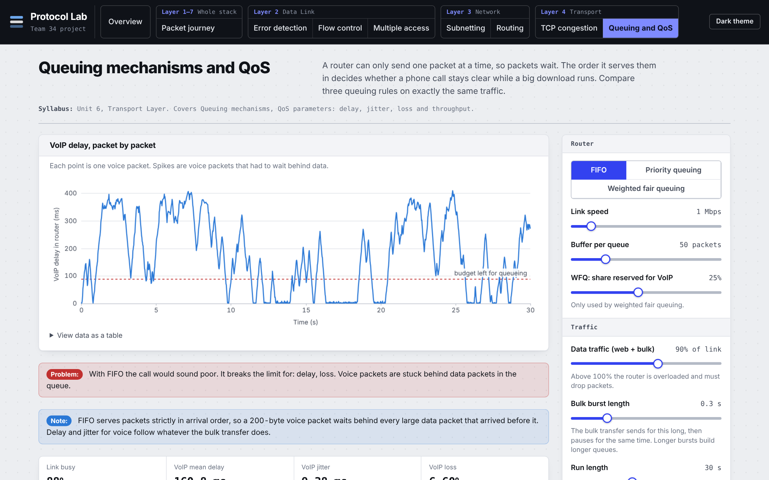
8. Queuing and QoS: protecting a phone call
What it shows
A router with one slow line shared by a phone call, web traffic and a big download. The order the packets leave in decides how good the call sounds.
Try this
The default is FIFO. Then click Priority queuing, then Weighted fair queuing.
The takeaway
FIFO makes voice wait behind big downloads: 160.8 ms mean delay and 6.60% loss. Priority gives 5.64 ms and WFQ 7.18 ms, both with no loss.
Layer 4 · Transport · Unit 6
A call counts as good with 95th percentile delay under 150 ms, jitter under 30 ms and loss under 1%.
Notes:
Each dot on the chart is a voice packet. Under FIFO the spikes are voice packets stuck behind 1500-byte data packets: mean delay 160.8 ms and 6.6 percent loss, and the lab says the call would sound poor. Click Priority queuing and the line goes flat, 5.64 ms. Weighted fair queuing is 7.18 ms, a little slower for voice, but every flow gets a guaranteed share, so the download cannot be starved. That is why it is preferred in practice.

Slide 12
Wrap-up
Eight labs covering Units 1 to 6, from encapsulation to queuing and QoS.
Each mechanism is shown next to its simpler baseline, and measured over 30 random seeds in the report.
Simplified on purpose: it teaches how things behave, not real-world numbers.
Not covered yet: DNS, HTTP and FTP (Unit 7). A DNS lab is next.
git clone https://github.com/savir18/CN.git
open f1_team34_index.html
Notes:
To wrap up: eight labs for Units 1 to 6, each one letting you change the conditions and see the result. The report measures four of the comparisons over 30 random seeds. It is simplified on purpose, so it teaches behaviour, not exact real-world numbers. The one gap is Unit 7, and a DNS lab is the next thing I would build. Anyone can try it: clone the repository and open one file. Thank you, and I am happy to open any lab for questions.

