Slide 1
Katran/XDP Acceleration
Real world use cases analysis
April-2019 By Rony Efraim, Amir Ancel, Mikhael Goikhman, Michael Savisko, Tal Gilboa and Noam Stolero

Slide 2
Using NIC HW Acceleration in XDP program
App
App should config TC
Legacy NIC compatible
For Example :
App set action Y to flow X
Use TC to skbedit with 0x1234 for flow X
Config XDP program to do action Y for mark = 0x1234
App set action drop for flow Z
Use TC to drop flow Z
Use TC to get counter
Flow X skbedit mark 0x1234
Skb->mark 0x1234 DO action Y
User
TC
XDP program
Kernel
TC HW offload
Hardware
NIC
eSwitch
Packets flow
Config flow

Slide 3
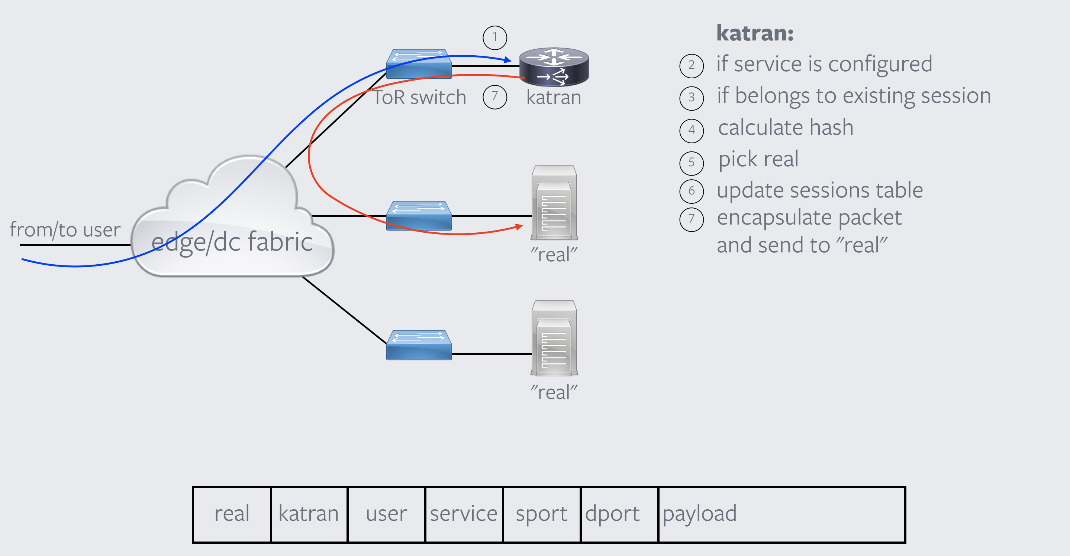
Katran – Overview
Stateful L4 load balancing (LB)
Open source by Facebook
Links: Open-sourcing Katran, a scalable network load balancer
https://github.com/facebookincubator/katran

Slide 4
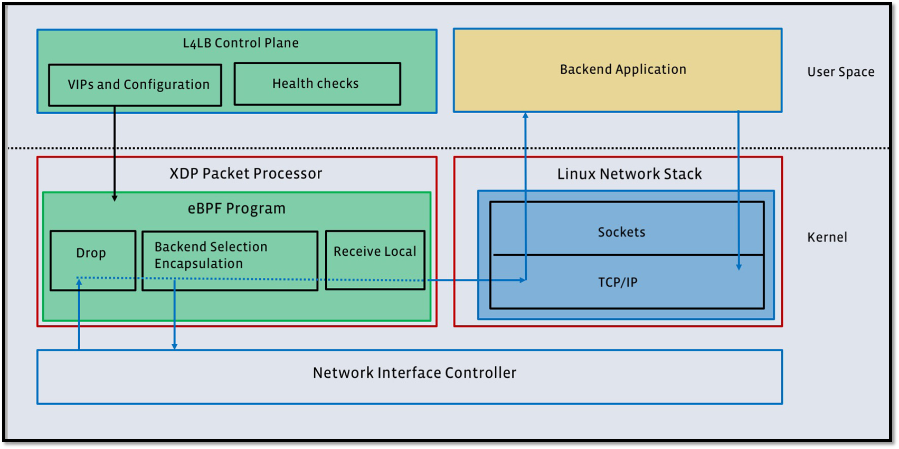
Katran – Architecture
Katran has two components:
User space control plane entity
XDP based packet processing code
Shared lookup tables
between the user space and XDP
XDP program actions:
Parsing + extract flow ID
Key generation for new flows
Lookup using the key to get Destination details.
Counters update - reflecting loads to the control plane entity.
Packet modification + Send to “Real” server

Slide 5


Katran – Acceleration (high level)
LB controller Update XDP MAP Call TC mark
User Space
XDP:
if (! Marked) {
Parse
Lookup flow_key
if (! flow_key) {
add to hash
Signal to user space
}
}
update stats
encapsulate + XDP_TX
Kernel
XDP program
HW marked packets

Slide 6
Katran – Acceleration (detailed)
XDP meta-data support
Using Saeed’s patches:
https://git.kernel.org/pub/scm/linux/kernel/git/saeed/linux.git/log/?h=topic/xdp_metadata
struct xdp_md_mark {
__u32 mark;
} __attribute__((aligned(4)));
In XDP program’s code:
struct xdp_md_mark *mark_ptr = (struct xdp_md_mark *)(uintptr_t)xdp->data_meta;
if (mark_ptr + 1 <= data)
markID = mark_ptr->mark;

Slide 7
Katran – Acceleration (detailed)
XDP program with acceleration support (1/3)
The signature of the XDP program is not changed: int balancer_ingress(struct xdp_md *ctx);
Special 32-bits meta-data field is HW markID is pushed by driver’s code before entering XDP program
A new per-CPU XDP map is created by user-space control application:
struct bpf_map_def SEC("maps") hw_accel_mapping = {
.type = BPF_MAP_TYPE_HASH,
.key_size = sizeof(__u32),
.value_size = sizeof(__u32),
.max_entries = MAX_SUPPORTED_CPUS,
.map_flags = NO_FLAGS,
};
A data-path structure hw_accel_flow is defined in XDP program code. Elements of this structure will be added to per-CPU ‘hw_accel_mapping’ every time a new flow is added to lru mapping:
struct hw_accel_flow {
__u32 vip_num;
__u32 real_key;
struct flow_key flow;
};

Slide 8
Katran – Acceleration (detailed)
XDP program with acceleration support (2/3)
Modified (accelerated) XDP program will first extract value of HW markID from packets metadata
struct xdp_md_mark *mark_ptr = (struct xdp_md_mark *)(uintptr_t)xdp->data_meta;
if (mark_ptr + 1 <= data)
markID = mark_ptr->mark;
Value 0 means that either HW acceleration is not enabled, or the received packet belongs to a new not yet marked flow. In both such cases the XDP program execution will continue as it was before HW acceleration modification (see in previous slides).
Non-zero value will mean that the received packet was successfully matched by HW to already existing flow, and the ID of this flow is the value in ‘mark’ field (stored there by Mellanox driver).
For non-zero markID the XDP program will perform look-up in ‘hw_accel_mapping’ map to find out corresponding struct hw_accel_flow
Once struct hw_accel_flow is found:
vip_num field is used to look-up destination VIP structure in special new mapping vip_map_by_id
real_index field is used as a key to find real target server description in “real” map
flow structure is used to obtain flow’s parameters (src_ip, dst_ip, protocol) instead of parsing the received packet
After that the XDP program execution will continue to packet encapsulation and stats updates

Slide 9
Katran – Acceleration (detailed)
XDP program with acceleration support (3/3)
Original XDP program flow must also be modified in order to correctly support HW acceleration
When get_packet_dst() function creates a new LRU mapping by calling bpf_map_update_elem() on LRU table it must also perform these additional steps after that:
Allocate a new HW mark ID from new map markid_pool_mapping
Create a new mapping in ha_accel_mapping map between the allocated ID and struct hw_accell_flow value filled with calculated flow_id, resolved real server key and VIP’s id number
Send special performance event using bpf_perf_event_output() eBPF helper function to update our user-space application about a new flow entering the LB

Slide 10
Katran – Acceleration (detailed)
User-space application – set-up TC rules
User-space application is responsible for the following:
Create new maps: hw_accel_mapping, vip_map_by_id, markid_pool_mapping, hw_accel_events
Fill-in for each forwarding CPU core markid_pool_mapping with selected range of HW marking IDs
Consume perf events produced by XDP program via bpf_perf_event_output()
Create TC rules for each received perf event:
tc filter add dev [ifname] protocol ip parent ffff: flower indev [ifname] skip_sw ip_proto [tcp|udp] src_ip X.X.X.X dst_ip Y.Y.Y.Y src_port [sport] dst_port [dport] action skbedit mark [markID]
Katran modified code is on Github: https://github.com/savisko/katran/tree/xdp_off

Slide 11
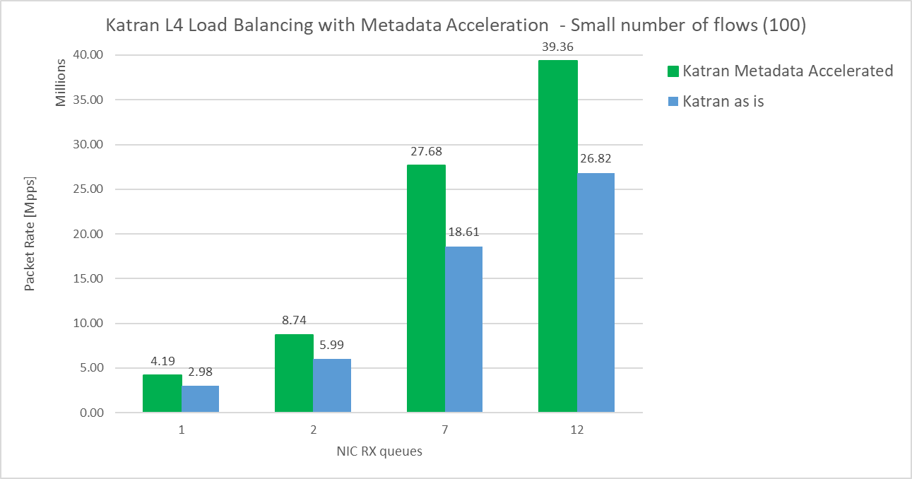
Katran Metadata Acceleration - Performance Results
46%
48%
46%
40%

Slide 12
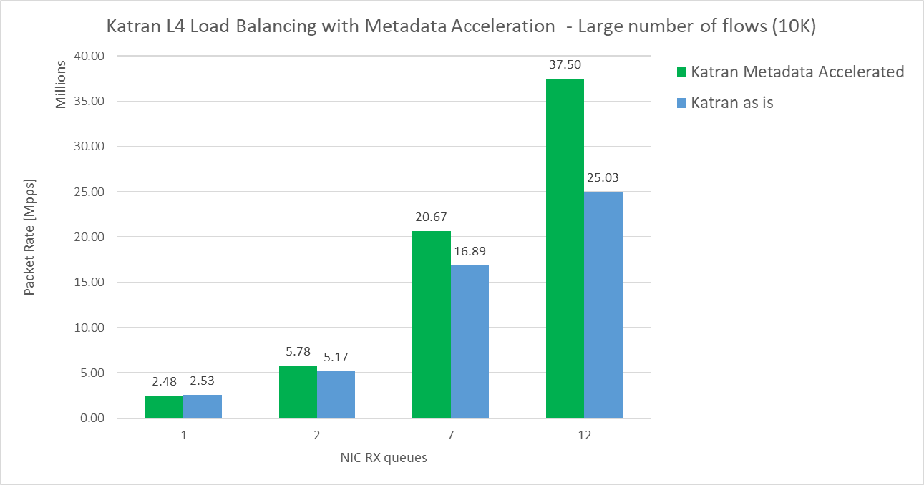
Katran Metadata Acceleration - Performance Results
50%
22%
12%
0%

Slide 13
/* TODO
We learn that the improvement is less effected when number of flows is more then 10K/core
Use mark for dest id and not flow id to reduce CPU caches misses
For stats, use per flow counter from TC (HW)
Expected performance for 1M flows will be similar to 100 flows:
Single core: ~4 Mpps
12 cores: ~40 Mpps
*/

