Slide 1
Katran/XDP Acceleration Netdev conf 0x13
Real world use cases analysis
March-2019 By Rony Efraim, Amir Ancel, Mikhael Goikhman, Michael Savisko, Tal Gilboa and Noam Stolero

Slide 2

Agenda: HW Acceleration for XDP
Using metadata prepared by the NIC HW.
Vendor agnostic by using generic Linux API like TC
Add support for XDP program to use metadata if exists
Bypassing packet parsing (including the cache miss)
Add rules to NIC HW to mark or drop packets

Slide 3



ASAP² features of ConnectX Network Adapters
Classification fields
Ethernet Layer 2
IP (v4 /v6)
TCP /UDP
Inner packet
VXLAN / NVGRE / GENEVE fields
Flexible fields extraction by “Flexparse”
All fields mandatory by OpenFlow
Actions
Marking (metadata)
Steering and Forwarding
Hair-Pin, forwarding back to the network
Same port or 2nd port
Header re-write
Drop / Allow
Counter set
Local and Remote Host Mirroring
Encapsulation
De-capsulation

Slide 4
Using NIC HW Acceleration in XDP program
App
App should config TC
Legacy NIC compatible
For Example :
App set action Y to flow X
Use TC to skbedit with 0x1234 for flow X
Config XDP program to do action Y for mark = 0x1234
App set action drop for flow Z
Use TC to drop flow Z
Use TC to get counter
Flow X skbedit mark 0x1234
Skb->mark 0x1234 DO action Y
User
TC
XDP program
Kernel
TC HW offload
Hardware
NIC
eSwitch
Packets flow
Config flow

Slide 5
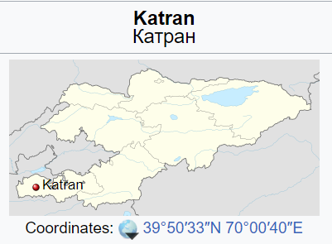
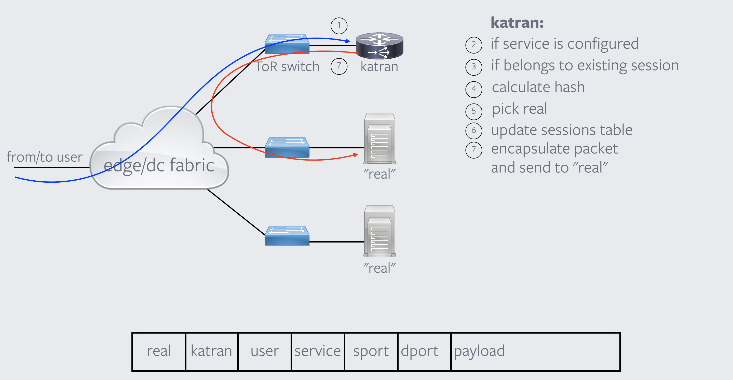
What is Katran ?
Village in Kyrgyzstan
“/bin/cat | /bin/run” with a typo
Cat running away
L4 load-balancer

Slide 6
Katran Overview
Stateful L4 load balancing (LB)
Open source by Facebook
Links: Open-sourcing Katran, a scalable network load balancer
https://github.com/facebookincubator/katran

Slide 7
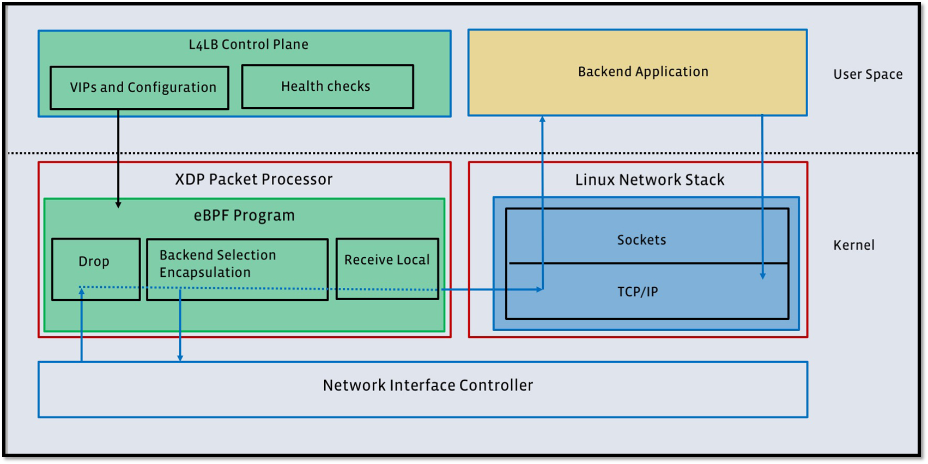
Katran – Architecture
Katran has two components:
User space control plane entity
XDP based packet processing code
Shared lookup tables
between the user space and XDP
XDP program actions:
Parsing + extract flow ID
Key generation for new flows
Lookup using the key to get Destination details.
Counters update - reflecting loads to the control plane entity.
Packet modification + Send to “Real” server

Slide 8


Katran – Acceleration (high level)
LB controller Update XDP MAP Call TC mark
User Space
XDP:
if (! Marked) {
Parse
Lookup flow_key
if (! flow_key) {
add to hash
Signal to user space
}
}
update stats
encapsulate + XDP_TX
Kernel
XDP program
HW marked packets

Slide 9
Katran Acceleration POC - User space app
user-space application – set-up TC rules
User-space application is responsible for the following:
Create new maps: hw_accel_mapping, vip_map_by_id, markid_pool_mapping, hw_accel_events
Fill-in for each forwarding CPU core markid_pool_mapping with selected range of HW marking IDs
Consume perf events produced by XDP program via bpf_perf_event_output()
Create TC rules for each received perf event:
tc filter add dev [ifname] protocol ip parent ffff: flower indev [ifname] skip_sw ip_proto [tcp|udp] src_ip X.X.X.X dst_ip Y.Y.Y.Y src_port [sport] dst_port [dport] action skbedit mark [markID]
Katran modified code is on Github: https://github.com/savisko/katran/tree/xdp_off

Slide 10
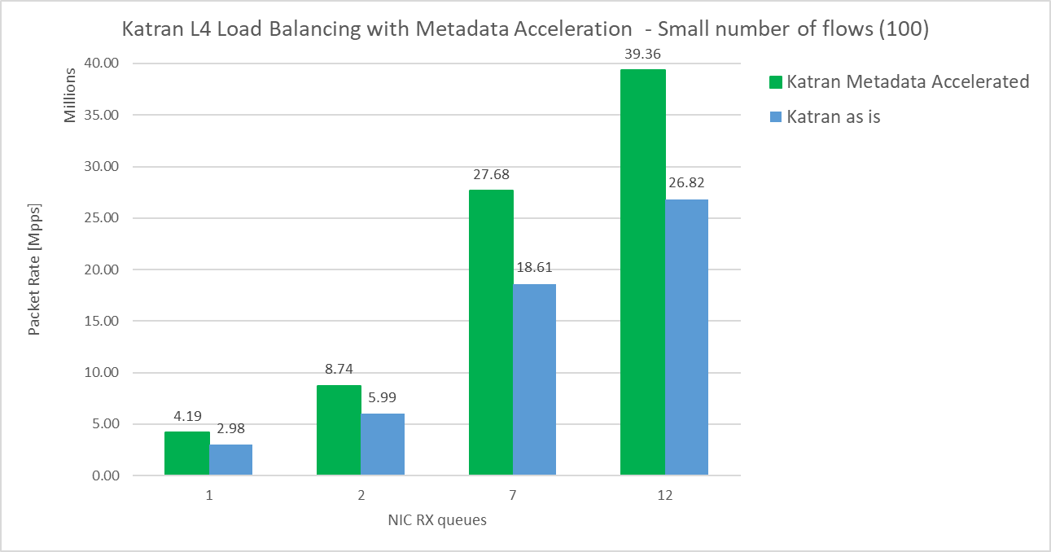
Katran Metadata Acceleration - Performance Results
46%
48%
46%
40%

Slide 11
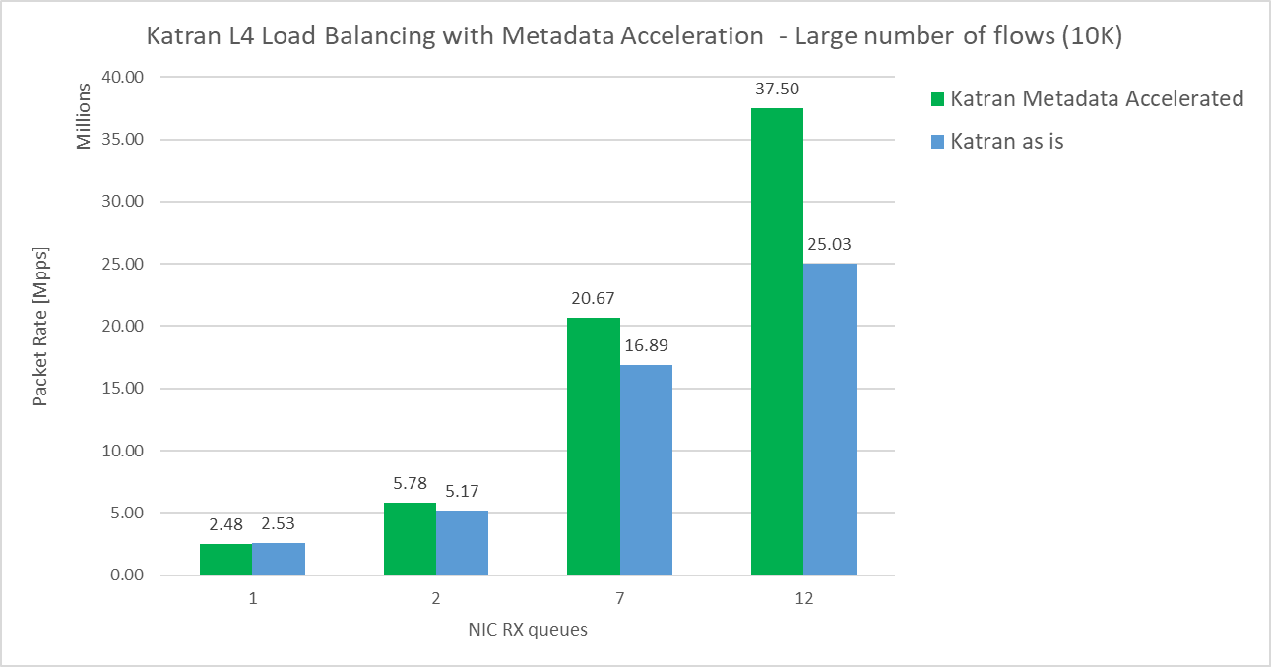
Katran Metadata Acceleration - Performance Results
50%
22%
12%
0%

Slide 12
/* TODO
We learn that the improvement is less effected when number of flows is more then 10K/core
Use mark for dest id and not flow id to reduce CPU caches misses
For stats, use per flow counter from TC (HW)
Expected performance for 1M flows will be similar to 100 flows:
Single core: ~4 Mpps
12 cores: ~40 Mpps
*/

