Slide 1
Group project Proposal
Kirsten Barkmeier and Savita Upadhayay

Slide 2
library(sf)
## Linking to GEOS 3.9.1, GDAL 3.2.3, PROJ 7.2.1; sf_use_s2() is TRUE
library(sp) library(terra)
## terra 1.5.21
library(RCurl) library(rvest) library(MODIStsp) library(rts)
## Loading required package: xts
## Loading required package: zoo
## ## Attaching package: 'zoo'
## The following object is masked from 'package:terra': ## ## time<-
## The following objects are masked from 'package:base': ## ## as.Date, as.Date.numeric
## rts 1.1-3 (2021-10-16)
library(gdalUtils)
## ## Attaching package: 'gdalUtils'
## The following object is masked from 'package:sf': ## ## gdal_rasterize
library(rgdal)
## Please note that rgdal will be retired by the end of 2023, ## plan transition to sf/stars/terra functions using GDAL and PROJ ## at your earliest convenience. ## ## rgdal: version: 1.5-28, (SVN revision 1158) ## Geospatial Data Abstraction Library extensions to R successfully loaded ## Loaded GDAL runtime: GDAL 3.2.3, released 2021/04/27 ## Path to GDAL shared files: /Library/Frameworks/R.framework/Versions/4.1-arm64/Resources/library/rgdal/gdal ## GDAL binary built with GEOS: TRUE ## Loaded PROJ runtime: Rel. 7.2.1, January 1st, 2021, [PJ_VERSION: 721] ## Path to PROJ shared files: /Library/Frameworks/R.framework/Versions/4.1-arm64/Resources/library/rgdal/proj ## PROJ CDN enabled: FALSE ## Linking to sp version:1.4-6 ## To mute warnings of possible GDAL/OSR exportToProj4() degradation, ## use options("rgdal_show_exportToProj4_warnings"="none") before loading sp or rgdal. ## Overwritten PROJ_LIB was /Library/Frameworks/R.framework/Versions/4.1-arm64/Resources/library/rgdal/proj
## ## Attaching package: 'rgdal'
## The following object is masked from 'package:terra': ## ## project
library(ggplot2)
## ## Attaching package: 'ggplot2'
## The following object is masked from 'package:terra': ## ## arrow
library(raster) library(tiff) library(rgdal) library(dplyr)
## ## Attaching package: 'dplyr'
## The following objects are masked from 'package:raster': ## ## intersect, select, union
## The following objects are masked from 'package:xts': ## ## first, last
## The following objects are masked from 'package:terra': ## ## intersect, src, union
## The following objects are masked from 'package:stats': ## ## filter, lag
## The following objects are masked from 'package:base': ## ## intersect, setdiff, setequal, union
library(tidyr)
## ## Attaching package: 'tidyr'
## The following object is masked from 'package:raster': ## ## extract
## The following object is masked from 'package:RCurl': ## ## complete
## The following object is masked from 'package:terra': ## ## extract
library(rasterVis)
## Loading required package: lattice
library(lattice) library(purrr) library(lubridate)
## ## Attaching package: 'lubridate'
## The following objects are masked from 'package:raster': ## ## intersect, union
## The following objects are masked from 'package:terra': ## ## intersect, union
## The following objects are masked from 'package:base': ## ## date, intersect, setdiff, union
setwd(“/Users/savitaupadhyay/Desktop/Stat 510 Project/Data”)

Slide 3
Introduction
Researchers have observed that land surface temperature anomalies could be the reason of lower moisture content of vegetations and could increase the possibility of fire.

Slide 4
Objective
The objective for this paper is:
Assess the relationship between land surface temperature(LST) anomalies and forest fire occurrence as well as further exploring related fire prediction factors.

Slide 5
Hypothesis
LST spatial distribution is associated with fire occurrences.

Slide 6
Study Area:
Victoria, as one of the states which has suffered most from wildfires in Australia, has also been affected by cause of climate change (Commissioner for Environmental Sustainability Victoria, 2018).
The province of Victoria comprises a total land surface area of 227,416 km2, located in south east Australia (141°–150°E, 34°–39°S) (Stewart & Nitschke, 2017). The area is composed of Australian Alps and plains, dominated by woody perennial vegetation (hardwood, softwood cover and large shrubs), with woody horticulture, grassland, urban and lakes. Forest cover accounts for over 25%, approximately 64 000 km2 including fire-intensive forest types like grassland, woody cover especially Eucalyptus regnans (Commissioner for Environmental Sustainability Victoria, 2018). The Victorian climate has been continuously warming since 2000s in the central and southern parts of the state, which causes a greater amount of fire occurrence (Stewart & Nitschke, 2017).

Slide 7
Data
MODIS LST Dataset
A dataset of daily gridded Terra-MODIS LST data (product MOD11A1, collection 6) from 2001 to 2019 retrieved from the Land Processes Distributed Active Archive Centre (LP DAAC, https://e4ftl01.cr.usgs.gov/) has been used for this study. The MOD11A1 V6 product provides daily land surface temperature (LST) values in a 1200 x 1200 kilometer grid.
Choosing diurnal instead of nocturnal data, and Terra-MODIS rather than Aqua-MODIS. MODIS Terra Satellite daily datasets could be calculated mean LST anomalies, standard deviation from January in each fire season peaks during the previous 20 years.
Fire Ignition Dataset:
This dataset describes recorded fire’s spatial information since 2001 to 2019, covering bushfires and DELWP (Department of Environment, Land, Water and Planning) planned burn information in state of Victoria. CFA data on fires occurring on private land has been covered from 2009. The dataset includes fire ignition, recorded date and time of fire extinction, and presumed causes (Department of Environment, Land, Water & Planning of Victoria, 2015).
Fire causes summary in January from 2001 to 2019
Variables :
Response : (derived variable)(Fire(0/1) binary variable. If (number of fires)Firenum_lodate >0, Fire =1 else Fire =0 Predictor: Land Surface Temprature anomaly(LST), latitude(lat), longitude(lon), t(derived variable: time sequence) Spatial location : Victoria, Australia (Bounding box: xmin: 140.9617 ymin: -39.13396 xmax: 149.9763 ymax: -33.99605)(use ozmap ‘R’ function) Time : Month of January across 2001 to 2019

Slide 8
Methodology
LST Anomalies Calculation:
To analyse each year’s LST variation we have chosen January data between the year 2001 and 2019 as the fire season peaks in January.
LST anomalies = $\frac{x_{DOY}−{\overset{‾}{x}}_{DOY}}{σ_{DOY}}$
where:
$x_{DOY}$ is observed LST for pixel x,y on day of year in year y
${\overset{‾}{x}}_{DOY}$ is mean LST of day of year over 19 years
$σ_{DOY}$ is standard deviation of LST of day of year over 19 years
Study the LST Data
Read the data from tiff files.(Tiff files are data stored as images)
Read the Land Surface Temprature data from two tiff files for the month of January from 2001 - 2019 as “Raster object”.
There are two raster objects LST1_15 and LST1_16.
Each raster object has multiple raster layers and a projection string.
Since both the tiff files are for Victoria, Australia their coordinate reference system are same.
LST1_15 has(15 x 19 layers : Each layer has data for a single date) and LST16_31 has(16x 19) layers.
Extract all the layers and stack them and convert the stack into a data frame. Since data frames are easy to analyse.
Study the Fire data
Study the distribution of fire data across different Fire causes and across all years.
Merge the LST Data and Fire Data.
Assign the coordinate reference system(crs) of LST data to Fire data.
Match(overlay on) the coordinates Fire data with LST data using ‘Nearest neighbor coordinate matching’.
Aggregate the data by month.
Study the aggregated merged data set.
Study the Empirical Spatial and temporal LST mean.
Empirical ST Covariogram :Study the covariabillity in the LST data as a function of temporal lags and spatial lags.
Modelling
Study the LST and Fire relationship : Pixelwise binary regression to study the relation between LST and Fire.
Forecasting: Predict Fire incidents using temporal basis and spatial random effects.

Slide 9
Raw Land Surface Temprature Data stored in Tiff files
raster::plot(LST_anomaly1_15,col=terrain.colors(10),main= "LST anomaly Jan1_15(2001 - 2019)")

Slide 10
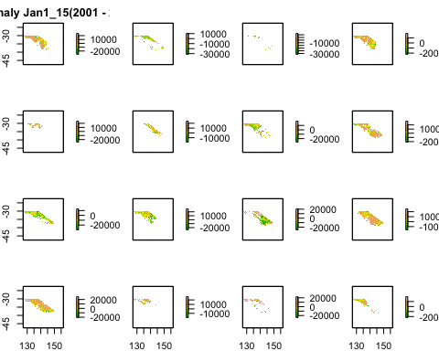

Slide 11
Since summer is at the peak in Australia in the month of January. Temperature is on the higher side. [ Input data is LST for entire Australia. We will subset the information for the state of Victoria for further analysis].
Each plot has data for one day of the month of January accorss all years. Therefore, the first plot is the LST input data for January 1 for all the 19 years from 2001 to 2019
There are some blank spaces in the input data(no colors) implying missing data.

Slide 12
Extract the data for the State of Victoria by taking a subset(lon,lat)

Slide 13
Victoria, Australia - xmin: 140.9617 ymin: -39.13396 xmax: 149.9763 ymax: -33.99605
After by taking a subset(lon,lat) the input data for January, 2017:

Slide 14
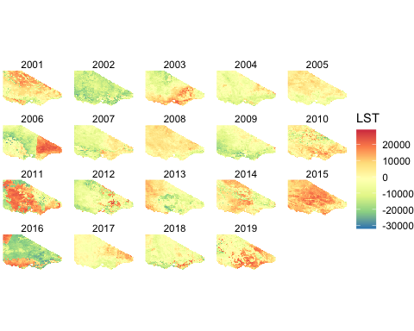

Slide 15
## Warning in rm(LST_plot): object 'LST_plot' not found

Slide 16
Fire data stored in shape files.[Saptialpoint objects]
The fire data has location(longitude,latitude), date, fire causes and number of fires.
There are 24 known causes of fires. Here is the summary of Fire Causes.
## # A tibble: 23 × 2 ## CAUSE FIRE_INCIDENTS ## <chr> <dbl> ## 1 LIGHTNING 59965 ## 2 UNATTENDED CAMPFIRE - CONTAINED WITHIN BOUNDARY 31426 ## 3 CAMPFIRE, BARBEQUE 31357 ## 4 OTHER 26531 ## 5 DELIBERATE LIGHTING (MALICIOUS) 15686 ## 6 BURNING VEHICLE, MACHINE 6269 ## 7 EXHAUST, OTHER 1774 ## 8 POWER TRANSMISSION 1609 ## 9 PIPE, CIGARETTE, MATCH 1273 ## 10 BURNING OFF, WINDROW, HEAP 767 ## # … with 13 more rows

Slide 17
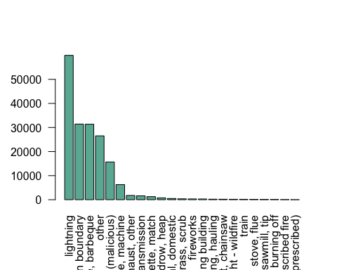

Slide 18
59965(highest across all fire cause)number of fires reported due to “Lightning”.
## # A tibble: 19 × 2 ## year FIRE_INCIDENTS ## <dbl> <dbl> ## 1 2019 38287 ## 2 2018 24464 ## 3 2015 17140 ## 4 2014 16126 ## 5 2017 12308 ## 6 2016 12033 ## 7 2003 7496 ## 8 2006 6329 ## 9 2013 5361 ## 10 2001 5177 ## 11 2010 5018 ## 12 2008 4658 ## 13 2009 4613 ## 14 2007 4356 ## 15 2005 4286 ## 16 2012 4267 ## 17 2004 3618 ## 18 2002 3496 ## 19 2011 268
## # A tibble: 19 × 2 ## year FIRE_INCIDENTS ## <dbl> <dbl> ## 1 2019 38287 ## 2 2018 24464 ## 3 2015 17140 ## 4 2014 16126 ## 5 2017 12308 ## 6 2016 12033 ## 7 2003 7496 ## 8 2006 6329 ## 9 2013 5361 ## 10 2001 5177 ## 11 2010 5018 ## 12 2008 4658 ## 13 2009 4613 ## 14 2007 4356 ## 15 2005 4286 ## 16 2012 4267 ## 17 2004 3618 ## 18 2002 3496 ## 19 2011 268

Slide 19
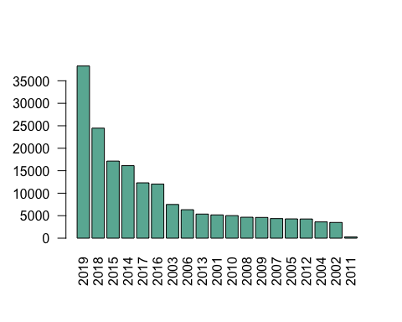

Slide 20
38287(highest in the year in entire Victoria region)number of fires reported in 2019.
14963 number of fires reported in 2019 due to ‘Unattended Camp Fire - contained within boundary.’ In 2019, 575 fires were due to unknown reasons.

Slide 21
Connect Fires and the Land Surface Temperature Data
## New names: ## * lon -> lon...1 ## * lat -> lat...2 ## * lon -> lon...3 ## * lat -> lat...4
## `summarise()` has grouped output by 'lon', 'lat', 'lon_nn', 'lat_nn', ## 'FIRE_START', 'CAUSE'. You can override using the `.groups` argument.

Slide 22
Nearest Neighbor coordinate matching:
The plot shows coordinate matching of Land Surface Temperature Data and Fire Data. using ‘nearest neighbor coordinate matching’.

Slide 23
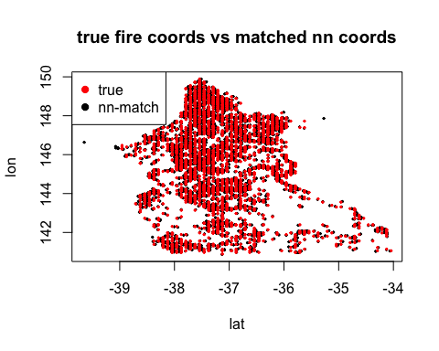

Slide 24
There are two outliers in the the data.We will remove these two outliers. Fire data is difficult to report the exact origin of Fire. It is reported where it was first observed.
Pending- remove the two outliers

Slide 25
Some aggregated plots
## Loading required package: viridisLite
## `summarise()` has grouped output by 'year', 'lon'. You can override using the ## `.groups` argument.

Slide 26
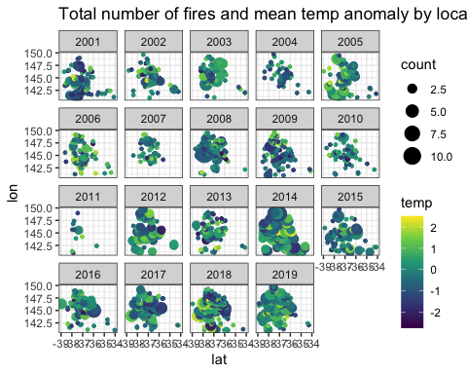

Slide 27
df_merge <- df_all_long %>% group_by(id,lon,lat,year) %>% summarize(temp = mean(LST),Firenum = sum(Firenum_locdate,na.rm = TRUE))
## `summarise()` has grouped output by 'id', 'lon', 'lat'. You can override using ## the `.groups` argument.
t_m <- as.data.frame(sort(unique(df_merge$year))) t_m$t = seq(1,nrow(t_m),1) colnames(t_m)<-c("year","t") df_merge = left_join(df_merge,t_m)
## Joining, by = "year"
df_merge$Fire <-if_else((!(is.na(df_merge$Firenum))&(df_merge$Firenum>0)),1,0) rm(t_m) rm(df_all_long)

