Slide 1
Comparing Proportions: A modern solution to a classical problem Presented By: Savita Upadhyay

Slide 2
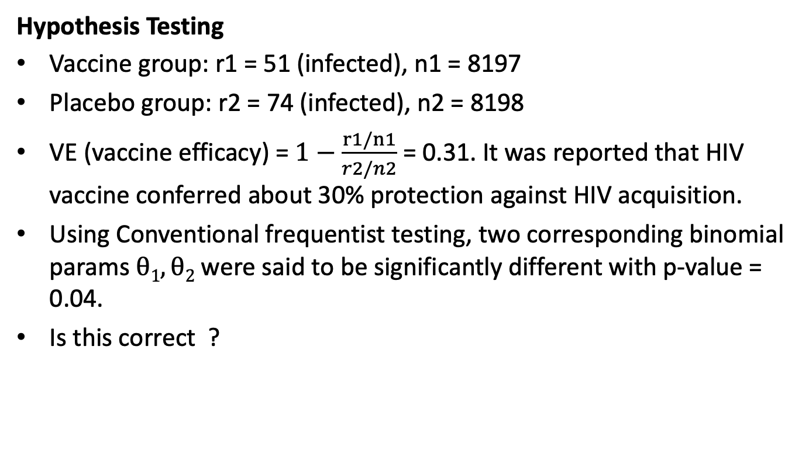
Thailand HIV Vaccine Trials
Hypothesis Testing
Vaccine group: r1 = 51 (infected), n1 = 8197
Placebo group: r2 = 74 (infected), n2 = 8198
VE (vaccine efficacy) = $1−\frac{r1/n1}{r2/n2}$ = 0.31. It was reported that HIV vaccine conferred about 30% protection against HIV acquisition.
Using Conventional frequentist testing, two corresponding binomial params $θ1, θ2$ were said to be significantly different with p-value = 0.04.
Is this correct ?

Slide 3


Introduction
Probability model: $M_{z}=\{p\left(z | ω\right),z∈Z,ω∈Ω\}.$
All that can be said about any function $θ\left(z | ω\right)$ $∈$ $Θ$ of vector $ω$ is contained in its posterior distribution p($θ$|z).
One would expect the same prior $p\left(ω\right)$ could be used to derive both type of summaries(estimation and hypothesis testing).
However, since Theory Of Probability (Jeffrey’s), Bayesian methods have made use of radically difference types of prior
Bayesian Theory
Estimation (Point and Region)
Hypothesis testing
Notes:
There are a few reasons for having different priors for testing and estimation.
One of them is that some priors commonly used for estimation have a terrible behavior when used for testing (such as converging to the null model with probability 1 as n—> infinity regardless of what the truth is, one example is using a flat prior on the real line for the regression coefficients, this one is commonly used for estimation but has this terrible behavior for testing). This is for example the case of the Jeffreys’ prior for the multivariate normal model, which can be used for estimation but not for testing.
Also, there is the issue that the author mentions in the paper, if you are testing a sharp null hypothesis you want that event to have probability greater than 0, and that is not the case if you have a continuous parameter

Slide 4
Key Ideas of the paper
It is argued that this is certainly not necessary use two radically different types of prior for estimation and some for hypothesis testing. A coherent solution to both problems using the same prior is possible within the standard framework of Bayesian decision theory.
The paper specifies:
Point estimation, Region estimation and precise hypothesis testing results are dependent of on the choice of both the loss function and prior distribution
Proposes the required properties of a loss function (intrinsic log loss) as a self – calibrated information bases continuous loss function for Hypothesis Testing
Shows that by using a common prior and intrinsic log loss on Normal and binomial distributions we can do both estimation and Hypothesis testing
Application to HIV trial data from Thailand

Slide 5
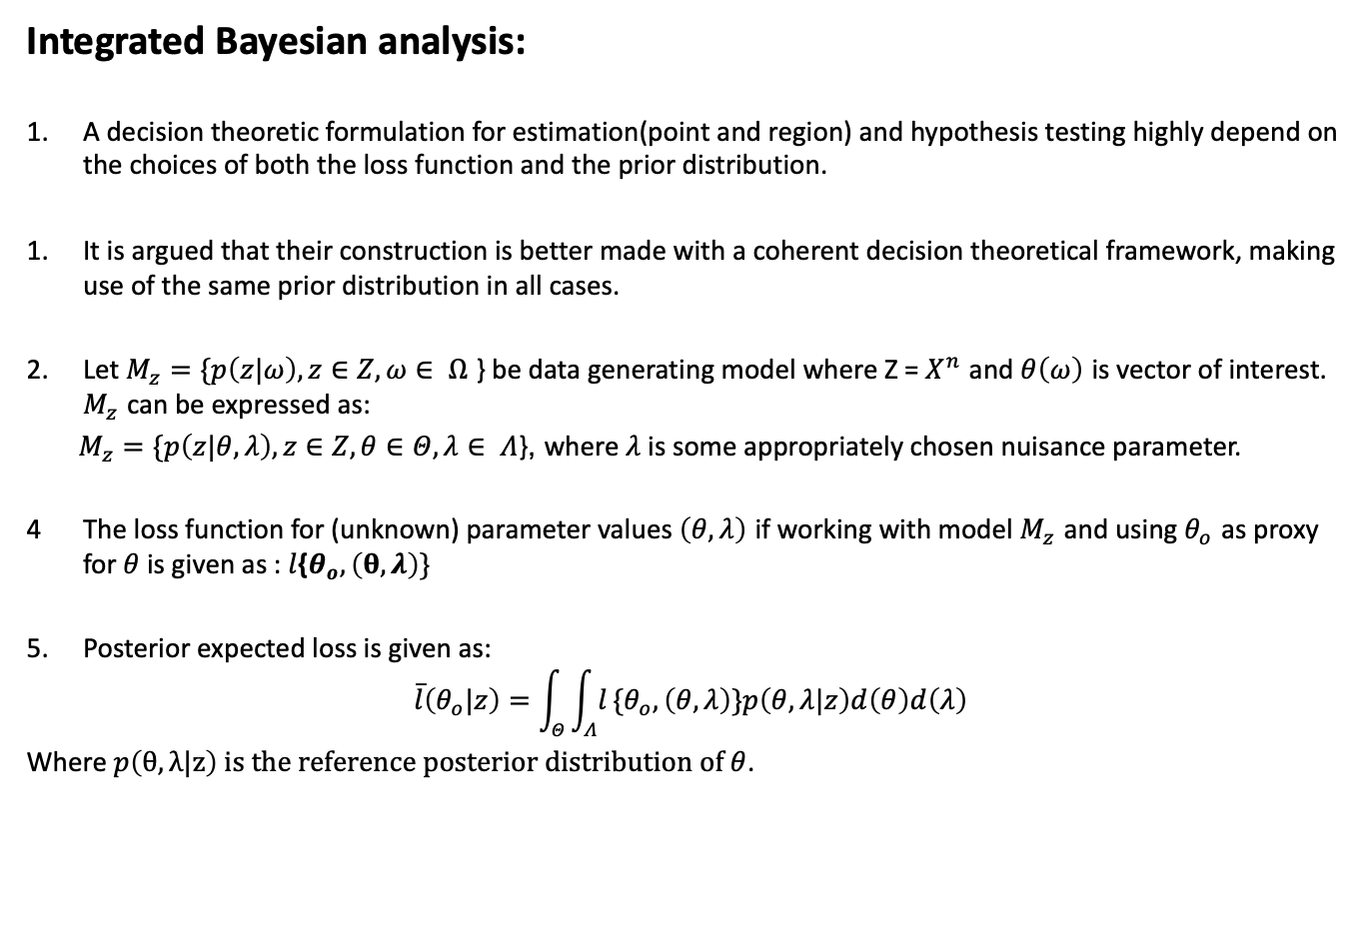
Integrated Bayesian analysis:
A decision theoretic formulation for estimation(point and region) and hypothesis testing highly depend on the choices of both the loss function and the prior distribution.
It is argued that their construction is better made with a coherent decision theoretical framework, making use of the same prior distribution in all cases.
Let $M_{z}=\{p\left(z|ω\right),z∈Z,ω∈ Ω$ } be data generating model where Z = $X^{n}$ and $θ\left(ω\right)$ is vector of interest. $M_{z}$ can be expressed as:
$M_{z}=\{p\left(z|θ,λ\right),z∈Z,θ∈Θ,λ∈ Λ$}, where $λ$ is some appropriately chosen nuisance parameter.
The loss function for (unknown) parameter values $\left(θ,λ\right)$ if working with model $M_{z}$ and using $θ_{o}$ as proxy for $θ$ is given as : $l${$θ_{o},\left(θ,λ\right)\}$
Posterior expected loss is given as:
$$\overset{‾}{l}\left(θ_{o}|z\right)=\int_{Θ}^{​}{\int_{Λ}^{​}{l}}\{θ_{o},\left(θ,λ\right)\}p\left(θ,λ|z\right)d\left(θ\right)d\left(λ\right)$$
Where $p\left(θ,λ|z\right) is the reference posterior distribution of θ$.

Slide 6
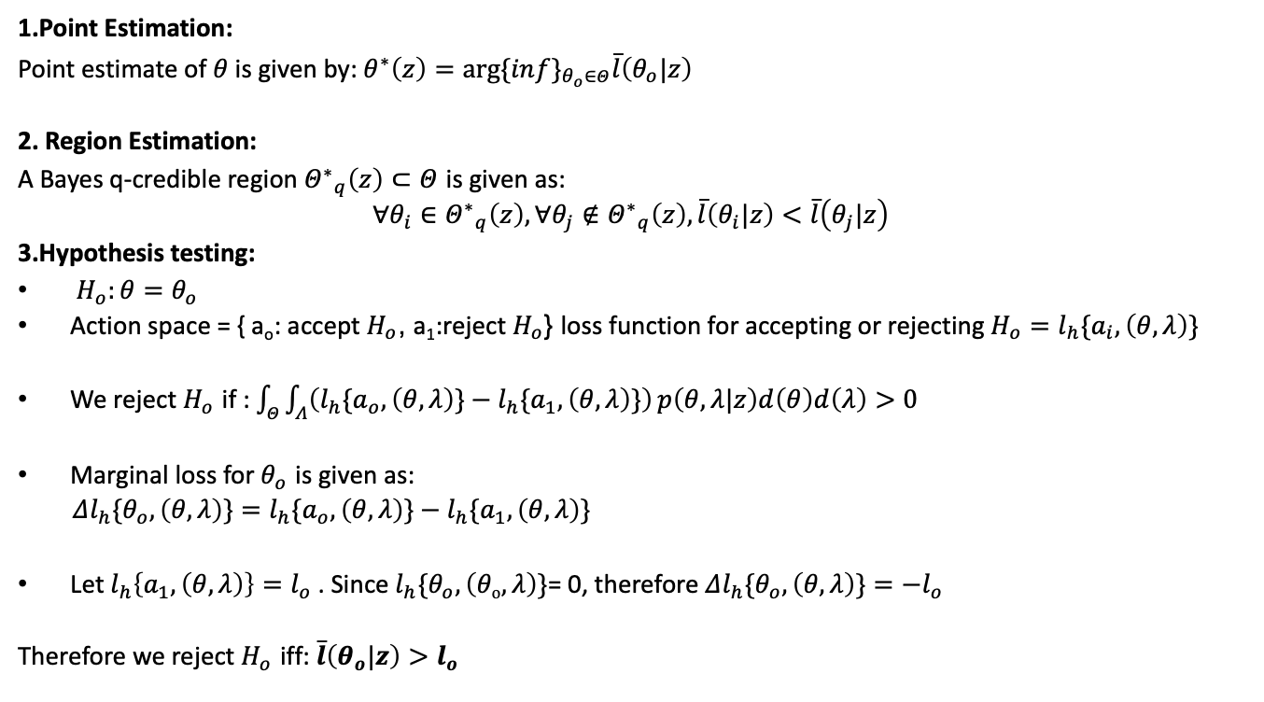
Point Estimation, Region Estimation and Hypothesis Testing
1.Point Estimation:
Point estimate of $θ$ is given by: $θ^{∗}\left(z\right)=arg⁡\{in{f\}}_{θ_{o}∈Θ}\overset{‾}{l}\left(θ_{o}|z\right)$
2. Region Estimation:
A Bayes q-credible region ${Θ^{∗}}_{q}\left(z\right)⊂Θ$ is given as:
$$∀θ_{i}∈{Θ^{∗}}_{q}\left(z\right),∀θ_{j}∉{Θ^{∗}}_{q}\left(z\right),\overset{‾}{l}\left(θ_{i}|z\right)<\overset{‾}{l}\left(θ_{j}|z\right)$$
3.Hypothesis testing:
$H_{o}:θ=θ_{o}$
Action space = { a_{o}: accept $H_{o}$, a₁:reject $H_{o}$} loss function for accepting or rejecting $H_{o}=l_{h}\{a_{i},\left(θ,λ\right)\}$
We reject $H_{o}$ if : $\int_{Θ}^{​}{\int_{Λ}^{​}{\left(l_{h}\{a_{o},\left(θ,λ\right)\}−l_{h}\{a_{1},\left(θ,λ\right)\}\right)}}p\left(θ,λ|z\right)d\left(θ\right)d\left(λ\right)>0$
Marginal loss for $θ_{o}$ is given as:
$Δl_{h}\{θ_{o},\left(θ,λ\right)\}=l_{h}\{a_{o},\left(θ,λ\right)\}−l_{h}\{a_{1},\left(θ,λ\right)\}$
Let $l_{h}\left\{a_{1},\left(θ,λ\right)\right\}=l_{o}$. Since $l_{h}\{θ_{o},\left(θo,λ\right)\}$= 0, therefore $Δl_{h}\{θ_{o},\left(θ,λ\right)\}=−l_{o}$
Therefore we reject $H_{o}$ iff: $\overset{‾}{l}\left(θ_{o}|z\right)>l_{o}$

Slide 7
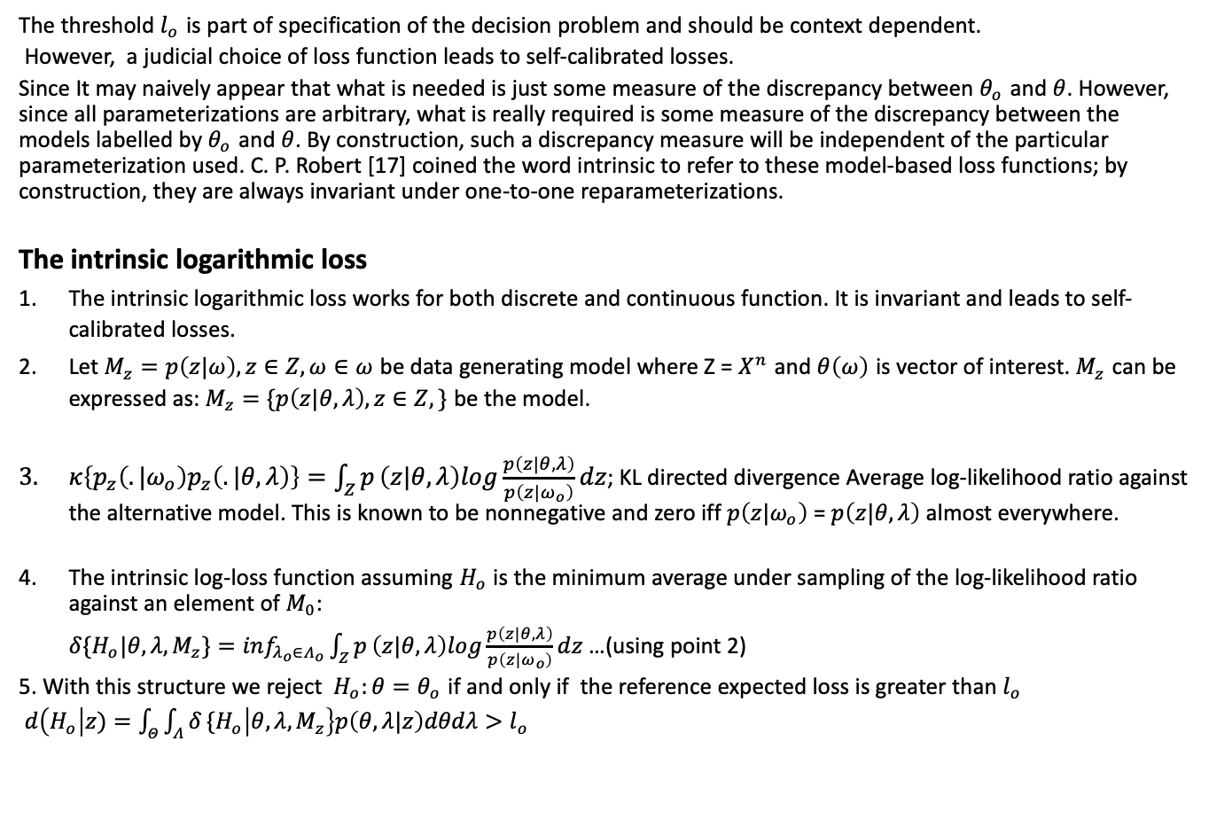
Loss Function
The threshold $l_{o}$ is part of specification of the decision problem and should be context dependent.
However, a judicial choice of loss function leads to self-calibrated losses.
Since It may naively appear that what is needed is just some measure of the discrepancy between $θ_{o}$ and $θ$. However, since all parameterizations are arbitrary, what is really required is some measure of the discrepancy between the models labelled by $θ_{o}$ and $θ$. By construction, such a discrepancy measure will be independent of the particular parameterization used. C. P. Robert [17] coined the word intrinsic to refer to these model-based loss functions; by construction, they are always invariant under one-to-one reparameterizations.
The intrinsic logarithmic loss
The intrinsic logarithmic loss works for both discrete and continuous function. It is invariant and leads to self- calibrated losses.
Let $M_{z}=p\left(z|ω\right),z∈Z,ω∈ω$ be data generating model where Z = $X^{n}$ and $θ\left(ω\right)$ is vector of interest. $M_{z}$ can be expressed as: $M_{z}=\{p\left(z|θ,λ\right),z∈Z,\}$ be the model.
$κ\left\{p_{z}\left(.|ω_{o}\right)p_{z}\left(.|θ,λ\right)\right\}=\int_{Z}^{​}{p}\left(z|θ,λ\right)log\frac{p\left(z|θ,λ\right)}{p\left(z|ω_{o}\right)}dz$; KL directed divergence Average log-likelihood ratio against the alternative model. This is known to be nonnegative and zero iff $p\left(z|ω_{o}\right)$ = $p\left(z|θ,λ\right)$ almost everywhere.
The intrinsic log-loss function assuming $H_{o}$ is the minimum average under sampling of the log-likelihood ratio against an element of $M_{0}$:
$δ\{H_{o}|θ,λ,M_{z}\}=inf_{λ_{o}∈Λ_{o}}\int_{Z}^{​}{p}\left(z|θ,λ\right)log\frac{p\left(z|θ,λ\right)}{p\left(z|ω_{o}\right)}dz$ …(using point 2)
5. With this structure we reject $H_{o}:θ=θ_{o}$ if and only if the reference expected loss is greater than $l_{o}$
$d\left(H_{o}\left|z)=\int_{Θ}^{​}{\int_{Λ}^{​}{δ}}\{H_{o}\right|θ,λ,M_{z}\right\}p\left(θ,λ|z\right)dθdλ>l_{o}$

Slide 8
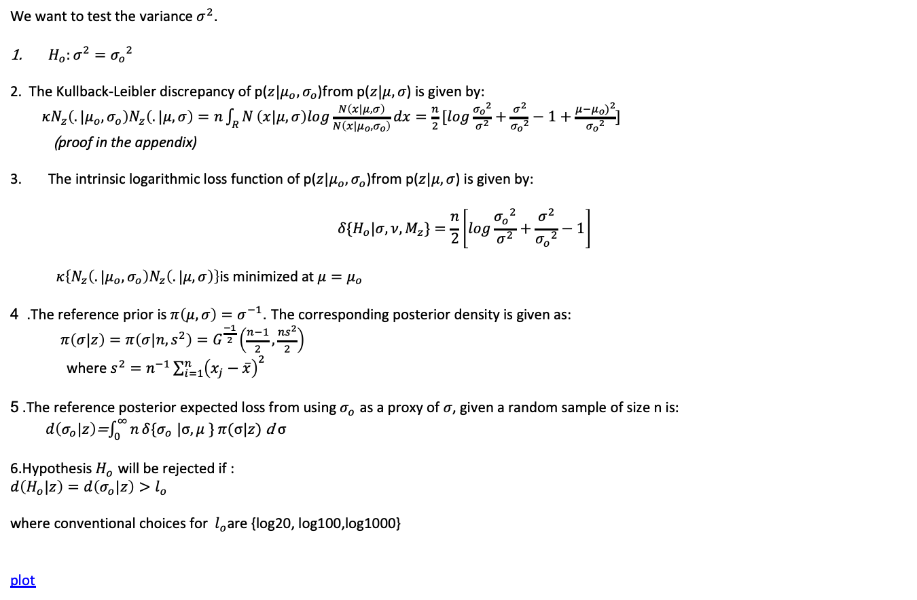
Example: Normal variance
We want to test the variance $σ^{2}$.
$H_{o}:σ^{2}={σ_{o}}^{2}$
2. The Kullback-Leibler discrepancy of p($z|μ_{o},σ_{o}$)from p($z|μ,σ$) is given by:
$κN_{z}\left(.|μ_{o},σ_{o}\right)N_{z}\left(.|μ,σ\right)=n\int_{R}^{​}{N}\left(x|μ,σ\right)log\frac{N\left(x|μ,σ\right)}{N\left(x|μ_{o},σ_{o}\right)}dx$ $=\frac{n}{2}[log\frac{{σ_{o}}^{2}}{σ^{2}}+\frac{σ^{2}}{{σ_{o}}^{2}}−1+\frac{μ−μ_{o})^{2}}{{σ_{o}}^{2}}]$
(proof in the appendix)
The intrinsic logarithmic loss function of p($z|μ_{o},σ_{o}$)from p($z|μ,σ$) is given by:
$$δ\{H_{o}|σ,ν,M_{z}\}={\frac{n}{2}\left[log\frac{{σ_{o}}^{2}}{σ^{2}}+\frac{σ^{2}}{{σ_{o}}^{2}}−1\right] }_{}$$
$κ\left\{N_{z}\left(.|μ_{o},σ_{o}\right)N_{z}\left(.|μ,σ\right)\right\}\text{is} \text{minimized} \text{at} μ=μ_{o}$
4 . The reference prior is $π\left(μ,σ\right)=σ^{−1}$. The corresponding posterior density is given as:
$π\left(σ|z\right)=π\left(σ|n,s^{2}\right)=G^{\frac{−1}{2}}\left(\frac{n−1}{2},\frac{ns^{2}}{2}\right)$
where $s^{2}=n^{−1}\sum_{i=1}^{n}{{\left(x_{j}−\overset{‾}{x}\right)}^{2}}$
5 .The reference posterior expected loss from using $σ_{o}$ as a proxy of $σ$, given a random sample of size n is:
$d\left(σ_{o}|z\right)$=$\int_{0}^{∞}{n}δ\{σ_{o}$ $|σ,μ$ } $π$($σ|z)$ d $σ$
6.Hypothesis $H_{o}$ will be rejected if :
$d\left(H_{o}|z\right)=d\left(σ_{o}|z\right)>l_{o}$
where conventional choices for${ l}_{o}\text{are}\text{ \{}\text{log}\text{20, }\text{log}\text{100,}\text{log}\text{1000\}}$
plot

Slide 9



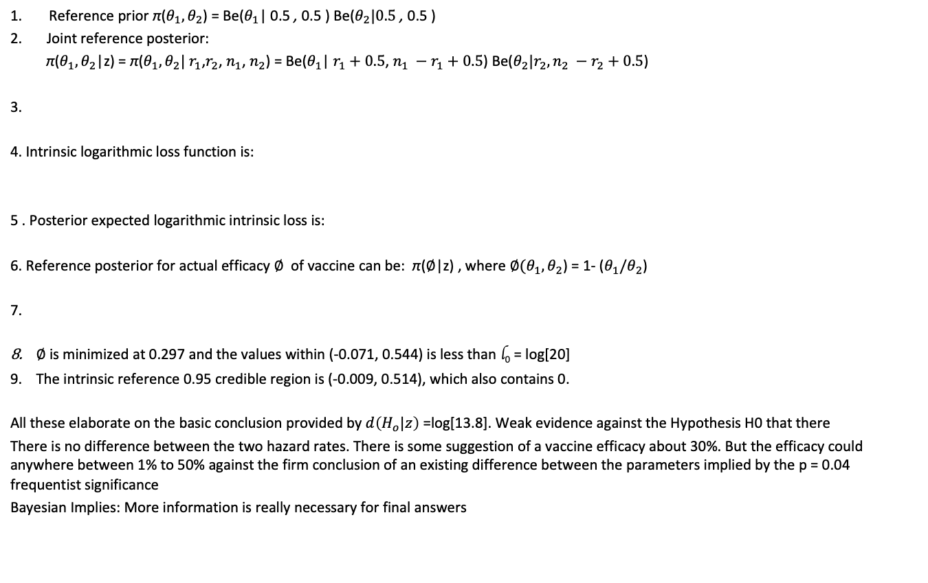
HIV Trials Revisited: Objective Bayesian Analysis
Reference prior π($θ_{1},θ_{2}$) = Be($θ_{1}$| 0.5 , 0.5 ) Be($θ_{2}|0.5$ , 0.5 )
Joint reference posterior:
π($θ_{1},θ_{2}$|z) = π($θ_{1},θ_{2}|$ $r_{1}$,$r_{2}$, $n_{1}$, $n_{2}$) = Be($θ_{1}$| $r_{1}+0.5$, $n_{1} −r_{1}+0.5$) Be($θ_{2}|r_{2},{n_{2} −r}_{2}+0.5$)
3.
4. Intrinsic logarithmic loss function is:
5 . Posterior expected logarithmic intrinsic loss is:
6. Reference posterior for actual efficacy $∅$ of vaccine can be: π($∅$|z) , where ${∅(θ}_{1},θ_{2}$) = 1- ($θ_{1}/θ_{2}$)
7.
$∅$ is minimized at 0.297 and the values within (-0.071, 0.544) is less than l₀ = log[20]
The intrinsic reference 0.95 credible region is (-0.009, 0.514), which also contains 0.
All these elaborate on the basic conclusion provided by $d\left(H_{o}|z\right)$ =log[13.8]. Weak evidence against the Hypothesis H0 that there
There is no difference between the two hazard rates. There is some suggestion of a vaccine efficacy about 30%. But the efficacy could anywhere between 1% to 50% against the firm conclusion of an existing difference between the parameters implied by the p = 0.04 frequentist significance
Bayesian Implies: More information is really necessary for final answers

Slide 10
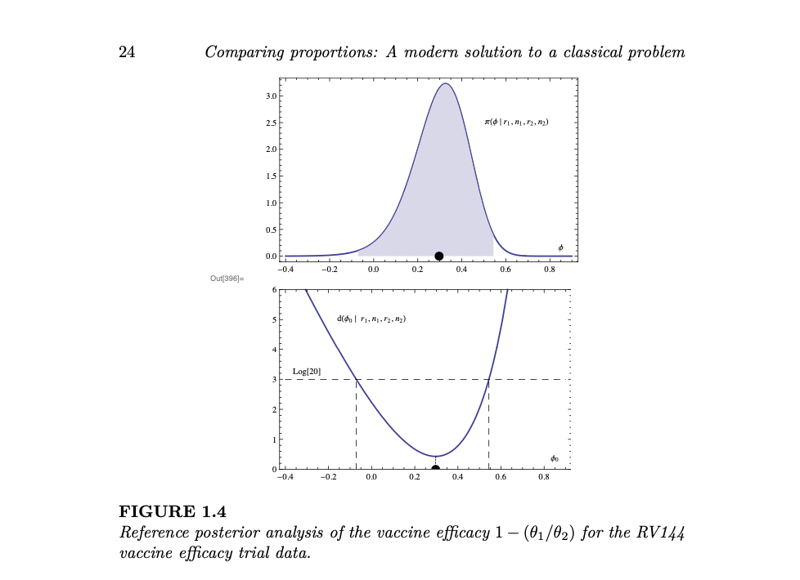
HIV Trials : Reference posterior efficacy of vaccince

Slide 11
Appendix

Slide 12
Very short summary of Jeffreys proposal
There are a few reasons for having different priors for testing and estimation.
One of them is that some priors commonly used for estimation have a terrible behavior when used for testing (such as converging to the null model with probability 1 as n—> infinity regardless of what the truth is, one example is using a flat prior on the real line for the regression coefficients, this one is commonly used for estimation but has this terrible behavior for testing). This is for example the case of the Jeffreys’ prior for the multivariate normal model, which can be used for estimation but not for testing.
Also, there is the issue that the author mentions in the paper, if you are testing a sharp null hypothesis you want that event to have probability greater than 0, and that is not the case if you have a continuous parameter

Slide 13
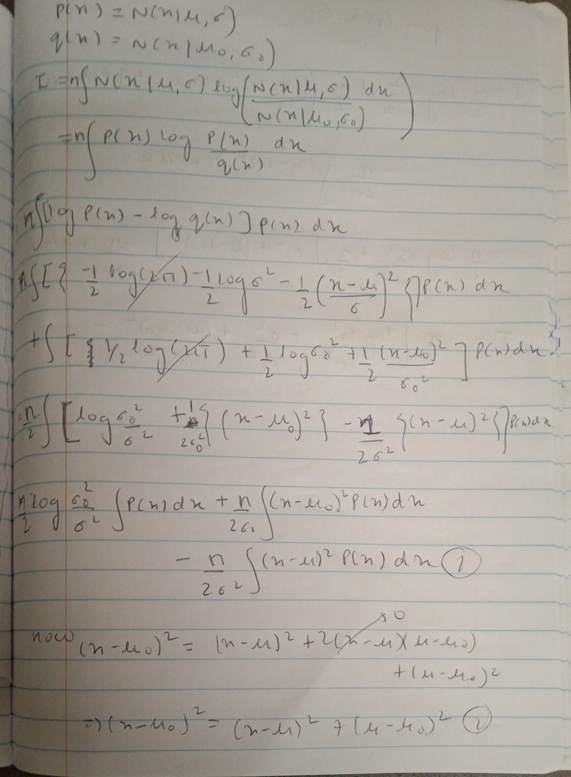
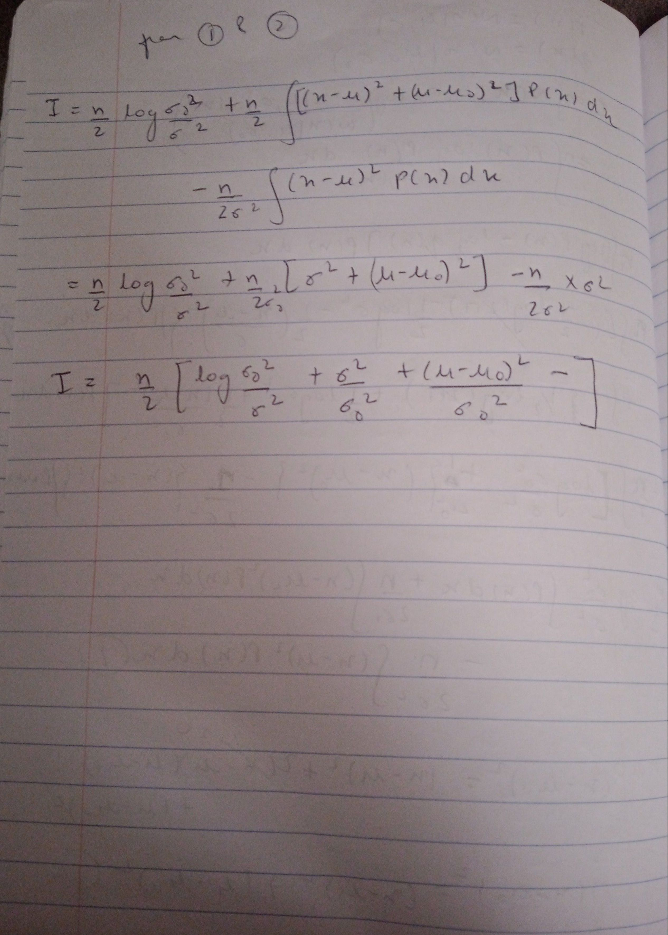
Proof

Slide 14
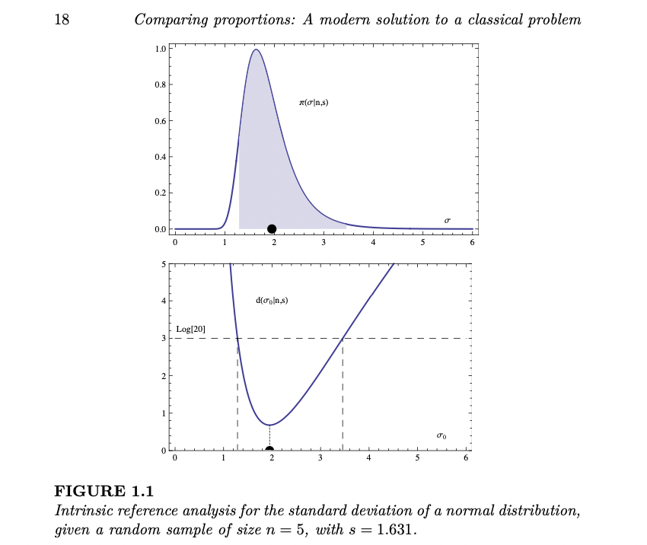
Normal Intrinsic loss

