Slide 1

SMARTATTEND
Online Attendance Management System
A modern web application featuring Dynamic QR Code Scanning, Automated Attendance Percentage Tracking, and Exam Eligibility Monitoring.
👨‍🏫 Teacher QR Generation • 👨‍🎓 Student Camera Scan • 📊 Real-Time Analytics

Slide 2
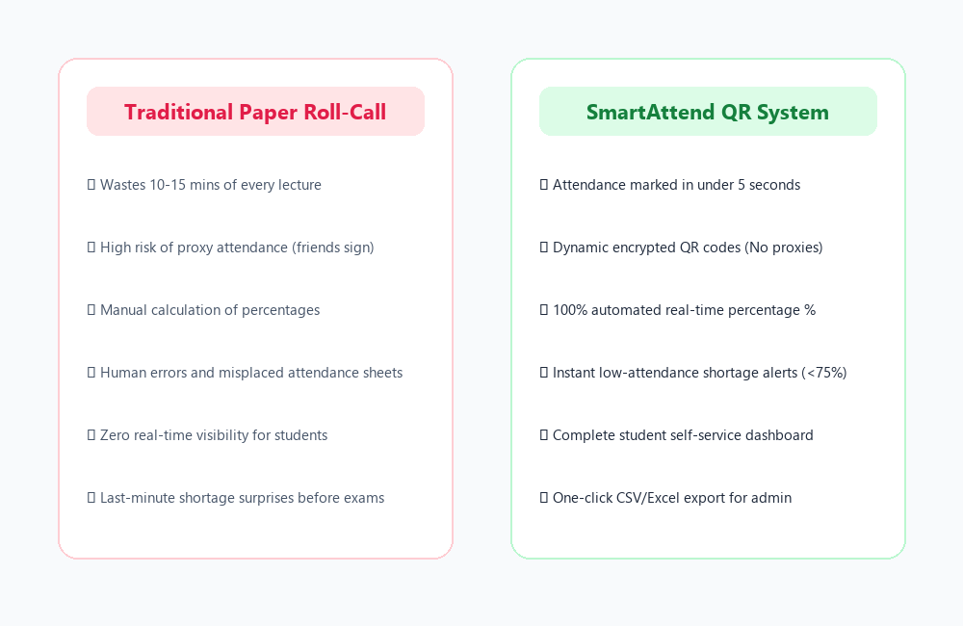
ONLINE ATTENDANCE MANAGEMENT SYSTEM
The Problem: Why Traditional Attendance Fails
• Time Inefficiency
Taking roll-calls manually consumes 10-15 minutes of an hour lecture, reducing actual teaching time by over 20%.
• Buddy Punching & Proxies
Paper signature sheets and verbal call-outs make it trivial for students to mark attendance for absent friends.
• Error-Prone Percentage Calculation
Faculty spend hours manually tallying registers at semester end, resulting in computation mistakes.
• Lack of Student Awareness
Students have zero real-time visibility into their subject percentage, leading to sudden exam debarment notices.

Slide 3
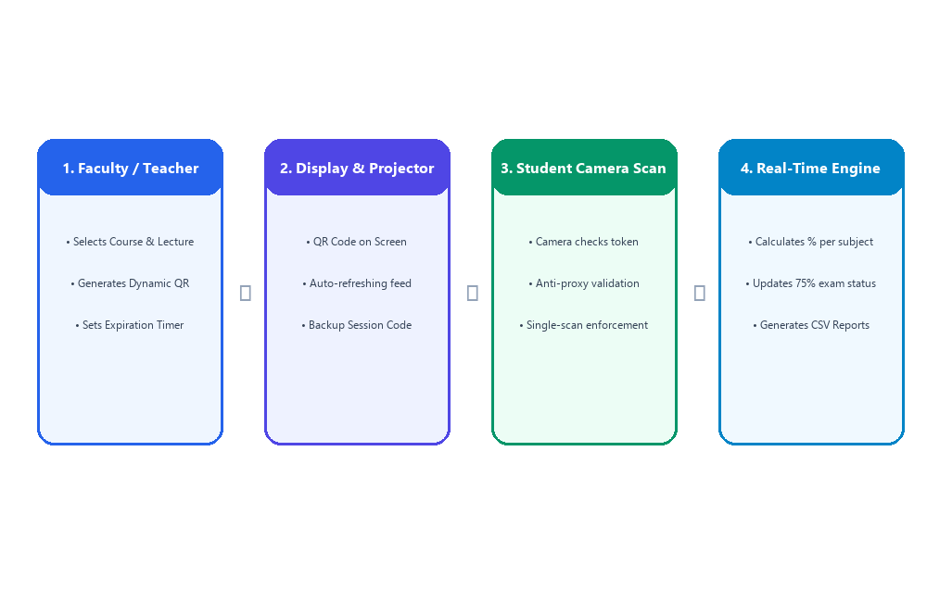
ONLINE ATTENDANCE MANAGEMENT SYSTEM
System Workflow & End-to-End Architecture
SmartAttend replaces manual workflows with a 4-step dynamic QR cycle backed by secure session tokens and an automated SQLite calculation engine.

Slide 4
ONLINE ATTENDANCE MANAGEMENT SYSTEM
Faculty Portal: Dynamic QR Generation & Live Monitor
• Dynamic QR Code Generation
Instructors select subject and lecture topic, generating high-resolution QR codes encoded with secure UUID tokens.
• Validity Timer & Auto Expiry
Set custom session lifespan (5m, 15m, 30m, 1h). The system automatically disables attendance when the timer expires.
• Fullscreen Projector Mode
Designed specifically for classroom smartboards and projector screens with high-contrast, scalable display.
• Live Turnout & Manual Override
Live attendee feed auto-updates every 3 seconds. Faculty can also manually mark or adjust status (Present/Absent).

Slide 5
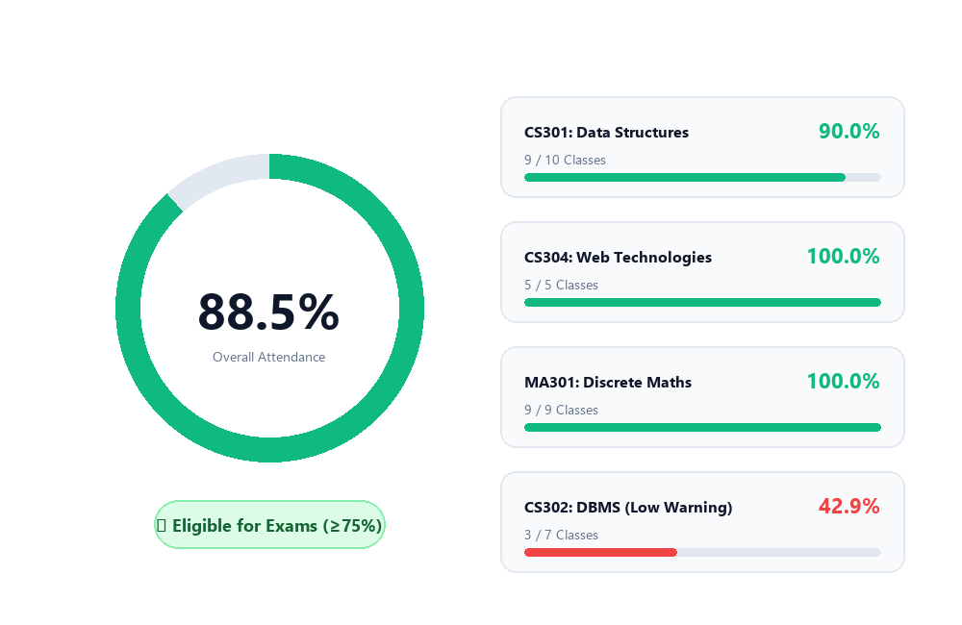
ONLINE ATTENDANCE MANAGEMENT SYSTEM
Student Dashboard: Attendance Percentage Tracking
• Animated Percentage Gauge
Overall attendance percentage calculated with a color-coded radial meter (Green ≥ 75%, Red < 75%).
• Exam Eligibility Status
Displays clear status: 'Eligible for Exams' or 'Attendance Shortage Warning' based on university criteria.
• Actionable Shortage Forecast
Automatically tells students exactly how many consecutive upcoming classes they need to reach 75%.
• Subject-Wise Breakdown
Individual progress bars and attended/missed lecture counts for every course enrolled.

Slide 6
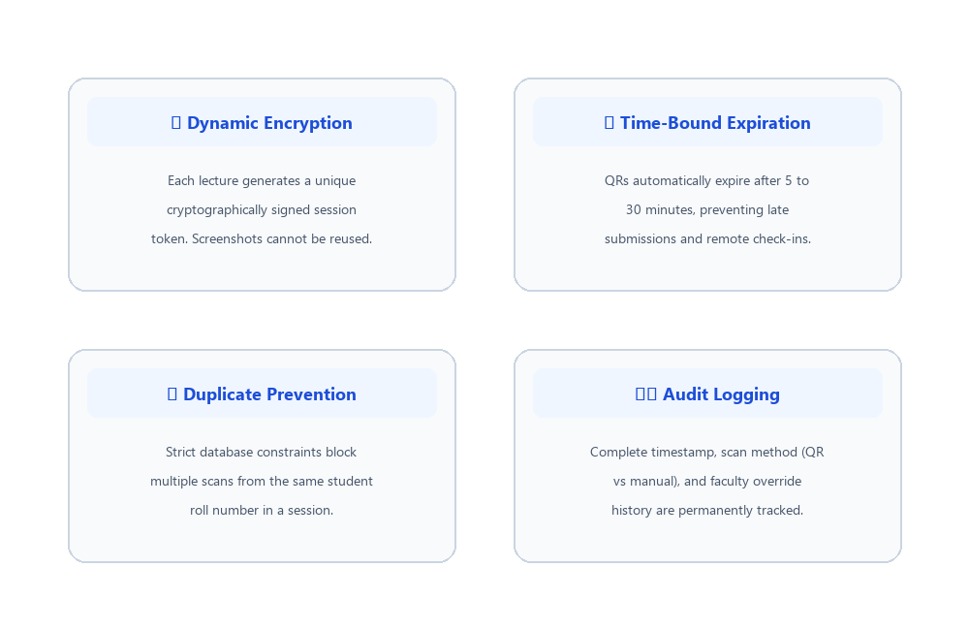
ONLINE ATTENDANCE MANAGEMENT SYSTEM
Camera QR Scanner & Student Check-in Experience
• Integrated Camera Scanner
Powered by HTML5-QRCode with camera toggle (Front & Back camera) for smartphones, tablets, and laptops.
• Web Audio API Chime & Confetti
Instant celebratory audio confirmation and particle confetti feedback when attendance is successfully recorded.
• Zero-Proxy Enforcement
Duplicate scans from the same student account are immediately blocked with previous check-in timestamp.
• Hardware-Free Fallbacks
Includes manual 6-character session code entry and photo upload for students with damaged webcams.

Slide 7
ONLINE ATTENDANCE MANAGEMENT SYSTEM
Anti-Proxy Protection & Security Mechanisms
• Dynamic Encrypted Tokens
Tokens are cryptographically generated per session, making static photo sharing completely ineffective.
• Strict Database Constraints
SQLite table unique index on (session_id, student_id) prevents double-dipping at the database level.
• Course Enrollment Validation
Only students officially registered in the specific subject can record attendance.
• Transparent Audit Logs
All check-ins record exact timestamps and marking method (QR scan vs instructor manual override).

Slide 8
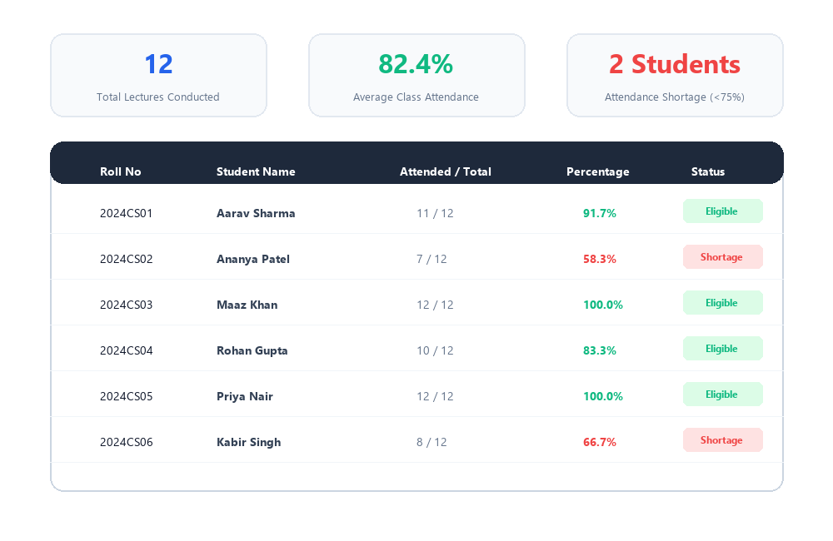
ONLINE ATTENDANCE MANAGEMENT SYSTEM
Administrative Analytics & CSV/Excel Export
• Course-Wide Attendance Turnout
High-level KPI metrics calculating total lectures, class average percentage, and students at risk.
• Automated Shortage Detection
Instantly flags any student below the 75% university requirement with red shortage badges.
• One-Click Excel / CSV Export
Generates official university spreadsheet reports with student roll numbers, names, attended, and eligibility.
• Student Management System
Faculty can add new students, edit roll numbers, and map courses with automatic roster propagation.

Slide 9
ONLINE ATTENDANCE MANAGEMENT SYSTEM
Technology Stack & Technical Implementation
BACKEND SERVER
Python 3.12 & Flask
Lightweight, reliable REST API architecture handling session tokens, attendance calculations, and dynamic CSV streams.
RELATIONAL DATABASE
SQLite 3 Engine
Zero-configuration SQL database with ACID compliance, relational foreign keys, and unique constraint enforcement.
FRONTEND & STYLING
Tailwind CSS & FontAwesome
Responsive glassmorphism UI, accessible typography, SVG radial percentage ring, and mobile camera support.
QR & MULTIMEDIA APIS
HTML5-QRCode & Web Audio
Browser-native webcam QR code scanner paired with synthesized double-tone audio feedback and Canvas confetti.

Slide 10
CONCLUSION & FUTURE ENHANCEMENTS
Modernizing Classroom Attendance Management
★ Saves 10-15 Minutes Per Lecture: Eliminates tedious manual roll-calls, giving valuable instructional time back to educators.
★ 100% Accurate Percentage Tracking: Zero calculation errors, instant shortage alerts, and fully automated eligibility checks.
★ Future Roadmap - Geolocation Fencing: Enforcing GPS coordinates so students can only scan when physically inside the classroom.
★ Future Roadmap - Automated Parent Alerts: Automated WhatsApp and email notifications triggered when attendance drops below 75%.
Thank You! Questions & Discussion.

