Slide 1
Offer Decline Root Cause Tracker Summary & Insights

Slide 2
Key Highlights
Compensation was the top decline reason (52%)
Created a Pareto chart to visualize top causes
Conducted 5 Whys Root Cause Analysis
Proposed 4 actionable recommendations

Slide 3
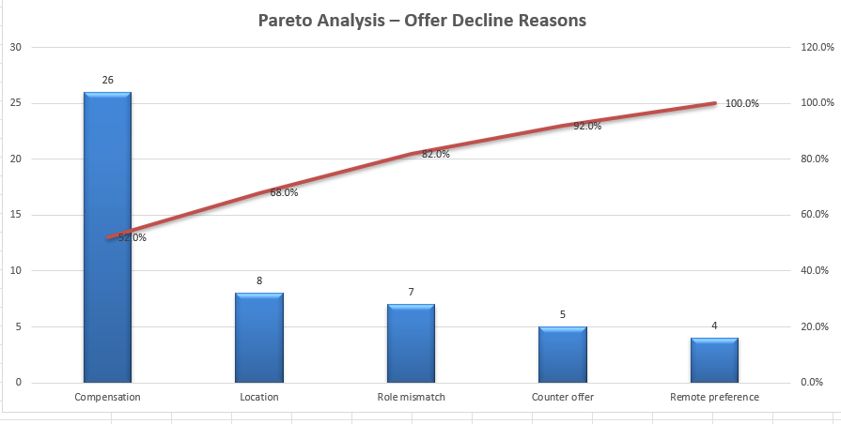
Mini Pareto Chart
Compensation alone caused 52% of offer declines. Addressing the top 3 reasons (Compensation, Location, Role mismatch) could reduce over 80% of all declines.

Slide 4
5 Why’s Technique
Why? | Reasons
1. Why did the candidate decline the offer? | Because the compensation didn’t meet their expectations.
2. Why didn’t it meet their expectations? | The salary offered was below what they were expecting based on market trends or competing offers.
3. Why wasn’t the expectation aligned earlier? | Recruiters discussed compensation only during the offer stage, not during initial screening.
4. Why wasn’t it discussed earlier? | There is no structured process requiring compensation expectations to be captured upfront.
5. Why is that process missing? | Because the current workflow assumes salary ranges are acceptable and doesn’t prioritize expectation alignment during sourcing.

Slide 5
Root Cause Summary
Root Cause: Lack of early-stage salary expectation alignment and benchmarking
Recommendations:
Add “expected salary” to screening forms
Share salary bands during outreach
Use external benchmarking tools
Train recruiters on upfront salary conversations
Impact Statement:
“Helped reduce compensation-related declines by introducing structured salary expectation discussions and market-aligned benchmarking.”

