Slide 1
Customer Support System: Using ChatGPT to build a web-based system that can answer questions about a website.
Savitha Shree M (19981)

Slide 2
TABLE OF CONTENTS
INTRODUCTION
DESIGN
IMPLEMENTATION
SAMPLE OUTPUT
CONCLUSION

Slide 3
INTRODUCTION
The project is to implement a web-based customer support system that can answer questions about a website using ChatGPT Models.
Web Question Answering (Web Q&A) embeddings using OpenAI typically involves leveraging language models to generate embeddings for web-based questions and answers.

Slide 4
DESIGN
It is built in Python Programming language using Flask framework.
Text-embedding-ada-002 model is used for embedding data.
The three major steps involved are:
Crawling the data
Embedding text
Running the UI

Slide 5
INSTALLATION
Create python virtual environment
sudo apt install python3.10 -venv
Install the required packages
python -m venv env
source env/bin/activate
pip install -r requirements.txt
Flask installation
pip install flask

Slide 6

IMPLEMENTATION
CRAWLING - It is the process of browsing over the web for extracting data from websites.
In our application, crawling is done on:
The goal is to crawl through and index only the content that lives under the OpenAI domain

Slide 7
IMPLEMENTATION
EMBEDDING - The collected text is now converted into Panda data frames and stored in the csv format.
Converting text to CSV involves looping through all the text files and formatting the data.
In our case, the converted files are stored as embeddings.csv

Slide 8
IMPLEMENTATION
Running the UI - After embedding, create a simple UI for the Question and Answer.
This will take a user's question, create an embedding of it, and compare it with the existing embeddings to retrieve the most relevant text from the scraped website.
The gpt-3.5-turbo-instruct model is then used to generate a natural sounding answer based on the retrieved text.
The website will be running on http://127.0.0.1:5000/

Slide 9
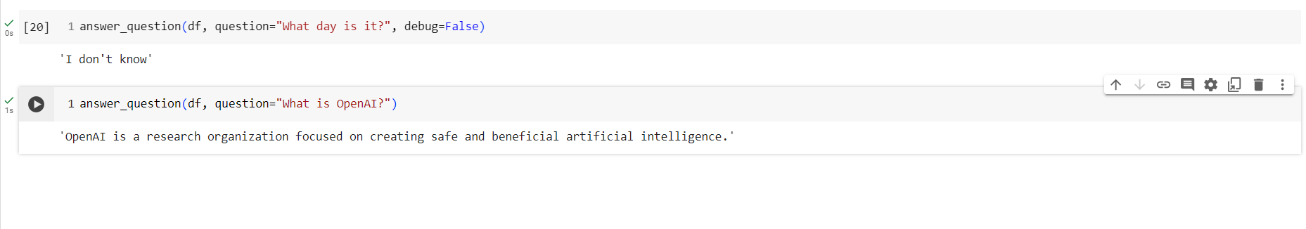
SAMPLE OUTPUT
JUPYTER NOTEBOOK

Slide 10
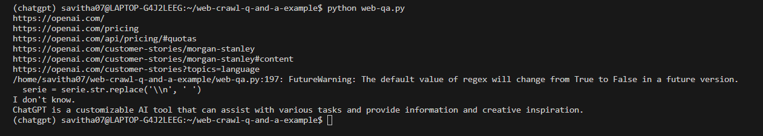
SAMPLE OUTPUT
COMMAND LINE SOLUTION
python web-qa.py

Slide 11
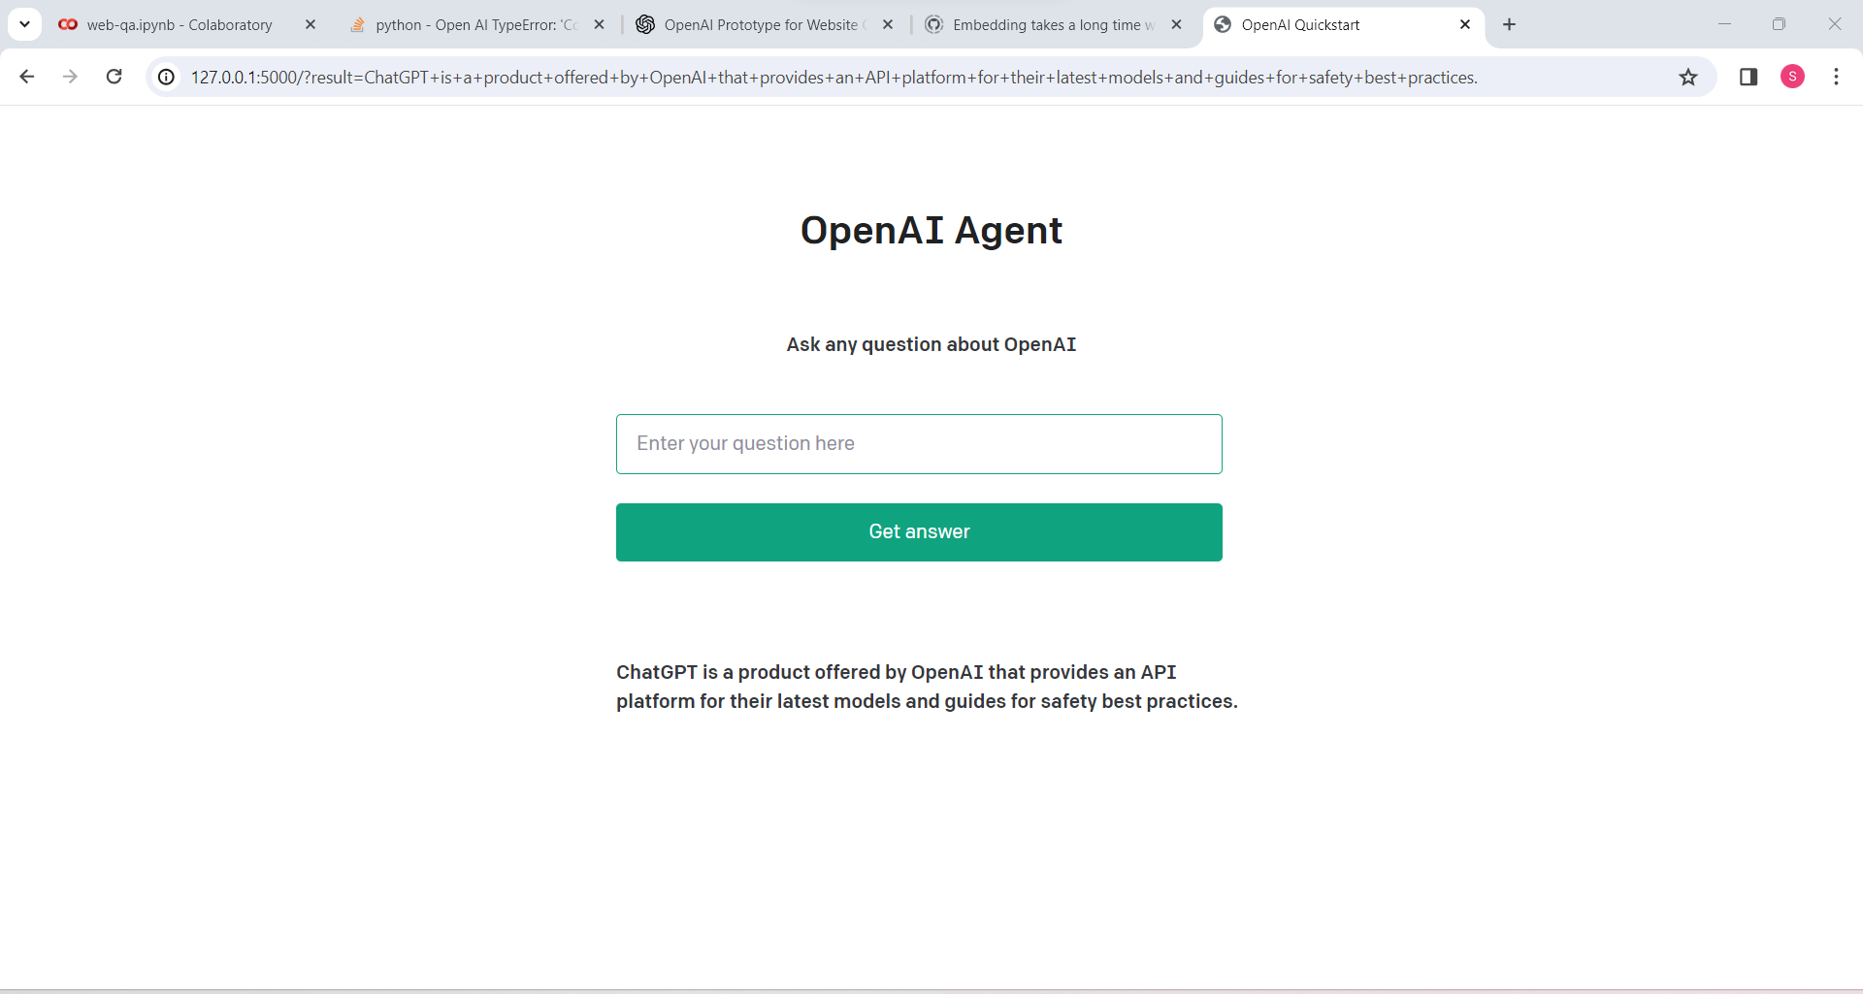
SAMPLE OUTPUT
WEB BASED SOLUTION - flask run

Slide 12
CONCLUSION
GITHUB LINK:
https://github.com/savithashreem07/Customer-Support-System
REFERENCES:
https://platform.openai.com/docs/tutorials/web-qa-embeddings

