Slide 1
Real-time Speech to Text to Speech : Building Your AI-Based Alexa - using Google's gTTS for Text-to-Speech
Savitha Shree M (19981)

Slide 2
TABLE OF CONTENTS
INTRODUCTION
DESIGN
IMPLEMENTATION
SAMPLE OUTPUT
CONCLUSION

Slide 3
INTRODUCTION
This project integrates real-time speech recognition and text-to-speech conversion functionalities, allowing users to interact with ChatGPT using natural language.
By employing Google's gTTS (Google Text-to-Speech) or OpenAI TTS for text synthesis, this project enables the transformation of textual responses into lifelike speech output.

Slide 4
DESIGN
It is built in Python Programming language.
gpt-3.5-turbo model is used for text completion.
The three major steps involved are:
Recording audio using PythonSpeechRecoginition.
Transcribing the audio using OpenAI Whisper.
Replying to User Request using gTTS or OpenAI TTS.

Slide 5
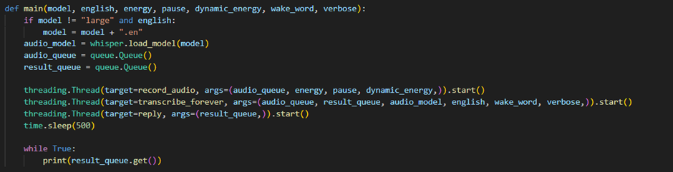
DESIGN
All the three steps are running simultaneously in multiple threads.

Slide 6
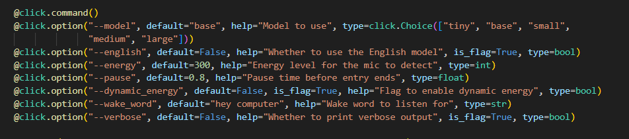
DESIGN
The audio input is transcribed only if it includes the wake word and certain commands like

Slide 7
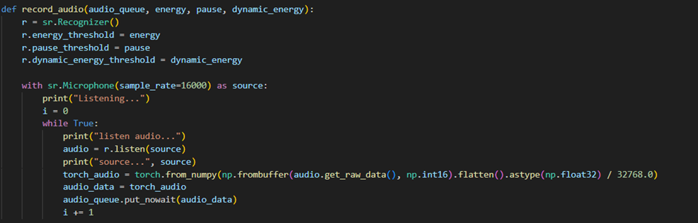
IMPLEMENTATION
STEP 1 - Get voice input from the user.
The question is asked through a microphone and the audio is recorded using PythonSpeechRecognition.

Slide 8
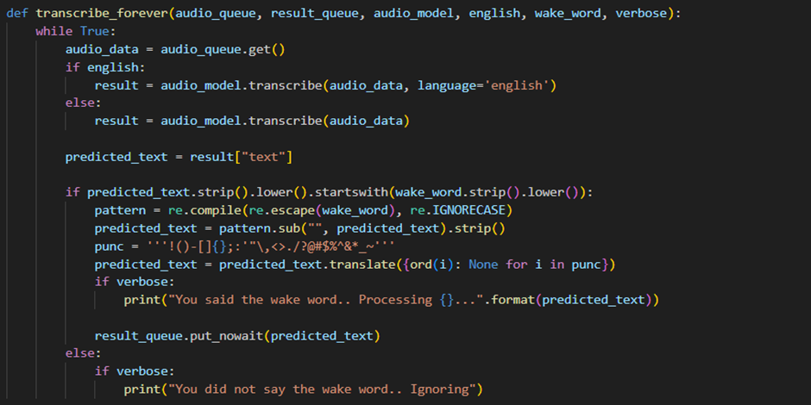
IMPLEMENTATION
STEP 2 - Transcribe the audio to text using OpenAI Whisper.

Slide 9
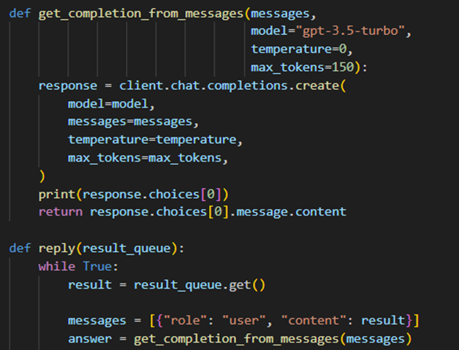
IMPLEMENTATION
STEP 3 - The text is processed using OpenAI text completion and the answer is returned as a text.

Slide 10
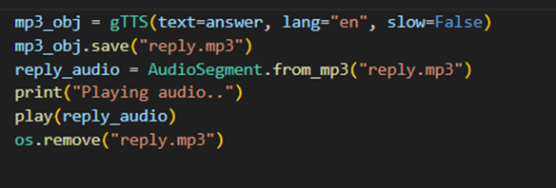
IMPLEMENTATION - gTTS
STEP 4 - Now the text is saved to mp3 file and sent to gTTS to send a voice response.

Slide 11
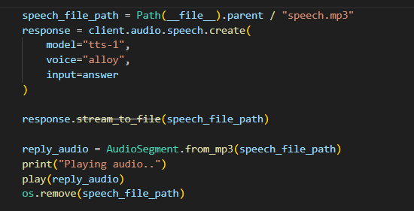
IMPLEMENTATION - OpenAI TTS
STEP 4 - The text is saved to mp3 file and sent to OpenAI TTS to send a voice response.

Slide 12
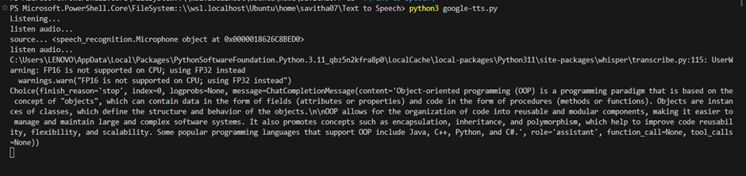

SAMPLE OUTPUT

Slide 13
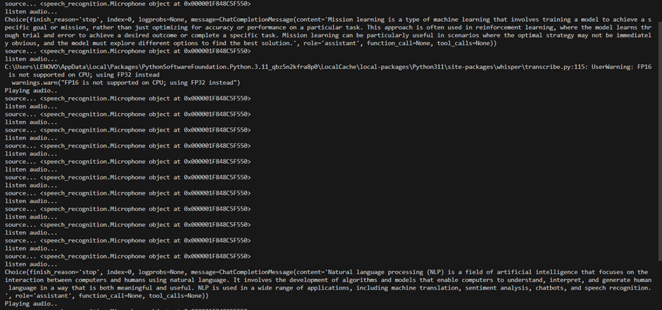
SAMPLE OUTPUT

Slide 14
CONCLUSION
GITHUB LINK:
https://github.com/savithashreem07/Text-To-Speech/tree/main
REFERENCES:
https://platform.openai.com/docs/guides/text-to-speech

