Slide 1
WelcomeHomeAB
Charles chukwukaeme, Oscar chen, savith jayasekera

Slide 2
Introduction
Home buying is a tedious process………..
Realtor Process ………. Realtor Fees……………Home-Buying Process
More expensive to buy, save your money
Step 1: Get a Pre-approval. ...
Step 2: Choose a REALTOR ® ...
Step 3: Make an Offer. ...
Step 4: Mortgage Approval. ...
Step 5: Firm Sale. ...
Step 6: Final Signing With Your Lawyer. ...
Step 7: Move In Day.

Slide 3

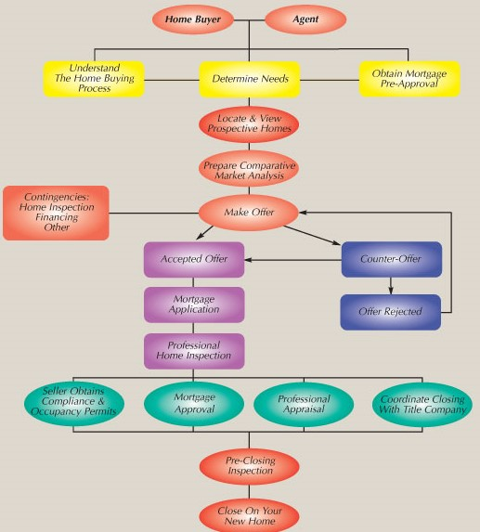
Home Buying Process
Tedious process for both sellers and buyers

Slide 4
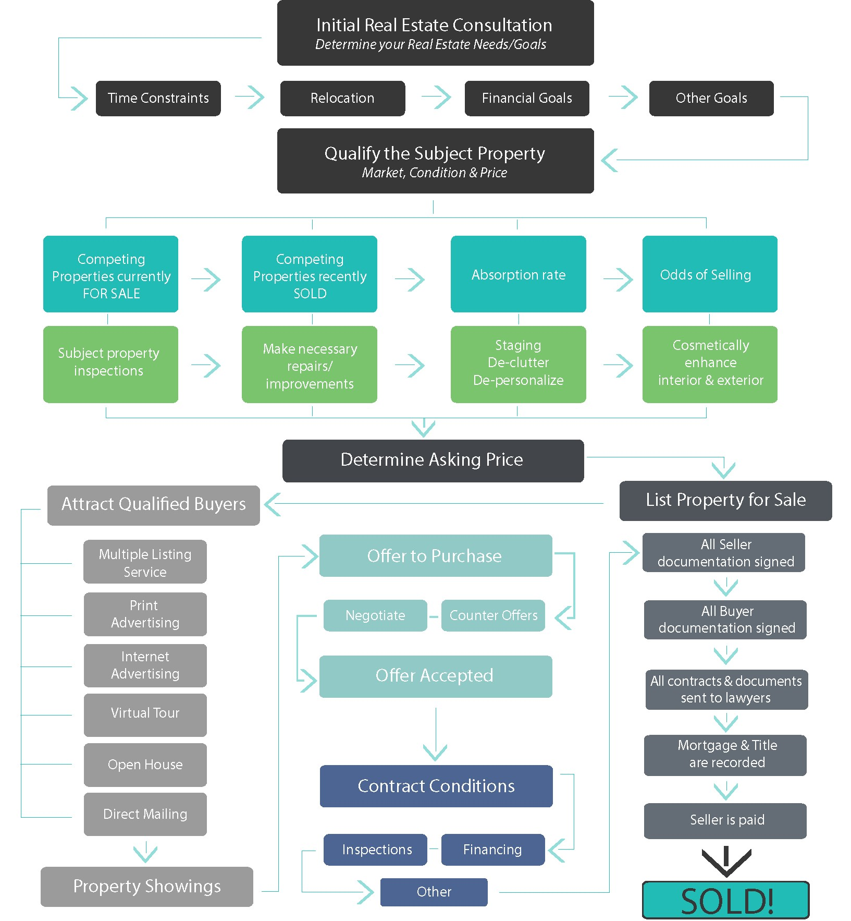
Home Selling Process
Market Research
Staging and marketing
Listing
Access to buyers
Pricing

Slide 5
Selling Price | Based on 7/3 Commission
$300,000 | $13,000
$400,000 | $16,000
$500,000 | $19,000
$600,000 | $22,000
$700,000 | $25,000
$800,000 | $28,000
$900,000 | $31,000
$1,000,000 | $34,000
$1,500,000 | $49,000
MLS is the propriety database for Realtors – not accessible by the public
NEED a realtor
Realtor Fees can be prohibitive -
7/3 meaning

Slide 6
WelcomeHomeAB – open up the database to the public
List your home
Access to market research
Comparative Analysis
Access to service providers –
Cleaning
Staging / Photos
Inspection
Document Review

Slide 7
GOALS
Demystify
Simplify
Provide access

Slide 8
