Slide 1
WelcomeHomeAB
Charles chukwukaeme, Oscar chen, savith jayasekera

Slide 2

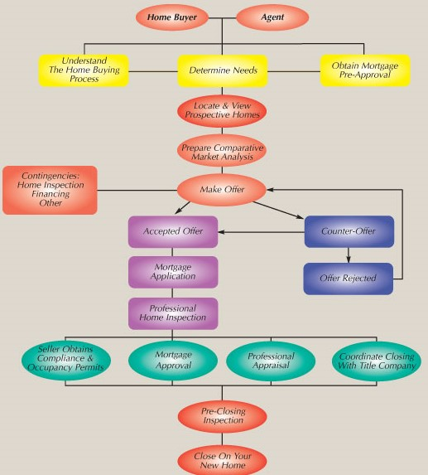
Home Buying
Tedious process
Restricted Access
Traditional
https://www.thefrugalbroker.com/sellers/selling-flowchart/

Slide 3
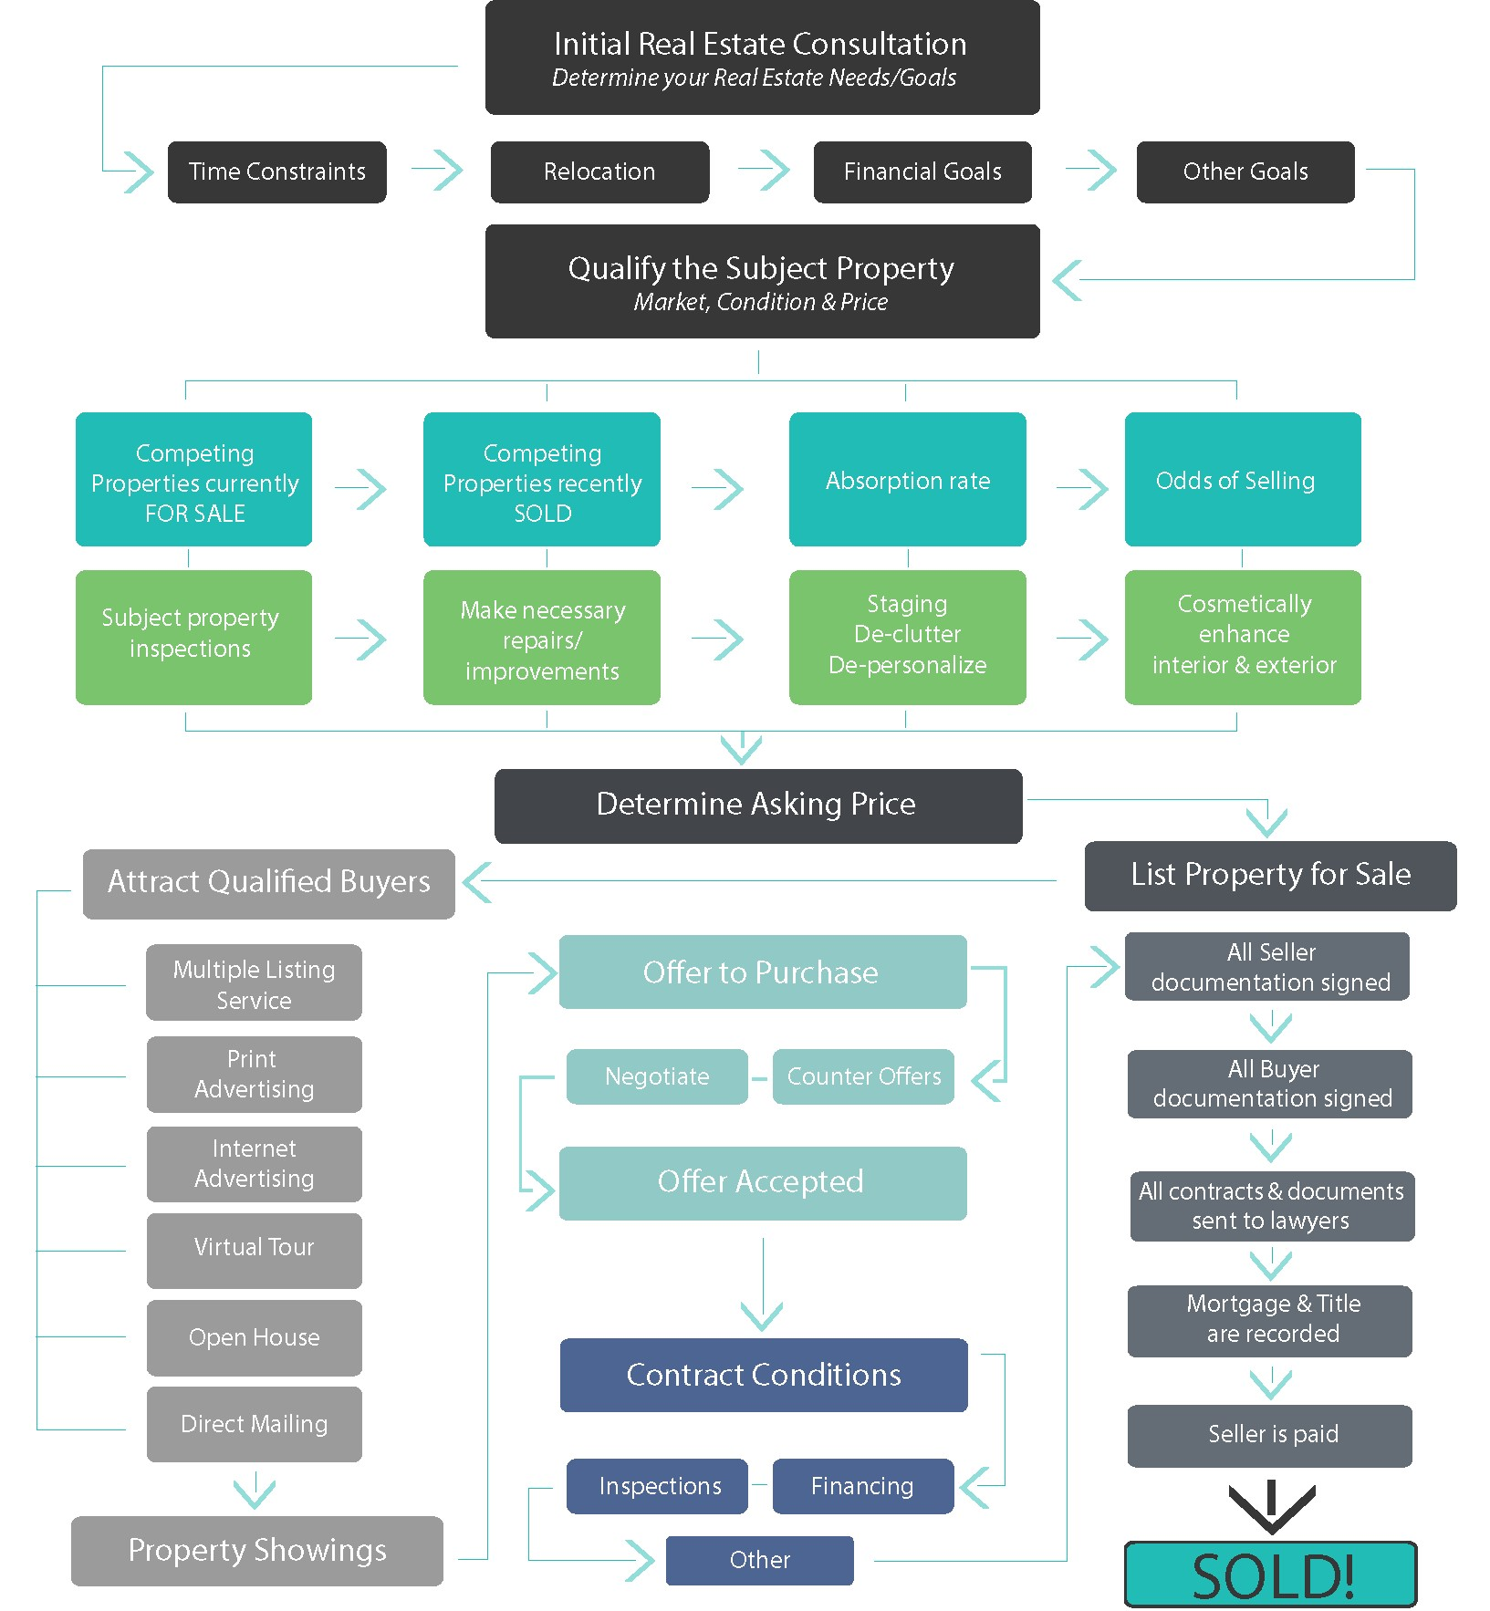
Home Selling
Essential Steps:
Market Research
Staging
Pricing
Marketing
Listing
Access to buyers
https://wallerrealestate.ca/home-selling-process-flow-chart/

Slide 4
Problem Definition
Selling Price | Based on 7/3* Commission
$300,000 | $13,000
$400,000 | $16,000
$500,000 | $19,000
$600,000 | $22,000
$700,000 | $25,000
$800,000 | $28,000
$900,000 | $31,000
$1,000,000 | $34,000
$1,500,000 | $49,000
Realtor dominated market
Propriety database – no public access
Millennials in prime homebuying age
Realtor fees are expensive
*7% of the first $100,000 and 3% on the balance of everything over
$100,000

Slide 5

Proposed Solution
Public access to database
Home Listings
Market research
Comparative Analysis
Direct access to services
Cleaning
Staging / Photos
Inspection
Document Review

Slide 6

GOALS
Access
Demystify
Simplify
https://www.tcphouses.com/home-buying-steps/

Slide 7
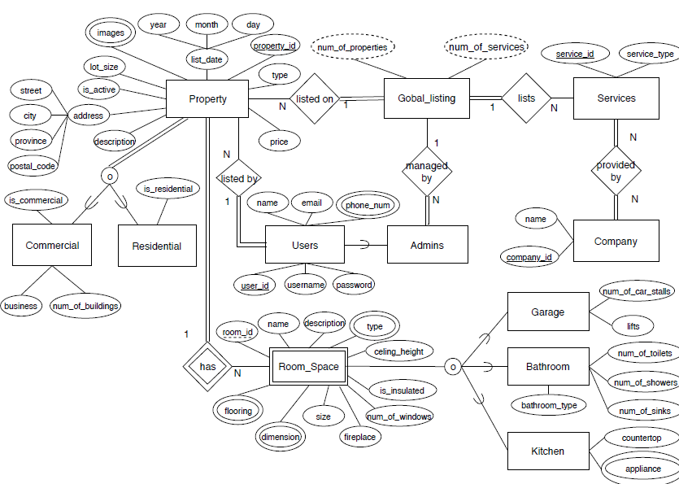
Entity Relationship Diagram

