Slide 1
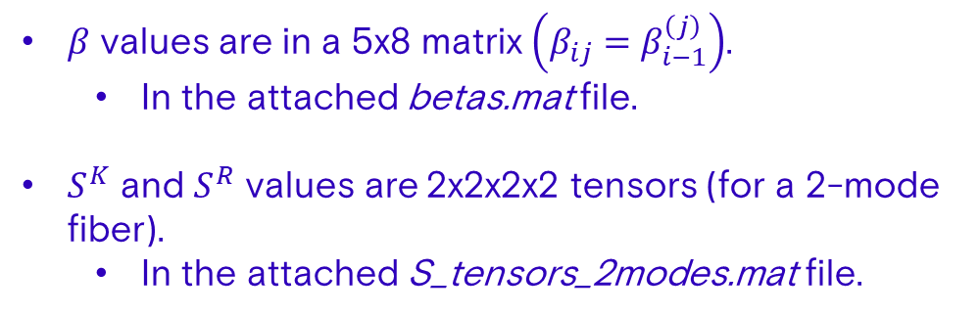
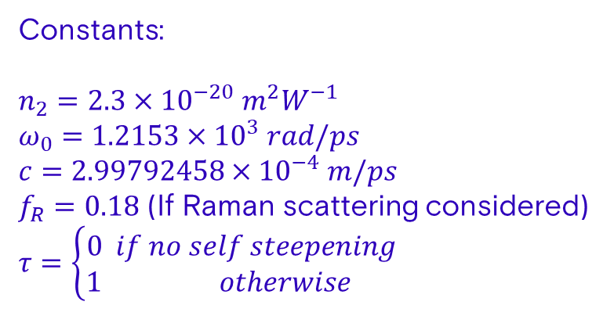
GMMNLSE
$$\frac{∂A_{p}}{∂z}=𝒟A_{p}+\frac{jn_{2}ω_{0}}{c}\left(1+τ\frac{j}{ω_{0}}\frac{∂}{∂t}\right)\sum_{l,m,n}{\left\{\left(1−f_{R}\right)S_{plmn}^{k}A_{l}A_{m}A_{n}^{∗}+f_{R}S_{plmn}^{R}A_{l}\left[h∗\left(A_{m}A_{n}^{∗}\right)\right]\right\}}$$
$$𝒟A_{p}=j\left(β_{0}^{\left(p\right)}−β_{0}^{\left(1\right)}\right)A_{p}−\left(β_{1}^{\left(p\right)}−β_{1}^{\left(1\right)}\right)\frac{∂A_{p}}{∂t}+j\sum_{n=2}^{4}{\frac{β_{n}^{\left(p\right)}}{n!}{\left(j\frac{∂}{∂t}\right)}^{n}A_{p}}$$
Constants:
$n_{2}=2.3×{10}^{−20} m^{2}W^{−1}$
$ω_{0}=1.2153×{10}^{3} rad/ps$
$c=2.99792458×{10}^{−4} m/ps$
$f_{R}=0.18$ (If Raman scattering considered)
$τ=\left\{\begin{aligned}0 if no self steepening \\ 1 otherwise \end{aligned}\right.$
$β$ values are in a 5x8 matrix $\left(β_{ij}=β_{i−1}^{\left(j\right)}\right)$.
In the attached betas.mat file.
$S^{K}$ and $S^{R}$ values are 2x2x2x2 tensors (for a 2-mode fiber).
In the attached S_tensors_2modes.mat file.

Slide 2
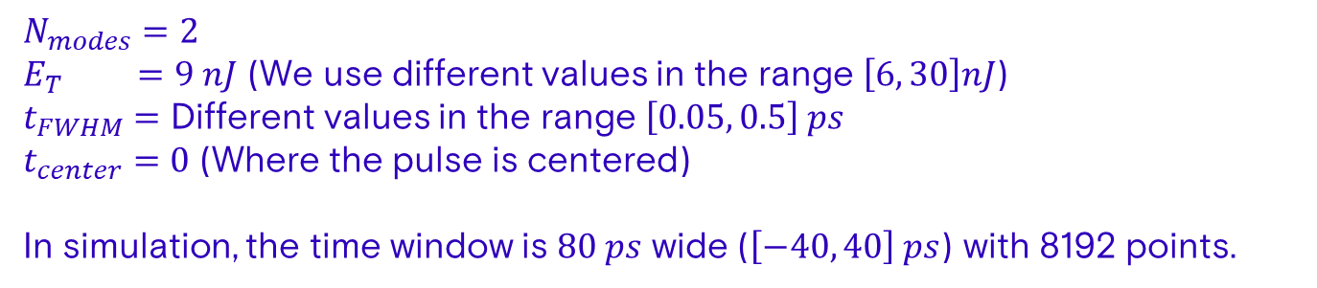
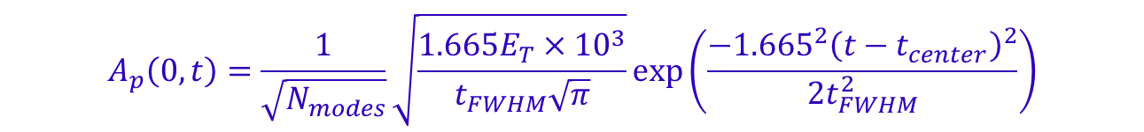
Initial Conditions
$$A_{p}\left(0,t\right)=\frac{1}{\sqrt{N_{modes}}}\sqrt{\frac{{1.665E}_{T}×{10}^{3}}{t_{FWHM}\sqrt{π}}}\exp\left(\frac{−{{1.665}^{2}\left(t−t_{center}\right)}^{2}}{2t_{FWHM}^{2}}\right)$$
$N_{modes}=2$
$E_{T} =9 nJ$ (We use different values in the range $\left[6, 30\right]nJ$)
$t_{FWHM}=$ Different values in the range $\left[0.05, 0.5\right] ps$
$t_{center}=0$ (Where the pulse is centered)
In simulation, the time window is $80 ps$ wide ($\left[−40, 40\right] ps$) with 8192 points.

