Slide 1
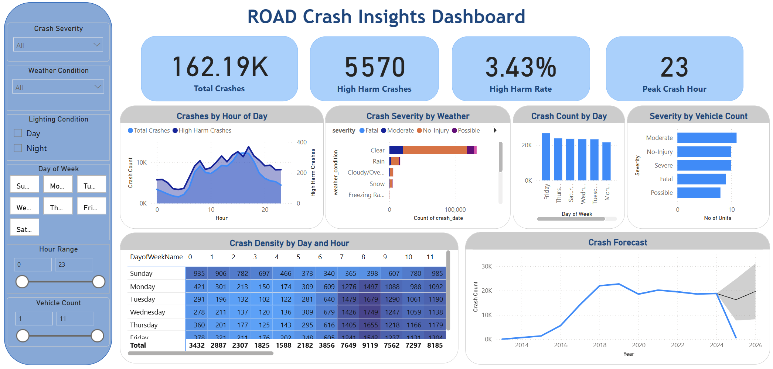
Road Crash Insights Dashboard – Enhancing Road Safety with Data-Driven Decisions
Business Problem
Data Product Design
Target Users & Value
Road accidents cause significant loss of life and property in urban environments. City authorities, such as those following Wellington’s Road to Zero strategy, aim to reduce fatalities and serious injuries by 40% by 2030. However, the ability to proactively deploy road safety interventions depends on identifying high-risk conditions and crash patterns.
A Power BI dashboard was developed to visualize and interact with over 160,000 traffic crash records. The dashboard integrates slicers for crash severity, weather, lighting, time of day, and vehicle count, enabling users to filter and explore insights easily.
Key components:
KPI Cards: Show total crashes, high-harm crashes, harm rate, and peak crash hour.
Crash Trend by Hour: Highlights when crash volumes and harm rates peak.
Crash Severity by Weather: Demonstrates increased risk during rain and low-visibility conditions.
Crash Count by Day: Reveals weekday vs. weekend variations.
Severity by Vehicle Count: Shows single-vehicle crashes often cause greater harm.
Crash Density Heatmap: Displays dangerous combinations of day and hour.
Crash Forecast: Projects crash volume trends to support planning decisions.
This dashboard is designed for:
City planners: to identify peak risk times for road upgrades.
Police and traffic authorities: to allocate enforcement efforts during high-risk periods.
Public safety analysts: to monitor crash patterns and evaluate safety strategies.
By enabling interactive exploration of crash data, this tool supports evidence-based decisions to reduce crash severity and frequency.
Research Questions
This project sought to answer:
What conditions increase the likelihood of fatal or severe crashes?
Are crashes more severe at night or in wet weather?
Which day-hour combinations pose the highest risk?
Do multi-vehicle crashes lead to greater harm?
Can crash volumes be forecasted to inform planning?
Evaluation & Benefits
The dashboard helps visually isolate high-risk conditions (wet, night, weekends).
Forecasting highlights upcoming trends in crash frequency.
Interactivity empowers stakeholders to filter and target specific scenarios.
Shortcomings:
Location-based visuals are not included due to missing geospatial data.
Machine learning-based predictions were not deployed inside the dashboard (done separately).
Dataset
Source: Kaggle (Ördekçi, 2025)
Records: 209,000+ traffic crashes
Fields: Crash date/time, weather, lighting, severity, number of vehicles, etc.
Tools Used: R for wrangling, Power BI for dashboard creation
Future Directions
Data Wrangling & EDA
Integrate geolocation data for spatial crash maps.
Embed R or Python visuals for live ML-based risk scoring.
Connect to real-time crash feeds for dynamic monitoring.
Cleaned and transformed data in R (removed NA, created new columns).
Added derived variables: hour, severity level, is_night, is_weekend.
Exploratory Data Analysis revealed:
Fatal crashes peak during wet weekend nights.
Single-vehicle crashes are often more severe.
Weekends show higher crash rates post 8PM.
Tools & Techniques
References:
Ördekçi, O. (2025). Traffic Accidents. https://www.kaggle.com/datasets/oktayrdeki/traffic-accidents.
Wellington, G. (2021). Wellington regional land transprt plan. Retrieved from https://www.gw.govt.nz/assets/Documents/2021/10/Wellington-Regional-Land-Transport-Plan-2021web.pdf?utm_source=chatgpt.com.
Power BI for dashboard development
DAX measures for KPIs (e.g., High Harm Rate, Peak Crash Hour)
Conditional formatting for crash heatmaps
Built-in forecasting for trend projections
Data wrangling and variable engineering (e.g., crash hour, is_night, severity levels) were performed in R and then exported to Power BI.
A D Savith Rangana – Student ID: 2024003716 PGDAV8.100 – Data Analytics and Visualisation, Eastern Institute of Technology Lecturer: Dr. Farhad Mehdipour

