Slide 1
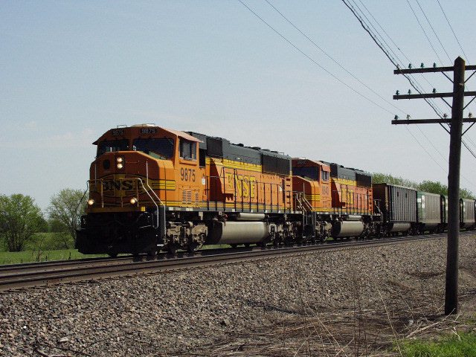
Online Railway Reservation

Slide 2

Software Requirements Specification
For
Automated Railway Reservation System
PREPARED FOR
PROF. HARSHALA
PREPARED BY
BEG JOVERIA MIRZA [11]
ARATHY NAIR [47]
(SYBSC.I.T. A)

Slide 3

SRS-Software Requirement Specifications
The initial specification of user requirements may be based on interviews with the database users and on the designers own analysis of the enterprise.
The basic issues that the SRS writer(s) shall address are the following:
  Functionality. What is the software supposed to do?
  b) External interfaces. How does the software interact with people, the system’s hardware, other hardware, and other software?
  c) Performance. What is the speed, availability, response time, recovery time of various software functions, etc.?
  d) Attributes. What are the portability, correctness, maintainability, security, etc. considerations?
Notes:
s

Slide 4
An SRS should be a) Correct b) Unambiguous c) Complete d) Consistent e) Ranked for importance and/or stability f) Verifiable g) Modifiable h) Traceable
e) Design constraints imposed on an implementation. Are there any required standards in effect, implementation language, policies for database integrity, resource limits, operating environment(s) etc.?

Slide 5
ER-Diagram:
An entity-relationship (ER) diagram is a specialized graphic that illustrates the interrelationships between entities in a database.
Structure chart:
The entry for every type of categorization under consideration is given in a structure chart.

Slide 6
ER-DIAGRAM:
BOOKING
Asks for
Name
Id
CUSTOMER DETAILS
Has a
Name
C.id
Address
Has a
Has a
PERSONAL
OFFICIAL
PID
O.id
Age
Tel.no
Office.add
Tel.no
Gender
Designation

Slide 7
TRAINS
Train no
Train name
User asks for
FARE
Distance
Class
User asks for
CANCELLATION
Class
Trnno.
CPNR
Date
Tno
SEAT AVAILABILITY
No. of seats
Src.Stn
Quota
Dest.Stn
User books
Date
Class

Slide 8
Is a
Fare
No. of seats
Class
Seats vacant
Source
Distance
Trn.no
Destination
TICKETS
Board
PNR
Trno
Date
Destination
No. of seats
Quota
Has a
date
TRno
CLASS
Sleeper
No of seats
PNRno
General
AC

Slide 9
STRUCTURED CHART
BOOKING/
STATIONS
Level 1
TRAINS
CUSTOMER DETAILS
Level 22
Level 3
CANCELLATION
SEAT
AVILABILITY
TICKETS
FARE
SCHEDULE
CLASS
DISCOUNTS
Level 4

Slide 10
DFD Principles :
The general principle in Data Flow Diagramming is that a system can be decomposed into subsystems, and subsystems can be decomposed into lower level subsystems, and so on.
Each subsystem represents a process or activity in which data is processed. At the lowest level, processes can no longer be decomposed.
Each 'process' in a DFD has the characteristics of a system.
Just as a system must have input and output (if it is not dead), so a process must have input and output.
Data enters the system from the environment; data flows between processes within the system; and data is produced as output from the system

Slide 11
DATA FLOW DIAGRAM
CONTEXT LEVEL
DFD

Slide 12
Terms and conditions/
passenger personal Info.
PASSENGER
Procedure
passenger/seat details
BOOKING
CENTRE
Schedule/Discounts Info.
Passenger Details (sign up)
Birth/Ticket Info.
Ticket Details
Booking Information
Book Ticket
Ticket confirmation
Ticket Confirmation
ONLINE RAILWAY RESERVATION
Cancellation/Change
Cancel/Change Confirmation
Schedule/Train Info .
Ticket Details
Seats available
Class/Birth Schedule
Passengers/Ticket Info
Fare/Discounts Details
Amount
SCHEDULE
Paid Details
FARES

Slide 13
Level - I

Slide 14
Update Profile
Change
Password
1.1
Make Reservation
Account
Profile
SIGN IN
Registration
Menu
Passenger
3.0
Cancellation
SIGN UP
Individual
Registration
Validates
2.0
Booked History
4.0
Cancelled Ticket
History
Passenger Account
Database
1.0
Find Train
Make Reservation
Database
Cancellation Database

Slide 15
Level - II

Slide 16
Valid source
Valid Destination
1.0
Find Train
Passenger
Check Date
Should be after three days
Check Quota
General
Details Required:
To
From
Date
Quota
Class
Tatkal(YES/NO)
Class
Ladies
Check Tatkal
Have to select one
Discounts
Find Trains
Only valid for some trains

Slide 17
Payment Options
Lists of Trains
1.1
Book Ticket
Passenger Account
Database
Birth preference
Select Train
Age
Reservation
Database
1.2
Get Fare
1.4
Show Route
1.3
Show Availability
Tatkal
Route
Distance
Quota
Status Report
Display
Class
Senior Citizen
Distance

Slide 18
Level III

Slide 19
2.0
Booked History
Cancellation
Database
PNR number
Valid
NO
Displays Error
YES
Displays details
Password
Passenger

Slide 20
3.0
Cancellation
Cancellation
Database
Booked
History
Password
Invalid
Displays
Error
Passenger
Valid
Processed

Slide 21
4.0
Cancelled
Ticket
History
Reservation
Database
PNR number
Valid
Displays Error
NO
YES
Displays details
Password
Passenger

Slide 22
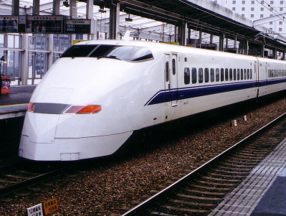
THANKING-YOU

