Slide 1
Problem Definition & Approach
Question: Which employees are at risk of burnout?
Target: burnout_binary — 1 if burnout_score ≥ 75th percentile (top 25%)
Why top 25%? Natural threshold — identifies employees significantly above
the median without being too restrictive. Balances sensitivity vs specificity.
Features: 62 encoded features (all columns except burnout_score to avoid leakage)
Models tested: Logistic Regression, Decision Tree, Random Forest,
Gradient Boosting, SVM-RBF — all with class_weight='balanced'
Class split: 26.0% burnout (positive) vs 74.0% no burnout
Notes:
We chose 75th percentile as the threshold because it identifies employees significantly above average burnout. Using median would label half the workforce as 'at risk' which is too broad for targeted interventions.

Slide 2
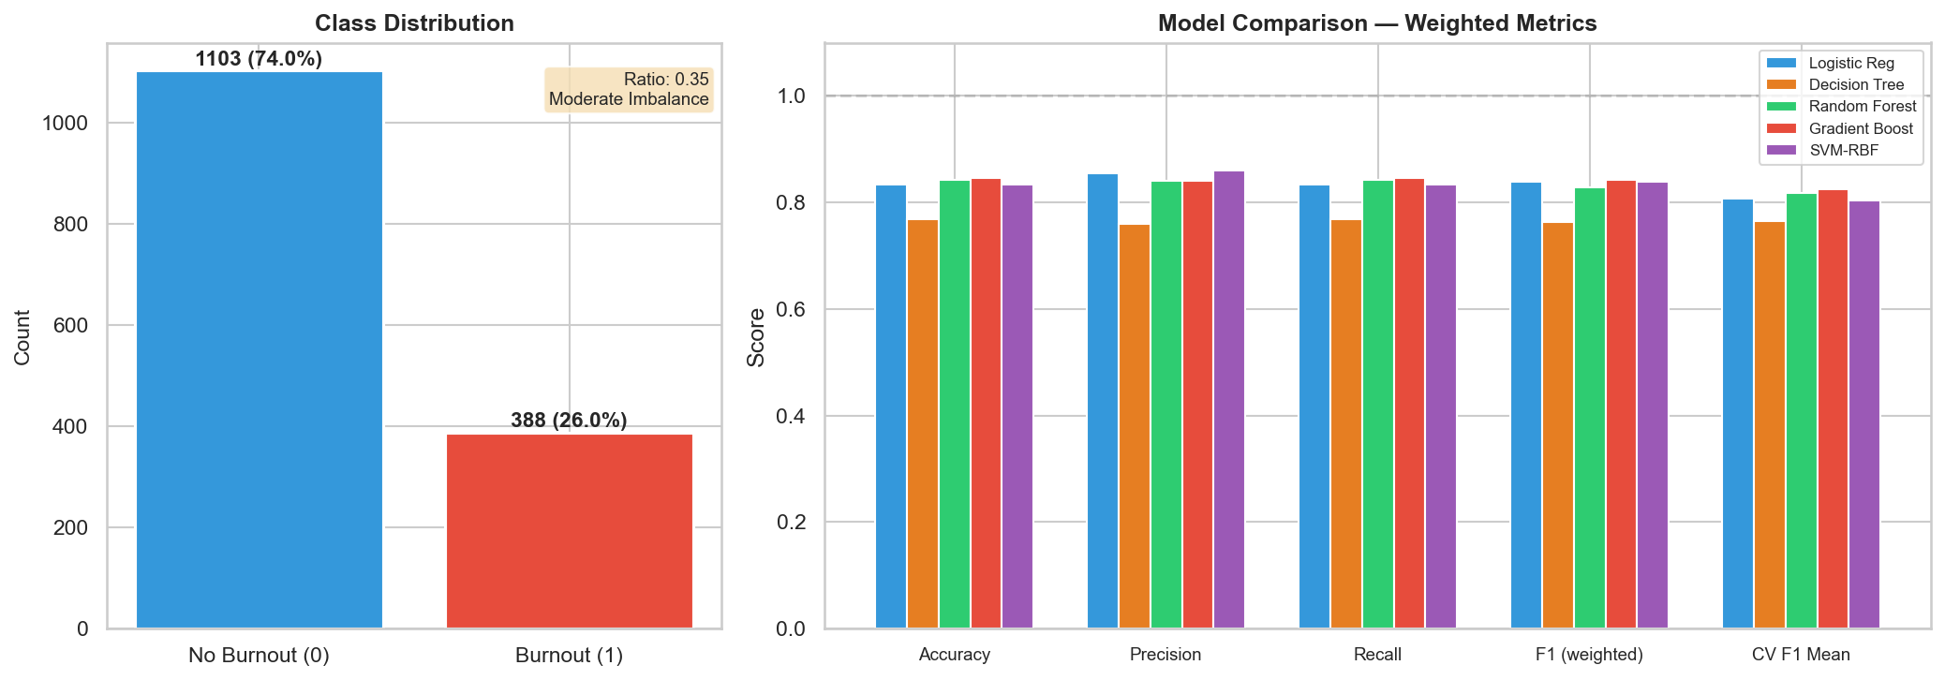
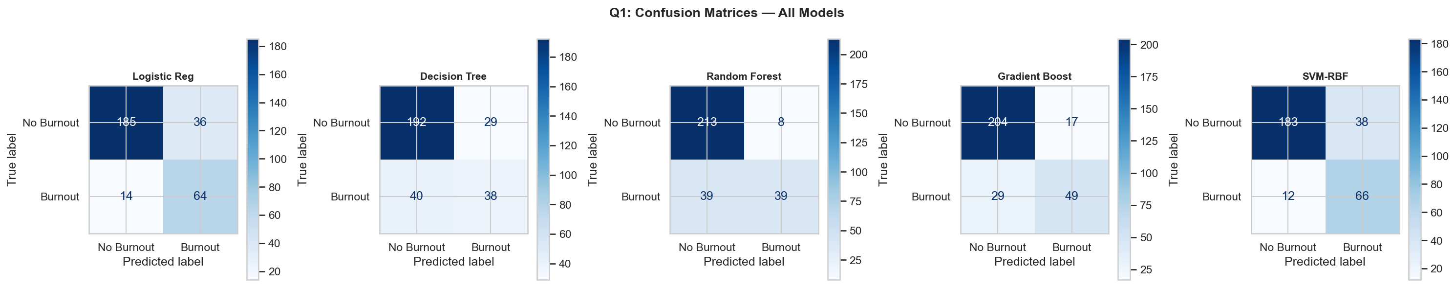
Class Balance & Model Comparison
Class split: 26.0% Burnout vs 74.0% No Burnout (ratio=0.35)
• Moderate imbalance → used class_weight='balanced'
Top performer (weighted F1): Gradient Boost — 84.6%
⚠️ PITFALL: Weighted F1 hides minority class performance!
• Dominated by majority class (74% No Burnout)
• Gradient Boost looks best here but misses 37% of burnout
• Need per-class breakdown to see real detection ability
Key: Accuracy alone is misleading — predicting 'No Burnout'
for everyone gets ~74% accuracy but catches 0 burnout cases.
Notes:
Class imbalance is moderate (not severe like 95/5), so class_weight='balanced' is sufficient. Weighted metrics are dominated by the majority class. A model can score 0.84 weighted F1 while only detecting 63% of actual burnout cases. Always check per-class metrics.
Key insight from confusion matrices:
- SVM-RBF: Best True Positive rate (catches most burnout cases) but more False Positives
- Random Forest: Fewest False Positives but misses half of burnout cases
- Decision Tree: Worst overall with balanced errors
The trade-off between FP and FN is visible here.

Slide 3
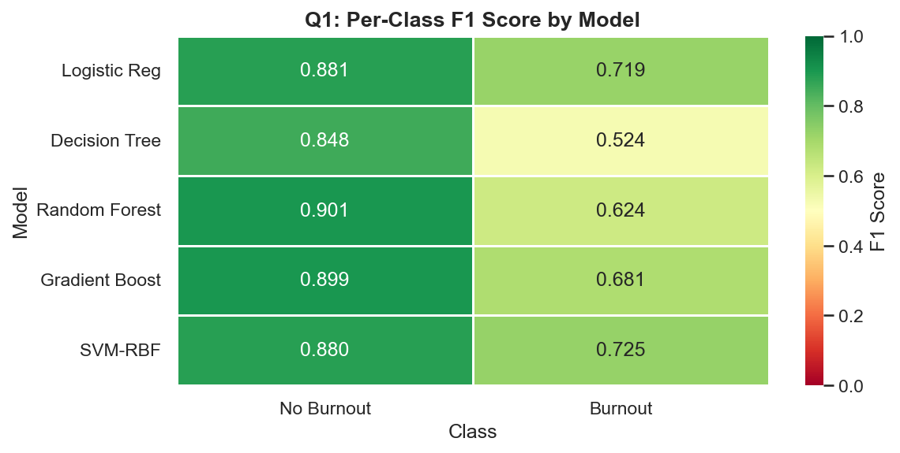
Per-Class Performance — Burnout Detection Focus
Weighted metrics hide minority class performance.
Per-class breakdown reveals the real story:
Model | Burnout Prec | Recall | F1
—————————————————————————————————————————————
SVM-RBF | 0.635 | 0.846 | 0.725 ← BEST
Logistic Reg | 0.640 | 0.821 | 0.719
Gradient Boost | 0.742 | 0.628 | 0.681
Random Forest | 0.830 | 0.500 | 0.624
Decision Tree | 0.567 | 0.487 | 0.524
⚠️ Gradient Boost looks #1 on weighted F1 but misses 37%
of burnout cases. SVM-RBF/Logistic Reg catch 82-85%.
For HR: Better to flag & check unnecessarily than miss burnout.
Notes:
Recall is more important than precision for burnout detection because:
- False Negative (missing burnout) = employee suffers without intervention
- False Positive (flagging non-burnout) = unnecessary check-in (low cost)
SVM-RBF and Logistic Reg are near-identical on recall (~82-85%).

Slide 4
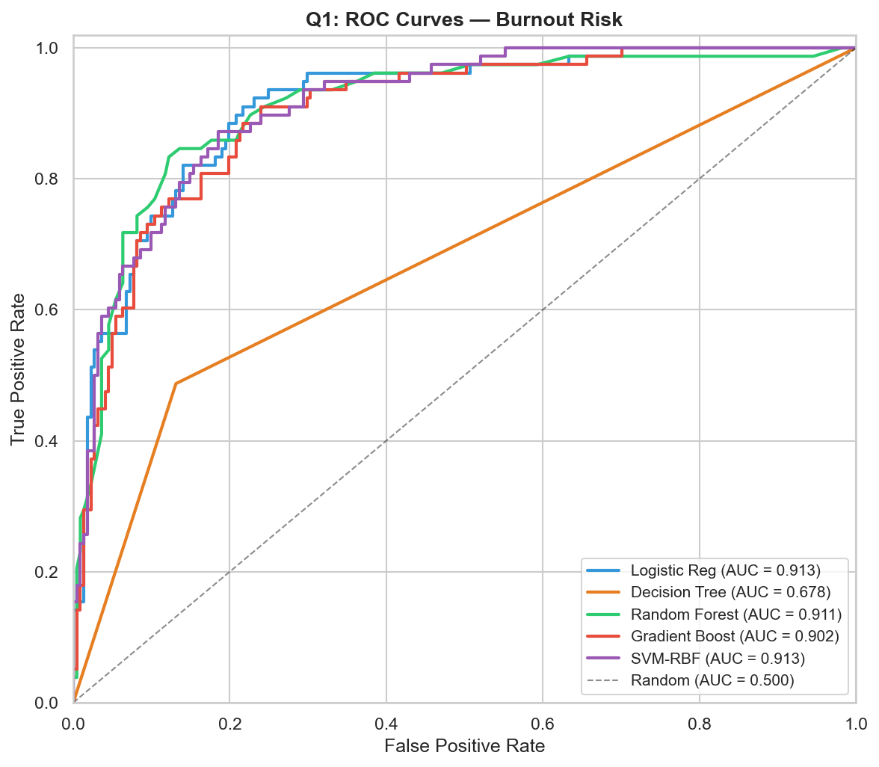
ROC Curves — Discrimination Ability
AUC Rankings:
1. SVM-RBF: 0.913
2. Logistic Reg: 0.913
3. Random Forest: 0.911
4. Gradient Boost: 0.902
5. Decision Tree: 0.678
Thought process:
• AUC > 0.9 for top 4 models — strong discrimination
• Decision Tree AUC ~0.68 — barely better than random
⚠️ ANOMALY: Decision Tree performs far worse than others.
Likely overfitting to training data
Notes:
AUC is threshold-independent — it tells us the model's overall ranking ability. An AUC of 0.91 means that a randomly chosen burnout employee will score higher than a randomly chosen non-burnout employee 91% of the time.

Slide 5
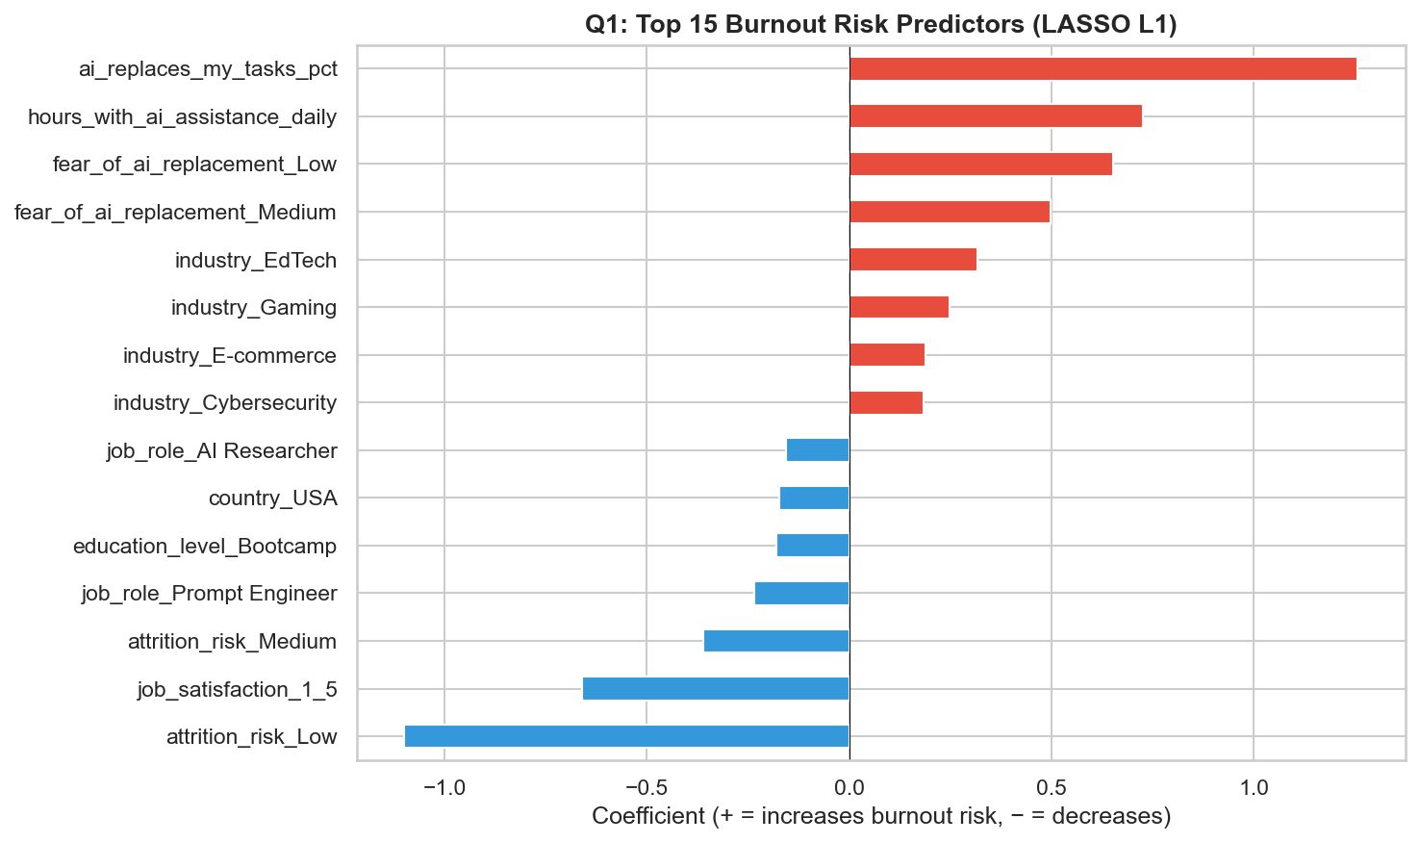
LASSO Feature Importance — What Drives Burnout?
L1 regularization kept 56/62 features
(eliminated 6 as irrelevant).
🔴 INCREASES burnout risk:
• ai_replaces_my_tasks_pct (STRONGEST)
• hours_with_ai_assistance_daily
• fear_of_ai_replacement (Low/Medium levels)
• Industries: EdTech, Gaming, E-commerce
🔵 DECREASES burnout risk:
• attrition_risk_Low (strongest protector)
• job_satisfaction_1_5
• attrition_risk_Medium
• job_role_Prompt Engineer
Thought process: LASSO used post-fitting for interpretability,
not for feature selection before training.
Notes:
LASSO (L1) drives coefficients to exactly zero, performing automatic feature selection. Features with non-zero coefficients have meaningful linear associations with burnout. The strongest predictor is AI task replacement percentage — employees whose tasks are being automated are most at risk.

Slide 6
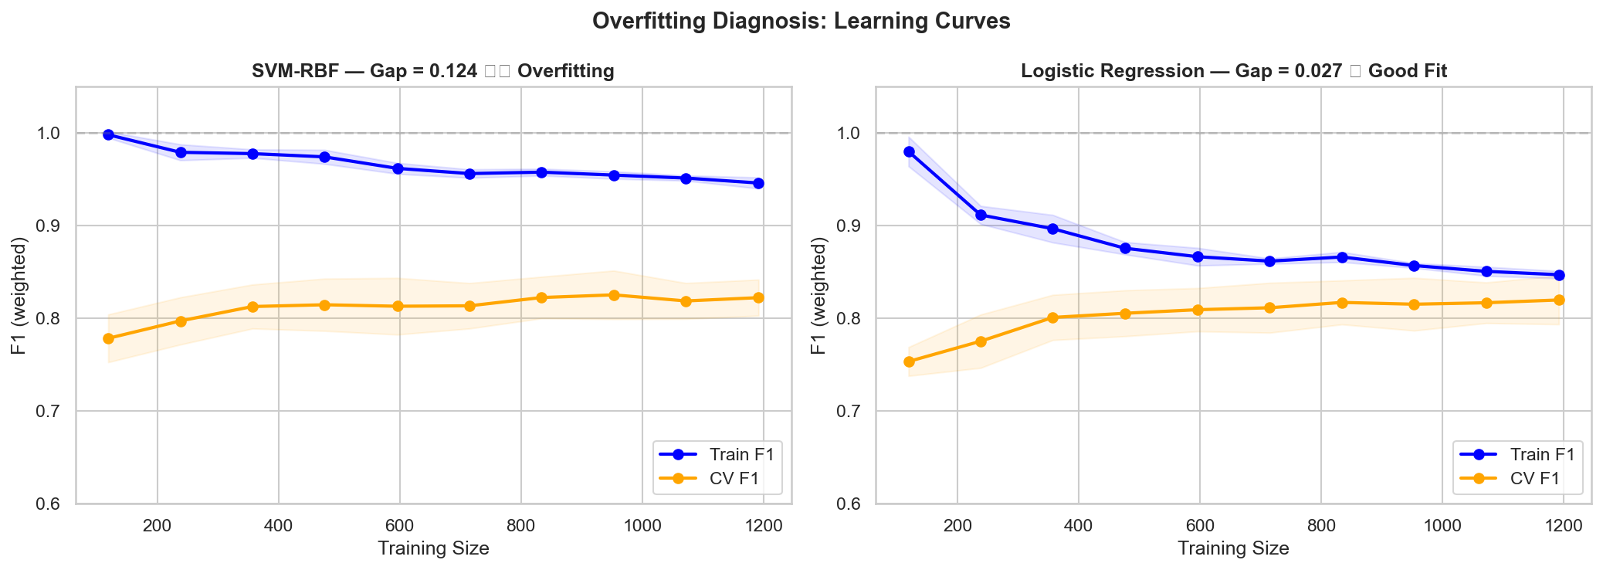
Overfitting Analysis — SVM-RBF vs Logistic Regression
Learning curves reveal generalization quality:
Metric | SVM-RBF | Logistic Reg
———————————————————
Training F1 | ~0.95 | ~0.85
Cross-Val F1 | ~0.82 | ~0.82
Overfit Gap | ~0.12 ⚠️ | ~0.03 ✅
Key insight:
• Both achieve SAME CV F1 (~0.82)
• SVM-RBF memorizes training data (Train=0.95)
• Logistic Reg generalizes honestly (Train ≈ CV)
Verdict: SVM-RBF's extra complexity adds minor overfitting
without improving real-world performance.
Logistic Regression is the more reliable model in this case.
Notes:
The learning curve is the simplest overfitting diagnostic. A large gap between train and CV scores means the model memorizes noise. SVM-RBF's gap (~0.12) is moderate overfitting — it won't generalize as well as its training score suggests. Logistic Regression's tiny gap (~0.03) means what you see in training is what you'll get in production. Lines close together → the model generalizes well (Logistic Regression: gap = 0.027)
Big gap between lines → overfitting — the model "memorized the textbook" but can't handle new questions (SVM-RBF: gap = 0.124)
Both lines low → underfitting — the model hasn't learned enough from either
In short: the learning curve answers "Is my model actually learning patterns, or just memorizing the training data?"

Slide 7
Anomalies & Pitfalls Identified
1. WEIGHTED METRIC DECEPTION
Gradient Boost appeared #1 (Weighted F1=0.846) but misses 37%
of burnout cases. The 74% majority class inflates aggregate scores.
2. PRECISION-RECALL TRADE-OFF
Random Forest: 83% precision but only 50% recall.
It's very sure when it flags someone but misses half the cases.
3. DECISION TREE OVERFITTING
AUC=0.678 — dramatically worse than all other models (>0.9).
Without max_depth pruning, it memorizes training data.
4. FEATURE LEAKAGE RISK
burnout_score must be excluded from features (it is the target).
attrition_risk has strong correlation — borderline leakage but
kept because it's independently measured in the dataset.
5. THRESHOLD SENSITIVITY
75th percentile threshold is arbitrary. Shifting it changes class
balance and model rankings. Sensitivity analysis recommended.
Notes:
These anomalies highlight common ML pitfalls: metric selection bias, overfitting without regularization, and the danger of feature leakage. Each should be addressed in a production deployment.

Slide 8
Conclusion & Recommendation
ANSWER: Employees most at risk of burnout have:
• High AI task replacement percentage (strongest signal)
• Long daily AI-assisted work hours
• Fear of AI replacement
• Work in EdTech, Gaming, or E-commerce industries
RECOMMENDED MODEL: Logistic Regression
NEXT STEPS:
• Deploy Logistic Regression — stable, interpretable
• Monitor ai_replaces_my_tasks_pct as early warning indicator
• Validate on new data
Notes:
Final recommendation: Logistic Regression wins on the generalization test. Both models achieve identical CV F1 (~0.82), but LR does so without overfitting (gap=0.03 vs 0.12). The 2.5% recall difference is within noise range. LR's coefficients provide direct interpretability for HR teams — they can see exactly which factors contribute to each employee's risk score.

