Slide 1
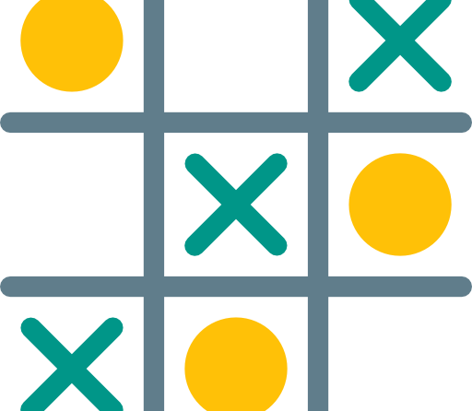
Tic Tac Toe Project
Using numpy, SqlLite, Tkinter, Matplotlib

Slide 2
What did we use?
We used variety of python library functions and a database including
Numpy, for managing arrays in the game.
Tkinter, for Designing the GUI Frames and Buttons(Tic Tac Toe board).
Matplotlib for plotting the Graph.
We have used SqlLite for our Database Implementation for Scoreboard and Histogram.

Slide 3
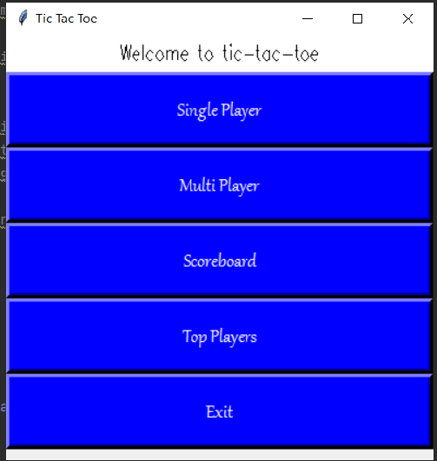
Structure of the Game
The structure of our game is separated into 5 major elements namely:
Single Player button – To play with computer
Multi Player button – To play with Friends
Scoreboard access- To show the scores
Top Players access- To show overall performance of Top 3 Players of our game
Exit Function button – To Terminate the game

Slide 4
Logic behind the Game ?
For single player we have used Random Function as an opponent to the player.
For Multi Player we have used buttons as to give each player turn to mark the required symbol on the board.
For scoreboard we have used SqlLite Database to integrate the information and store them for the record in bar graph.

Slide 5
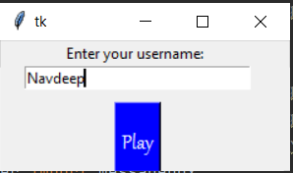
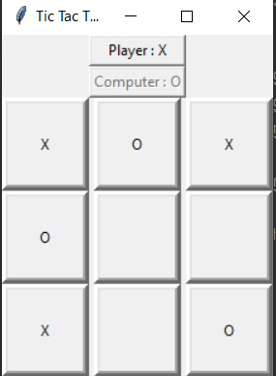
Single Player Play of our Game
User needs to input their name inside the text area and click PLAY
A 3x3 Board will appear next to the main window.
User will then have to compete with computer and either win or lose will be generated through output window.
User can than again select for any play from the main window after the scores gets registered automatically into the database.

Slide 6
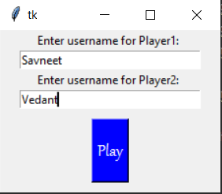
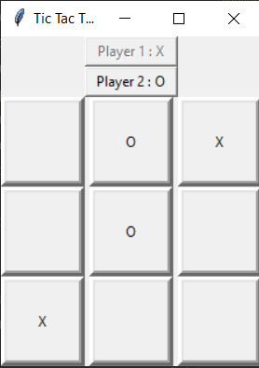
Multi Player Play of our Game
Both the Users needs to input their name inside the text area and click PLAY
A 3x3 Board will appear next to the main window.
User will then have to compete with each other and either win or lose will be generated through output window depending upon their choices in the game.
Users can than again select for any play from the main window after the scores gets registered automatically into the database.

Slide 7
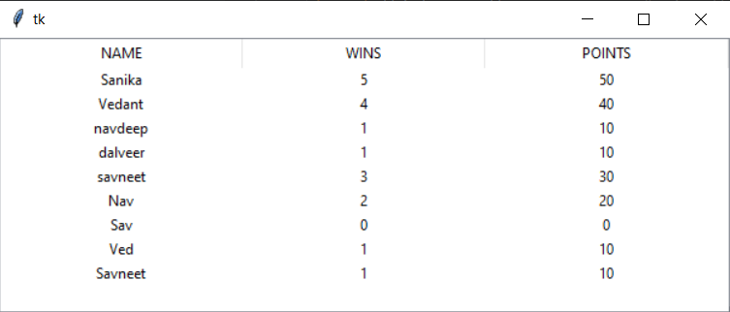
Scoreboard of our Game
This section is for displaying the player performance.
A 450x450 window is generated using Tkinter Library.
All the stats of a particular player will be displayed here.
The scoreboard includes

Slide 8
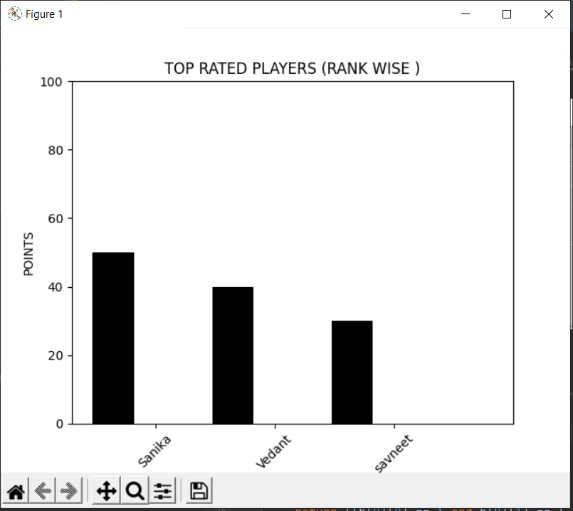
Top Player Bar Graph of our Game
This section displays the overall top performance player among the database and number of wins.
It shows the top 3 Players from all the database of all the records.
The X-axis displays the names and Y-axis displays the points of the players.

Slide 9
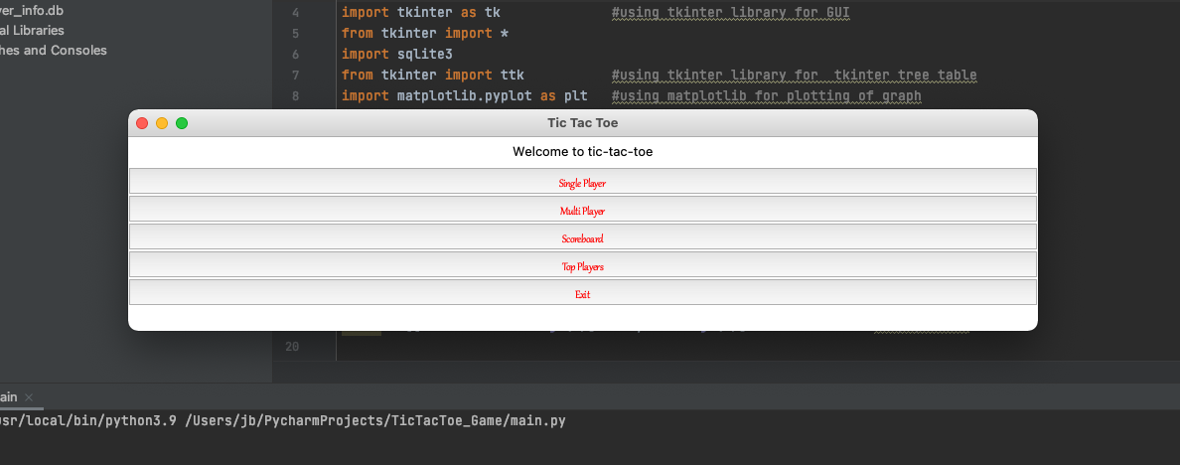
Practical Presentation

Slide 10
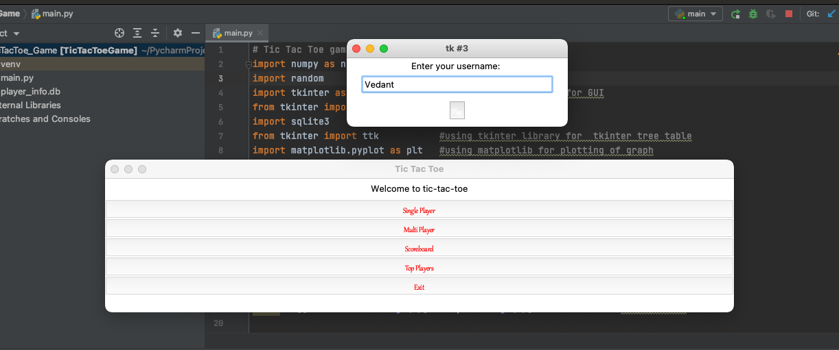
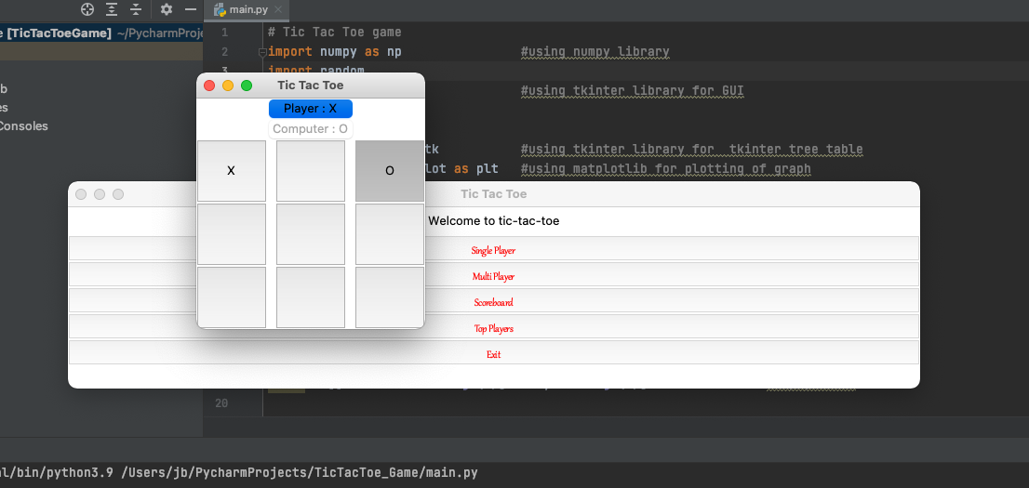

Slide 11
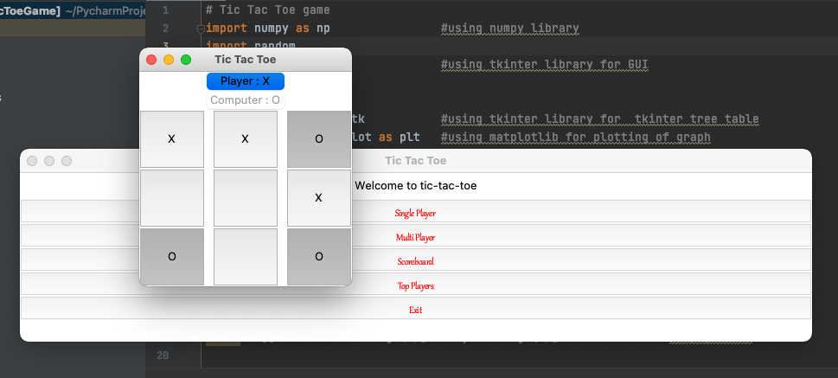
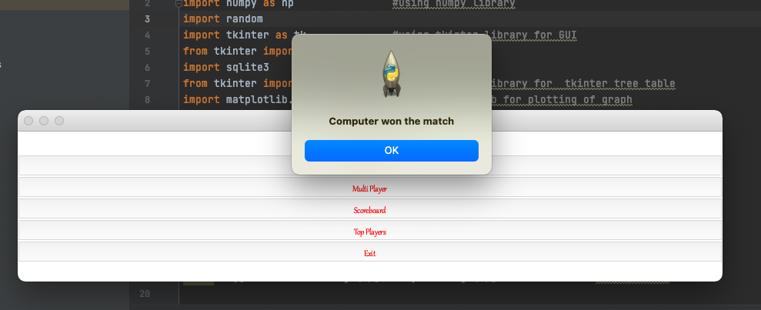

Slide 12
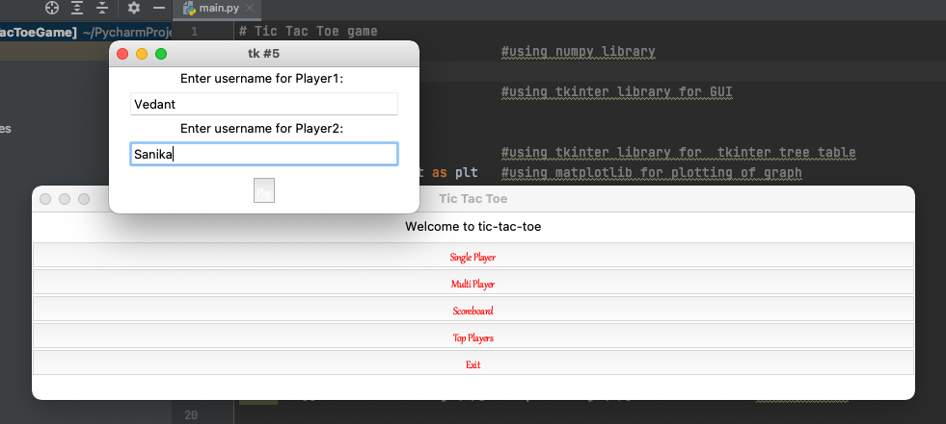
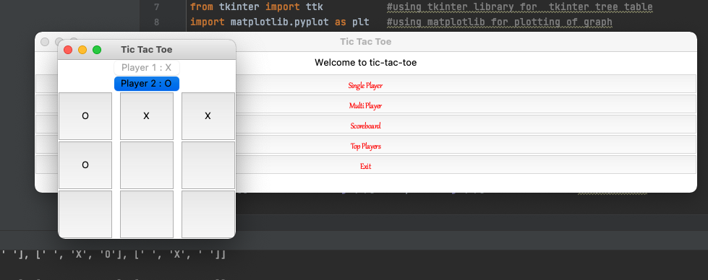

Slide 13
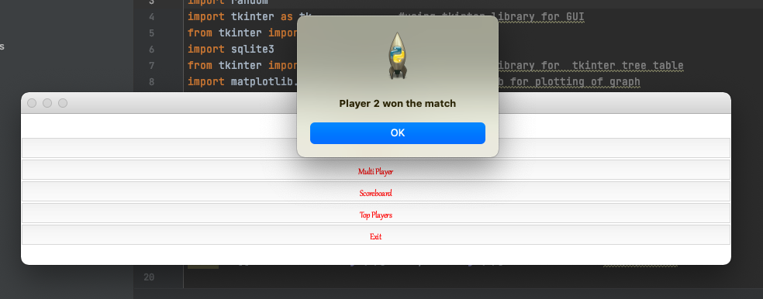

Slide 14
Github Link:- https://github.com/savneetshuann/TicTacToe_Game

Slide 15
Submitted by:- Vedant Chokshi (C0779423) Savneet (C0777993) Navdeep Kaur (C0785549) Dalveer Singh (C0789821)

