Slide 1
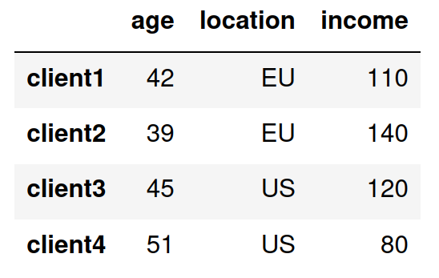

rule 1
rule 2
rule 3

Slide 2
selection based on rule 1
selection based on rule 2
selection based on rule 3

Slide 3
selection based on rule 1
selection based on rule 2
selection based on rule 3

Slide 4

rule 1 is more important than rule 2

