Slide 1



ICTC Training program
CC-BY-NC-SA

Slide 2
Versioning
Version | Date de version | Auteur / Contributeurs | Nature des modifications
3.1 | 2017-03-01 | Carolandrea Guerrero Mickaël Brard Julien Jézéquel-Bréard | Diffusion initiale
3.2 | 2017-03-01 | Mickaël Brard Julien Jézéquel-Bréard | Ajout Slide 16
CC-BY-NC-SA

Slide 3
Introduction
CC-BY-NC-SA

Slide 4

Course Goals
Guided by an use case we will:
Introduce the main modules of Odoo to improve the operations and processes of the companies
Show how smoothly everything is integrated with other Odoo applications
CC-BY-NC-SA

Slide 5
Integrated Business Process with Odoo
Odoo is a suite of open source business apps used by over two million people and organizations of all size to grow their sales, run their operations, organize marketing activities, boost productivity and empower their human resources.
Purchasing
CRM
Suppliers
Manufacturing
Business Processes
Customers
Inventory
Sales
Human Resources
Accounting
Projects
Employees
CC-BY-NC-SA

Slide 6










ERP Modules - Overview
CRM
Sales
Purchasing
Manufacturing
Sales team Management
Customer Management
Lead Management
Opportunities Management
Help Desk & Support
Quotation Management
Order Management
Invoice Management
Products & Pricing Management
Purchasing Management
Replenishment
Supplier Management
Products / Services Management
Production Order
Bill of Material
Routing
Quality & Maintenance
Lean Manufacturing
Inventory
Accounting
Projects
Human Resources
Inventory Management
Logistics – In & Out Bound
Stock Allocation
Warehouse & Locations Management
Account Receivables
Account Payables
Bank & Cash Management
Business Analytics
Set taxes
Cost Accounting
Budget & Forecast
Business Strategy
Ressource & Capacity Planning
Executive Dashboard & Control
Key Projects Metrics
Timesheet & Activity tracking
Expense Management
Recruitment
Employees
Performance Management
Compensation
Training & Development
Attendance & Leaves
Expenses
CC-BY-NC-SA

Slide 7
Access to Odoo On-line
CC-BY-NC-SA

Slide 8
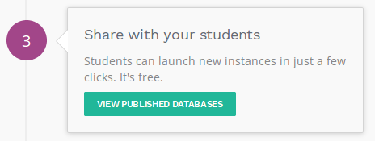
1. Create a database
All databases created are valid for 10 months. After this period, they will automatically expire. However, your personal account will remain active.
Go to https://www.odoo.com/page/edu
Click on the 3rd option « View published Databases ».
You will get access to the list of all the DB already shared. You can directly click on « edu-ictc » database or make a simple search on the top right corner in order to find this database.
CC-BY-NC-SA

Slide 9
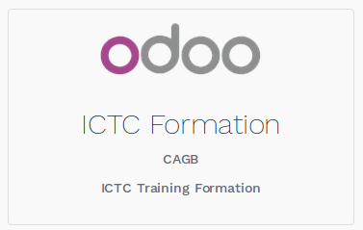
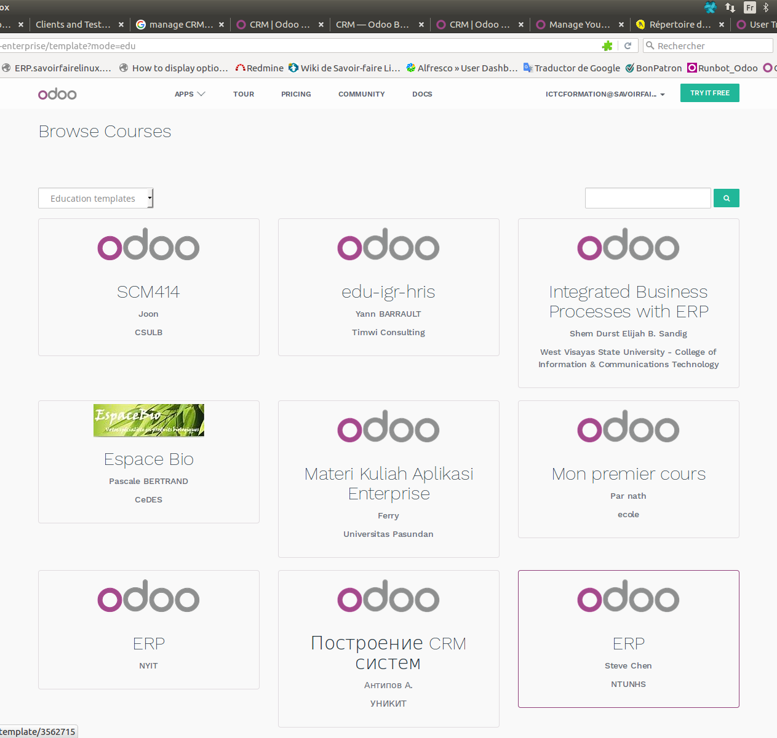
Create a database and Odoo account
Click on the following database :
You can use the search engine to make the search of the course database faster :
Once in the database, you can choose a name to create a new database with the initial data of the case study, which will use during the execution of this course.
CC-BY-NC-SA

Slide 10
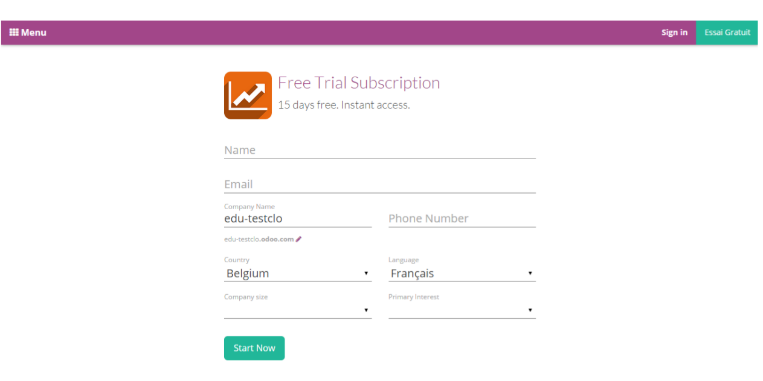
Create an Odoo account
Fill out your name and email address. It is recommended to use an email address that is running smoothly.
You have to choose your database name (the company name). Note that you have to keep the prefix “edu-”. If you do not enter this prefix, you will not have 10-month free access to Odoo Online and you will be charged.
Note: the name of the database can not be changed, it will be permanent.
Name of the database created by the student
edu-XX
Canada
CC-BY-NC-SA

Slide 11
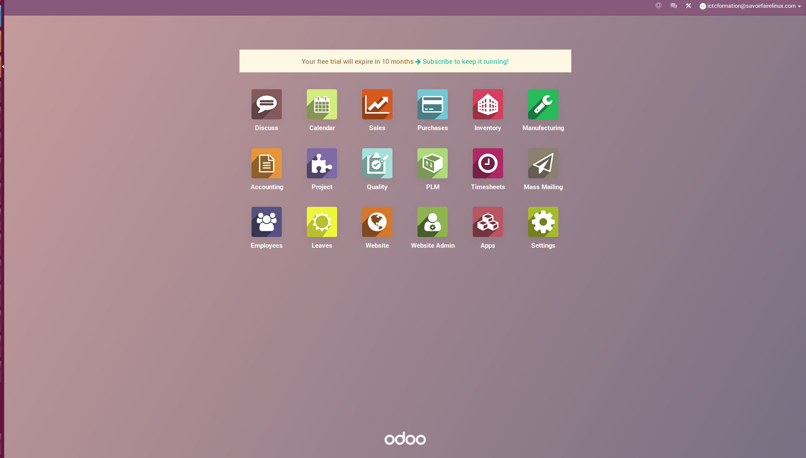
Welcome to Odoo Online!
Your own Odoo account and database are created.
CC-BY-NC-SA

Slide 12
Set a company
CC-BY-NC-SA

Slide 13
General Configuration
General configuration for a company :
CC-BY-NC-SA

Slide 14
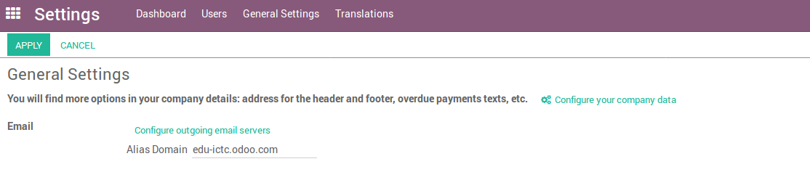
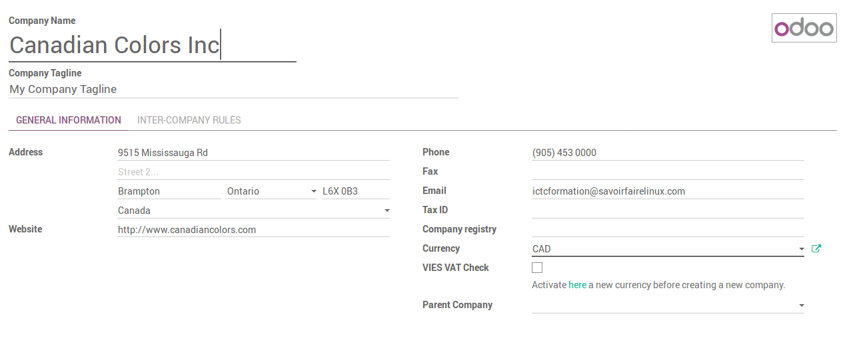
General Configuration
1
2
Keep your email address by default
CC-BY-NC-SA

Slide 15
Deployment Project
CC-BY-NC-SA

Slide 16

ERP Project management
Bases
- Formalization of current business processes (how people work)
Paper work
Process re-engineering
Analysis
- Target business process needs
- Gap analysis vs. Standard
- Customization general functional specification
Detailled specifications
- Standard configuration needs
- Customization detailed functional specification
- Technical installation on a server (2 or 3 environments : production, tests)
- Code source management and versioning
Odoo functional skills
Odoo technical skills
Infrastructure skills
Project management skills
Installation
- Installation and configuration of standard/existing modules
- Customization : technical specifications, development
Development // configuration
- Unit testing
- Functional testing
- UAT & Final user validation
Testing
-Final data import, switch from older to new system
- Training of key users and all users
- Change management should be started from the beginning of the project
Training, Go Live // change management
Support
CC-BY-NC-SA

Slide 17

Solutions de gestion informatique
LICENCE : CC-BY-NC-SA

