Slide 1



ICTC Training program
CC-BY-NC-SA

Slide 2
Versioning
Version | Date de version | Auteur / Contributeurs | Nature des modifications
2.1 | 2017-03-01 | Carolandrea Guerrero Mickaël Brard Julien Jézéquel-Bréard | Diffusion initiale
CC-BY-NC-SA

Slide 3
Customer Relationship Management
CC-BY-NC-SA

Slide 4
Outcomes
Generating, managing and converting leads into opportunities.
Managing Sales teams determining optimal sales organization size, structure, and deployment.
Converting and managing key sales activities from leads to quotes.
Using email marketing for marketing campaigns to customers and prospects.
Adding value to create customer intimacy and long-term loyalty (customer database).
Achieving and maintaining a superior level of customer service and support.
CC-BY-NC-SA

Slide 5
CRM Strategies
CRM Strategies
1. Customer Acquisition
2. Customer Retention
3. Customer Service
4. Improvement
Sales teams/channels
Sales cycle
Call Center / Contact Form
Lead Workflow Management
Campaign Management
Newsletter
Customer Knowledge
Customer Segmentation
Customer Lifecycle
Management
Tracking
Customer Care / Loyalty
Satisfaction Inquiry
Customer Support
Surveys / Quality
KPI’s
Marketing Strategies
Loyalty Programs
Sales Strategies
CC-BY-NC-SA

Slide 6

CRM
Odoo allows tracking all data about each lead in order to optimize the conversion rate.
Core Process
Features
Sales Team Management
Manage sales team
Manage salespeople
Gamification tool
Customer Management
Adress Book
Customer Preferences
Multi-Adress Support
Full History
Lead Management
Lead Scoring
Mass Mailing
Call-to-actions
URL Tracker
Opportunities Management
Activities & Calls Management
Pipeline Management
Stage Customization
Meetings Scheduling
Communication & Reporting Tools
Integrated VOIP
Call Logs
Email Gateways
Custom Dashboards
CC-BY-NC-SA

Slide 7
















CMR – Leads & Opportunities Mgmt
Phone
E-mail
Fax
1. Leads Entering from Multi-Channels
2. Converting to Contact
3. Associating Account to CRM
4. Creating an Opportunity
5. Sales Process
Customer
Mail
Web visit
CC-BY-NC-SA

Slide 8
Case Study
CC-BY-NC-SA

Slide 9
Case Study
Abstract
« Canadian Colors Inc » is a small company that counts with distribution centers, service and development of products through Ontario and Quebec.
Its object is the manufacture and commercialization of agrochemicals, paints, emulsions, resins and products for the treatment of metals.
With three business units that deliver solutions for the agricultural, industrial, construction and decoration sectors and that have consolidated and positioned its brand as one of the best of paint technology in the regional market.
In 2013, the division of emulsions and adhesives was created in the organization. Due to its progressive growth, Canadian Colors needs to expand its production capacity and with its physical facilities, to ensure the timely supply of products to its customers. Later in 2014, a merger with Quebec Paints factory and in 2015 established the new production plant in this region.
Canadian Colors develops 65% of its products in Ontario and 35% is manufactured in Quebec.
The founder of Canadian Colors decided to opt for an ERP Solution as an internal tool to organize its business process.
CC-BY-NC-SA

Slide 10


Case Study
« Canadian Colors Inc » is a small company that counts with distribution centers, service and development of products through Ontario and Quebec.
OBJECTIVE manufacture and commercialization of agrochemicals, paints, emulsions, resins and products for the treatment of metals.
Business
Units
Manufacturing
& Warehouses
Sales
channels
Indirect
Network of resellers
(Wholesale distributors and Independent representatives)
Direct
(9) Sales representatives
(6) Points of Sales - « Colors Stores »
Website
Agriculture
Industry
Construction
Decoration
« Canadian Colors Inc » Toronto
« Canadian Colors Inc » Montréal
CC-BY-NC-SA

Slide 11
Customer Acquisition
CC-BY-NC-SA

Slide 12
Exercise – Customer Acquisition
60 min
Last week, Canadian Colors participated in « Toronto Home Expo ». This event showcases products from Building Construction, Chemicals & Dyes, Home Furnishings & Home Textiles, Architecture & Designing, Real Estate Agents industries. Among the visitors were professional retailers (specialty shops, resale of construction materials and home centers), architects, decorators, interior designers, engineers, paint specialists, chemists, paint companies, owners and managers of tinplate and repainting workshops automotive, among other industries in general.
Canadian Colors shows its last new product to the market and obtained potential sales contacts or prospects interested in this particular product. The company would like to manage its sales funnel, track leads, close opportunities and get accurate forecasts with CRM Odoo.
In addition, the company made an email marketing to launch the new product in all its sales channels.
CC-BY-NC-SA

Slide 13
Exercise – Customer Acquisition
TO DO
Create a new team member into sales team (Direct – Indirect – Web).
Create leads from this event and assign to the salespeople. If you want you can create new salespeople.
Use tags to better qualify lead’s interests.
Open a lead and convert it into an opportunity. The contact is automatically set as a customer.
Simulate and manage customer interactions from an opportunity like internal notes, meetings, and calls.
Customize your pipeline creating a new stage (e.g. lost)
In the pipeline, you can drag & drop opportunities between stages. You can verify the stage of an opportunity is changed automatically.
Add more information like next actions, an expected closing date and expected revenues.
CC-BY-NC-SA

Slide 14
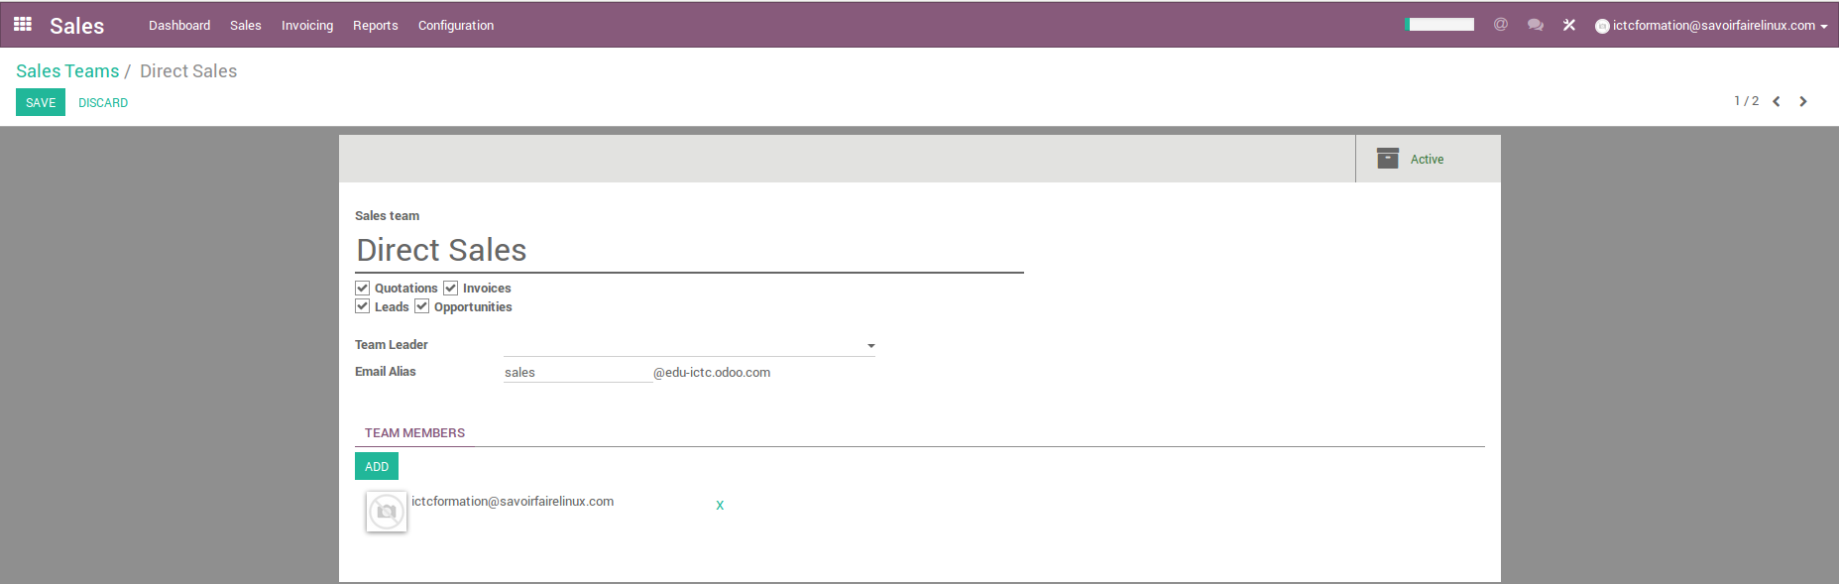
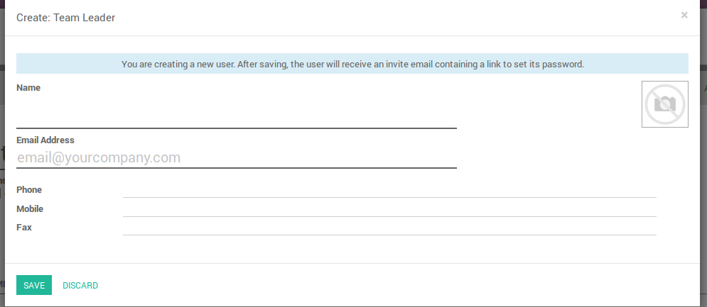
CRM – Sales Team Management
Configuration Sales Team & Team Members
1
CC-BY-NC-SA

Slide 15
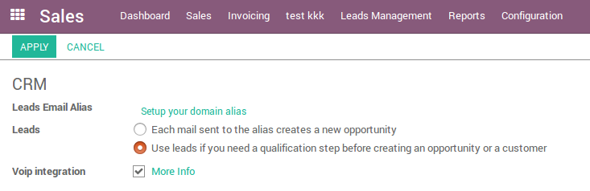
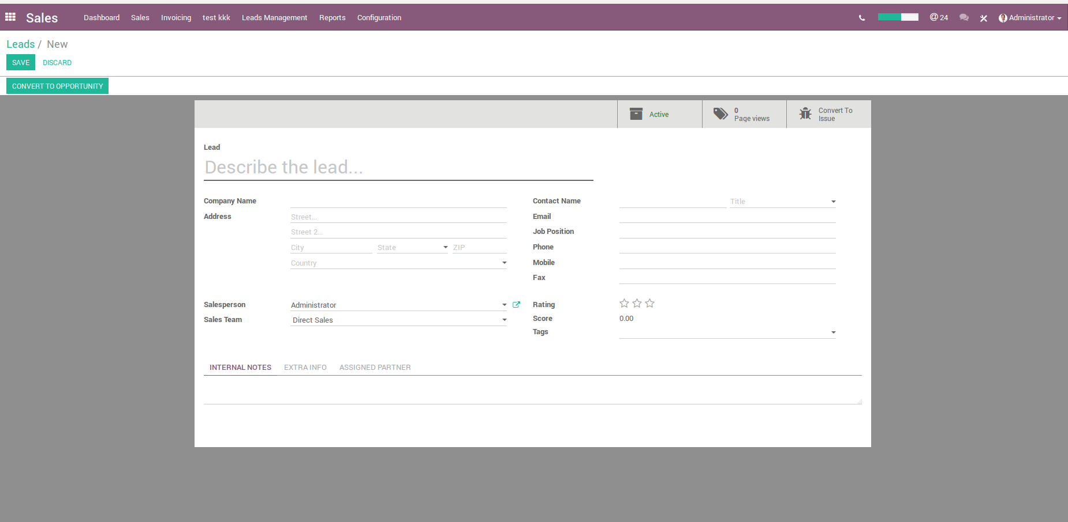
CRM – Leads Management
Configuration Leads
CC-BY-NC-SA

Slide 16
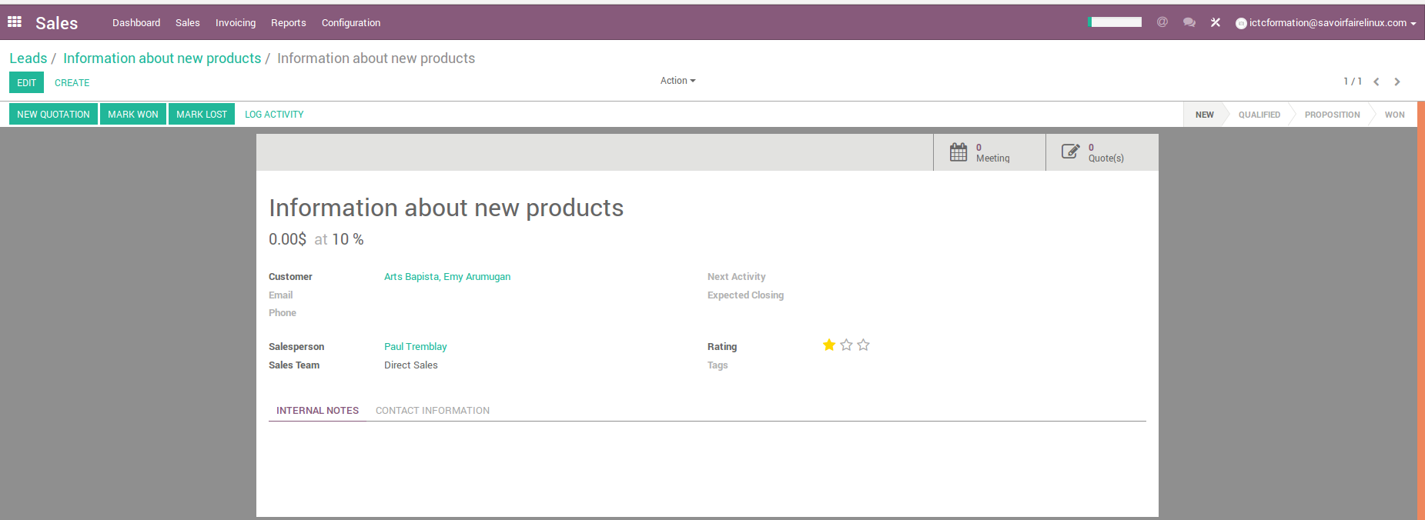
CRM – Leads Management
Information that you can manage in a lead
CC-BY-NC-SA

Slide 17
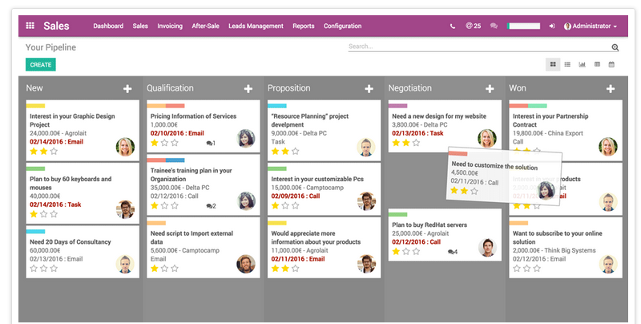
CRM – Leads Management
Drag & drop opportunities between stages in the pipeline
CC-BY-NC-SA

Slide 18
Exercise – Customer Acquisition
15 min
Generate leads from incoming emails
Canadian Colors would like to route, sort and filter incoming email to generate leads from them or route them to the sales team automatically.
TO DO:
Setup your domain alias in settings
Personalize and setup team alias on Dashboard
CC-BY-NC-SA

Slide 19
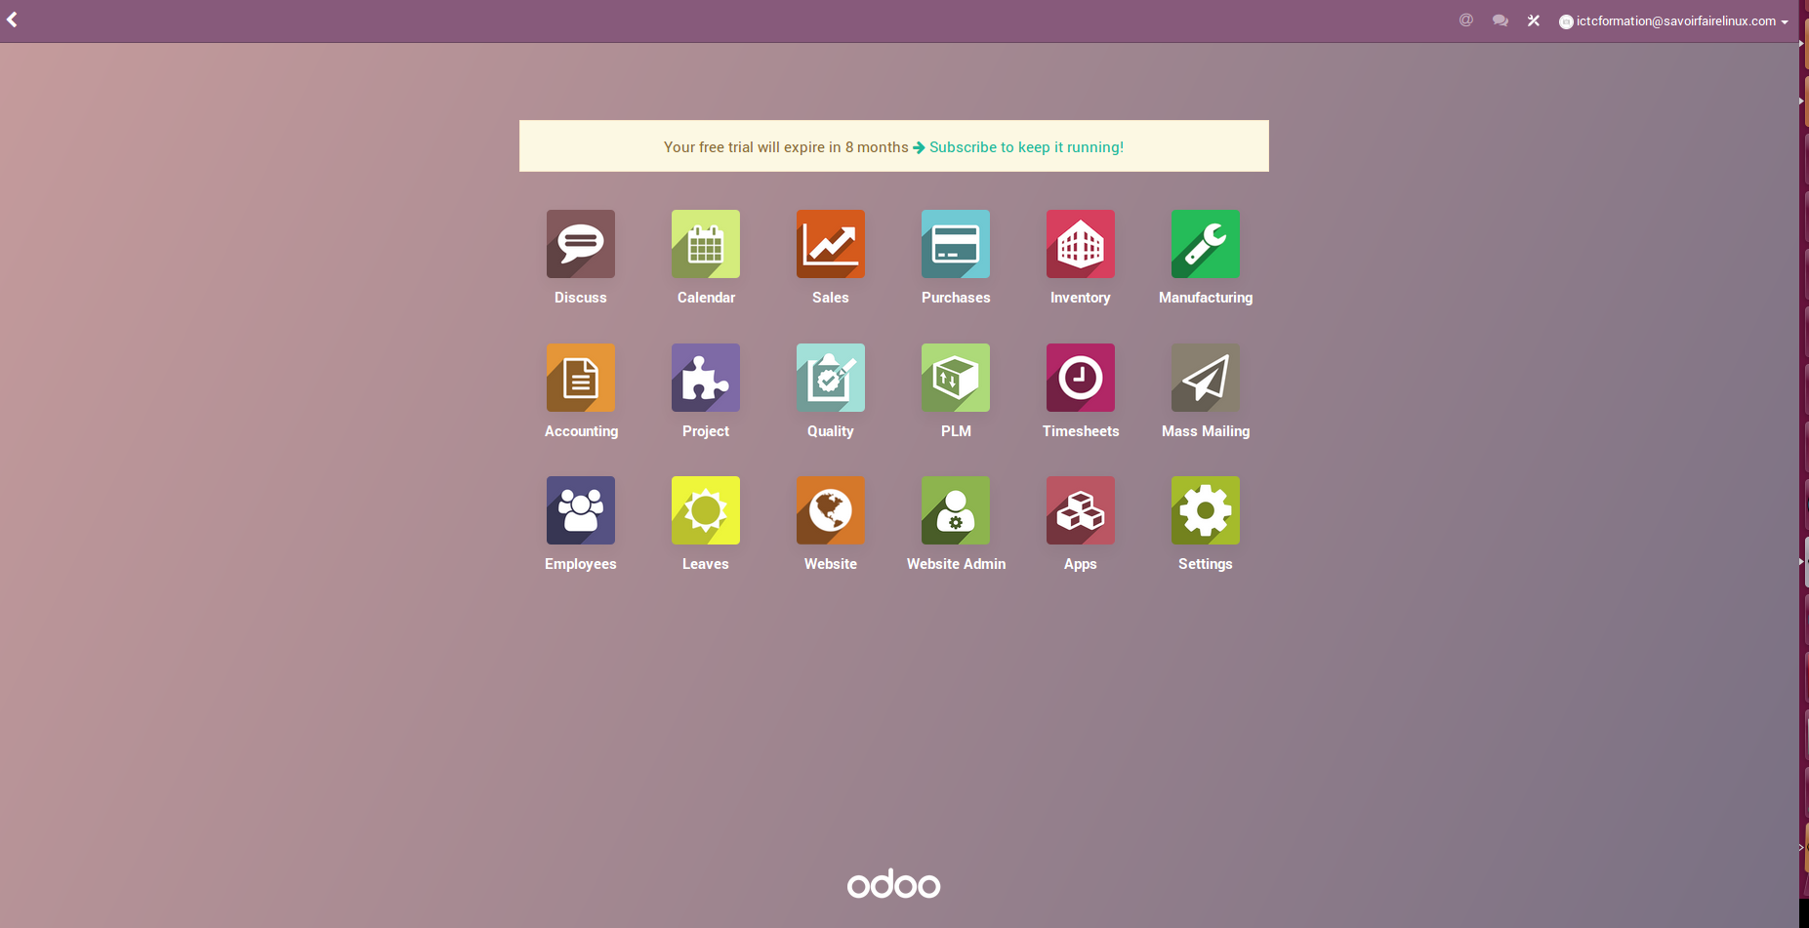
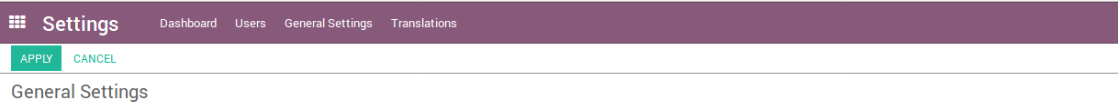
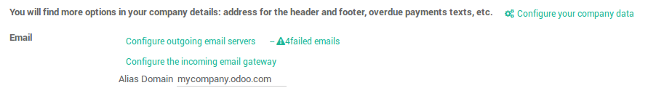
CRM – Setup the company domain
Odoo General Settings
CC-BY-NC-SA

Slide 20
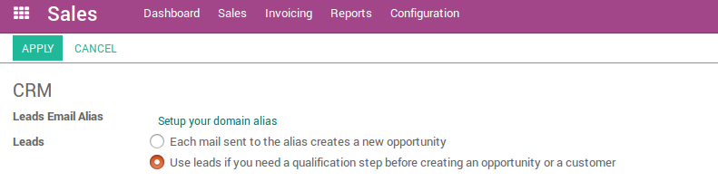
CRM – Setup domain alias
Menu configuration
Settings CRM Leads Email Alias Setup your domain alias
CC-BY-NC-SA

Slide 21
Website Visitor
CC-BY-NC-SA

Slide 22
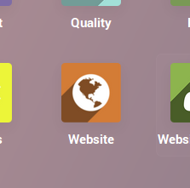
Exercise – Website visitor
15 min
As a common visitor, go on the website and if possible use 2 different email adresses to :
  Fill the contact form : to generate a lead
  Subscribe to the newsletter : for next exercice
TO DO:
Go on the website as a visitor
Fill out the contact form
Find the created lead
Subscribe to the newsletter
Find your subscription in Mass mailing
CC-BY-NC-SA

Slide 23
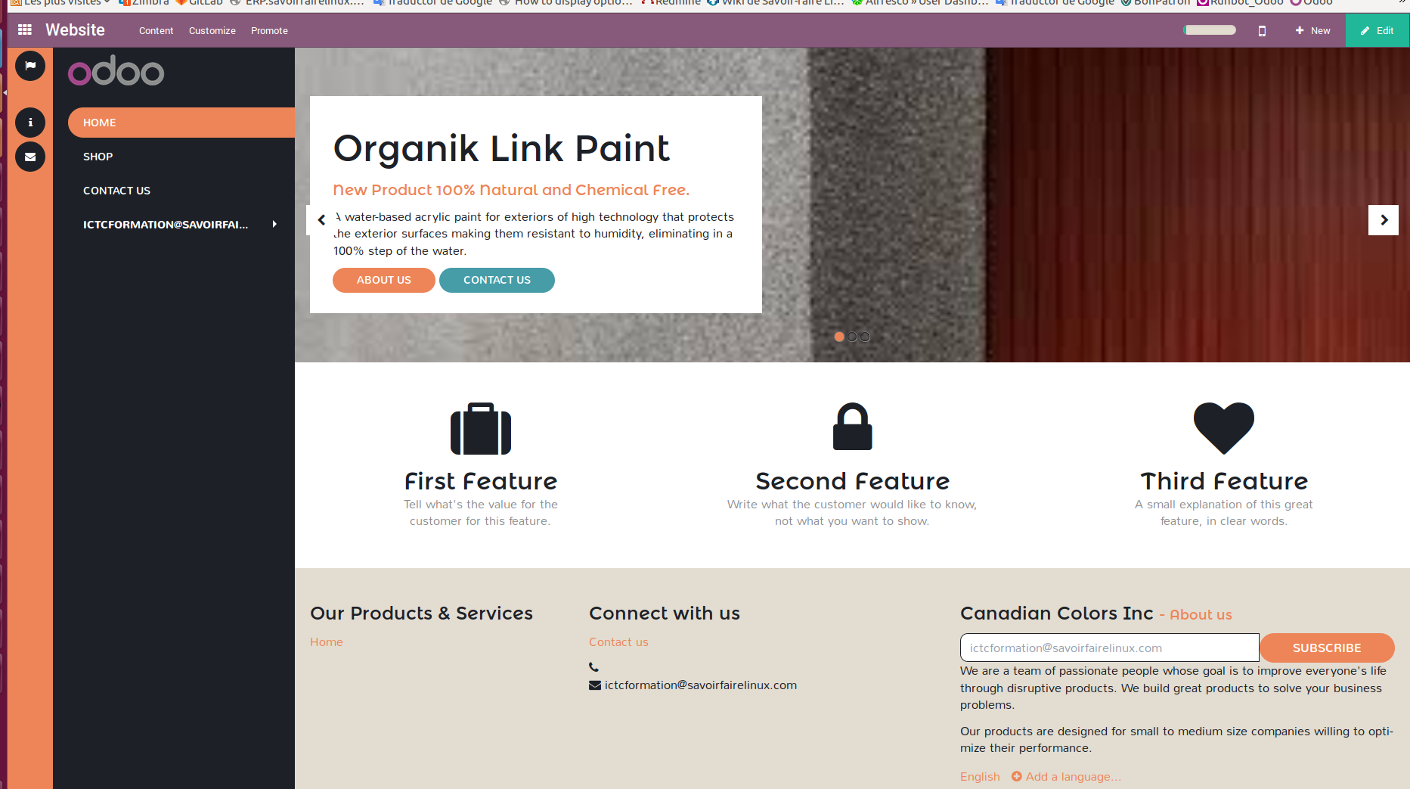
Website visitor – Contact form
CC-BY-NC-SA

Slide 24
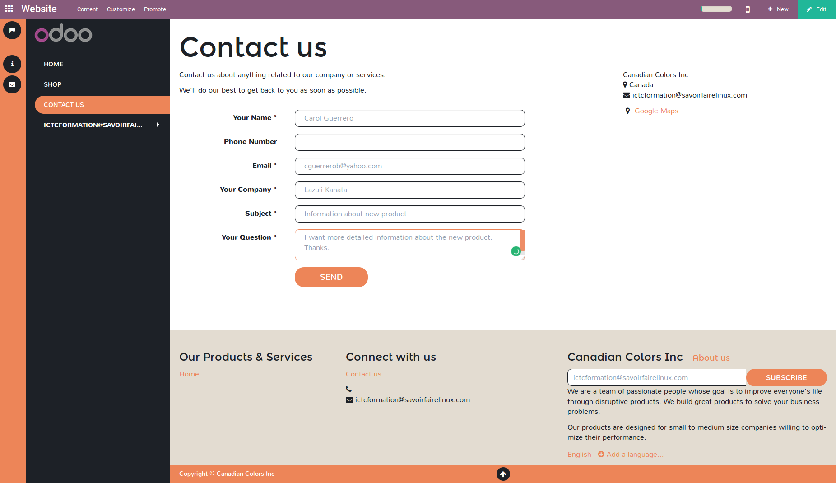
Website visitor – Contact Form
CC-BY-NC-SA

Slide 25
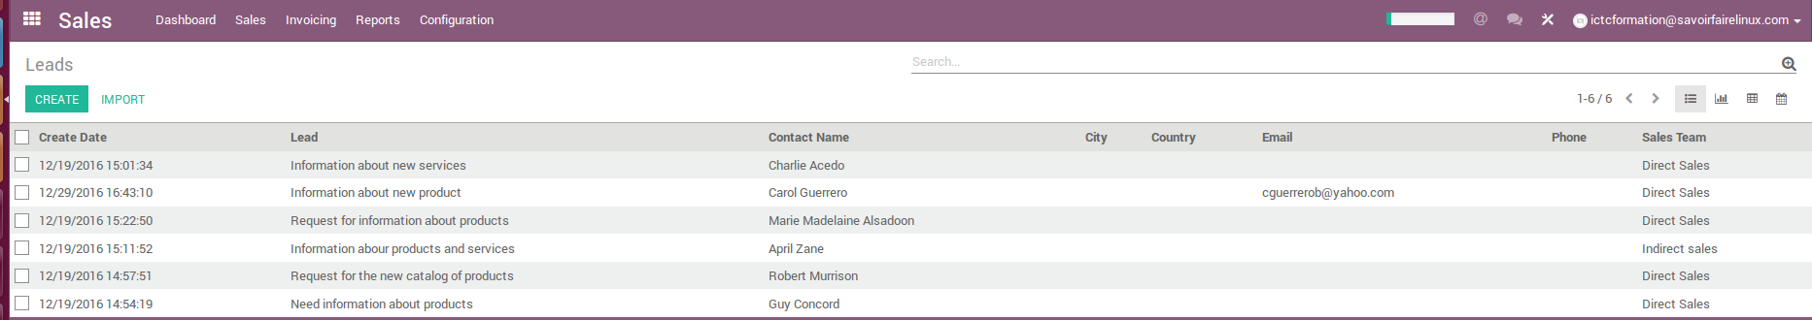
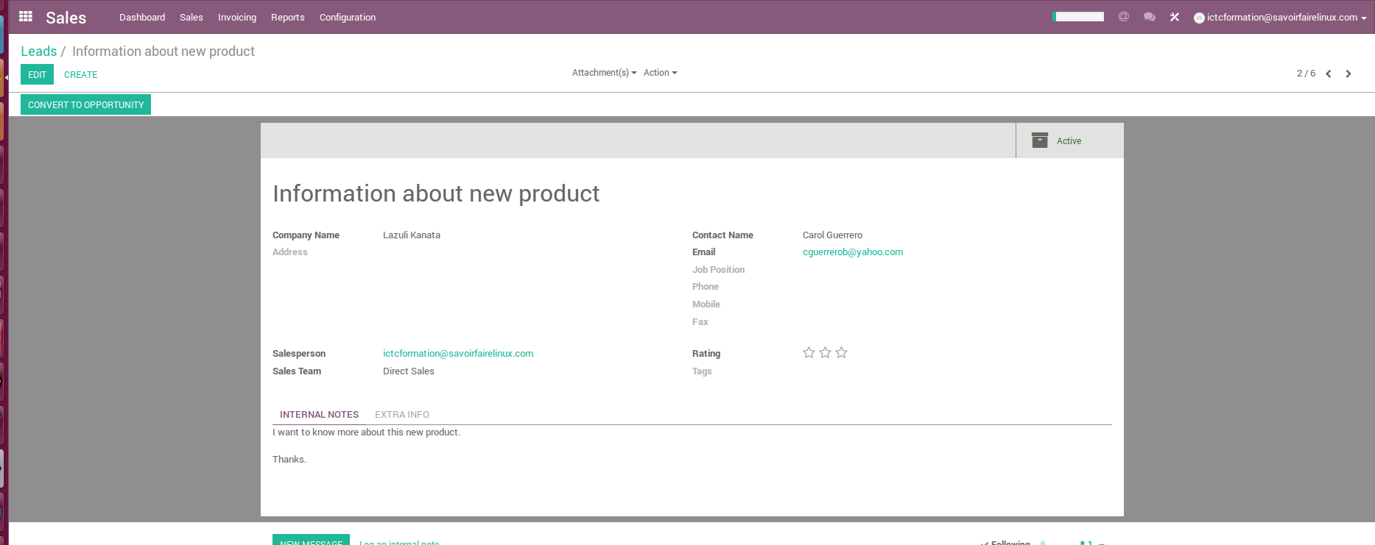
Website visitor – Leads from website
CC-BY-NC-SA

Slide 26
Website visitor – Newsletter subscription
CC-BY-NC-SA

Slide 27
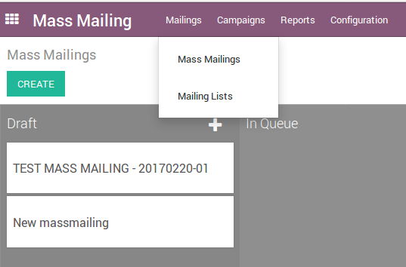
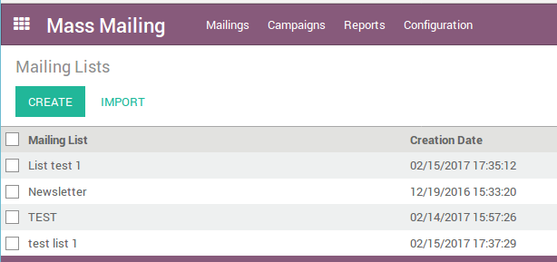
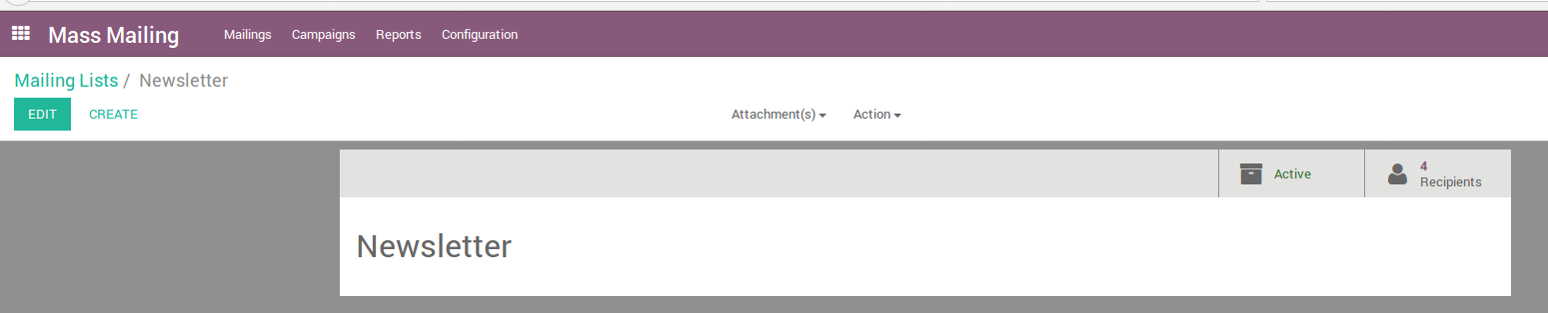
Website visitor – Newsletter subscription
Mass Mailing Mailings Mailing Lists : Select the Newsletter list
Open Recipients to verify your subscription has been added to the list.
CC-BY-NC-SA

Slide 28
Mass - mailing
CC-BY-NC-SA

Slide 29









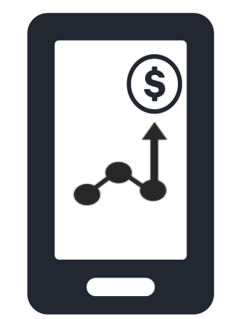
CMR – Mass Mailing
Build Campaigns & create own personalized emails
Track & Improve campaigns (real-time statistics on every email sent out)
Mailing List Management (segment database)
Content Full Responsive on every screen (tablet, mobile phone, laptop or desktop computer)
Track the clicks, opportunities, and revenue generated by campaigns
Calculate ROI (analyze the conversion rate, the expected revenue and the generated revenue of each campaign)
CC-BY-NC-SA

Slide 30
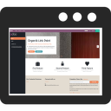

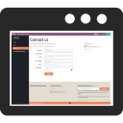

CMR – Mass Mailing
Phases of the marketing campaign
HI, LET ME
KNOW YOUR
NEEDS
Purchase Decision
Prospect receives a call
from the sales team
Secured as Sales
Opportunity
Awareness Phase
Prospect fills out the contact
form on the website requesting
more information from the
new product.
Recognition Phase
Prospect receives a newsletter
with more detailed information
about the new product and
community events.
Evaluation Phase
Prospects use contact form
to ask the available inventory
and special delivery.
CC-BY-NC-SA

Slide 31
Exercise – Customer Acquisition
Create and send a newsletter
Canadian Colors has designed a marketing campaign to inform customers and prospects about its new product « Organic Link Paint » a water-based acrylic paint for exteriors of high technology that protects the exterior surfaces making them resistant to humidity, eliminating in a 100% step of the water.
The marketing team wants that you design the next version of newsletter including information about this new product. Likewise, one the piece is designed, send to new prospects.
CC-BY-NC-SA

Slide 32
Exercise – Customer Acquisition
90 min
You have previously subscribed to the Newsletter.
TO DO
Design the newsletter including information about this new product.
Send the newsletter to the dedicated mailing list. Be aware of including the new subscription created through the website.
Select the recipients of your choice to optimize the results. By default all clients are within the mailing list « Newsletter » but we can select the recipients at the time of the creation of the campaign.
CC-BY-NC-SA

Slide 33
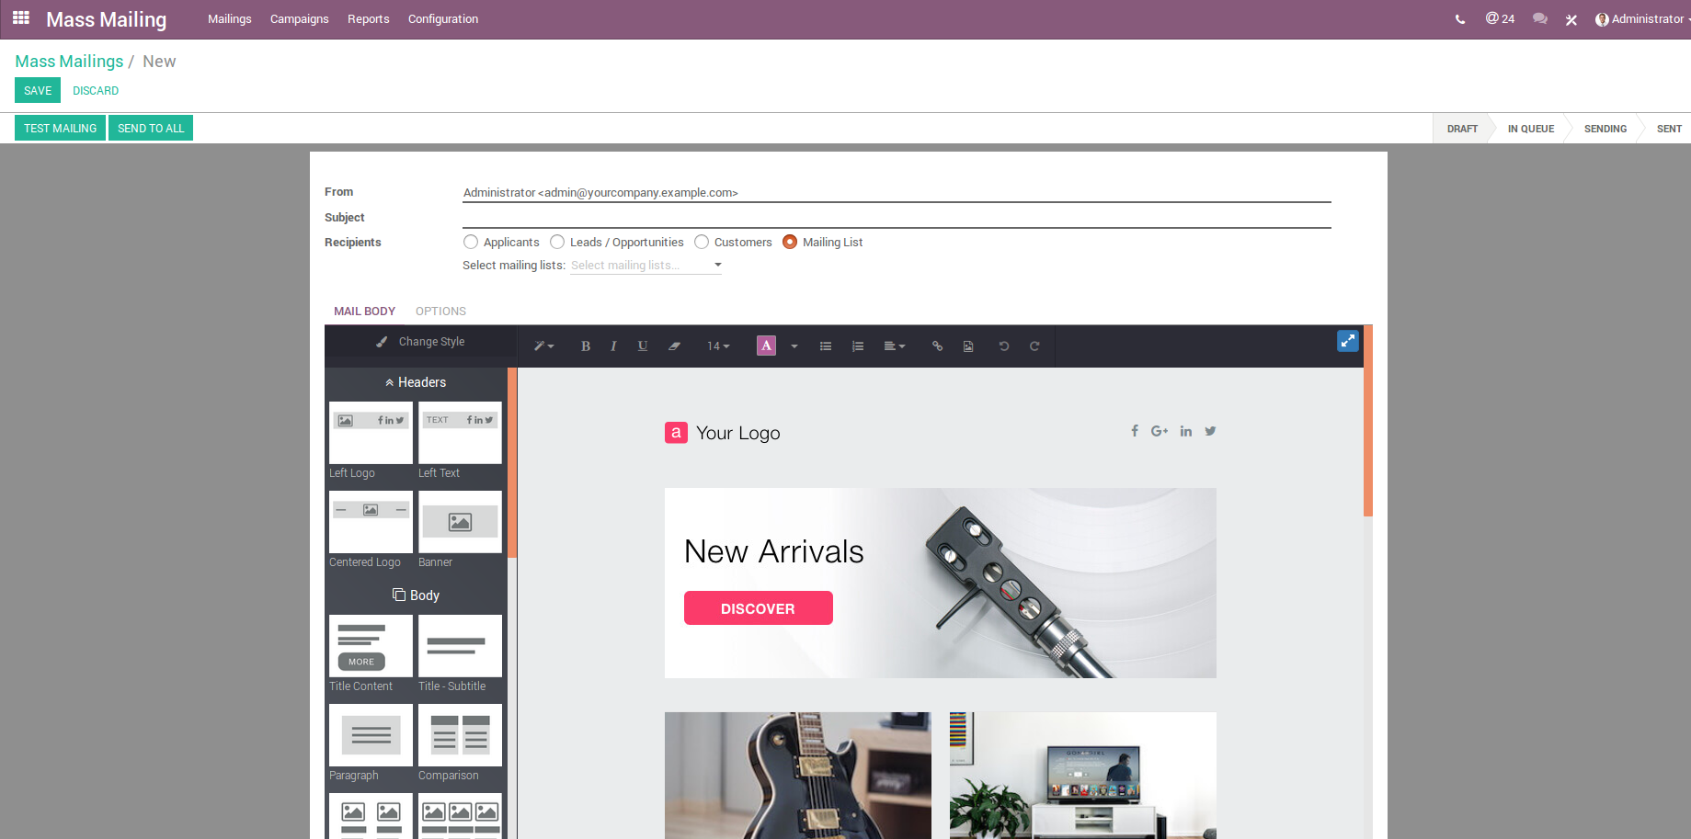
CRM – Mass Mailing
CC-BY-NC-SA

Slide 34
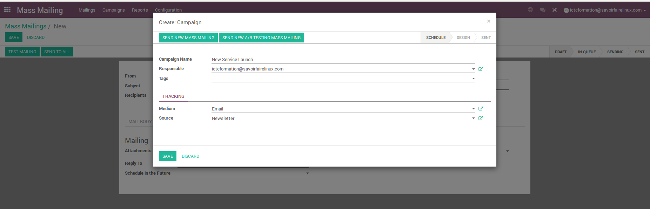
CRM – Mass Mailing
CC-BY-NC-SA

Slide 35
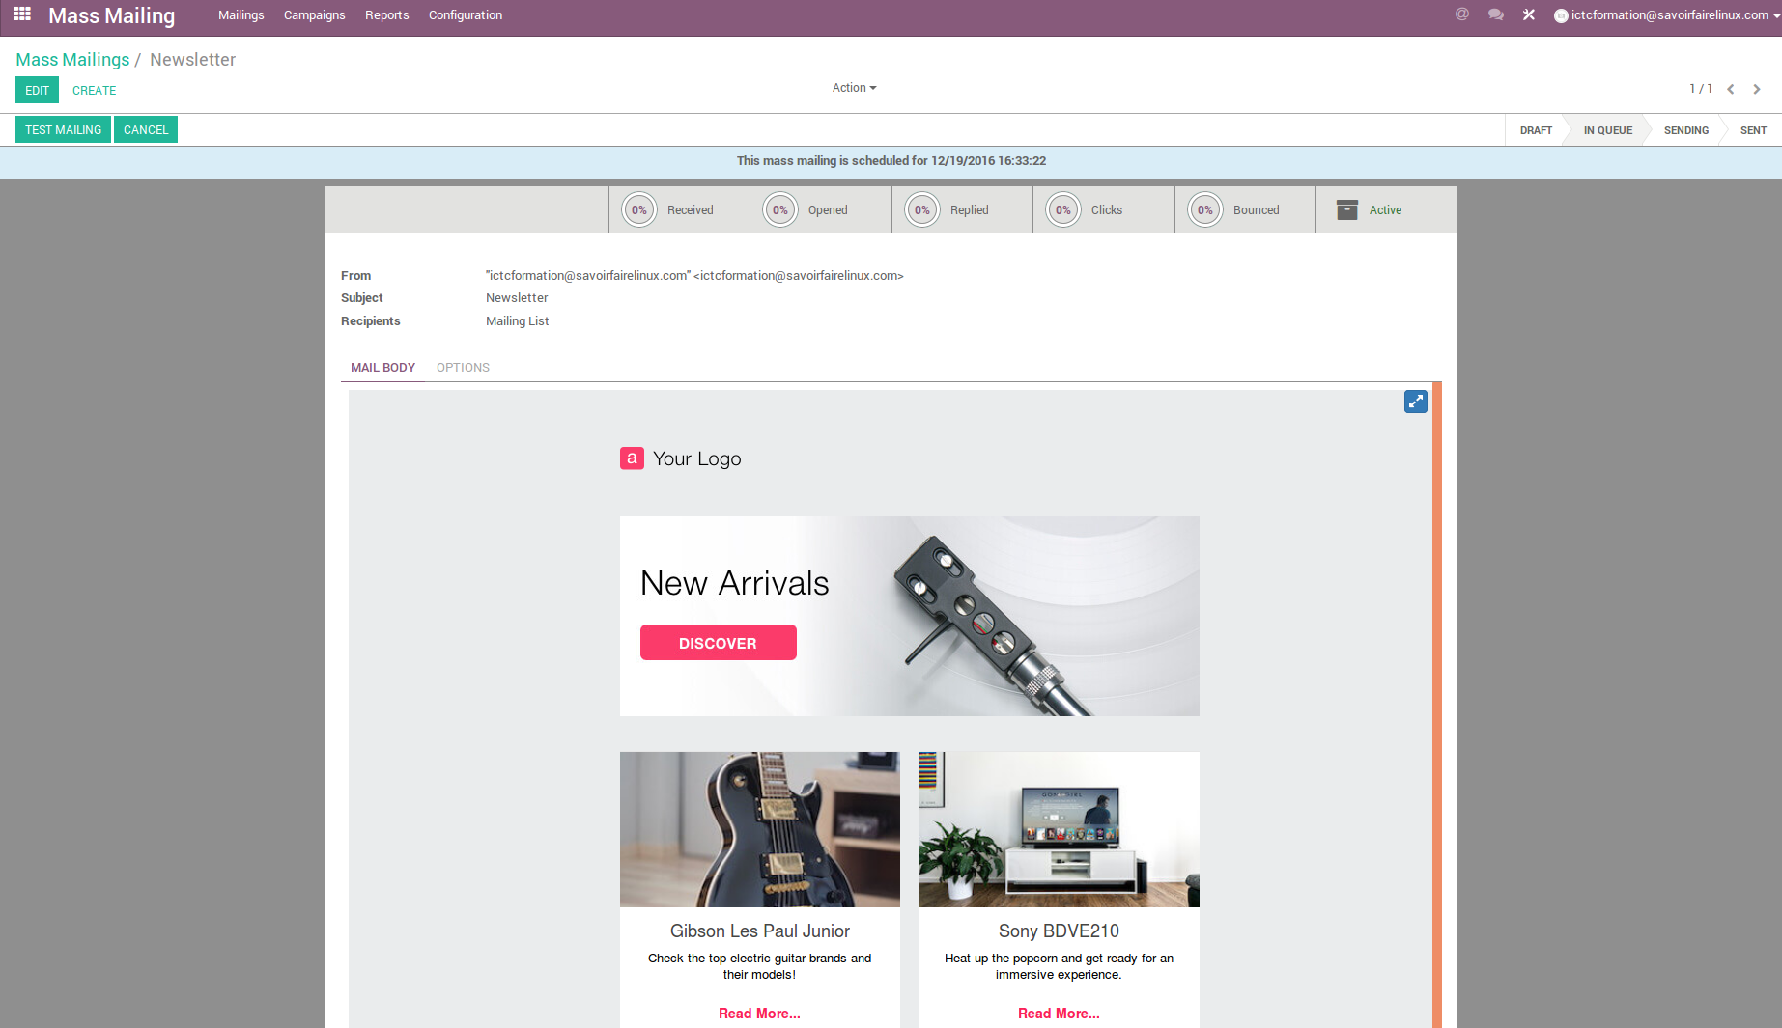
CRM – Mass Mailing
CC-BY-NC-SA

Slide 36
Customer Retention
CC-BY-NC-SA

Slide 37



CRM – Customer Retention Example
Customer retention strategies using Mass Mailing
Purchase confirmation
Invitation to subscribe to the newsletter
Seasonal Discounts Email Marketing
Customer Anniversary Email
Customer Ranking Email
Online Customer Behavior
Cross Selling Email Marketing
CC-BY-NC-SA

Slide 38
Customer Management
CC-BY-NC-SA

Slide 39
CMR – Client Lifecycle
MARKETING
SALES
CUSTOMER
SERVICE
Impressions
RFQ
Adoption
Trafic
Sales Qualified Leads
Infatuation
Prospects
Won Opportunity
Retention
Inquires
Growth
Activation
Marketing Qualified Leads
Advocacy
CC-BY-NC-SA

Slide 40
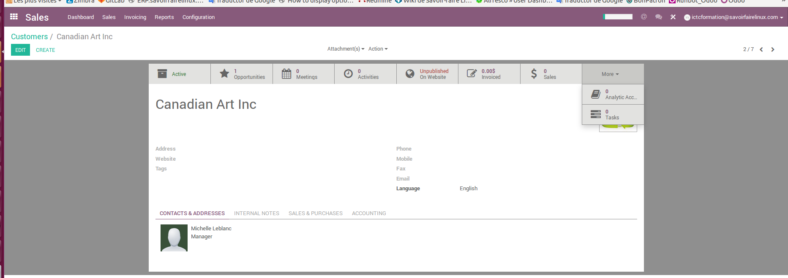
CRM – Customer Management
CRM – Customer Management
CC-BY-NC-SA

Slide 41
Customer Service
CC-BY-NC-SA

Slide 42

Exercise – Help Desk
30 min
Canadian Colors would like to create the scheme of the service and support to customers including the line of care and the system for monitoring complaints and claims.
TO DO
Install « Help Desk » Module
Register a customer complaint. A customer wants to return a product because it corresponds to another reference.
Create work teams as the customer service team and second level technical support team
Assign the customer complaint to a responsible person
Register the follow-up and closure of the complaint.
CC-BY-NC-SA

Slide 43
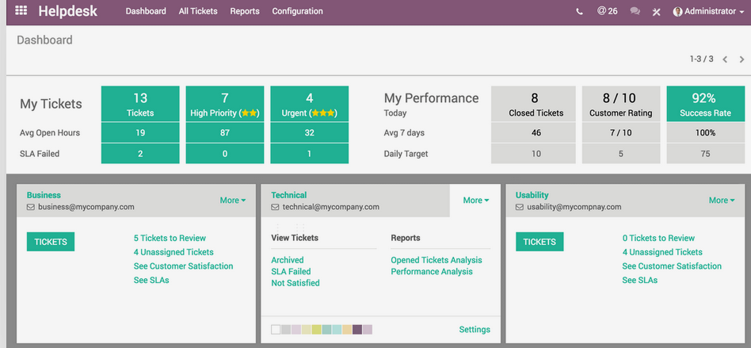
CRM – Help Desk
CC-BY-NC-SA

Slide 44

Solutions de gestion informatique
LICENCE : CC-BY-NC-SA

