Slide 1

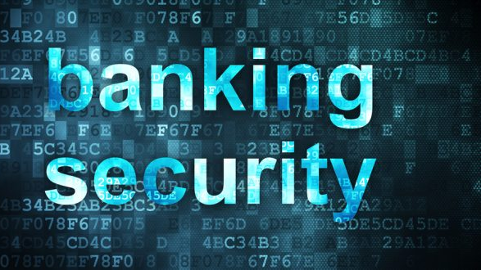
Case Study: Bank Security
By: Savon Jackson

Slide 2
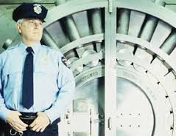
Evolution of Bank
Until the 1979, all transaction took place inside the banks. So in order taking anything out of the bank legally or otherwise they would have to physically be there. So security normally include armed guards, camera.
In 1980 four Major Banks- Citibank, Chase Bank, Chemical Banks, and Manufactures Hanover started offering home banking services.
Later in 1999 a European Banks over mobile banking.

Slide 3
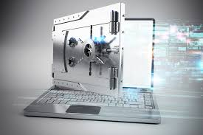
Cyber Threats
With advance in technology and the convince of online banking, the risk to banks themselves increase because of cyber attacks.
Banks are constantly being barrage by cyber threats. In the last 12months there were over 85 cyber breach attempt with 36% of them succeeding in taking data.

Slide 4

Cyber threats To Banks
Other threats include other countries & synthetic fraud which person creates an identity.
North Korean is prime example of threats from other counties. Hitting a bank in Taiwan for over $60million in 2016.

Slide 5

What are Banks Doing to prevent this.
There no fool proof way to stop cyber attacks. Each years new ways are being created. So, what are banks doing to protect themselves and your investments?
Well for starter a lot of money. By 2020 banks will spend well over $101.billion on cybersecurity software and hardware.
Also, when accessing information online, there are two firewall you must go through.

Slide 6

SAFE PASS
Bank of America Introduce “Safe Pass.”
Safe Pass - a six-digit one time use pass code is generated which is used to complete online transactions which can be sent directly to your mobile phone.

Slide 7
Layered Security
When comes to what is the best Security Measures for banks, there’s no 100 percent fool proof plan to stop it. Instead banks use a method called layered Security.
Layered Security is another approach banks use for security.
Layered Security is defense that banks built up over time, so that when one system of defense is bypassed of another would remain intact. A good example of this could be if people are able to by pass an alarm triggered at a winnows, the motion detectors inside are still working.

Slide 8
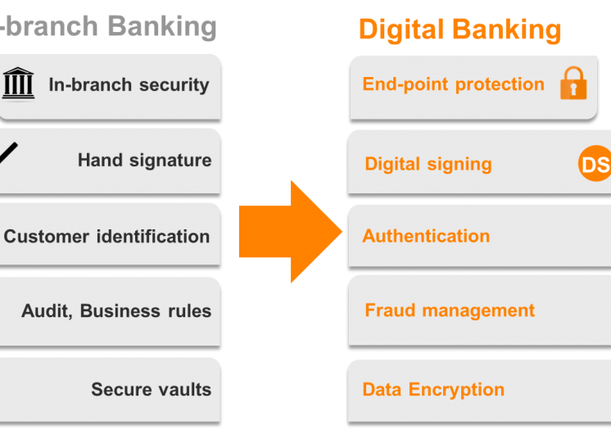
Physical & Digital
Physical Layer security has Digital Equivalents

Slide 9
https://blog.gemalto.com/security/2016/06/01/layered-security-banks-physical-digital-parallels/
https://www.bai.org/banking-strategies/article-detail/high-tech-wrecking-balls-the-five-biggest-cyber-threats-to-banks-in-2018

