Slide 1
Attrition
Fabio Savorgnan
DDS
SMU

Slide 2
Background
IBM CEO Ginni Rometty says methods used in the traditional human resources model are failing American workers and it needs assistance from ML.
IBM artificial intelligence technology is now 95 percent accurate in predicting workers who are planning to leave their jobs, said Rometty.
“The best time to get to an employee is before they go,” she said.

Slide 3
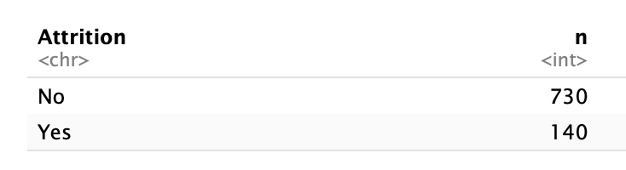
Data Description
ID
Age
Attrition,
BusinessTravel
DailyRate
Department
DistanceFromHome
Education
EducationField
EmployeeCount
EmployeeNumber
EnvironmentSatisfaction
Gender
HourlyRate
JobInvolvement
JobLevel”
JobRole
JobSatisfaction
MaritalStatus
MonthlyIncome
MonthlyRate
NumCompaniesWorked
Over18
OverTime
PercentSalaryHike
PerformanceRating
RelationshipSatisfaction
StandardHours
StockOptionLevel
TotalWorkingYears
TrainingTimesLastYear
WorkLifeBalance
YearsAtCompany
YearsInCurrentRole
YearsSinceLastPromotion
YearsWithCurrManager
36 Variables
870 rows

Slide 4
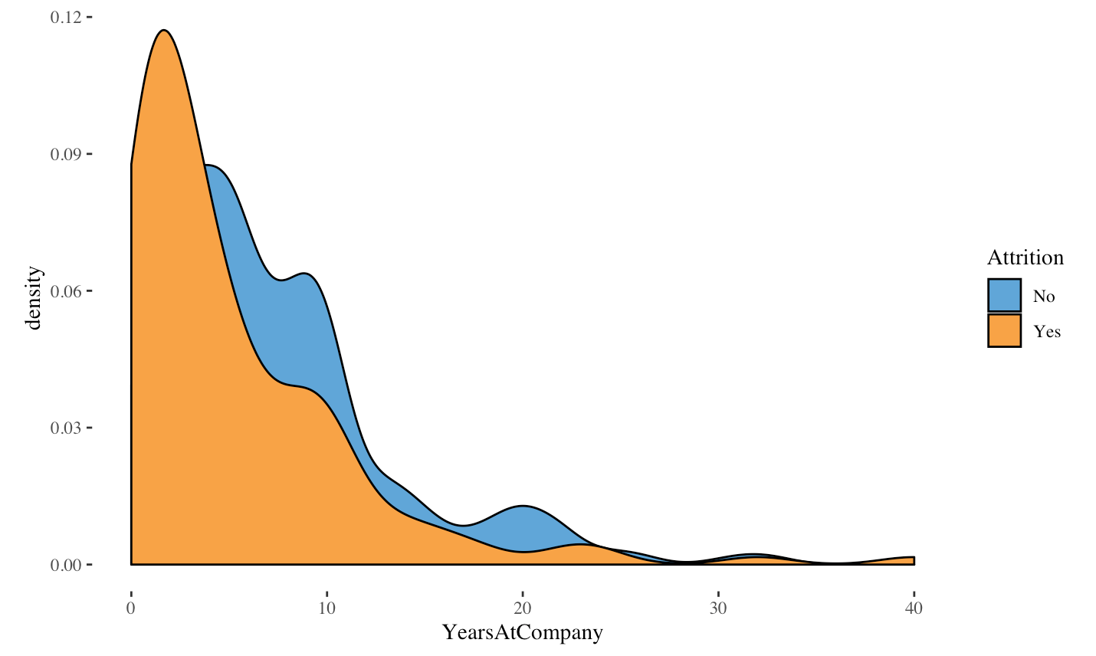
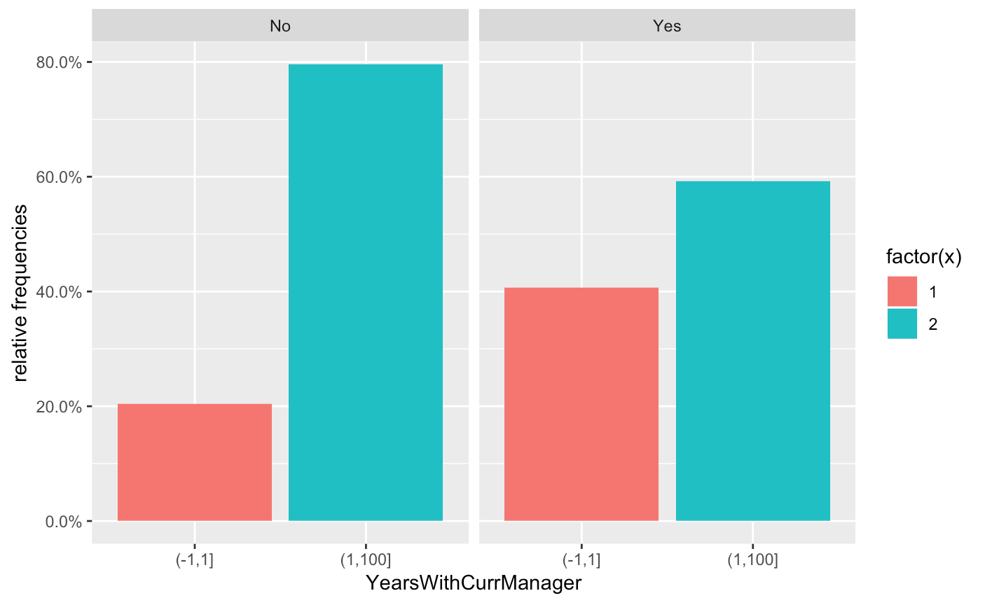
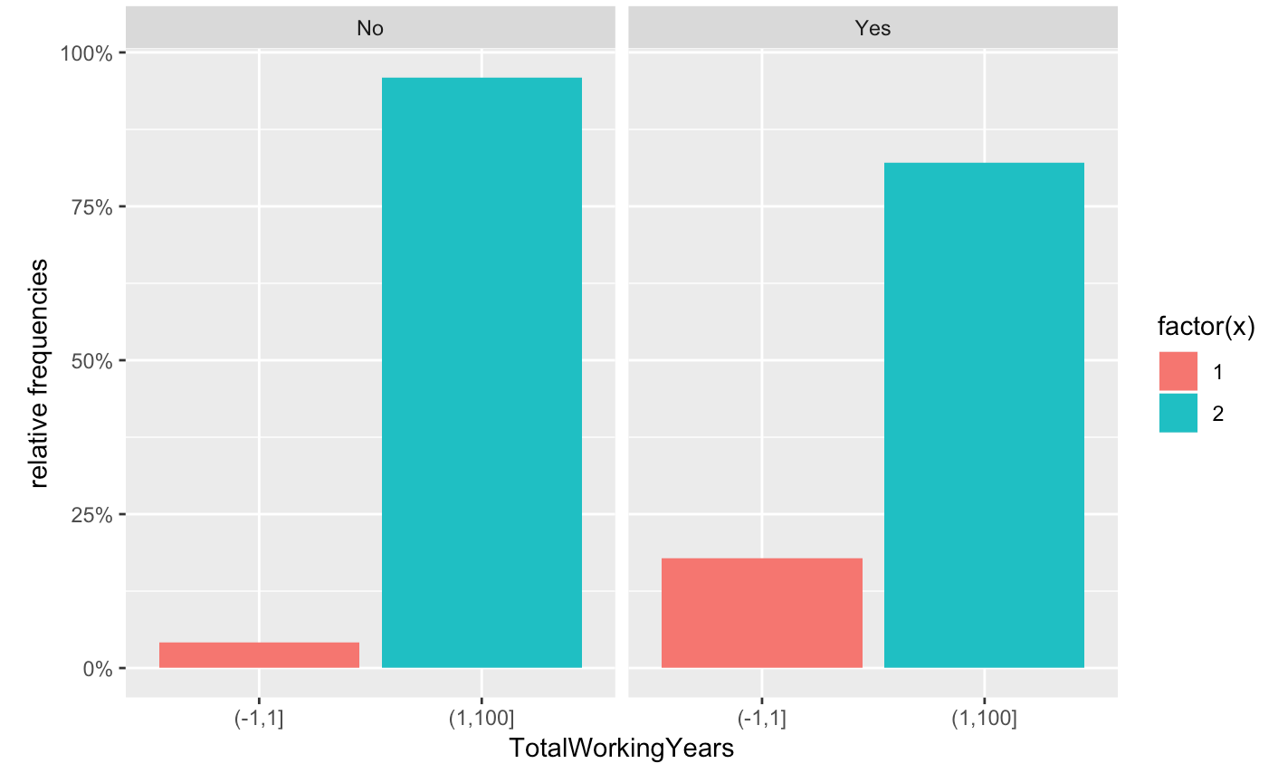
EDA and Trend

Slide 5
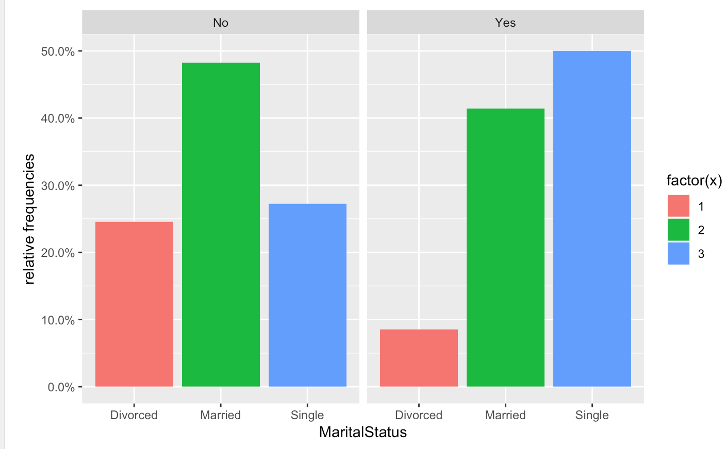
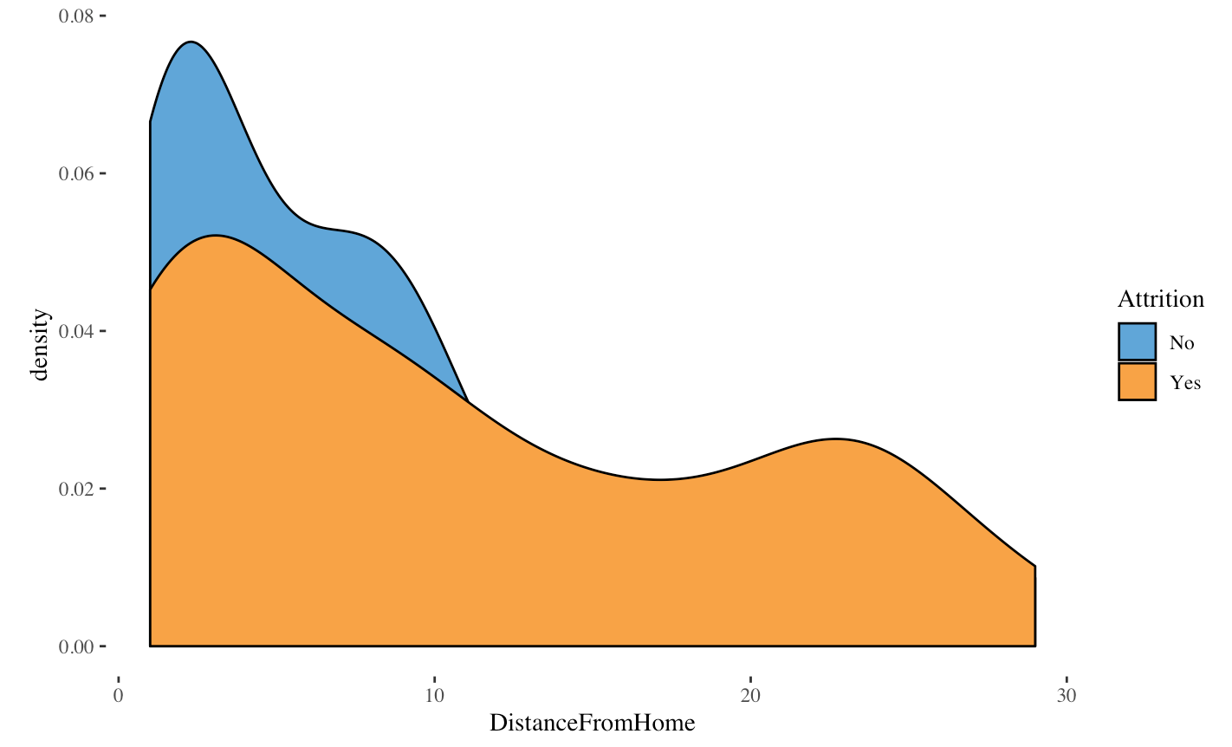
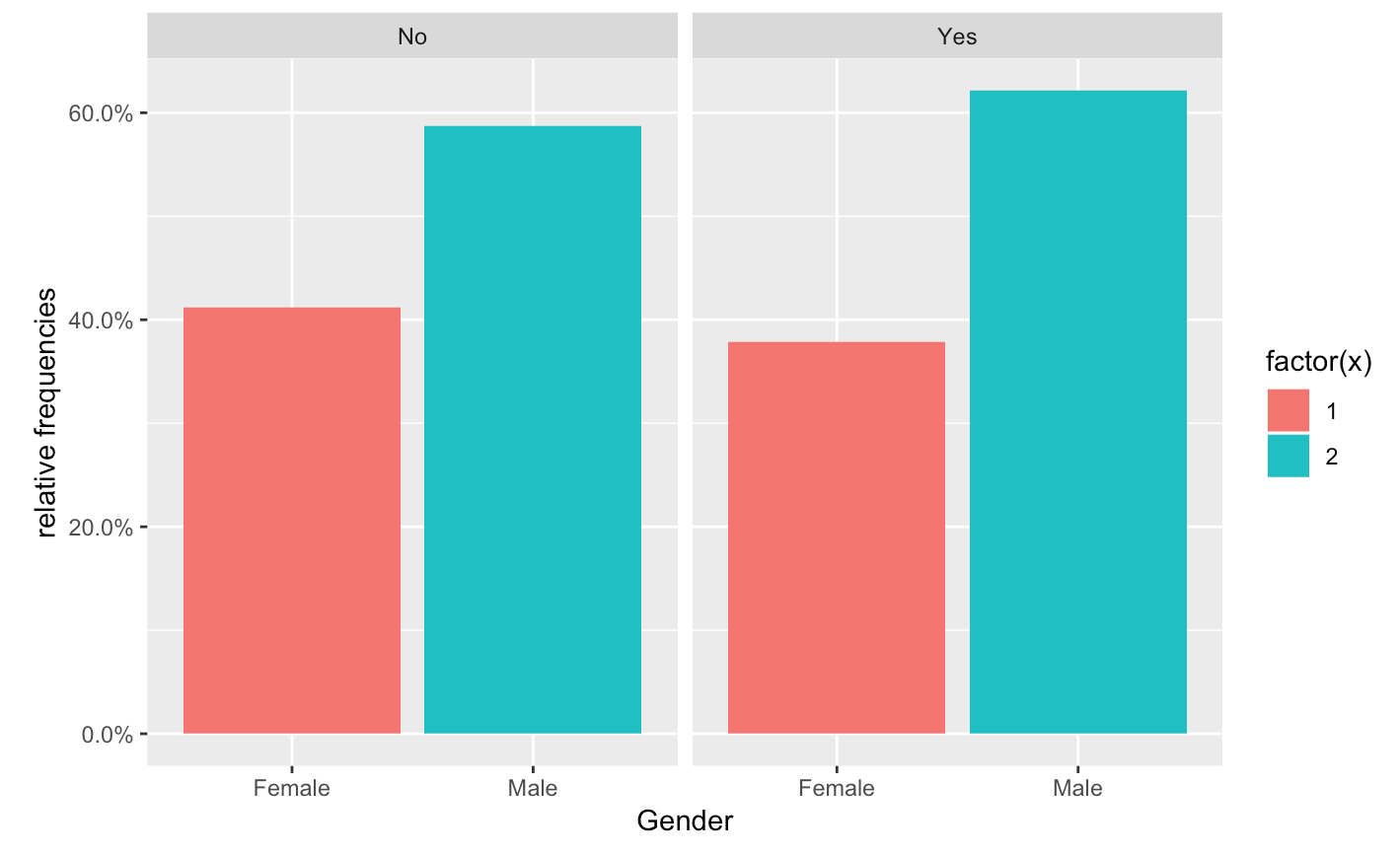
EDA and Trend

Slide 6
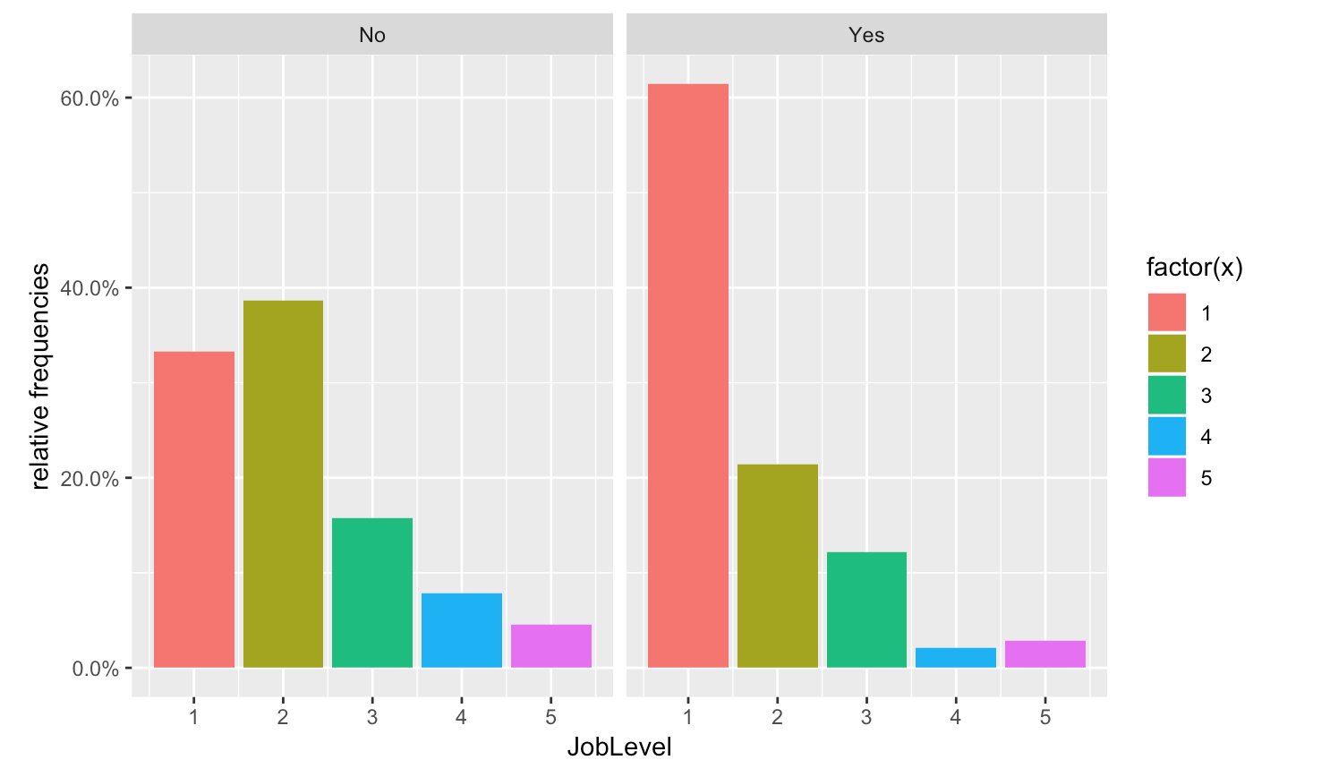
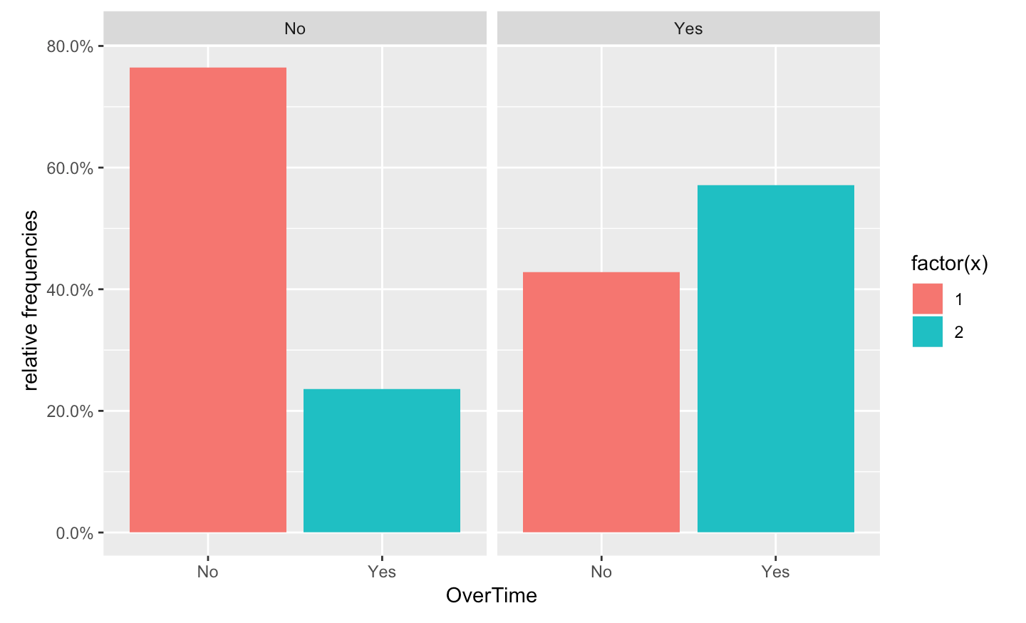
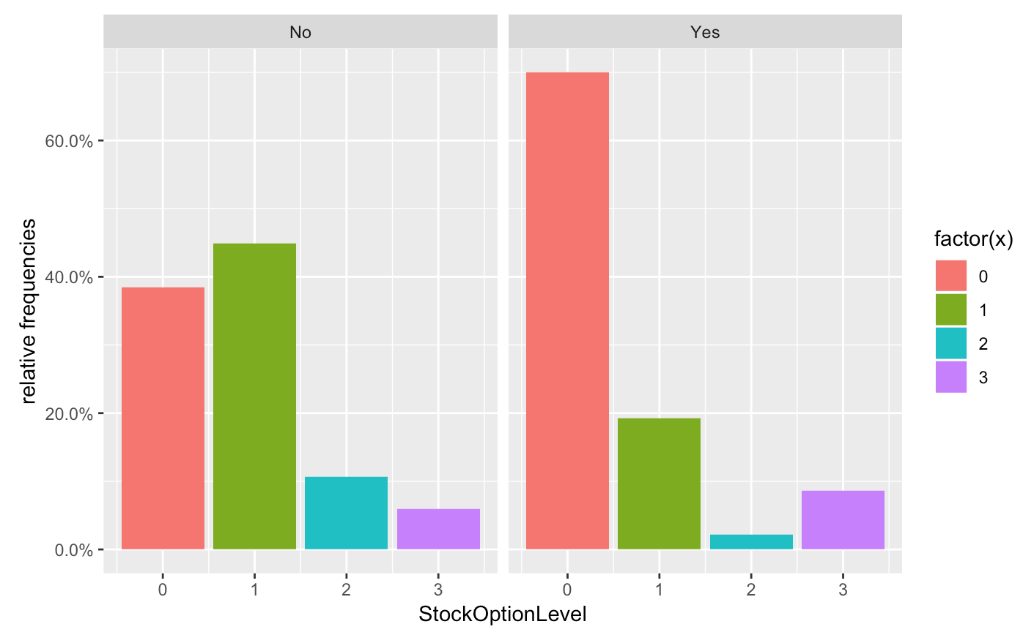
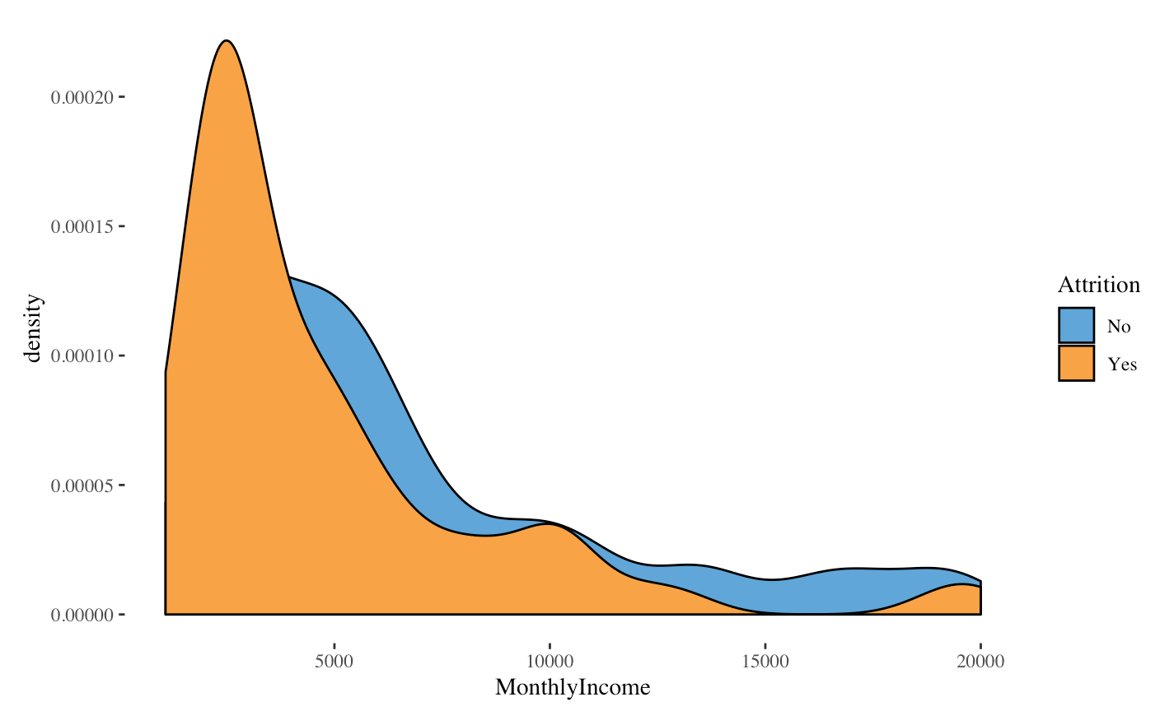
Important Variables for Attrition

Slide 7
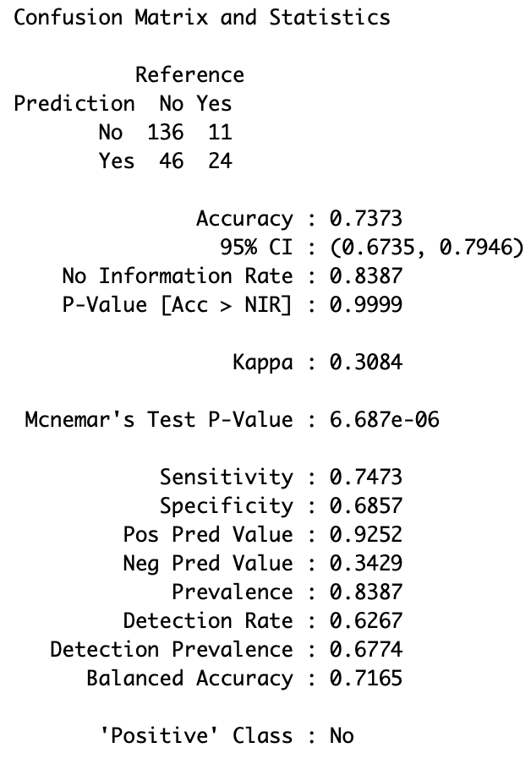
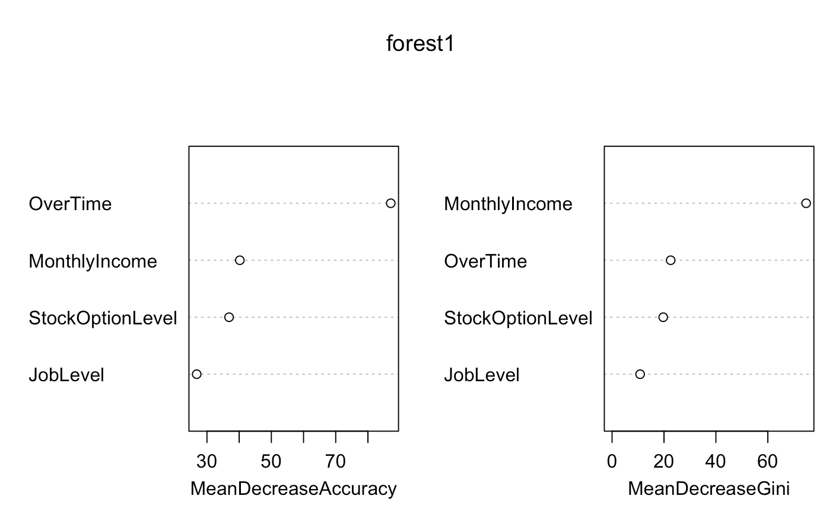
Model For attrition = Naïve Bayes classifier

Slide 8
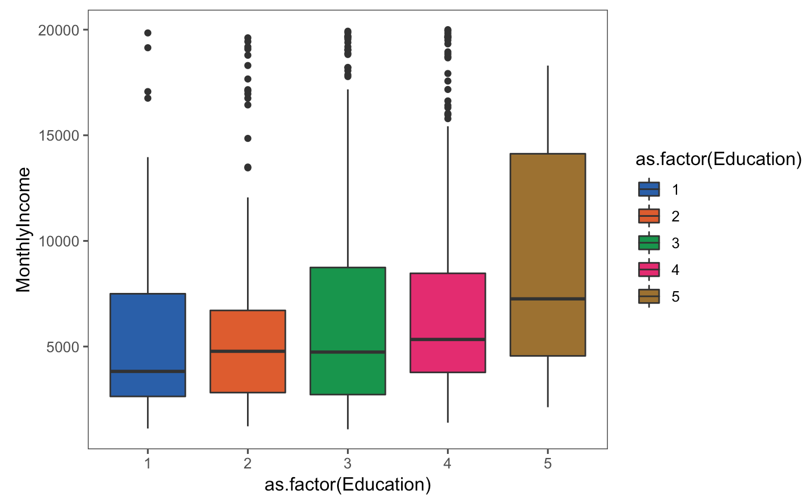
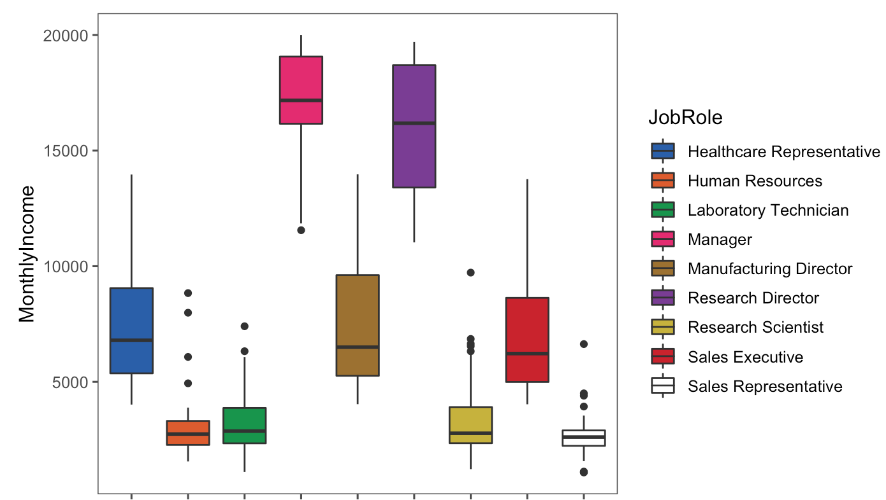
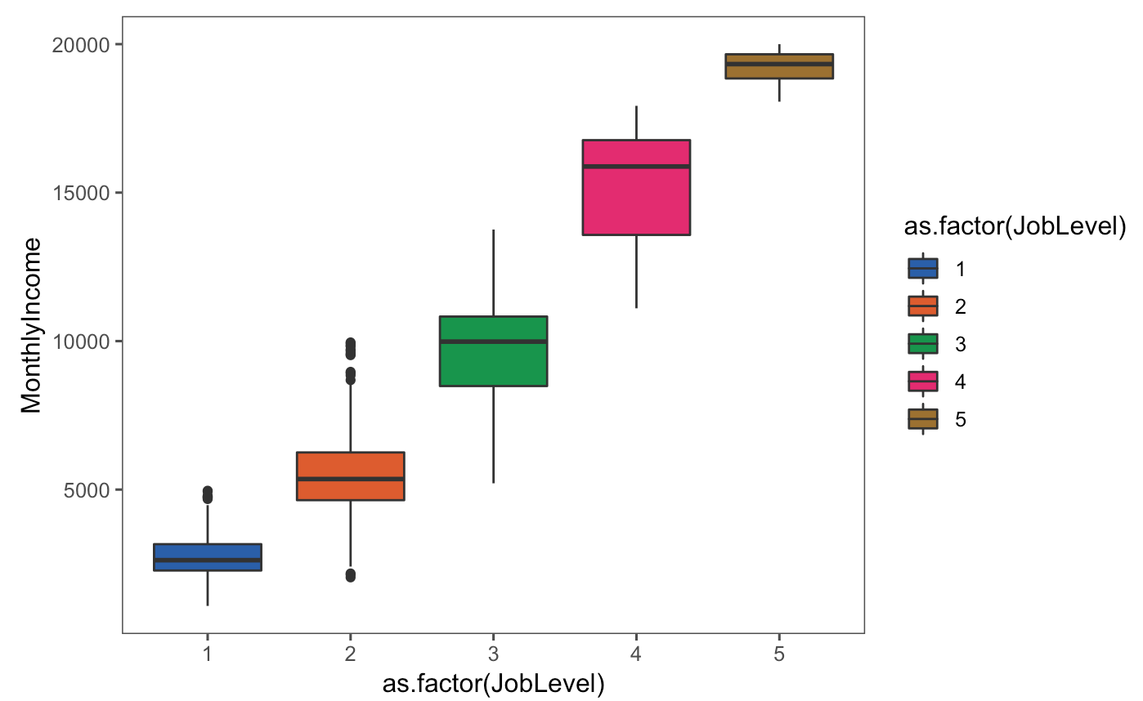
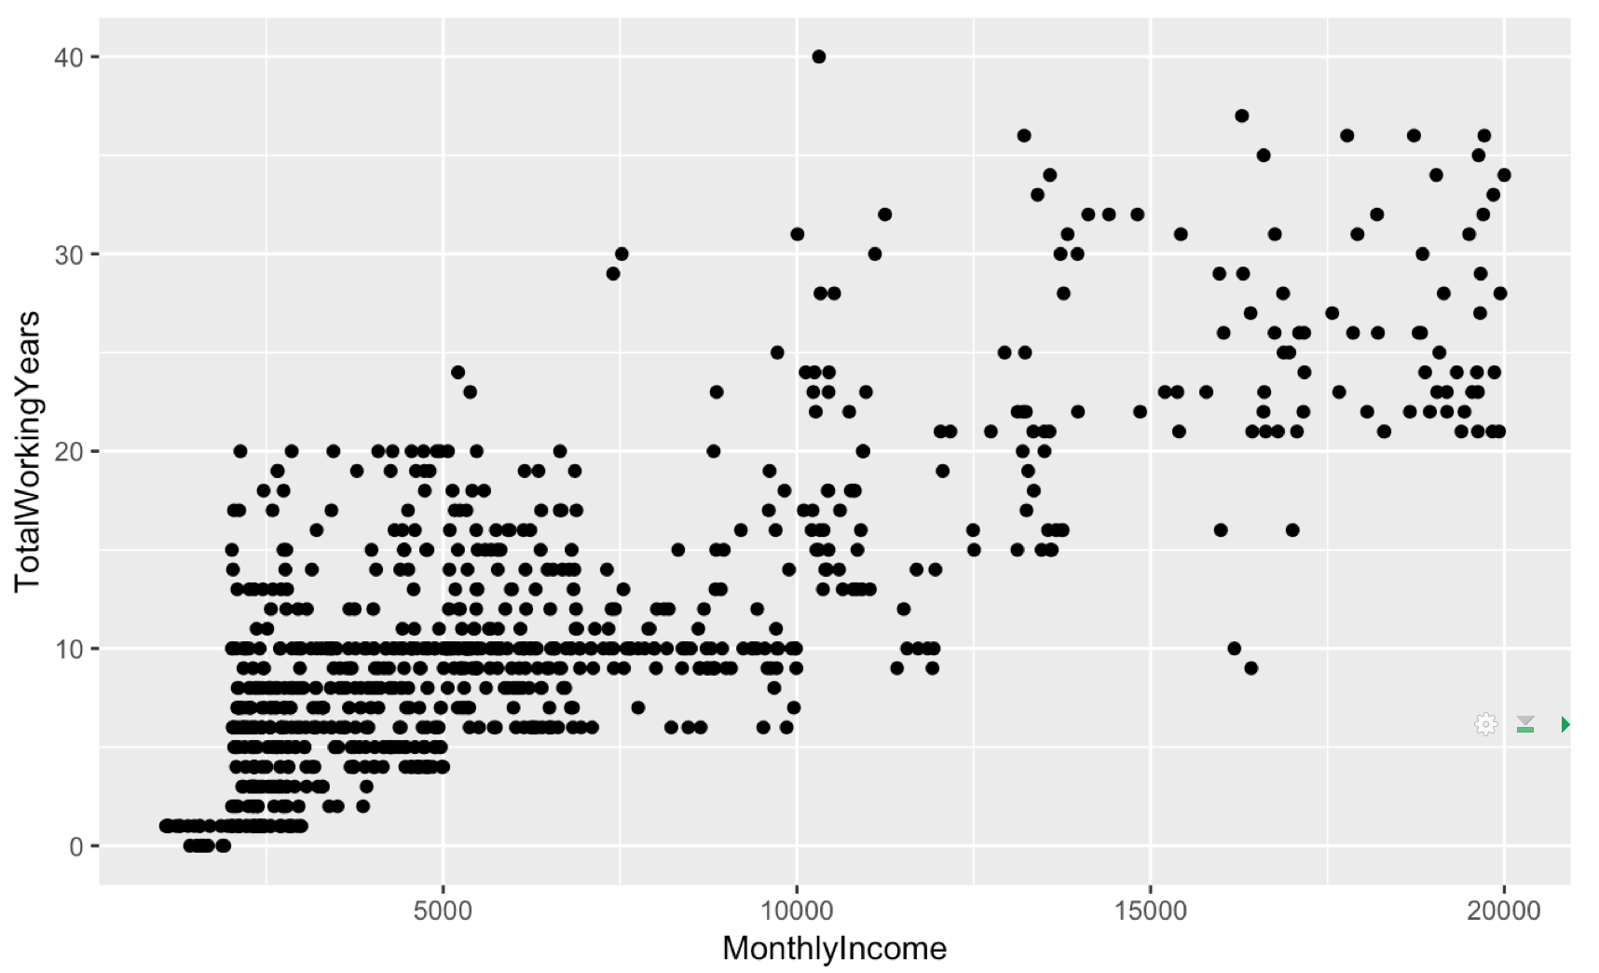
Important Variables for MI

Slide 9
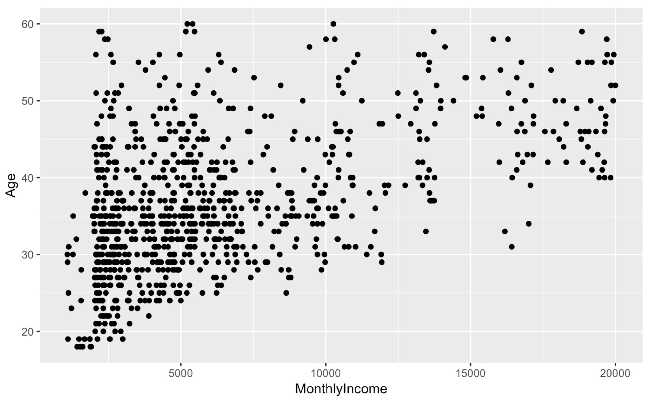
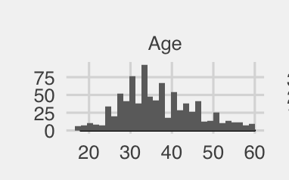
Important Variables for MI

Slide 10
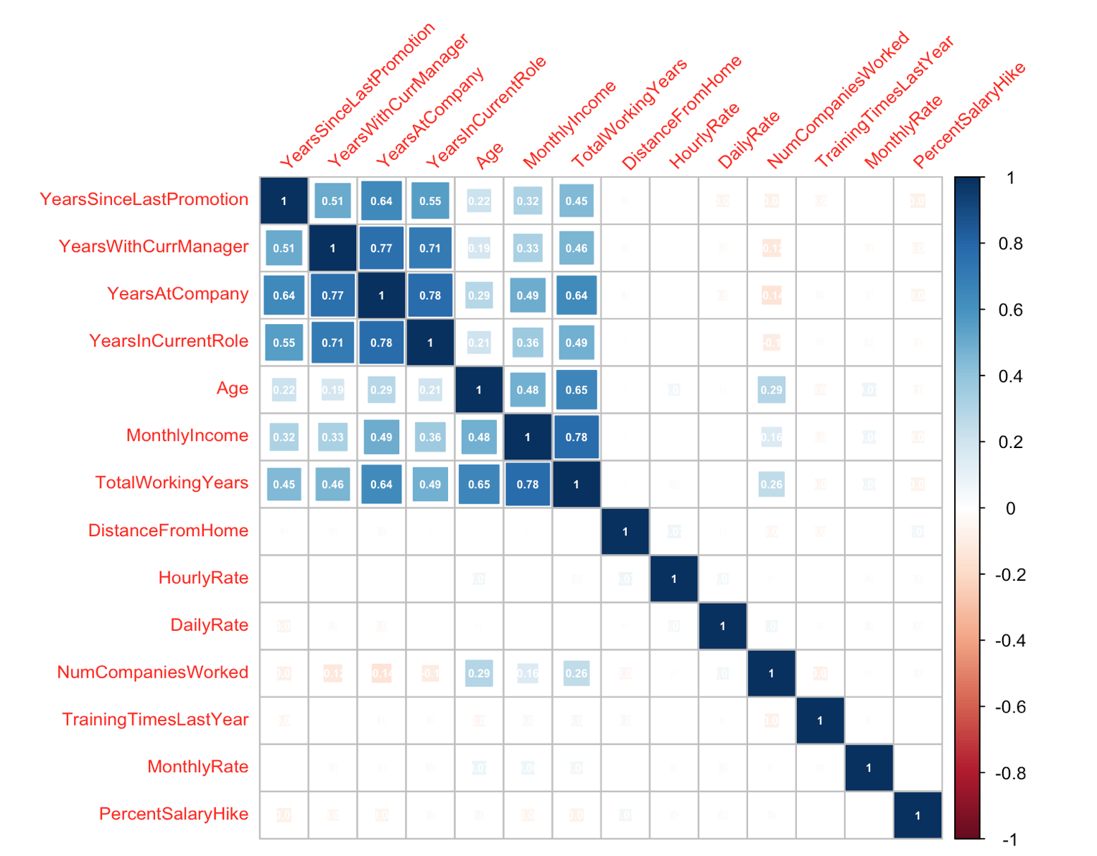
Correlation Between the Variables and MI

Slide 11
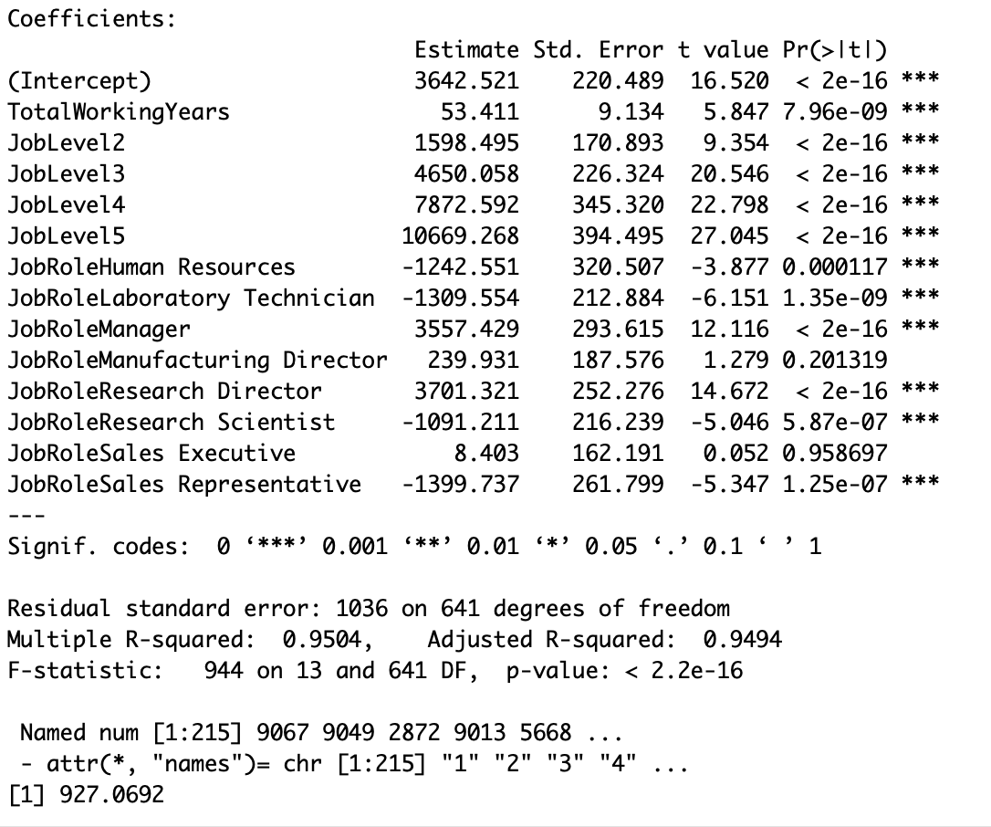
Model for MI = Regression
AIC = 10970.58
BIC = 11037.85
RMSE = 927.0692

Slide 12
Conclusion
Attrition
Monthly Income
Over Time
Stock Option Level
Monthly Income
Job Level
Job Role
Time Working Years

Slide 13
Link to the video
https://youtu.be/SeucGT5a9gI

