Slide 1
Case Study 1 Bitterness & Concentration Across US Breweries SMU - DDS 6306
Fabio Savorgnan
Jeremy Otsap

Slide 2
Overview
Beer Data Set
Name: Name of the beer.
Beer_ID: Unique identifier of the beer.
ABV: Alcohol by volume of the beer.
IBU: International Bitterness Units of the beer.
Brewery_ID: Brewery id associated with the beer.
Style: Style of the beer.
Ounces: Ounces of beer.
Brewery Data Set
Brew_ID: Unique identifier of the brewery.
Name: Name of the brewery.
City: City where the brewery is located.
State: U.S. State where the brewery is located.

Slide 3
Intro:
Given the datasets Beer and Brews, we want to know:
-Where our headquarters should be?
-What style and name of beer would appeal to the widest audience?
-What ABV and IBU should be used for the production of beers?

Slide 4
Combined Data Set
Brewery_id | Beer_Name | Beer_ID | ABV | IBU | Style | Ounces | Brewery_Name | City | State
1 | Get Together | 2692 | 0.045 | 50 | American IPA | 16 | NorthGate Brewing | Minneapolis | MN
1 | Maggie's Leap | 2691 | 0.049 | 26 | Milk / Sweet Stout | 16 | NorthGate Brewing | Minneapolis | MN
1 | Wall's End | 2690 | 0.048 | 19 | English Brown Ale | 16 | NorthGate Brewing | Minneapolis | MN
1 | Pumpion | 2689 | 0.06 | 38 | Pumpkin Ale | 16 | NorthGate Brewing | Minneapolis | MN
1 | Stronghold | 2688 | 0.06 | 25 | American Porter | 16 | NorthGate Brewing | Minneapolis | MN
1 | Parapet ESB | 2687 | 0.056 | 47 | Extra Special / Strong Bitter (ESB) | 16 | NorthGate Brewing | Minneapolis | MN
Brewery_id | Beer_Name | Beer_ID | ABV | IBU | Style | Ounces | Brewery_Name | City | State
556 | Pilsner Ukiah | 98 | 0.055 | NA | German Pilsener | 12 | Ukiah Brewing Company | Ukiah | CA
557 | Heinnieweisse Weissebier | 52 | 0.049 | NA | Hefeweizen | 12 | Butternuts Beer and Ale | Garrattsville | NY
557 | Snapperhead IPA | 51 | 0.068 | NA | American IPA | 12 | Butternuts Beer and Ale | Garrattsville | NY
557 | Moo Thunder Stout | 50 | 0.049 | NA | Milk / Sweet Stout | 12 | Butternuts Beer and Ale | Garrattsville | NY
557 | Porkslap Pale Ale | 49 | 0.043 | NA | American Pale Ale (APA) | 12 | Butternuts Beer and Ale | Garrattsville | NY
558 | Urban Wilderness Pale Ale | 30 | 0.049 | NA | English Pale Ale | 12 | Sleeping Lady Brewing Company | Anchorage | AK

Slide 5
Missing Values In Data Set
Brewery_id | Beer_Name | Beer_ID | ABV | IBU | Style | Ounces | Brewery_Name | City | State
0 | 0 | 0 | 62 | 1005 | 0 | 0 | 0 | 0 | 0
Alcohol by Volume – 62 of 2410 entries were missing. ~2.57%
International Bitterness – 1005 of 2410 entries were missing. ~41.7%
NOTE: Bitterness data not available for South Dakota

Slide 6
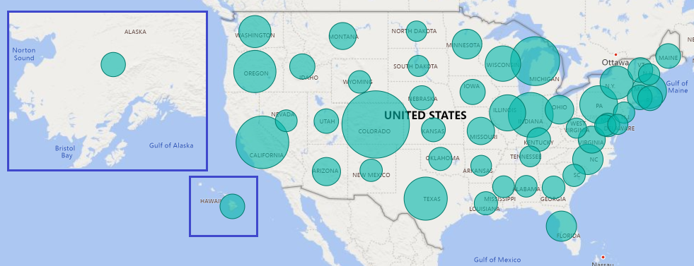
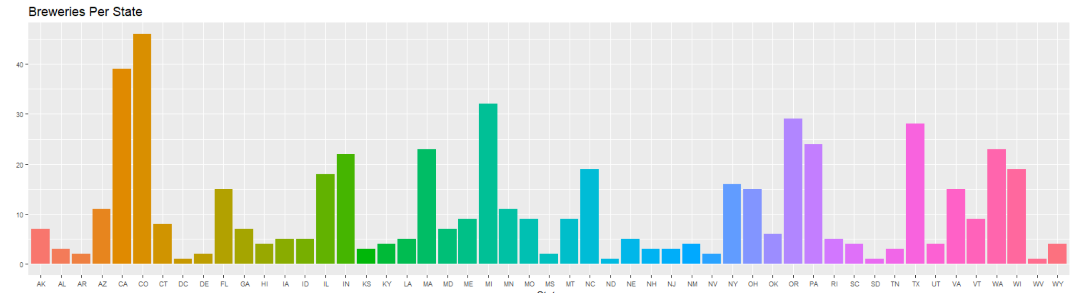
Breweries Per State
Top 5 States
Colorado
California
Michigan
Oregon
Texas
BOTToM 4 States**
DC
South Dakota
North Dakota
West Virginia
**Each of these have only 1 brewery in the entire state

Slide 7
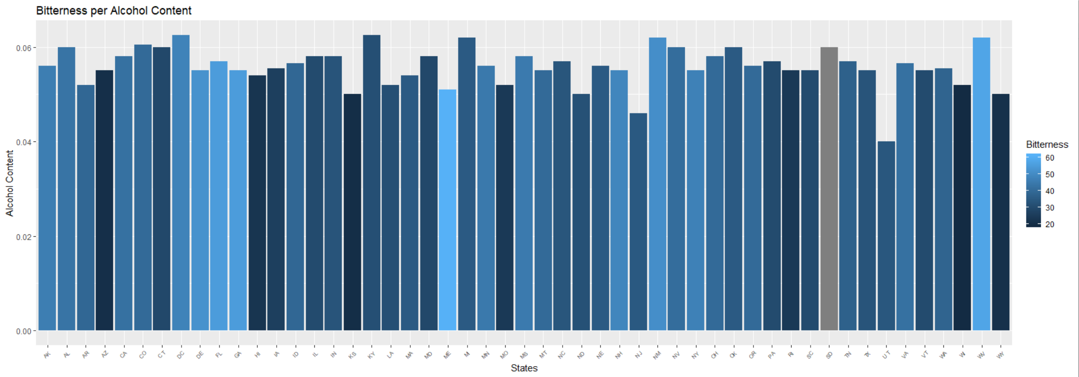
Median Alcohol & Bitterness By State
TOP 5 HIGHEST ALCOHOL
DC 6.25%
Kentucky 6.25%
Michigan 6.2%
New Mexico 6.2%
West Virginia 6.2%
TOP 5 HIGHEST BITTERNESS
Maine 61
West Virginia 57.5
Florida 55
Georgia 55
Delaware 52
BOTTOM 5 LOWEST ALCOHOL
Utah 4%
New Jersey 4.6%
Kansas 5%
North Dakota 5%
Wyoming 5%
BOTTOM 5 LOWEST BITTERNESS
Wisconsin 19
Kansas 20
Arizona 20.5
Wyoming 21
Hawaii 22.5

Slide 8
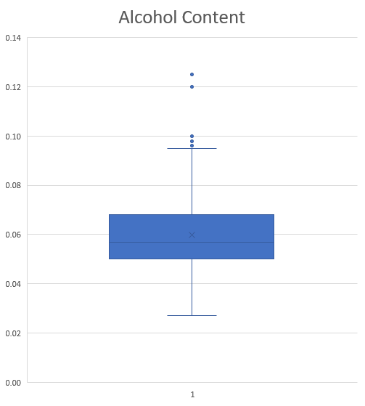
Alcohol Content
Highest Alcohol Beer
Lee Hill Series Vol. 5 - Belgian Style Quadrupel Ale
12.8% ABV
NO IBU SCORE
19.2 Oz Quadrupel
Made by: Upslope Brewing Company
Colorado
Highest Bitterness Beer
Bitter Bitch Imperial IPA
8.2% ABV
IBU of 138
12 Oz American Double / Imperial IPA
Made by: Astoria Brewing Company
Oregon
Max 12.8%
3rd Quart 6.7%
Median 5.6%
1st Quart 5%
Min 1%

Slide 9
Correlation Between Bitterness & Alcohol Content
Correlation: 67.06%
R-squared: 44.97%
This shows a moderate correlation between the bitterness and strength of the alcohol.
About 45% of the bitterness of a particular beer is accounted for by its alcohol content

Slide 10
Additional Analysis
Examining correlation between state population and number of breweries
There appears to be a moderate correlation of 62.1%
The R-squared value is 38.57% which means that almost 39% of the brewery density can be explained by the respective state’s total population
2018 Census Data on https://www.census.gov

Slide 11
Additional Analysis
Examining correlation between number of breweries and median alcohol content
2018 Census Data on https://www.census.gov

Slide 12
Additional Analysis
Examining correlation between population and median alcohol content
2018 Census Data on https://www.census.gov

Slide 13
Most popular beer style and name in the US
Most popular beer style in the US: American IPA.
Most popular beer name in the US: Nonstop Hef Hop

Slide 14
Conclusion:
-We will recommend to have the headquarter in a state with the lowest amount of breweries which is Mississippi
-The style of beer that we would recommend will be American IPA. We found American IPA to be the most
popular style
-The name of the beer that will recommend will be Nonstop Hef Hop. We found Nonstop Hef Hop to be
the most popular beer name
-According to our sadistic summary from ABV and IBU , for an average ABV beer at 0.06 the recommended
IBU is roughly 40.
-We will recommend to target the states with less breweries regardless of the population, because we did not find
any strong correlation between the population and the amount of breweries

