Slide 1
JavaScript
Soreangsey KIV
kivsoreangsey@gmail.com
2012-2013

Slide 2
Outline
Introduction to JavaScript
Data type and Syntax
Operation and Control structure
Object and Array
Functions
DOM (Document Object Model)
Events
Conclusion

Slide 3
JavaScript?
A scripting language is a lightweight programming language.
JavaScript is a piece of programming code which can be inserted directly into HTML pages or imported from the external files.
JavaScript embedded in HTML pages can be performed by all modern browsers.
JavaScript is easy to learn.
One of the tools to develop the "dynamic web" (client side DHTML or interactive HTML)
First scripting language for the web and created by Netscape
JS was developed by Netscape in 1995 (original name was LiveScript)

Slide 4
Main features
_
_
JS is an interpreted programming language , weak typing.
The basic data type are simples (number, string and boolean)
Functions and variables can be declared any where.
It is an object based but not object oriented programming language.
Object is simple, it has its own properties(attributes) and functions.
It has a system garbage collector which is automatically triggered.
.......
_
Interpreted language?
Compiling language

Slide 5
JavaScript Avantages
JavaScript code is embedded directly into the HTML document (or in another file. 'Js')
Is quick to load and simple enough to understand
Make your web pages comes to live, more attractive and interactive
Manipulate information quickly at the client side before submitting to server (check data types: integer, string, date, ...)
Is reusable (functions, ...)

Slide 6
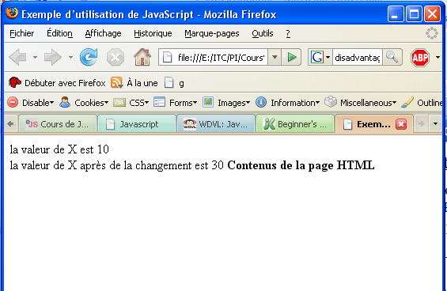
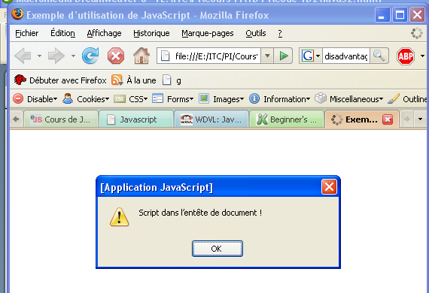
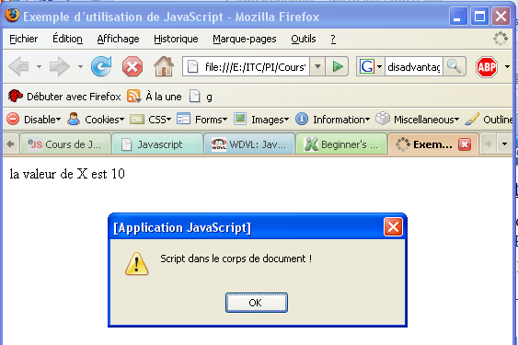
Where we can put JS code?
You can add JavaScript code in the HTML document using the container tag <script> ...... </ script>. The container <script> ... </ script> can be put any where, in the header or in the body of the HTML document.
<html>
<head>
<title> Exemple d’utilisation de JavaScript</title>
<script language="JavaScript">
var x=10; //déclaration de variable x
alert ("Script dans l’entete de document ! ");
document.write ("la valeur de X est "+x); //écrire une chaîne dans le document HTML
x = 30;
</script>
</head>
<body>
<!-- corps du document HTML -->
<script language ="JavaScript">
document.write ("<Br>la valeur de X devient "+x);
</script>
<b>Contenus de la page HTML</b>
</body>
</html>

Slide 7
Où peut-on mettre les codes?
We can import the JavaScript code in a separated files from the HTML document.
Nom du fichier : Page.html
<html>
<head>
<title> Exemple d'utilisation de JavaScript</title> <script language="javascript" src="fichier.js" >
</script>
</head>
<body> <!-- corps du document HTML -->
<script language="JavaScript">
alert ("Script dans le corps de document ! "); document.write ("<br> Valeur de X devient: "+x+"<br>"); </script>
<b>Contenus de la page HTML</b>
</body>
</html>
Nom du fichier : fichier.js
var x=15; //déclaration de variable x
alert ("Script at the header of the document!");
document.write("the value of X is"+ x);x=30;

Slide 8
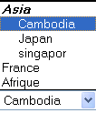
Où peut-on mettre les codes?
We can also initial the value of some HTML tag attributes to manage events by using JavaScript.
<html>
<head>
<title> Exemple d’utilisation de JavaScript</title>
</head>
<body>
<img src="planet2.jpg" alt="cliquez ici pour quitter" onClick="alert('test');">
<form name="f1" action="#" method="get">
<input type="text" name="nom" onFocus="document.f1.nom.value='red';" onBlur="alert(document.f1.nom.value);">
<select name="pays" onChange="alert('ce pays est '+document.f1.pays.value);">
<optgroup label="Asia" >
<option value="cam">Cambodia
<option value="jap">Japan
<option value="sin">singapor
</optgroup>
<option value="France"> France
<option value="Afrique"> Afrique
</select>
</form>
</body>
</html>

Slide 9
Masquage d’un script
Some older version of browsers can not recognize <script> tag
Browsers will ignore tags <Script> and they will display JavaScript codes on your beautiful web page. We can avoid this by putting JavaScript code between <!-- And //-->
<noscript>
textes affichés quand
le navigateur web ne sait
pas interpréter de codes
du script
</noscript>
<head>
<title> Exemple d’utilisation de JavaScript</title>
<script language ="JavaScript">
<!-- masquer les codes de l’ancien navigateur web
var x=10; //déclaration de variable x
alert ("Script dans l’entete de document ! ");
document.write ("la valeur de X est "+x); /*écrire une chaîne dans le document HTML*/
x = 30;
//-->
</script>
<noscript>Ce navigateur ne supporte pas de script</noscript>
</head>

Slide 10
Sommaire
Introduction to JavaScript
Data type and Syntax
Operation and Control structure
Object and Array
Functions
DOM (Document Object Model)
Events
Conclusion

Slide 11
Types primitives de données
JavaScript has three primitives data type:
number, string and boolean
Number (integer and real)
Nb hexadecimal started with 0x or 0X
Ex: 0x456
Number octal started 0
Ex: 067
Number of decimal is written directly without prefix
Ex: 982

Slide 12
Types primitives de données
String
A string is enclosed by two single quotes'' or double quotes ""
You can also use ' or "" in the string. To the do that you need to make sure that the outside and inside quote do not match each other:
"Qu'y a-t'il dans c:\windows"
You can add special characters in the string by adding "\" in front them.
Ex: : 'Qu\'y a-t\'il dans c:\\windows\n"
The characters in red are the special characters

Slide 13
Types primitives de données
The special characters are:
\' single quote
\" double quote
\\ backslash
\n new line
\r carriage return
\t tab
\b backspace
Boolean (True, False)
0, "0", "" (empty string), undefined, null and NaN (Non a Number) equal to the value False
Beside that equal to the value true.

Slide 14
Types composées de données
Object
An object is a particular type of data, having its own properties and methods(functions).
All data types in JavaScript are the objects, a string, a number, a string, an array ....
Ex: the string type has its own properties length and functions substring().
JavaScript allows you to create your own objects as well.

Slide 15
Types composées de données
Array
Array is used to store multiple values ​​in a single variable.
Array can contain multiple value of multiple types at once.
It is also an object which has its own properties and function.
There are different ways to create and initialize the value in an array.
There are still composed data types such as Date, Math, RegExp (Regular Expression) ..

Slide 16
Type spéciaux de données
There is some special data type in JavaScript
Undefined: the variable that was created without initializing.
Ex: var titi;
Null: the variable that is defined with the value “null”
Ex: var titi = null;
NaN (Not a Number): If the variable value can not be forced to number type, this is the NaN type.

Slide 17
Déclaration des variables
The declaration of a variable is started with a keyword 'var'
Variable name is sensitive case
Although the word 'var' is optional but it is recommended to put (if it is right to put)
Variable declared in a function is local to that function
The variable is visible only in the current function.
You must use the keyword 'var' to differentiate with the global variable
Variable declared outside the function is global (the variable is visible from anywhere)

Slide 18
Déclaration des variables
Simple declaration
Ex: var count;
Group declaration
Ex: var count, amount, level;
Variable declaration and initialization within one statement.
Ex: var count = 0, amount = 100;
The variable JavaScript is weakly typed. It means that a variable can hold data of any type. The type of a variable changes along the value of variables that it stores.

Slide 19
Déclaration des variables
Exemples:
var iToto; // iToto is undefined
var iToto=10; //iToto is number
var bVraiFaux = true; // bVraiFaux is boolean
bVraiFaux = "iToto"; // bVraiFaux is string
bVraiFaux = iToto; //its value = the value of iToto which is the number 10.
phrase= 2; //phrase is number
phrase = phrase + " version" + true; /the variable « phrase» is in the type string, having the value « 2versiontrue ».

Slide 20
Nomination des variables
JavaScript variable name is a Sensitive-case. This means that the variable named as myCounter is different from the name MyCounter.
Variable names can be in any length.
The rules for creating a variable names are:
The first character must be a letter (uppercase or lowercase) or an underscore (_) character. Note that a number can not be used as the first character.
The following characters must be letters, digits or underscores (_).
The name of the variable must not be a reserved keyword.

Slide 21
Nomination des variables
The reserved keywords are:
Break delete if this while case do in throw with catch else instanceof try continue finally new typeof debugger for return var default function switch void....

Slide 22
Sommaire
Introduction to JavaScript
Data type and Syntax
Operation and Control structure
Object and Array
Functions
DOM (Document Object Model)
Events
Conclusion

Slide 23
Opérateurs
Arithmetic operator
+ - * / % ++ --
Relational operator(the result is boolean)
== != < <= > >= === ==!
Logic operator
&& (and), || (or), ! (not)
Bitwise operation
& | ^ ~ <<(décalage à gauche) >>(décalage à droite)
Assignment operator
= += -= *= /= %= <<= >>= &= |=

Slide 24
Opérateurs
Exemple:
A=10 B=5
A= B+ 1
B++
A==B
A>=B
B+=A
A*=B
A=B++
A=++B

Slide 25
Opérateurs
Conditional operator
Condition ? Valeur1_cas_vrai : Valeur2_cas_faux ;
Exemple: text= (a==10)?"a is 10":"a is not 10"; document.write(text);

Slide 26
Opérateurs
Notes!
== And != It return true if the value of operands are equal even if they have different data types.
=== And ==! It return true only if both value and type are equal.
You can use the '+' operator to concatenate variable value and the result is in the type of strings.

Slide 27
Commentaires
To post comments, JavaScript uses the conventions used in C / C + +
To comment out a line , we use double slash
Ex: // All characters behind // is ignored
To comment part of the text (multiline), we use /* and */
EX: /* All lines between these markers are ignored by the interpreter code */
The nested comments can easily lead to the fault.
Ex: /* Comment is /* wrong */ in this case */

Slide 28
Structures de contrôle If{…}, elseif{…}, else{…}
if (condition){
instruction1;
instruction2;
…..
instructionN;
} [else if (condition) {
instructions;}]
[else {
instructions;}]
if (a>0){
document. write("a >0 !<br>");
alert("a>0!<br>");
a++;
}else if (a<0) {
document.write("a>0! <br>");
}else
document. write("a=0!<br/>");

Slide 29
Structures de contrôle Switch { case …}
a=2a=2a=2
switch (expression) {
case expression :
instruction;
break;
[case expression :
instruction;
break;
...
default :
instructions;]
}
a=2;
switch (a) {
case 1: document.write("a="+a);
case 2: document.write("a="+a);
case 3: document.write("a="+a);
default : document.write("a="+a);
}
a=2
a=2;
switch (a) {
case 1: document.write("a="+a); break;
case 2: document.write("a="+a); break;
case 3: document.write("a="+a); break;
default : document.write("a="+a); break;
}

Slide 30
Boucle (Loop)
for(initialisation; condition; incrémentation){
instructions;
instructions;
instructions;
}
i=0;
for(; i<4; i++)
alert("test i ="+i+"<br>");
for(i=0; i<4; i++){
alert("test i ="+i+"<br>");
}
while(conditions){
instructions;
instructions;
instructions;
}
do{
instructions;
instructions;
} while(conditions);

Slide 31
Mots-clés "break" et "continue"
The instruction 'break' is used to jump out of the loop or switch current instruction block to the statement immediately following the loop or block.
The statement 'continue' to start over the loop or statement block by transferring control to the first instruction of the loop or block.
for(i=0; i<6; i++){
document.write("i ="+i+"<br>");
if (i>3) break;
alert("i="+i);
}
for(i=0; i<6; i++){
document.write("i ="+i+"<br>");
if (i>3) continue;
alert("i="+i);
}

Slide 32
Sommaire
Introduction to JavaScript
Data type and Syntax
Operation and Control structure
Object and Array
Functions
DOM (Document Object Model)
Events
Conclusion

Slide 33
Objet
Object is an instance of a class. An object is defined by:
Properties
Functions or procedures
Class is a object model. It group all the objects which have the same characteristic.
Objet
-
-
-
-
-
-
-
Properties
Liste of properties
Object
Functions or procedures
Liste des function

Slide 34
Exemple
Attributs
Méthodes
-
-
-Nom : string
-Prénom : string
-Age : integer
-Sexe : character
-Adr : string
-Tél : string
- …etc.
-Afficher() : void
-changer_Adr(chaîne) : void
-Incrément_Age(entier) : entier
-
- …….etc.
Personne class
In the execution
Attributs
Méthodes
-
-
-Nom : "Titi"
-Prénom : "Toto"
-Age : 25
-Sexe : M
-Adr : France
-Tél : +331111211
- …etc.
-Afficher() : void
-changer_Adr(chaîne) : void
-Incrément_Age(entier) : entier
-
-……etc.
Personne object

Slide 35
3 façons pour créer un objet
By using object literal.
Ex: var un_etudiant= {id: "e2005i05", nom: "Tito", sexe: 'M', ecole: "itc"}
By using the keyword new Object() to create a null object and then we insert the value of each property.
var un_etudiant = new Object();
un_etudiant.id = "e2005i05"; un_etudiant["nom"]= "Tito";
un_etudiant.sexe='M'; un_etudiant["ecole"] = "itc";
We can create and use the constructor.
function Etudiant(_id, _nom, _sexe, _ecole){
this.id = _id; this.nom = _nom; //Mot-clé "this" est nécessaire
this.sexe = _sexe; this.ecole = _ecol;
}
var un_etudiant = new Etudiant("e2005i05", "Tito", "M", "itc");

Slide 36
Itérations particulières
We can access to the object property by:
Syntax: objecName.propertyName or
objectName["propertyName "]
var tab= {1: "2005i05", a:"Tito", 7 : 8 , ecole: "itc"}
tab["1"] , tab.1 have the same meaning, return the value 2005i05
We can even access to the object property by writing as below:
tab["ec"+"ole"] return "itc"

Slide 37
Itérations particulières
We can execute the instruction for every object property :
Syntax : for (variable in Object) { instructions; }Example: for (var ele in un_etudiant){
document.write("prop :" + un_etudiant[ele]);
}
with: keyword to access object properties without repeated call of object.
Syntax : with(Objet){ instructions; }
Example: with (un_etudiant) { id = "e2006i23"; }
with (document.form1) {
nom = nom + prenom; sexe = 'M';
}

Slide 38
Tableau (Array)
"Array" is an structure data type which allows to stores multiple value at the same time.
In JavaScript we have literal array
Array Couleur : var Couleur = ["rouge", "jaune", "vert", "bleu"];
Access to array element : Couleur[0] ➔ "rouge"
In array, there can also be empty element
Ex: Couleur = ["rouge", , , , "vert", "bleu"];
Access to array element : Couleur[4] ➔ ”vert"
Couleur[1] ➔ undefined
If the comma “,” is put at the last, it will be ignored
Ex: Couleur = ["rouge", , , , "vert", "bleu", ];

Slide 39
4 façons pour créer un tableau (Array)
Array is also an object in JavaScript. We can use keyword "new Array()" to create an empty array and we can assign the value later.
var couleur = new Array();
couleur[0]="red"; couleur[4]="yellow"; couleur[2]="black";
We can use "new Array(élément1, élement2, …, élémentN)" to create an array of N element and define the value directly
var couleur = new Array(4, "test", 46, true, 2);
We use "new Array(N)" to create an empty array, having N element
var couleur = new Array(5);

Slide 40
Taille d'un tableau (Array)
Array is an objet that we can know about its size by accessing to the property length.
Array size is changed when we add the new element into it. Example:
var tab = new Array(5); // tab.length return the value 5
tab[17] = "bonjour"; //tab.length return the value 18
The maximum size of array is 2³² -1
There is no two dimension array in javaScript, but we can represent in the form of “Array of Array”
Exemple : var tab= new Array(2);
tab[0]=2;
tab[1]= new Array(6); tab[1][5]="Hello";

Slide 41
Sommaire
Introduction to JavaScript
Data type and Syntax
Operation and Control structure
Object and Array
Functions
DOM (Document Object Model)
Events
Conclusion

Slide 42
Fonctions
Objective
A set of instructions grouped in a code block, performing an operation "complex”
Each block is identified by a name
It can be invoked (executed) as many times as needs within JavaScript tag
It helps to avoids rewriting same code several times in a program
function nom_fonction(parametre1, param2, …) {
Instructions;
[return variable;]
}

Slide 43
Exemple d'une fonction
Create an constructor of an object:
function Point(_x, _y){
this.x = _x;
this.y = _y;
}
monPoint = new Point(4, 56);
Create function in another function:
function distance(x1,y1){
function sqr(x) {return x*x;} //local
return Math.sqrt(sqr(this.x-x1) + sqr(this.y-y1));
}

Slide 44
Portées des variables
The variable 'v' in this case is a local variable. If you reference elsewhere in the script outside this function, this variable will be unknown to the JavaScript interpreter.
function cube(nb){
var v = nb*nb*nb;
}
function cube(nb){
v = nb*nb*nb;
}
<script language="javascript">
var v = 1;
function cube(nb){
var v = nb*nb*nb;
}
</script>
If the variable is declared contextually (without using the keyword 'var'), its scope will be global. It can be used both inside and outside the function.
Variables declared at the beginning of the script, outside functions are always global, whether declared with 'var' or contextually.

Slide 45
Fonctions pour l'objet "Array"
Méthode | Description
sort() | Trier alphabétiquement des éléments du tableau
reverse() | Inverser les éléments du tableau
push(…) | Insérer quelques nouveaux éléments dans le tableau
pop() | Supprimer et retourner le dernier élément du tableau
toString() | Retourner une chaîne de caractères contenant les valeurs de tous les éléments du tableau, séparées par le virgule
…Etc.

Slide 46
Fonctions pour l'objet "Math"
Méthode | Description
abs(val) | Retourne la valeur absolue d'une valeur
ceil(val) | ceil(5.14)= 6; ceil(5.5)= 6; ceil(5.74)= 6;
exp(val) | Retourne la valeur exponentielle d'une valeur donnée
floor(val) | floor(5.14)= 5; floor(5.5)= 5; floor(5.74)= 5;
round(val) | round(5.14)= 5; round(5.5)= 6; round(5.74)= 6;
cos(val), sin(val), acos(val), asin(val), tan(val)
log(val) | Logarithme de base e d'une valeur entrée
sqrt(val) | Racine carrée d'une valeur
random() | Retourne une valeur aléatoire entre 0 et 1
max(val1, val2) | Trouver la valeur max entre 2 valeurs données
min(val1, val2) | Trouver la valeur min entre 2 valeurs données
pow(val1, val2) | Retourne une valeur (val1^{val2})

Slide 47
Fonctions pour l'objet "String"
Méthode (valeur) | Méthode (caractéristique d'affichage)
charAt(position) | anchor(nom_a_donner)
indexOf(sous-chaîne, start_position) | big(), bold()
lastIndexOf(sous-chaîne,start_position) | blink()
substring(position1, position2) | fixed()
toLowerCase() | italics()
toUpperCase() | link(URL)
toUpperCase() | small()
 | strike()
 | sub()
 | sup()
 | fontsize(Size)

Slide 48
Fonctions pour l'objet "Date"
Méthode | Description
getDay() | Retourner un nombre entier représentant le jour de la semaine. 0: Dimanche, 1: Lundi, 2: Mardi, 3: Mercredi, ……, 6: Samedi
getHours() | Retourner l'heure d'un objet "Date"
getMinutes() | Retourner les minutes d'un objet "Date"
getSeconds() | Retourner les secondes d'un objet "Date"
getTime() | Retourner un nombre d'entier en millisecondes
getMonth() | Retourner le mois d'un objet "Date"
getYear() | Retourner l'année d'un objet "Date"
setDate(Day) | Initialiser le jour à un objet "Date"
setMonth(Month) | Initialiser le mois à un objet "Date"
setYear(Year) | Initialiser l'année à un objet "Date"
setTime(ms) | Initialiser le temps (milliseconde) à un objet.

Slide 49
Sommaire
Introduction to JavaScript
Data type and Syntax
Operation and Control structure
Object and Array
Functions
DOM (Document Object Model)
Events
Conclusion

Slide 50
DOM (Document Object Model)
The Document Object Model (DOM) is an application programming interface (API) for valid HTML and well-formed XML documents. It defines the logical structure of documents and the way a document is accessed and manipulated.
With the DOM, programmers can build documents, navigate their structure, and add, modify, or delete elements, content, anything found in an HTML or XML document can be accessed.
DOM provides a standard programming interface that can be used in a wide variety of environments and applications. It is designed to be used with any programming languages.

Slide 51
DOM (Document Object Model)
Core DOM
Defines the core feature that can access to both XML and HTML doc.
XML DOM
HTML DOM
Core feature + XML feature that can access to only XML doc
Core feature + HTML feature that can access to only HTML doc

Slide 52
HTML DOM TREE
For DOM, every element that appear in the browser are treated as object and When a web page is loaded, the browser creates a Document Object Model of the page and constructed as a tree of Objects:
The most common type of nodes in HTML documents are:
Document node: Represents the entire document (the root-node of the DOM tree, “window.document”)
Element node: Represents an element in the document (e.g. <body>, <a>, <h1> etc...)
Attribute node: Represents an attribute (e.g. class="funEdges")
Text node : represent text characters between tag in an html document including carriage returns and white space

Slide 53
Accès à un élément
We access to an element by giving the full path of the object from the outermost containing the referenced object.
Example: to reach the element checkbox, inside a form, we must access by the hierarchy as below:
window
document
forms
checkbox

Slide 54
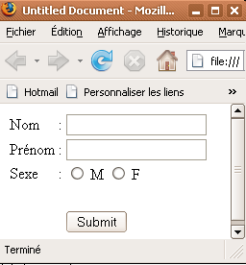
Accès à un élément
Objet fenêtre
'window'
Objet 'document'
Objet textbox
Objet formulaire
'forms'
Objet radiobox
Objet bouton

Slide 55
DOM
button
Window
checkbox
self,window, parent, top
fileupload
images
hidden
navigator
layers
password
frames
anchors
radio
location
applets
reset
history
links
select
options
document
forms
submit
status
text
textarea

Slide 56
Eléments d'objet "window"
Window : represents an open window in a browser.
self : return the current window
parent : return the parent window of the current window
top : return the topmost browser window
frames[ ] : return an array of all the frames in the current window

Slide 57
Eléments d'objet "window"
length : returns the number of frames in a window
document: returns the Document object for the window
navigator : returns the Navigator object for the window
appName : navigator name
platform : which platform the browser is compiled.
status : return the text in the status bar of a window
location : returns the Location object contains information about the current URL.
window.location.reload() : Reloads the current document

Slide 58
Méthodes d'objet "window"
window.open(URL,name,specs,replace): open a new browser window
URL: Specifies the URL of the page to open. If no URL is specified, a new window with about:blank is opened
name: Specifies the target attribute(_blank,_parent,_self, _top) or the name of the window.
specs: Specifies the characteristic of the new window
Status, toolbar, menubar, resizable, scrollbars, height, width, left, top, titlebar, fullscreen...etc
replace : optional, Optional.Specifies whether the URL creates a new entry or replaces the current entry in the history list
close () : close the current window

Slide 59
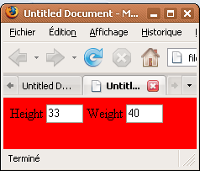
Méthodes d'objet "document"
anchors[], images[], links[], forms[],body, bgColor, title, URL...
length : count the number of elements in the previous array : anchors[], images[], links[], form[]...
elements[ ] : return array of elements in the form
Index starts from 0, 1, 2….
Exemple:
<form name="fr1" action="" method="post">
Height <input type="text" name="height" size="3" />
Weight <input type="text" name="weight" size="3" />
</form>
<script language="JavaScirpt" type="text/javaScript">
document.bgColor="red";
alert (document.bgColor);
document.fr1.height.value = 33;
document.fr1.elements[1].value = 40
</script>

Slide 60
Accessing to elements
The most commonly way to find and access to the elements in HTML document are:
document.getElementById( "id") : return an element that have the id = "id".
document.getElementsByName("name"): return array of elements that have the name = "name“
document.getElementsByTagName("tag") : return array of elements that the tag = "tag“

Slide 61
Creating, adding and deleting elements
To create a new element in HTML we use the methods :
document.createTextNode(”The new text node”)
document. createElement(“tag”)
tagName.setAttribute(“attributeName”, “attributeValue”)
After we create the new element/node, we can insert into HTML by:
parentNode.appendChild(childNode)
parentNode.insertBefore(newNode, oldNode)
We can also remove or replace elements in the HTML by:
parentNode.removeChild(childeNode)
parentNode.replaceChild(newNode, oldNode)

Slide 62
Changing HTML content
We can create a dynamic HTML contents and attributes value as following:
document.write(“text to display on the document”)
element.innerHTML = “new content” : modify the content between an HTML container tag by the “new content”.
element.textContent = “new content” : modify the text contained in an HTML container tag by the “new content”
element. attributeName = “attribute value” : set or change the attribute of the element with the attribute value
Style is also one of the attribute in HTML, thus we can also change the style by this way.
element.style.attributeStyle = “style value”

Slide 63
Getting HTML content
In the same way that we use to change contents and property, we can also get the value of contents and property.
valueA = elementA.innerHTML : to set the valueA equal to the content between the element
attributeA = elementA.attributeNameA.value : to set the value of attributeA equal to the value attributeNameA of the elementA.

Slide 64
Exemples DOM
window.open();
window.open("http://www.javascript-coder.com", "mywin", "location=1, status=1, scrollbars=1, width=100, height=100 ")
window.close();
window.location.reload();
window.location ="http://www.google.com";
alert (""+window.document.forms[0].sexe.value);
document.images["img_name"].src="image path";
document.forms[0].nom.value = "Mary";
document.fr1.nom.value = ''Jean";
document.write("valeur = "+document.fr1.nom.value);

Slide 65
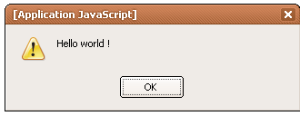
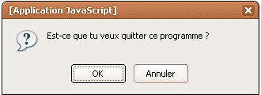
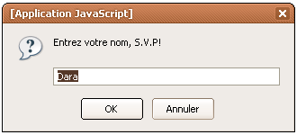
Pop up message
The 'alert' is used to display an information.
alert("Hello world !");
The 'confirm' is used to display text to confirm the visitor. It returns a Boolean value.
var flag = confirm("Est-ce que tu veux quitter ce programme ?");
if (flag) document.write("quitter!");
else document.write("continuer!");
The 'prompt' is used to request the user to enter a text. After clicking OK, it returns a value entered.
var x = prompt("Entrez votre nom, S.V.P!", "Dara");

Slide 66
Sommaire
Introduction to JavaScript
Data type and Syntax
Operation and Control structure
Object and Array
Functions
DOM (Document Object Model)
Events
Conclusion

Slide 67
Evènements (1/3)
onabort - The event occurs when loading an image is aborted
onblur - The event occurs when a form element loses focus
onchange - The event occurs when the content of a form element, the selection, or the checked state have changed
onclick - The event occurs when the user clicks on an element
ondblclick - The event occurs when the user double-clicks on an element
onerror - The event occurs when an image does not load properly
onfocus - The event occurs when an element gets focus (or becomes active)
onkeydown - when you press a key
onkeypress - when a button is pressed

Slide 68
Evènements (2/3)
onkeyup - when a key is released
onload - after loading the page
onunload - when leaving the current page
onsubmit - when you click on a "submit" button on a form
onmousedown - that when you click
onmousemove - when you move the mouse
onmouseout - when the mouse leaves the element
onmouseover - when the mouse is over the element
onmouseup - when you release the mouse button
onreset - when you click on a "reset" button on a form
onresize - when the window is resized
onselect - when you select text

Slide 69
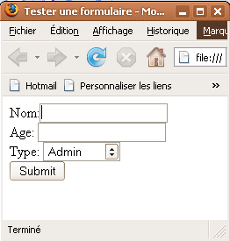
Evènements (3/3)
<html>
<head>
<title>Tester une formulaire</title>
<script language="javascript" type="text/javascript">
function test_formulaire(){
if((document.fr1.nom.value).length==0){
document.fr1.nom.focus();
return false;
}else if(((document.fr1.age.value).length==0)||(isNaN(document.fr1.age.value)==true)){
alert ("Entrez votre age ! ");
document.fr1.age.value="";
document.fr1.age.focus();
return false;
}
return true;
}
</script>
</head>
<body>
<form name="fr1" method="post" action="" onsubmit="return test_formulaire();">
Nom:<input type="text" name="nom" /><br />
Age:&nbsp;<input type="text" name="age" /><br />
Type: <select name="type">
<option value="A">Admin</option>
<option value="U">Utilisateur</option>
</select>
<br />
<input type="submit" name="Submit" value="Submit" />
</form>
</body>

Slide 70
Sommaire
Introduction to JavaScript
Data type and Syntax
Operation and Control structure
Object and Array
Functions
DOM (Document Object Model)
Events
Conclusion

Slide 71
JavaScript sait faire (1/3)
Control the content and appearance of Web page
write () ... to show additional text dynamically
dynamically build a page
Control features of Web Browser
Display message or dialog box in the status bar
Entering data
Opening and managing displays a URL in the browser window

Slide 72
JavaScript sait faire (2/3)
Content Management web page
Access to the list of hyperlinks, images, Java applets, ..., a page
Access to all controls buttons, input box, ... a page
Management of user interactions
Managements of actions related to user events: moving the mouse over a control, validation of a seizure, a submission on a form ...
Handling and image management
Possibility of achieving effects images: mouseover on an image or at a clicked image ...

Slide 73
JavaScript sait faire (3/3)
Reading and Writing Cookies
Cookies: originally scheduled by CGI scripts, code written and read by the CGI server and stored on the client to generate pages based on client context.
JS can read and write Cookies and sometimes replace the use of CGI
etc. ..
Using time window.setTimeout ()
Using sophisticated functions Management Date and Time

Slide 74
Références
Cours JavaScript sur : http://www.w3schools.com
http://www.editeurjavascript.com/cours/cours_01.php
http://www.tizag.com/
Framework: http://prototypejs.org/
Questions?

