Slide 1
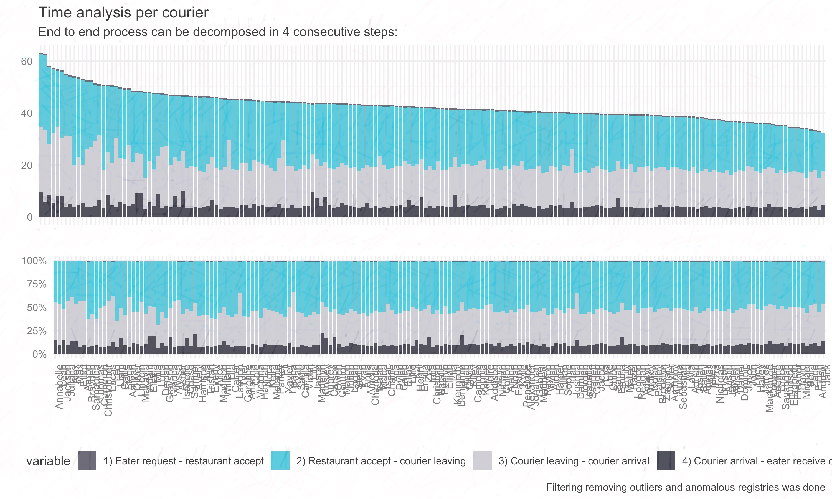
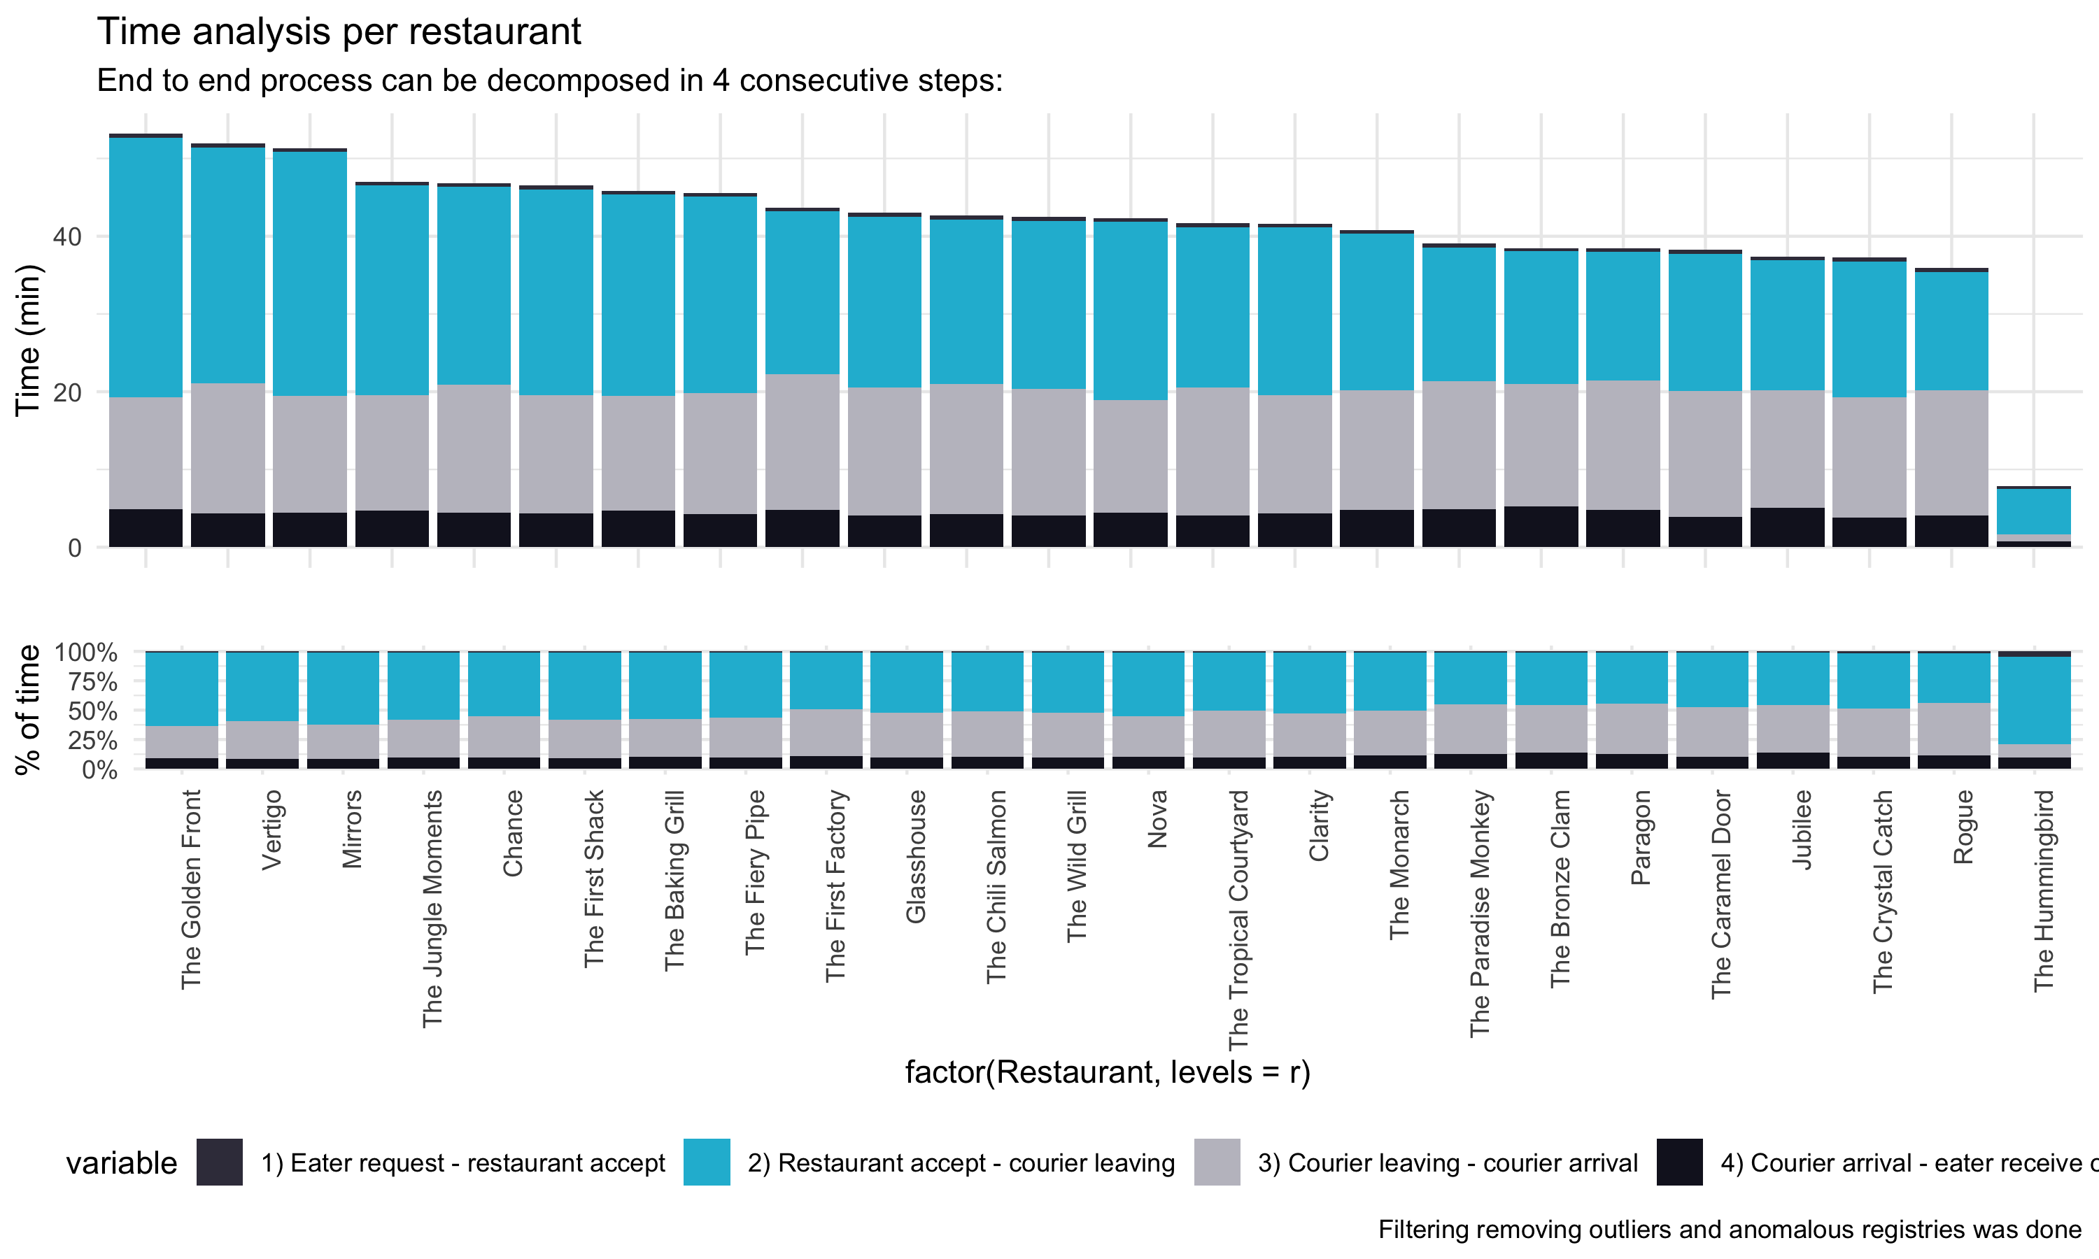
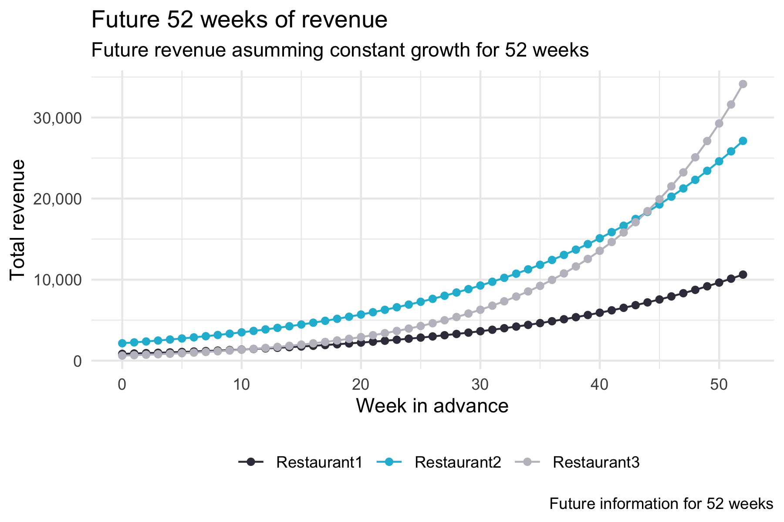

Operations Manager | Uber Eats Exercise
Salvador Garcia
09/09/2019

Slide 2
Getting to the goal of 35 minutes per order
Improving End to end Time performance

Slide 3
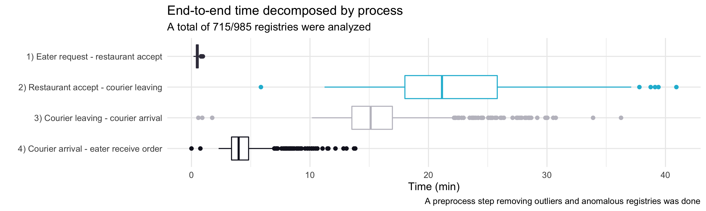
Total E2E time can be decomposed in 4 consecutive steps From eater request to eater receive order, it is possible to detect 4 consecutive steps. A wide dispersion it is found on two steps that can be managed by Uber Eats team. Currently the average E2E time is 40.7 minutes.
On average, 21.1 minutes is taken on the restaurant
Eater request to restaurant accept
(0.5 min)
Restaurant accept to courier leaving
(21.1 min)
Courier leaving to courier arrival eater
(15.8 min)
Courier arrival eater to eater receive
(4.4 min)
In terms of time, an effort on improving and standardizing times in steps
2) and 3) can provide an improvement that leads to the goal of 35 minutes

Slide 4
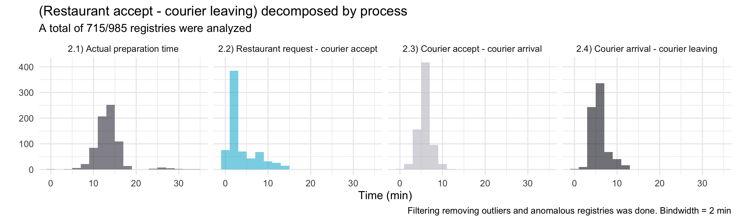
The wider dispersion (2) can be divided in 4 further steps In an optimal scenario, the only extra time after the restaurant accepting the order should be the preparation time (on average 14.7 min), but 21.1 minutes are spend on the restaurant. As a consequence, 6.4 min on average can be saved.
Time to begin trip (21.1 min)
Preparation time (14.7 min)
Find courier (3.2 min) + Courier arrival (5.7 min) + Courier leave (5.8 min)
On optimal scenario, the two
process can be performed
on parallel. Thus, taking only
the maximum time amount of both of them
Dispersion on finding a courier is high, some taking over 10 minutes. In addition, an standardization
of actual preparation time should be suggested, as some orders take over 30 minutes

Slide 5
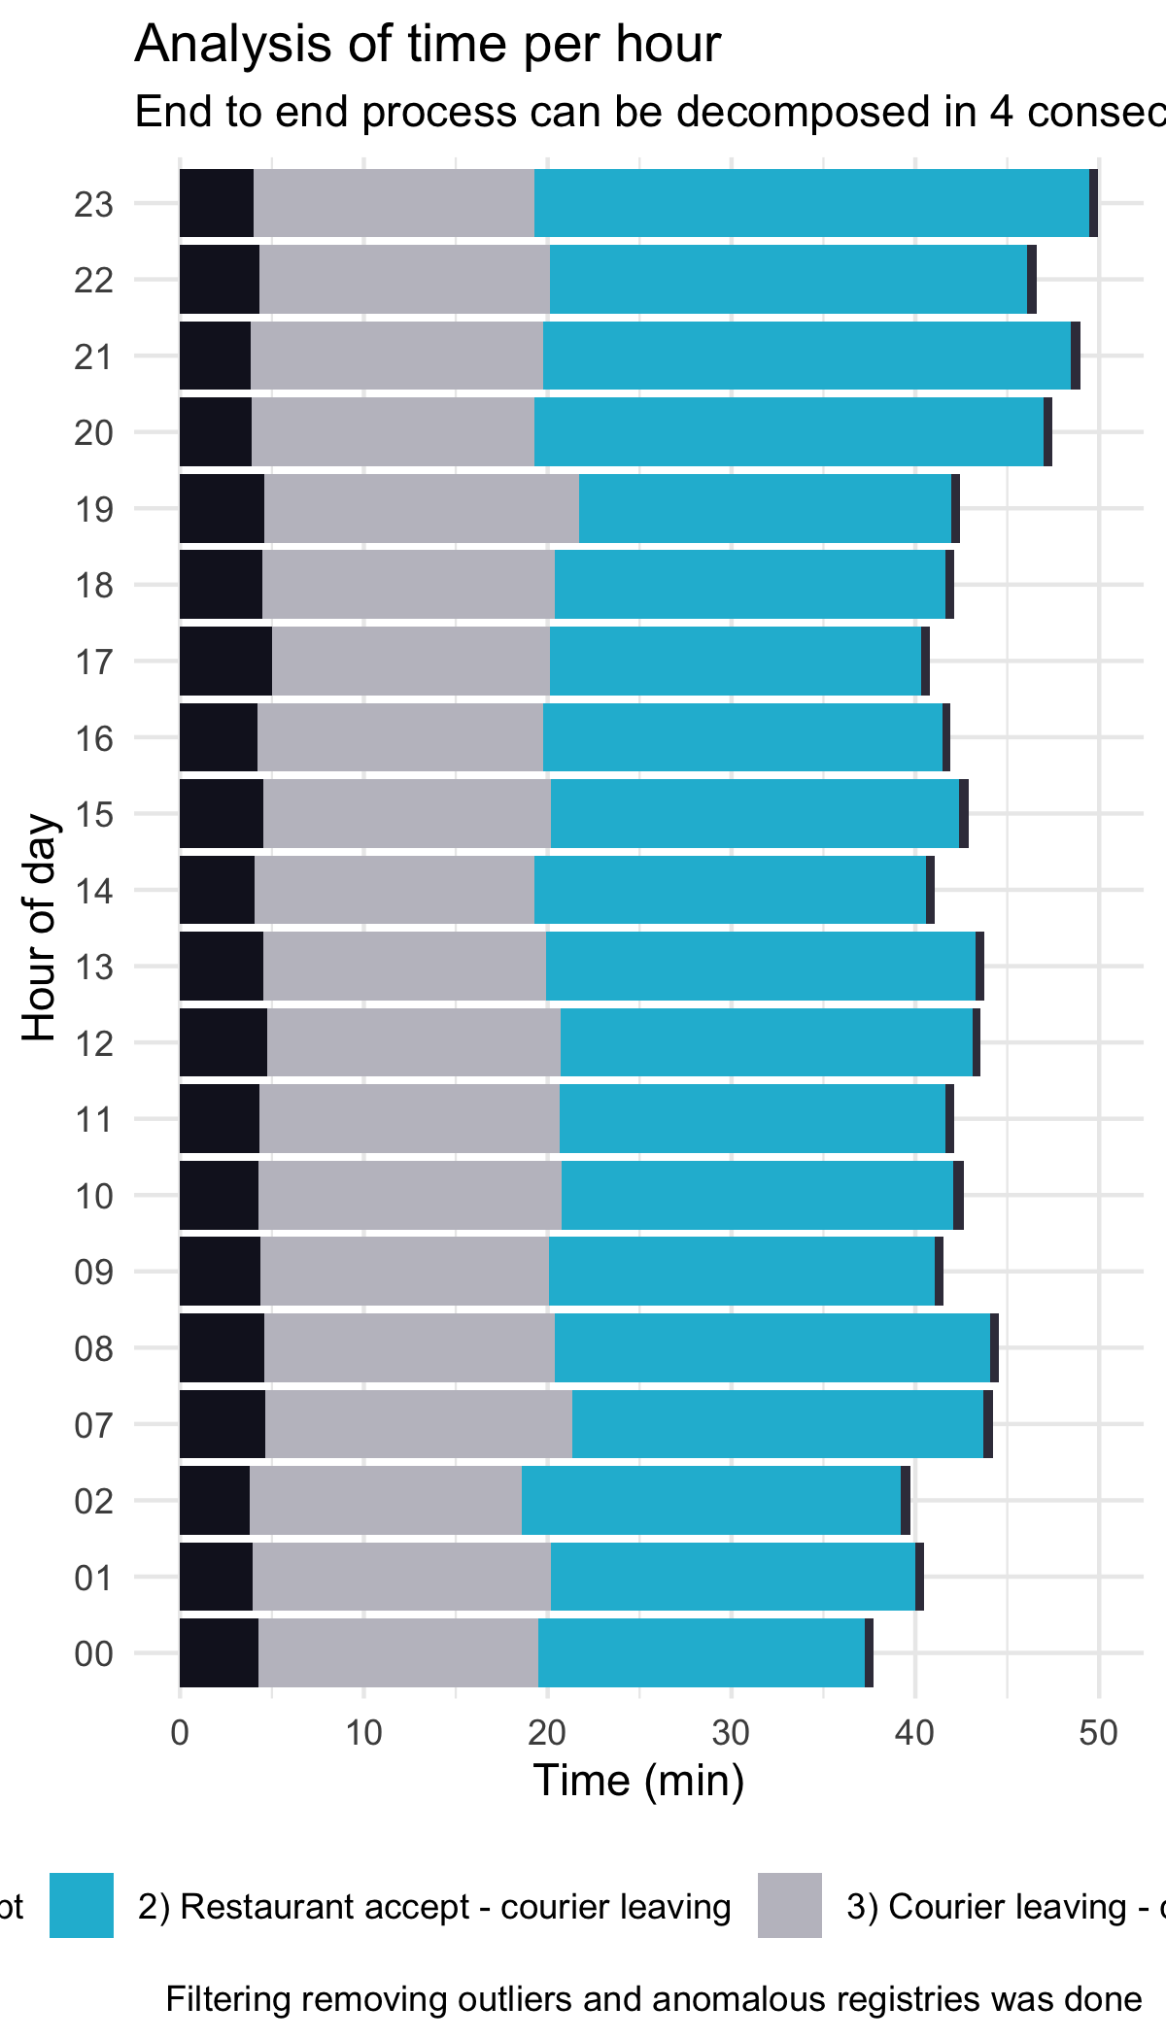
Step 2.2 exhibits long waiting time, causing order to be delayed
In some hours of the day the E2E time takes longer, in special the waiting time for courier. These hours are at 7,8,20,21,22,23 hours, so implementing a custom demand incentives for courier availability can be performed
Hour | Rest request – courier accept
0 | 12.2
1 | 11.7
2 | 10.7
7 | 11.1
8 | 2.4
9 | 2.5
10 | 2.8
11 | 3.1
12 | 2.5
13 | 2.6
14 | 3.1
15 | 2.8
16 | 2.9
17 | 2.5
18 | 2.7
19 | 2.7
20 | 2.6
21 | 3.0
22 | 2.1
23 | 1.8
Incentives to reduce
Time in some hours
For orders in hour 0,1,2,7,8
Up to 9 minutes can be reduced
(but just a small amount of orders)
At some hours, acceptance time is longer, degrading service performance

Slide 6

Standardization of times per courier and restaurant
Data exhibits a time difference taking into consideration restaurants and couriers. Some difference can be justified by travel time and order complexity, but top/bottom performers can be identified
Detect works performers
And make incentives to
reduce time.
Reward desired behavior
Best performer couriers exhibit in average half the time vs
worse performers. The same applies to restaurants

Slide 7
A plan consisting in 3 pillars is suggested
The first and most important pillar is the automatization of automatic suggestion of when to ask for a courier to reduce E2E time in long term. This has a potential of reducing up to 6.4 minutes avg the E2E time. Next is the always provide excellent service
 |  | Month 1 |  |  |  |  |  | Month 2 |  |  |  |  |  | Month 3 |  |  |  |  |  | Month 4 |  |  |  |  |  | Month 5 |  |  |  |  |  | Month 6
Standardize Couriers/Restaurant times
Incentives implementation to reduce time in step 2.2)
Automatization of suggestion of when to ask for courier
“Always provide excellent service”
Detect couriers/restaurants outside acceptance ranges
Segment courier/restaurant according to bad behavior type
Design customized incentives/rewards according to problem
“Quick hits”
Continuous monitoring of couriers/restaurants E2E time (automatic communication)
Incentives can be provided
for quick hits
Design short-term incentives to reduce time in step 2 (looking to decrease the 6.4 extra minutes)
Provide incentives to improve courier availability at special hours
“Reduce time in long term”
Initialization and requirements gathering
POC design (design affected KPIs)
Post mortem validation
MVP design and Performance measurement

Slide 8
Uber availability improvement
Detecting service gaps for couriers

Slide 9
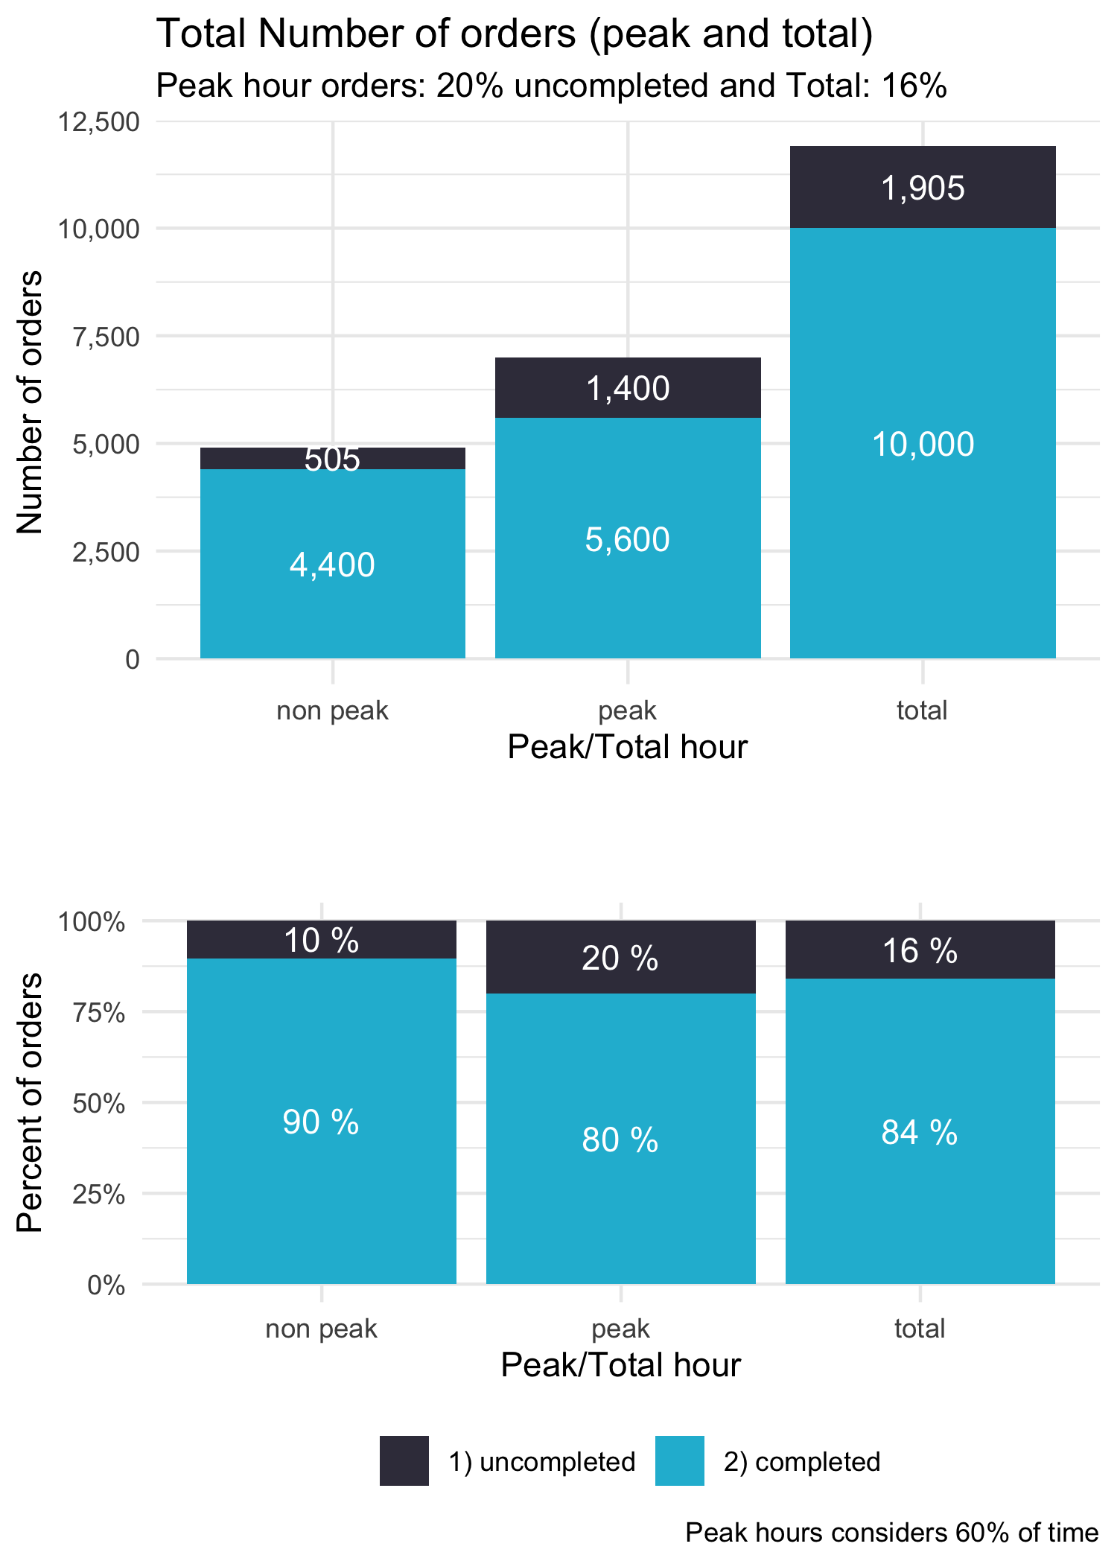
Peak hours exhibits a larger amount of incomplete orders
In average for peak hours 20% of orders are nor provided. This represents 1400/1905 (73%) of total orders not provided in 60% of the total time.
Focus efforts on peak hour
If reduced peak incomplete orders to levels of non-peak hours, the total
incomplete orders would be reduced up to 6 percent points
(700 complete orders per week, 6% more of orders per wek)

Slide 10
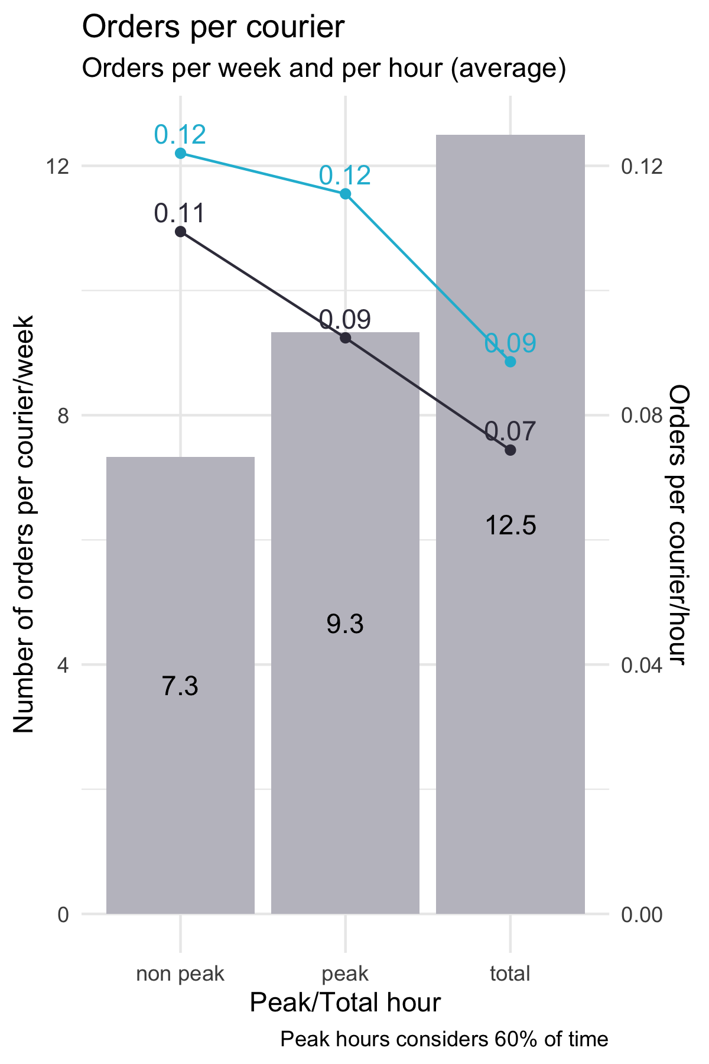
The total number of courier for the market seems to be adequate
When normalizing by courier and by courier/hour, only 12.5 orders per week per courier are accountable. This means that per hour (assuming 8*5 working hours), only 0.09 orders per hour in average is presented (low courier share of time)
This can be caused because of the couriers work hours (not full time). Thus an strategy as follows can be implemented:
Increase courier database at start (quick hit)
Create incentives to increase total time spent on the app (quick hit)
Segment courier database to reward good behave couriers (long term strategy)
Try to maintain a healthy database where full time courier are procured (long term strategy, low cost, more experience couriers)
Assuming 600
couriers on not
peak hours

Slide 11
Revisiting fee strategy
Best restaurant selection

Slide 12
With a forecast of revenue, the best option at long term is found
When considering a time window of 52 weeks (assuming constant growth) in terms of revenue, the restaurant 3 is the most promising option. If only a time window of 26 weeks is considered, then Restaurant 2 is the best option
When considering a time window of 26 weeks,
The restaurant 2 is a promising option. This restaurant
is a safe option because it has a good yelp review, so
It is very likely that users like the meal (thus, good image for
Uber)
For the unitary revenue, the fee %, the avg
basket size and the delivery cost is considered
For the total revenue, the total number of eaters,
the number of weekly orders and the unitary revenue is
considered
In time window of 26 weeks, restaurant 2 provide
more total revenue than other options

