Slide 1

Prepared by Savitha Rani Ravichandran
Models in Text Processing

Slide 2
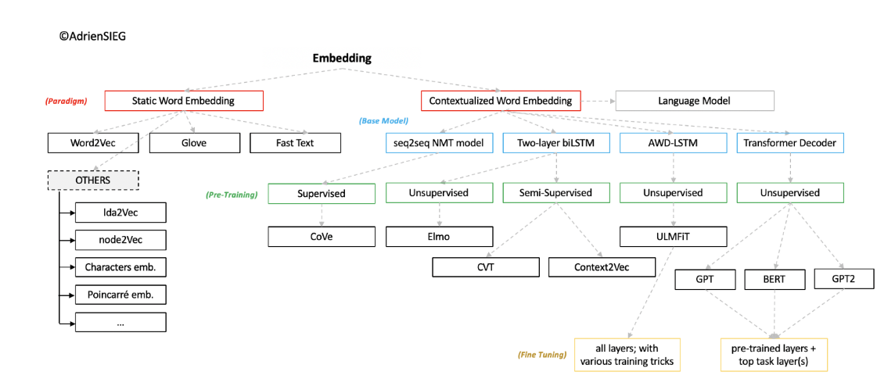
Embedding
A word embedding is a learned representation for text where words that have the same meaning have a similar representation.

Slide 3
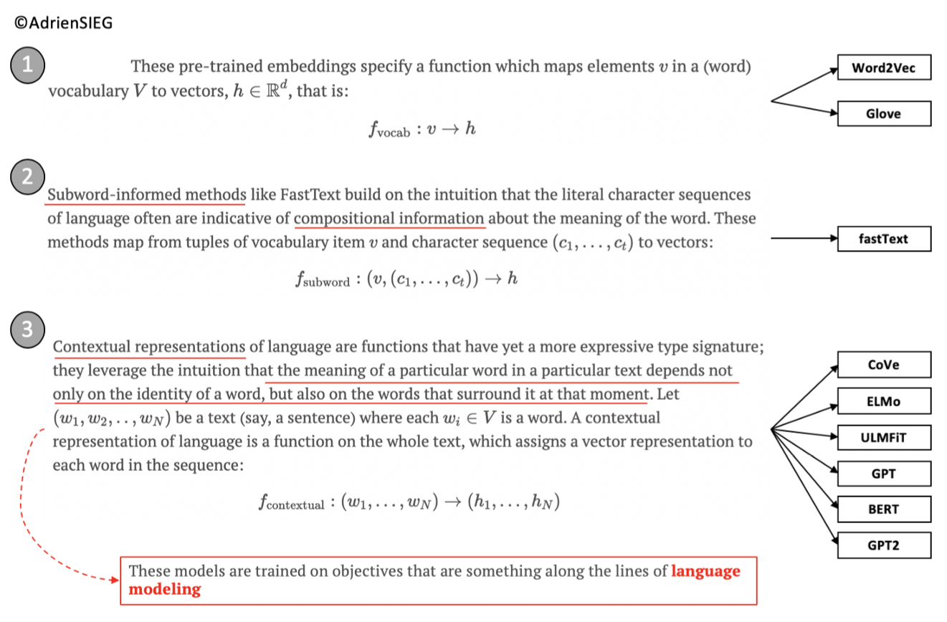
Main Families of model
https://towardsdatascience.com/what-the-heck-is-word-embedding-b30f67f01c81

Slide 4
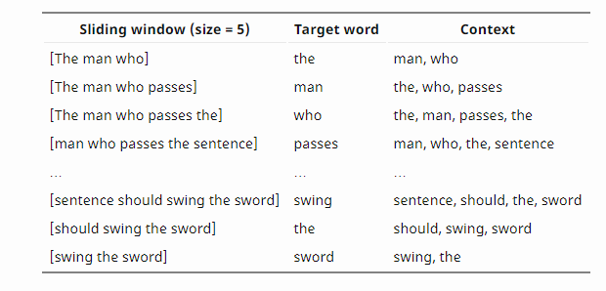
Word 2 vec Embedding
Word2vec is not a single algorithm but a combination of two techniques – CBOW(Continuous bag of words) and Skip-gram model. Both of these are shallow neural networks which map word(s) to the target variable which is also a word
Skip GramThe continuous skip-gram model learns by predicting the surrounding words given a current word
Common Bag Of Words (CBOW)This method takes the context of each word as the input and tries to predict the word corresponding to the context. The Continuous Bag-of-Words (CBOW) is another similar model for learning word vectors. It predicts the target word (i.e. “swing”) from source context words (i.e., “sentence should the sword”).

Slide 5
Glove
Stanford researchers also have their own word embedding algorithm like word2vec called Global Vectors for Word Representation
Global Vectors (GloVe) model which combines the benefits of the word2vec skip-gram model when it comes to word analogy tasks, with the benefits of matrix factorization methods that can exploit global statistical information.
GloVe is an unsupervised learning algorithm for obtaining vector representations for words. Training is performed on aggregated global word-word co-occurrence statistics from a corpus, and the resulting representations showcase interesting linear substructures of the word vector space.
For example, if the two words “cat” and “dog” occur in the context of each other, say 20 times in a 10-word window in the document corpus, then:
Vector(cat) . Vector(dog) = log(10)
This forces the model to encode the frequency distribution of words that occur near them in a more global context.

Slide 6
Fast text
FastText uses a bag-of-words model to extract features and a linear classifier to train the model.
Because the bag-of-words model does not recognize sentence word order, the generalized contextual features of high-frequency words are not shared with low-frequency words, resulting in lower accuracy proportional to lower word frequency.
Instead of learning vectors for words directly, fastText represents each word as an n-gram of characters. So, for example, take the word, “artificial” with n=3, the fastText representation of this word is <ar, art, rti, tif, ifi, fic, ici, ial, al>, where the angular brackets indicate the beginning and end of the word.
This helps capture the meaning of shorter words and allows the embeddings to understand suffixes and prefixes. Once the word has been represented using character n-grams, a skip-gram model is trained to learn the embeddings. This model is considered to be a bag of words model with a sliding window over a word because no internal structure of the word is taken into account. As long as the characters are within this window, the order of the n-grams doesn’t matter..
Fastetxt library contains word2vec models and a pre-trained model which you can use for tasks like sentence classification.

Slide 7
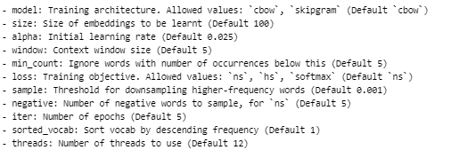

Hyper parameters to tune in Fastetext

Slide 8
Glove Vs fastext
GloVe focuses on words co-occurrences over the whole corpus. Its embeddings relate to the probabilities that two words appear together .In NLP, global matrix factorization is the process of using matrix factorization methods from linear algebra to reduce large term frequency matrices. These matrices usually represent the occurrence or absence of words in a document
FastText improves on Word2Vec by taking word parts into account, too. This trick enables training of embeddings on smaller datasets and generalization to unknown words.
FastText works well with rare words. So even if a word wasn’t seen during training, it can be broken down into n-grams to get its embeddings.
Word2vec and GloVe both fail to provide any vector representation for words that are not in the model dictionary. This is a huge advantage of Fasttext method.
https://dzone.com/articles/glove-and-fasttext-two-popular-word-vector-models

Slide 9
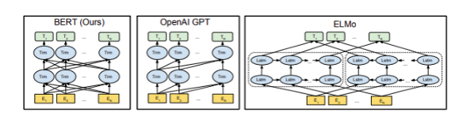
Language modelling
LM is the task of assigning a probability distribution over sequences of words that matches the distribution of a language.
Although it sounds formidable, language modeling (i.e. ELMo, BERT, GPT) is essentially just predicting words in a blank.
More formally, given a context, a language model predicts the probability of a word occurring in that context.
this method forces the model to learn how to use information from the entire sentence in deducing what words are missing.
https://towardsdatascience.com/from-pre-trained-word-embeddings-to-pre-trained-language-models-focus-on-bert-343815627598

Slide 10
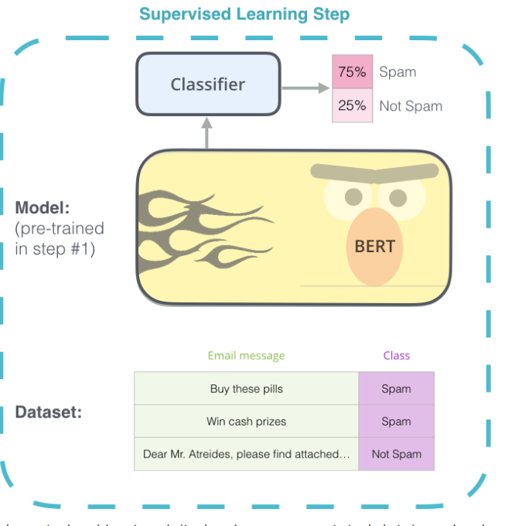
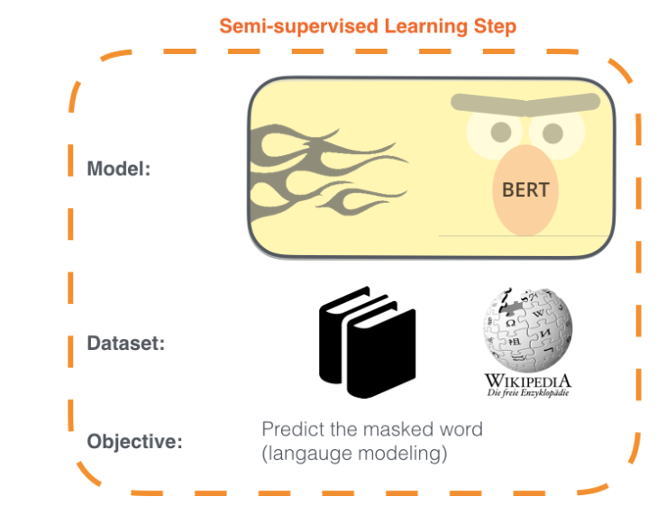
BERT-Bidirectional Encoder Representations from Transformers (BERT)
Step1: Trying to grasp the pattern. By the end of training Bert will have language processing capabaility

Slide 11
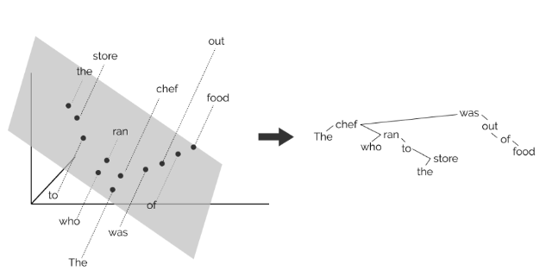
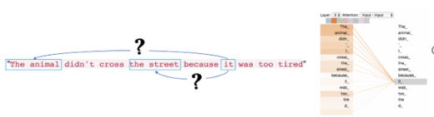
BERT(Bidirectional Encoder Representations from Transformers)
BERT encode human-like parse trees and find tree structures in these vector spaces when computer have represented each word in the sentence as a real-valued vector, with no explicit representation of the parse tree.
Encoder must be able to use the fact that some words are in a given position while, in the same sequence, other words are in other specific positions. That is, we want the network to able to understand relative positions and not only absolute ones
https://mostafadehghani.com/2019/05/05/universal-transformers/

Slide 12
References

Slide 13
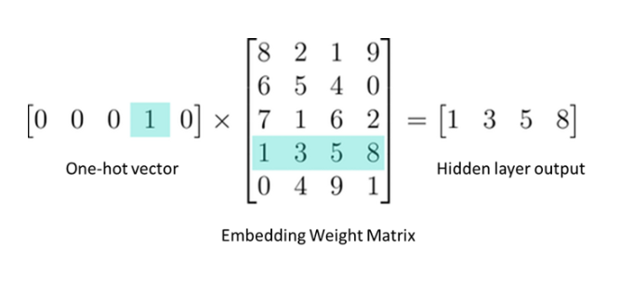
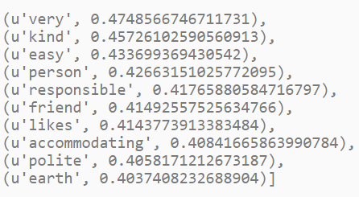
Word Similarities
King –men +women = Queen

Slide 14
Word2Vec
Example:-
CBOW: The boy is running on the _____. Fill in the blank, in this case, it’s “treadmill”.
Skip-gram: ___ ___ ___ treadmill. Complete the word’s context. In this case, it’s “The boy is running on the”
CBOW will learn the context as shown in fig 4 and then CBOW model will tell the most probably word is “Treadmill”,” Beach” or “Road”. The words like “Mountain” will get less attention of the model because it is designed to predict the most probable word.
Skip-gram will understand the word ‘Treadmill’ as shown in fig 5 and tell us, that there is huge probability, the context is ‘The boy is running on’, ’The girl is running on’ or some other relevant context.

Slide 15
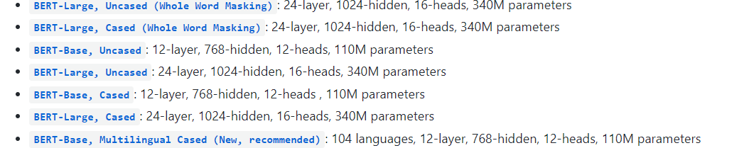
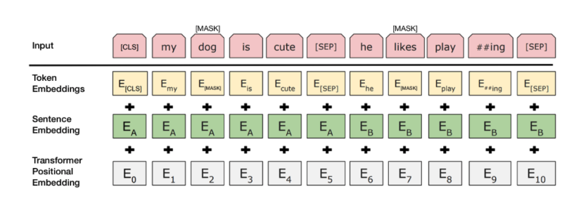
BERT-Transformer model

