Slide 1
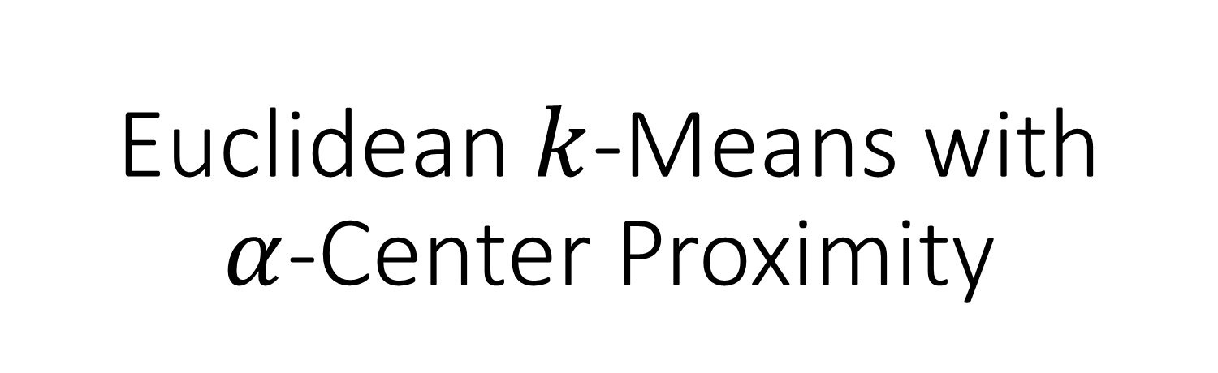
Euclidean $k$-Means with $α$-Center Proximity
Apoorv Vikram Singh Visiting Here
Joint work with Amit Deshpande (Microsoft Research, India)
and Anand Louis (Indian Institute of Science, India)

Slide 2
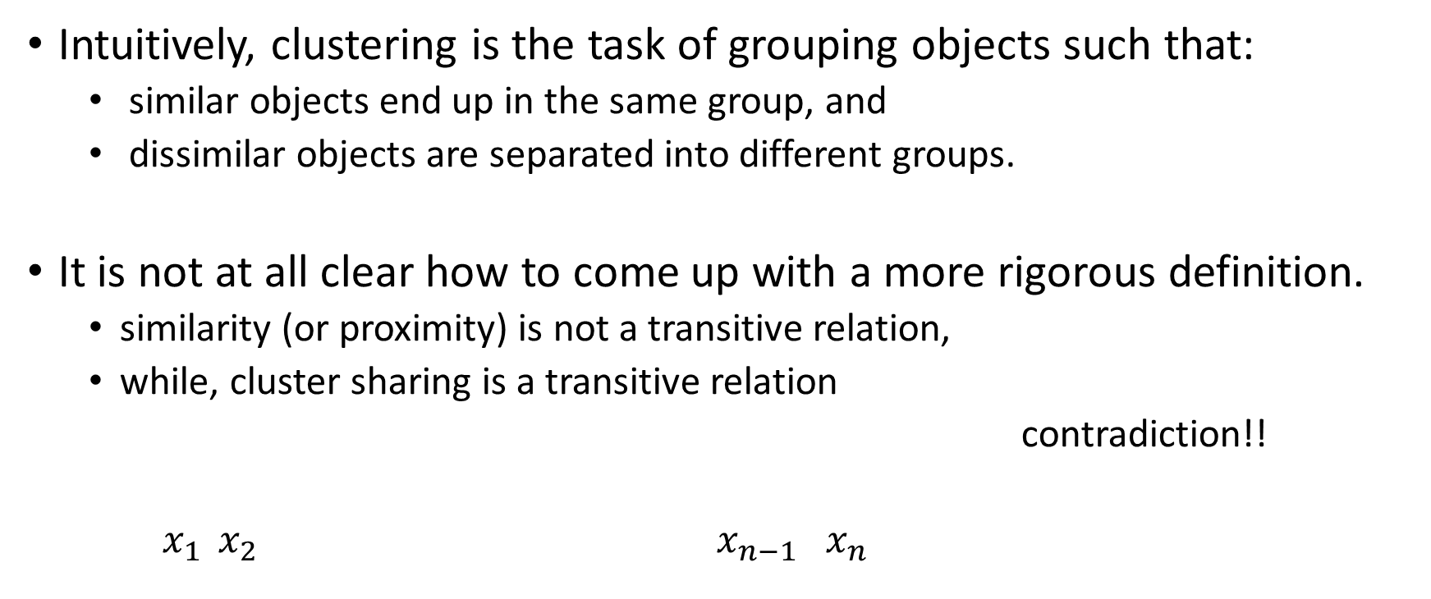
Clustering Definition?
Intuitively, clustering is the task of grouping objects such that:
similar objects end up in the same group, and
dissimilar objects are separated into different groups.
It is not at all clear how to come up with a more rigorous definition.
similarity (or proximity) is not a transitive relation,
while, cluster sharing is a transitive relation
contradiction!!
$x_{1 } x_{2} x_{n−1} x_{n}$

Slide 3
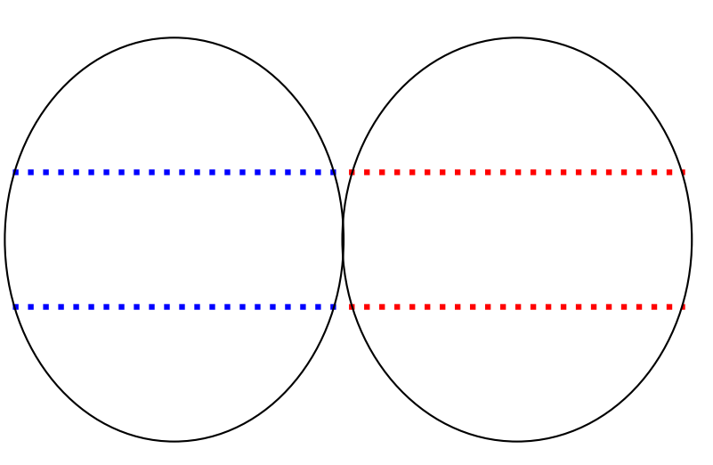
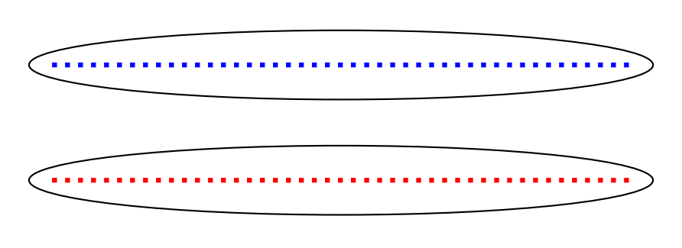
Another Problem: lack of “ground-truth” clustering (there is no absolute success evaluation )
vs

Slide 4
Popular Approach: define a cost function over a parameterized set of possible partition
The Goal: Find a partitioning that outputs minimum/minimal cost clustering.
Popular cost functions: k-means, k-medians, k-centers, etc.
Today we will focus on the k-means objective function.

Slide 5
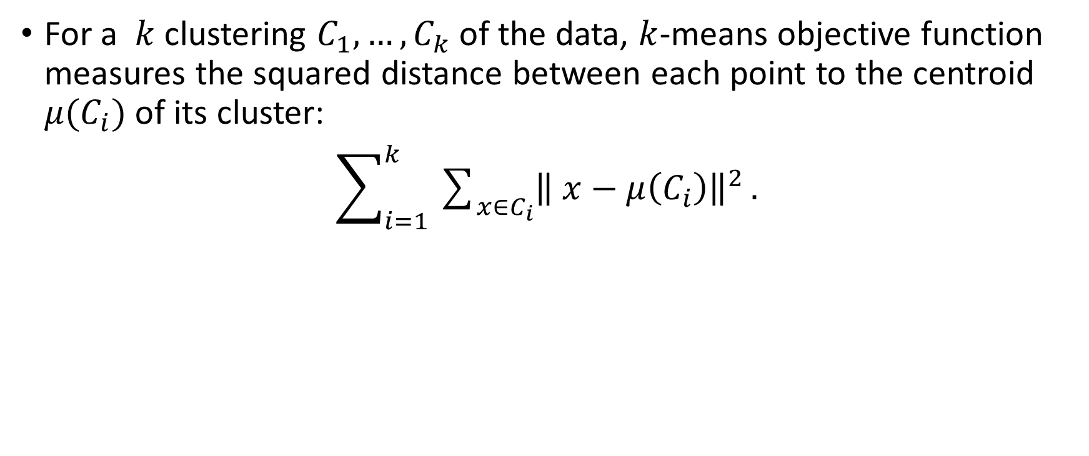
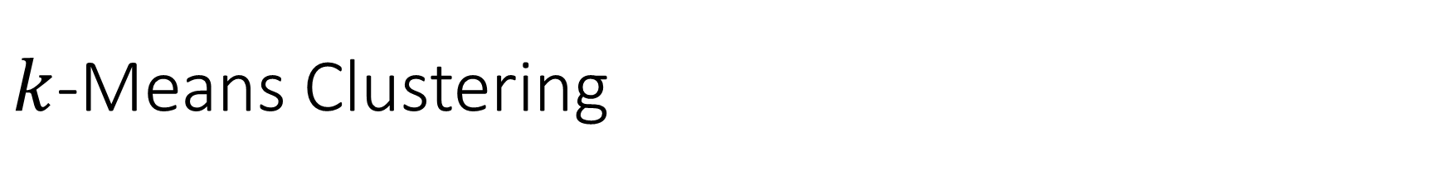
$k$-Means Clustering
For a $k$ clustering $C_{1},…,C_{k}$ of the data, $k$-means objective function measures the squared distance between each point to the centroid $μ(C_{i})$ of its cluster:
$\sum_{i=1}^{k}{\sum_{x∈C_{i}}{{\left\| x−μ\left(C_{i}\right)\right\|}^{2}}}.$

Slide 6
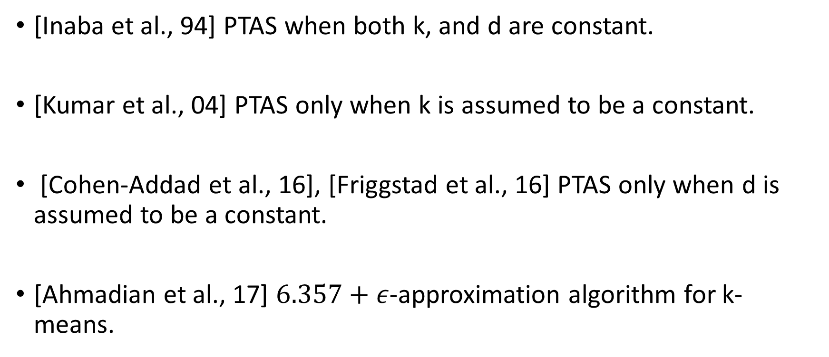
Existing k-Means Result
[Inaba et al., 94] PTAS when both k, and d are constant.
[Kumar et al., 04] PTAS only when k is assumed to be a constant.
[Cohen-Addad et al., 16], [Friggstad et al., 16] PTAS only when d is assumed to be a constant.
[Ahmadian et al., 17] $6.357+ε$-approximation algorithm for k-means.

Slide 7
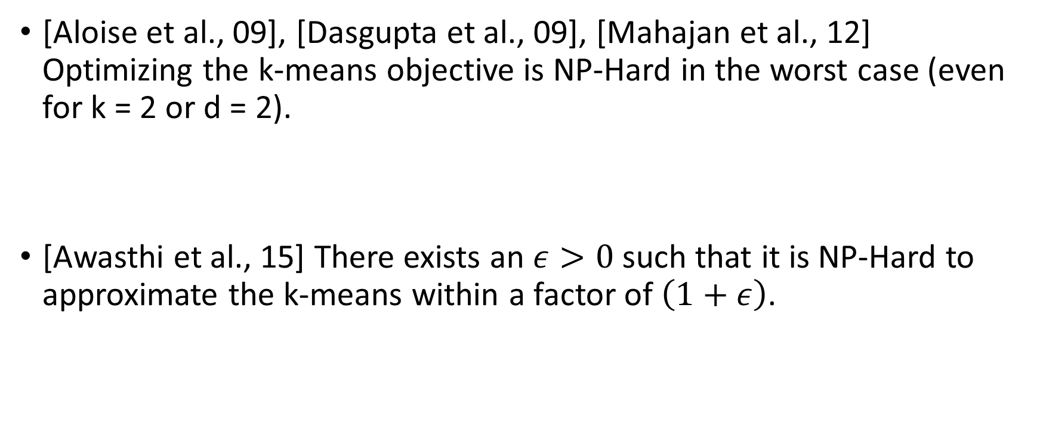
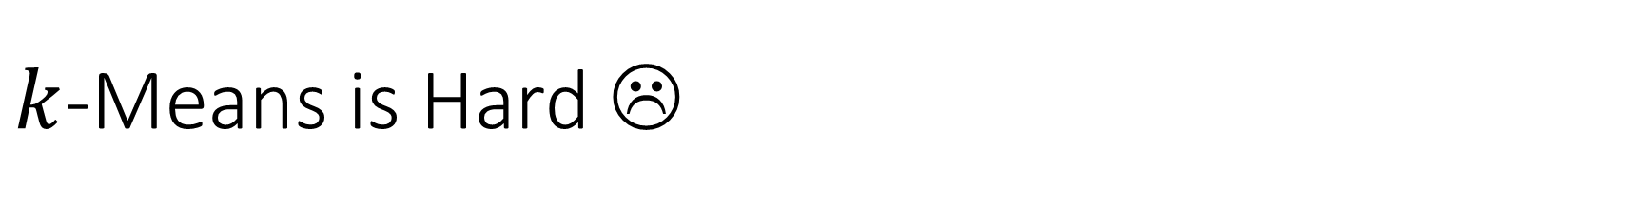
$k$-Means is Hard ☹
[Aloise et al., 09], [Dasgupta et al., 09], [Mahajan et al., 12] Optimizing the k-means objective is NP-Hard in the worst case (even for k = 2 or d = 2).
[Awasthi et al., 15] There exists an $ε>0$such that it is NP-Hard to approximate the k-means within a factor of $\left(1+ε\right)$.

Slide 8
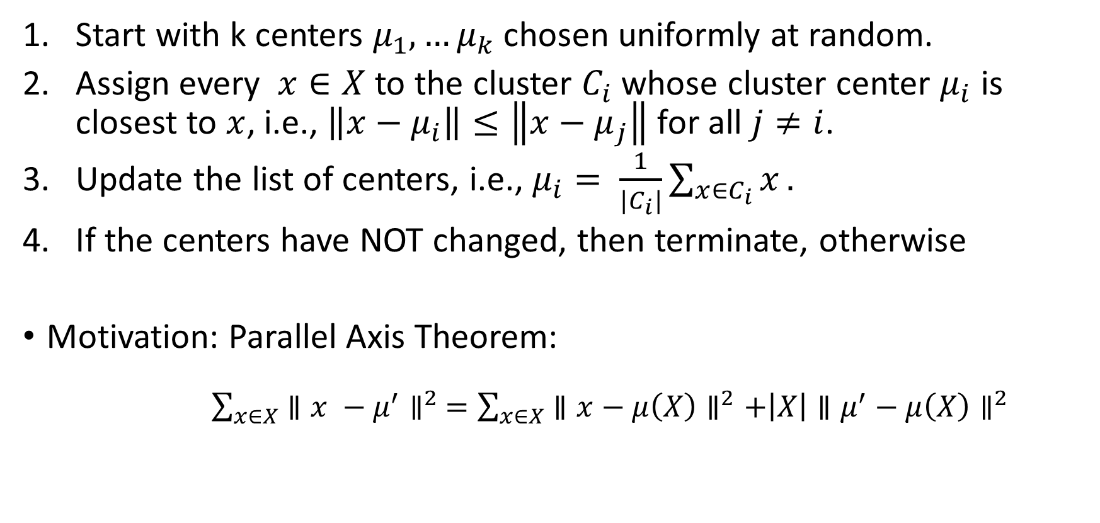
Lloyd’s Algorithm: a famous algorithm
Start with k centers $μ_{1},…μ_{k}$ chosen uniformly at random.
Assign every $x∈X$ to the cluster $C_{i}$ whose cluster center $μ_{i}$ is closest to $x$, i.e., $\left\|x−μ_{i}\right\|≤\left\|x−μ_{j}\right\|$ for all $j≠i$.
Update the list of centers, i.e., $μ_{i}= \frac{1}{{|C}_{i}|}\sum_{x∈C_{i}}{x}.$
If the centers have NOT changed, then terminate, otherwise
Motivation: Parallel Axis Theorem:
$\sum_{x∈X}{∥x −μ^{′}∥^{2} =\sum_{x∈X}{∥x−μ\left(X\right)∥^{2}+\left|X\right|∥μ^{′}−μ\left(X\right)∥^{2}} }$

Slide 9
Lloyd’s can be bad!
There is no provable bound Lloyd’s algorithm achieves. The cost can be arbitrarily bad.
There are also known worst-case instances where the popular Lloyd’s algorithm takes exponentially many iterations to converge to a local optimum.
However, Lloyd’s work quite fast in real life (which makes it the most commonly used algorithm for clustering).
[Arthur et al., 09] Lloyds algorithm has a smoothed running time polynomial in n.

Slide 10
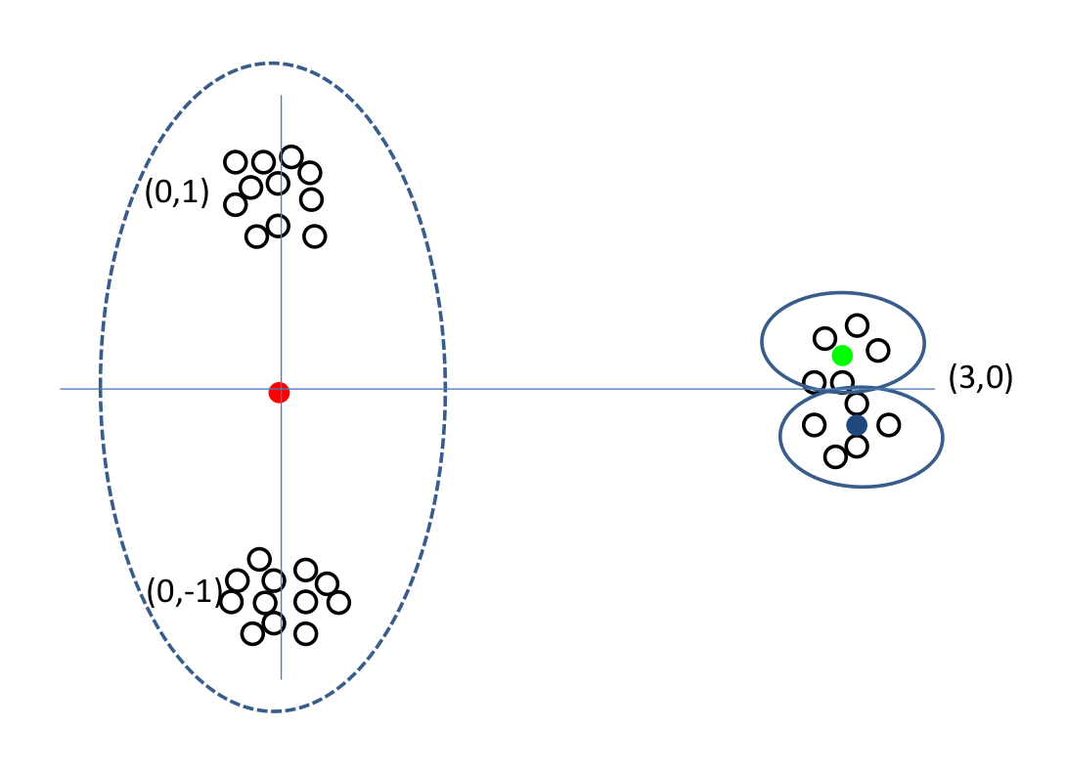
Lloyd’s behaving bad
Locally-optimal but Globally sub-optimal

Slide 11
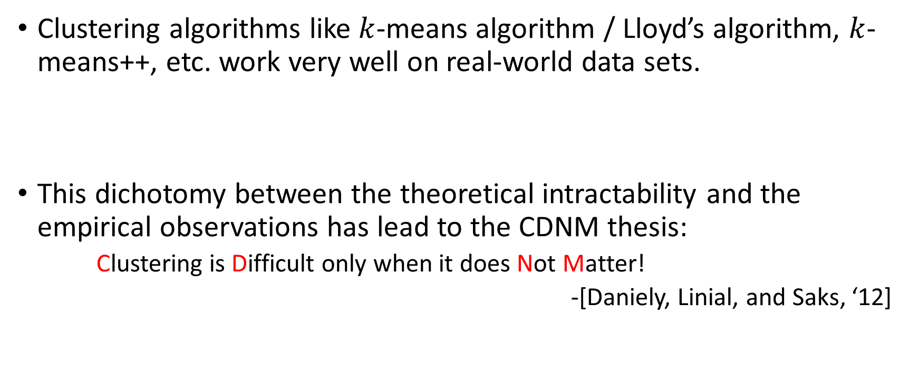
In practice…
Clustering algorithms like $k$-means algorithm / Lloyd’s algorithm, $k$-means++, etc. work very well on real-world data sets.
This dichotomy between the theoretical intractability and the empirical observations has lead to the CDNM thesis:
Clustering is Difficult only when it does Not Matter!
-[Daniely, Linial, and Saks, ‘12]

Slide 12
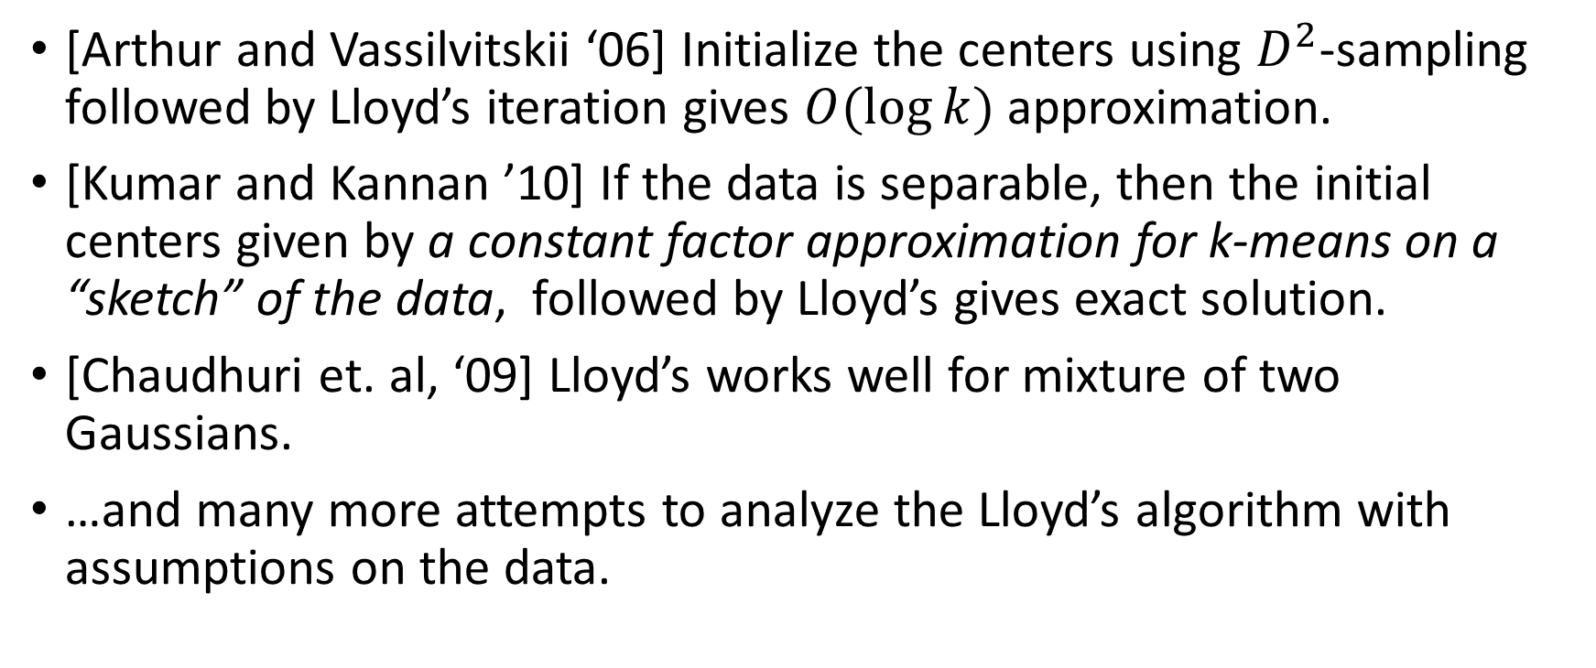
Lloyd’s Guarantee
[Arthur and Vassilvitskii ‘06] Initialize the centers using $D^{2}$-sampling followed by Lloyd’s iteration gives $O(\log{k)}$ approximation.
[Kumar and Kannan ’10] If the data is separable, then the initial centers given by a constant factor approximation for k-means on a “sketch” of the data, followed by Lloyd’s gives exact solution.
[Chaudhuri et. al, ‘09] Lloyd’s works well for mixture of two Gaussians.
…and many more attempts to analyze the Lloyd’s algorithm with assumptions on the data.

Slide 13
Why does clustering work well on real-world data?
In most real-world data, the underlying “ground-truth” clustering is unambiguous and is “stable” under small perturbations of the data.
This has lead to the study of “beyond worst-case analysis” in the TCS community.

Slide 14
Intuition: a “stable” instance

Slide 15
Formalizing the Intuition

Slide 16
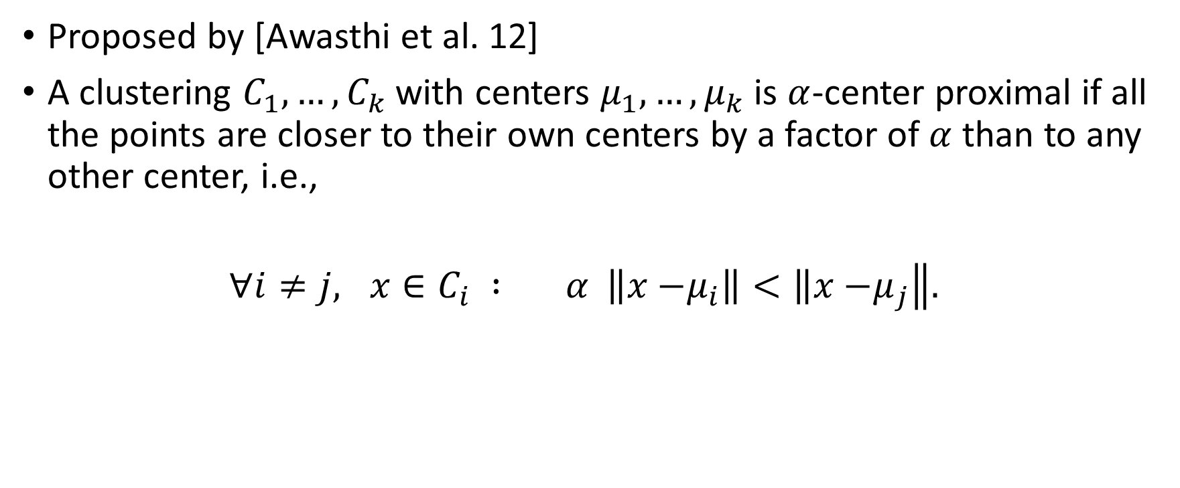

Formally known as: $α$-Center Proximity
Proposed by [Awasthi et al. 12]
A clustering $C_{1},…,C_{k}$ with centers $μ_{1},…,μ_{k}$ is $α$-center proximal if all the points are closer to their own centers by a factor of $α$ than to any other center, i.e.,
$∀i≠j, x∈C_{i} : α \left\|x−\right.\left.μ_{i}\right\|<\left\|x−\right.\left.μ_{j}\right\|.$

Slide 17

Previous Result for Stable Instances
[Angelidakis et al. 17]: Can cluster in polynomial time if:
$α≥2.$
The optimal $k$-means solution must be $α$-center proximal.

Slide 18
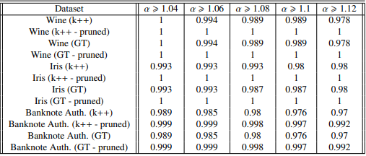

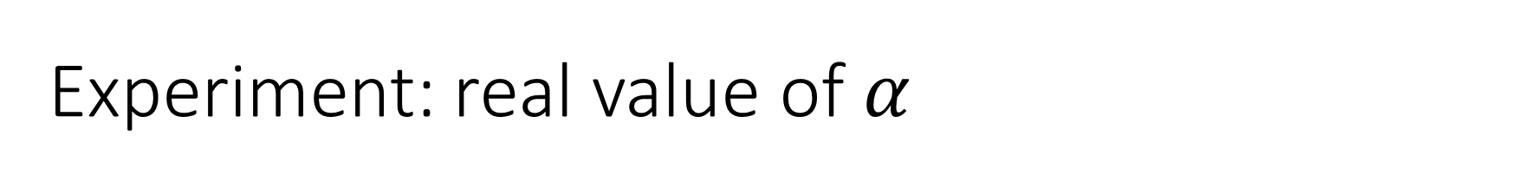


Experiment: real value of $α$
$$α∼1.12$$
$$α∼1.025$$

Slide 19
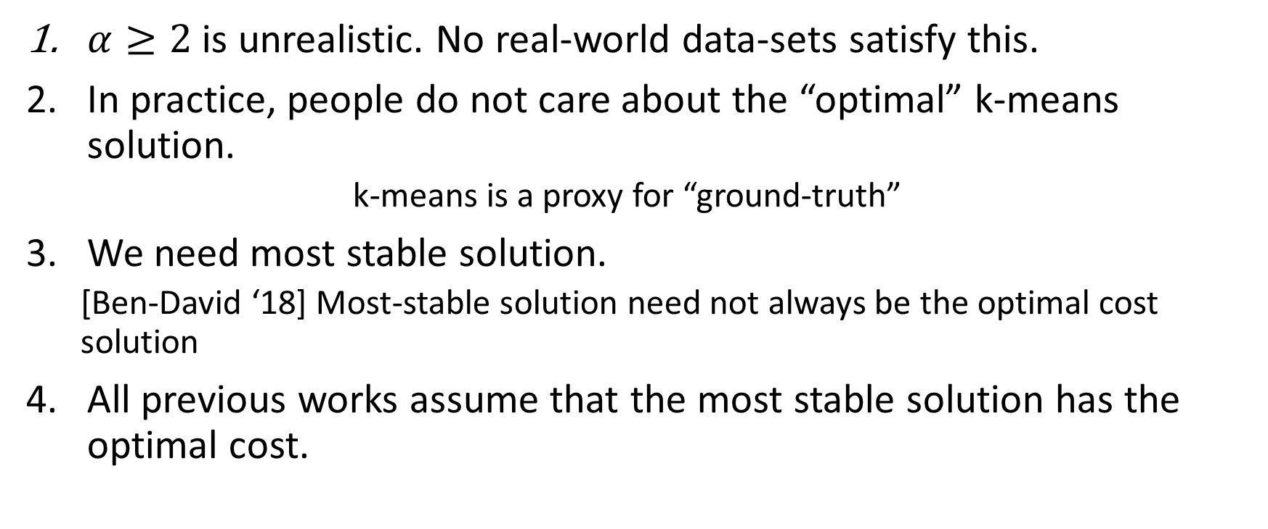
Comments about previous works
$α≥2$ is unrealistic. No real-world data-sets satisfy this.
In practice, people do not care about the “optimal” k-means solution.
k-means is a proxy for “ground-truth”
We need most stable solution.
[Ben-David ‘18] Most-stable solution need not always be the optimal cost solution
All previous works assume that the most stable solution has the optimal cost.

Slide 20
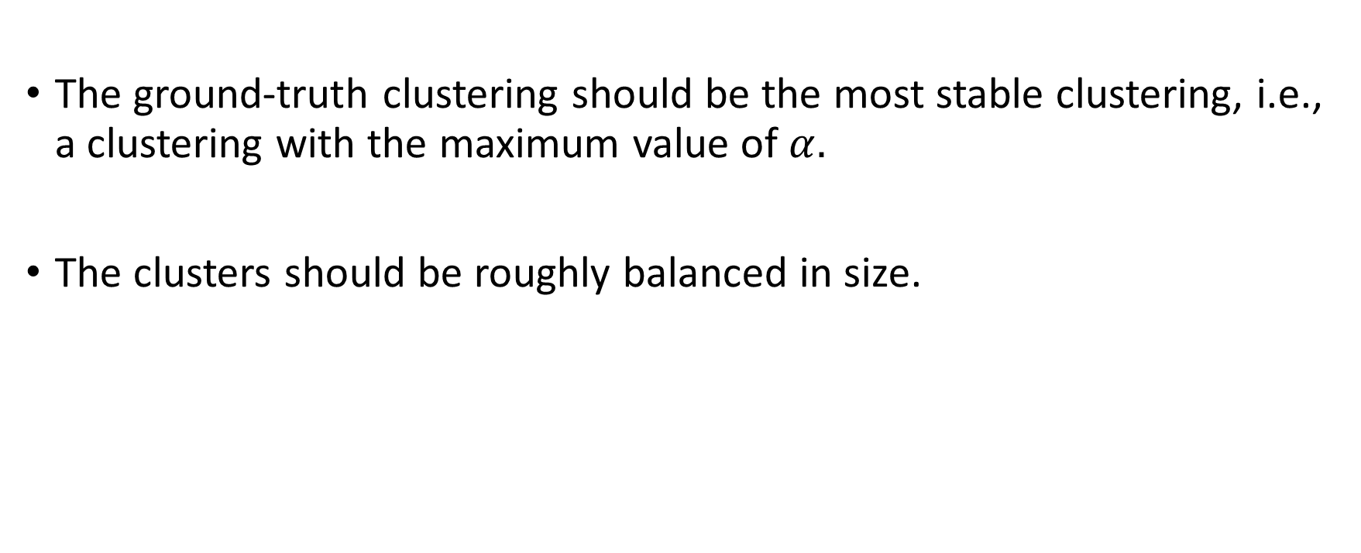
Desirable Properties of “Ground-Truth” Clustering
The ground-truth clustering should be the most stable clustering, i.e., a clustering with the maximum value of $α.$
The clusters should be roughly balanced in size.

Slide 21
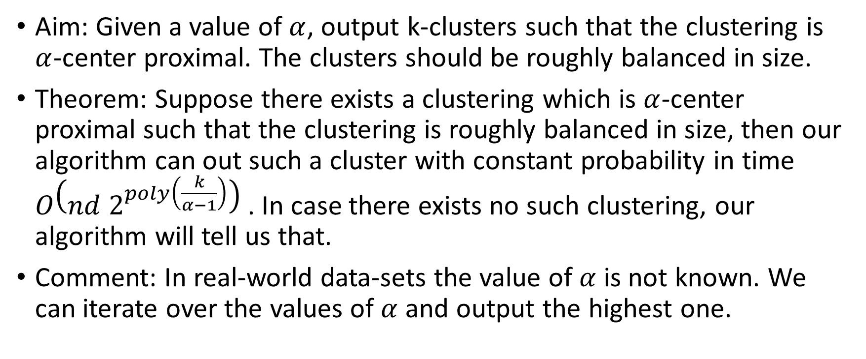
Our Algorithmic Result
Aim: Given a value of $α$, output k-clusters such that the clustering is $α$-center proximal. The clusters should be roughly balanced in size.
Theorem: Suppose there exists a clustering which is $α$-center proximal such that the clustering is roughly balanced in size, then our algorithm can out such a cluster with constant probability in time $O\left(nd 2^{poly\left(\frac{k}{α−1}\right)}\right)$. In case there exists no such clustering, our algorithm will tell us that.
Comment: In real-world data-sets the value of $α$ is not known. We can iterate over the values of $α$ and output the highest one.

Slide 22
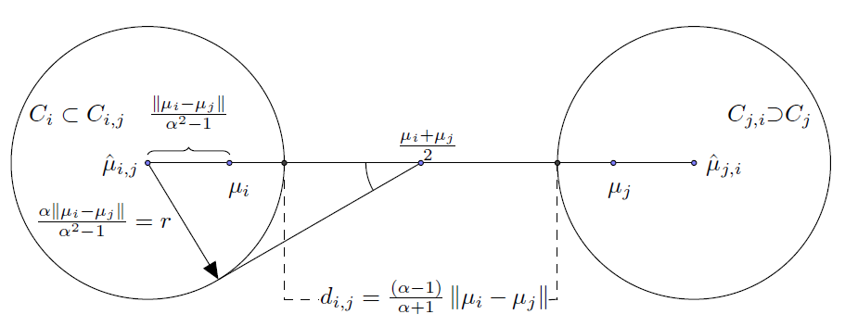

Algo Proof Sketch Insight 1
Recall: $∀x∈C_{i},$
$$α∥x −μ_{i}∥ <∥x −μ_{j}∥$$
This property gives us a nice geometry.

Slide 23
Insight 1: Main Points
All clusters lie in a bounded radius circle
There is a scope to make error in estimating the centers and still get the correct clustering (due to center proximity)
The previous figure

Slide 24
Proof Sketch: Insight 2
Approximate Caratheodory Theorem: Sample points uniformly at random from a cluster of bounded radius. Mean of the sample is close to the cluster mean. Number of sampled points do not depend on the dimension!!
Actually it is something more general.

Slide 25
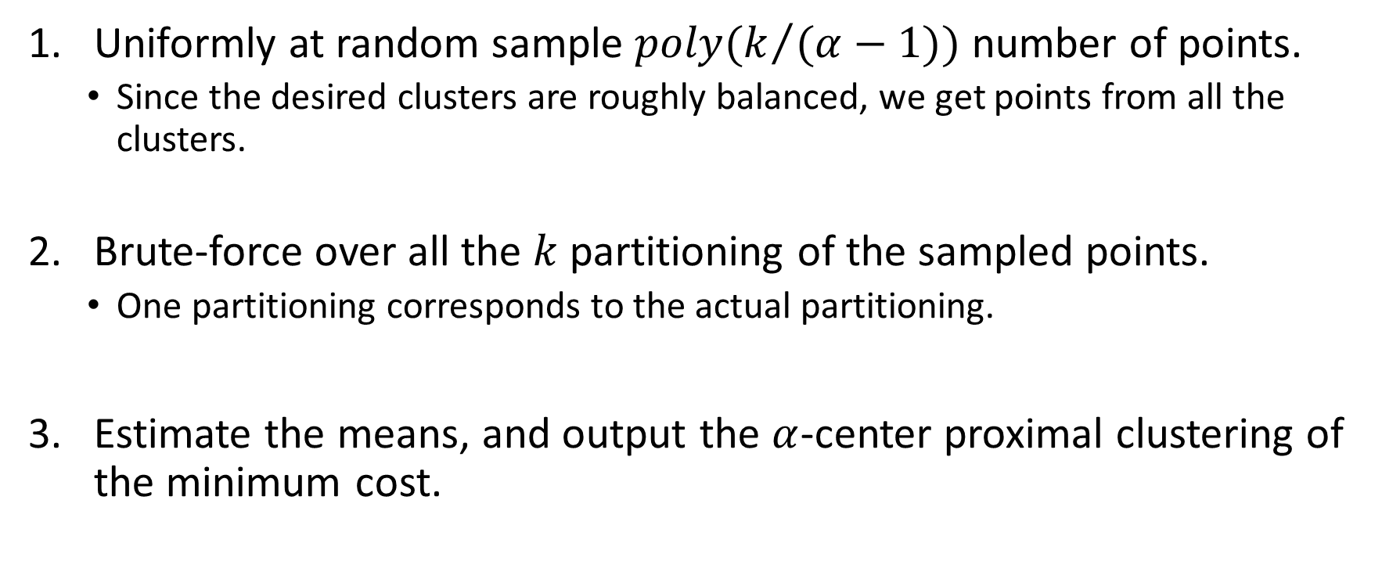
The Algorithm: putting the two insights together
Uniformly at random sample $poly(k/{(α−1))}$ number of points.
Since the desired clusters are roughly balanced, we get points from all the clusters.
Brute-force over all the $k$ partitioning of the sampled points.
One partitioning corresponds to the actual partitioning.
Estimate the means, and output the $α$-center proximal clustering of the minimum cost.

Slide 26
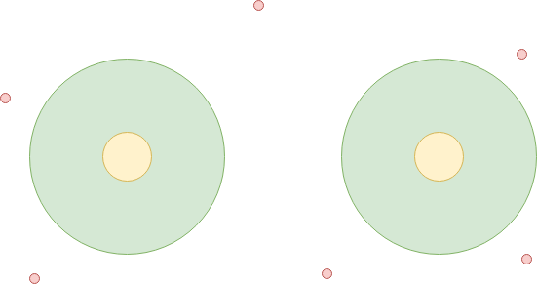

Handling Certain Class of Outliers
Let Z be the class of outliers. Suppose we know $\left|Z\right|$ (the number of outliers)
For$x∈C_{i}$, $α∥x−μ_{i}∥ <‖x−μ_{j}‖$. Moreover, $x∈C_{i}$ and $z∈Z$ we have$α∥x−μ_{i}∥<\left\|z −μ_{j}\right\|.$

Slide 27
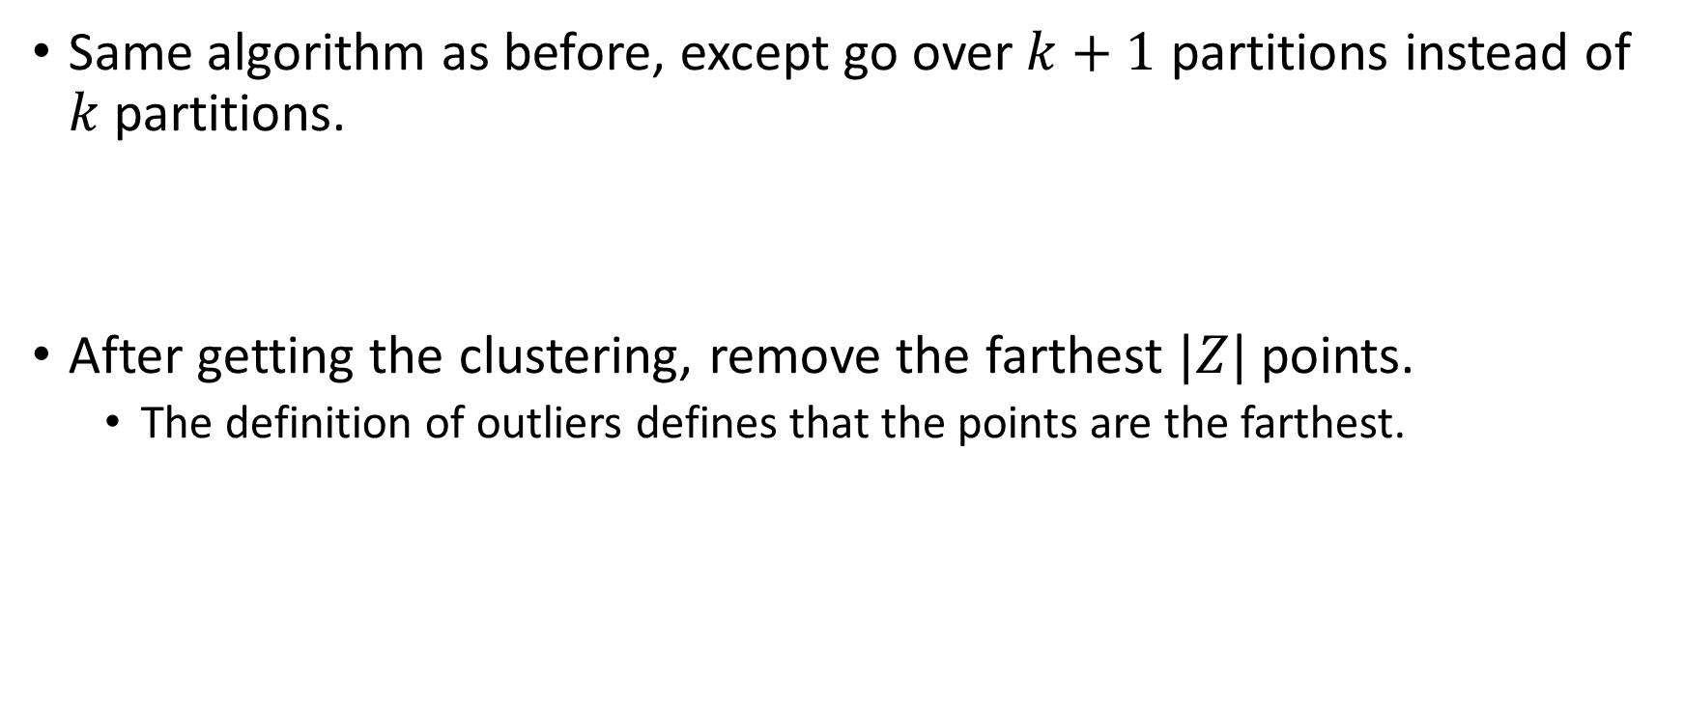
Handling Outliers
Same algorithm as before, except go over $k+1$ partitions instead of $k$partitions.
After getting the clustering, remove the farthest $|Z|$ points.
The definition of outliers defines that the points are the farthest.

Slide 28
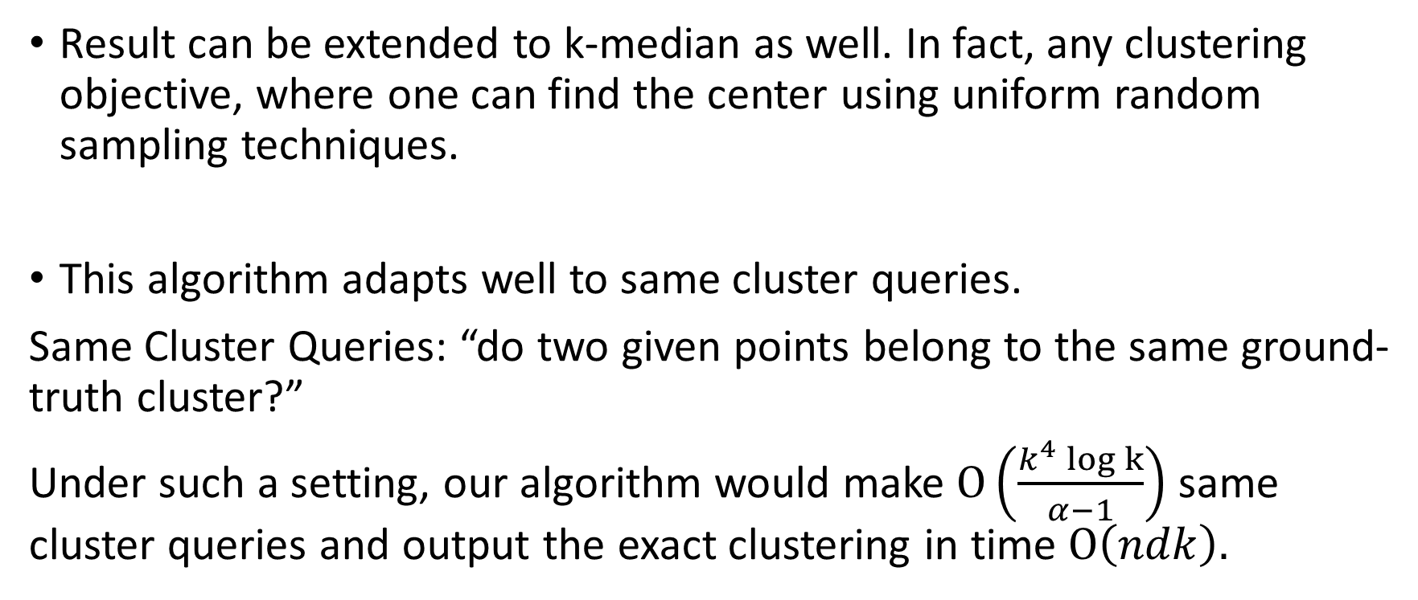
Discussions
Result can be extended to k-median as well. In fact, any clustering objective, where one can find the center using uniform random sampling techniques.
This algorithm adapts well to same cluster queries.
Same Cluster Queries: “do two given points belong to the same ground-truth cluster?”
Under such a setting, our algorithm would make $Ο\left(\frac{k^{4} log k}{α−1}\right)$ same cluster queries and output the exact clustering in time $Ο\left(ndk\right).$

Slide 29
Discussions
The sampling technique is very useful.
Can be used to many kind of problems like facility location, cost-balanced clustering, topic modelling, fair clustering, etc. [Kumar et al.’10; Deshpande, Louis, S’ 19]

Slide 30
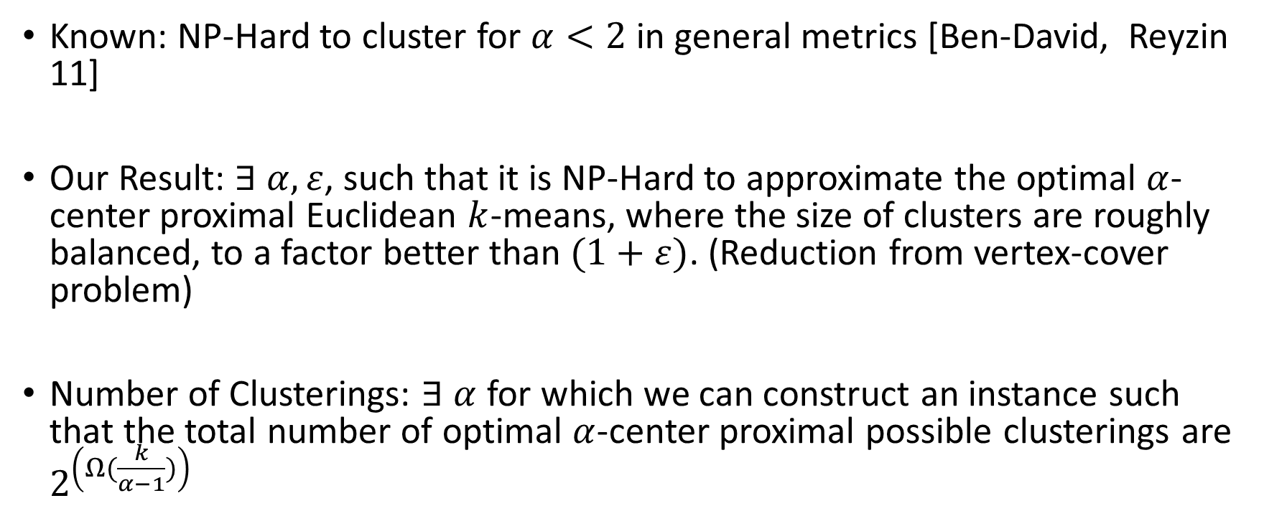
Lower Bounds
Known: NP-Hard to cluster for $α<2$in general metrics [Ben-David, Reyzin 11]
Our Result: $∃ α, ε$, such that it is NP-Hard to approximate the optimal $α$-center proximal Euclidean $k$-means, where the size of clusters are roughly balanced, to a factor better than $(1+ε)$. (Reduction from vertex-cover problem)
Number of Clusterings: $∃ α$ for which we can construct an instance such that the total number of optimal $α$-center proximal possible clusterings are $2^{\left(Ω(\frac{k}{α−1})\right)}$

Slide 31


Slide 32
Have Merci!
Thank You!

