Slide 1
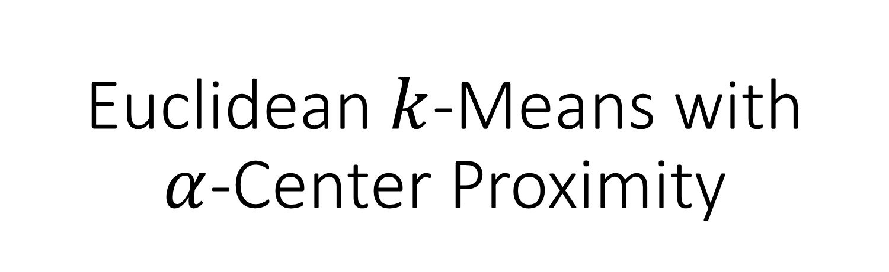
Euclidean $k$-Means with $α$-Center Proximity
Apoorv Vikram Singh
Project Associate at CSA, IISc
Joint work with Amit Deshpande (MSR, Bangalore) and Anand Louis (CSA, IISc)

Slide 2
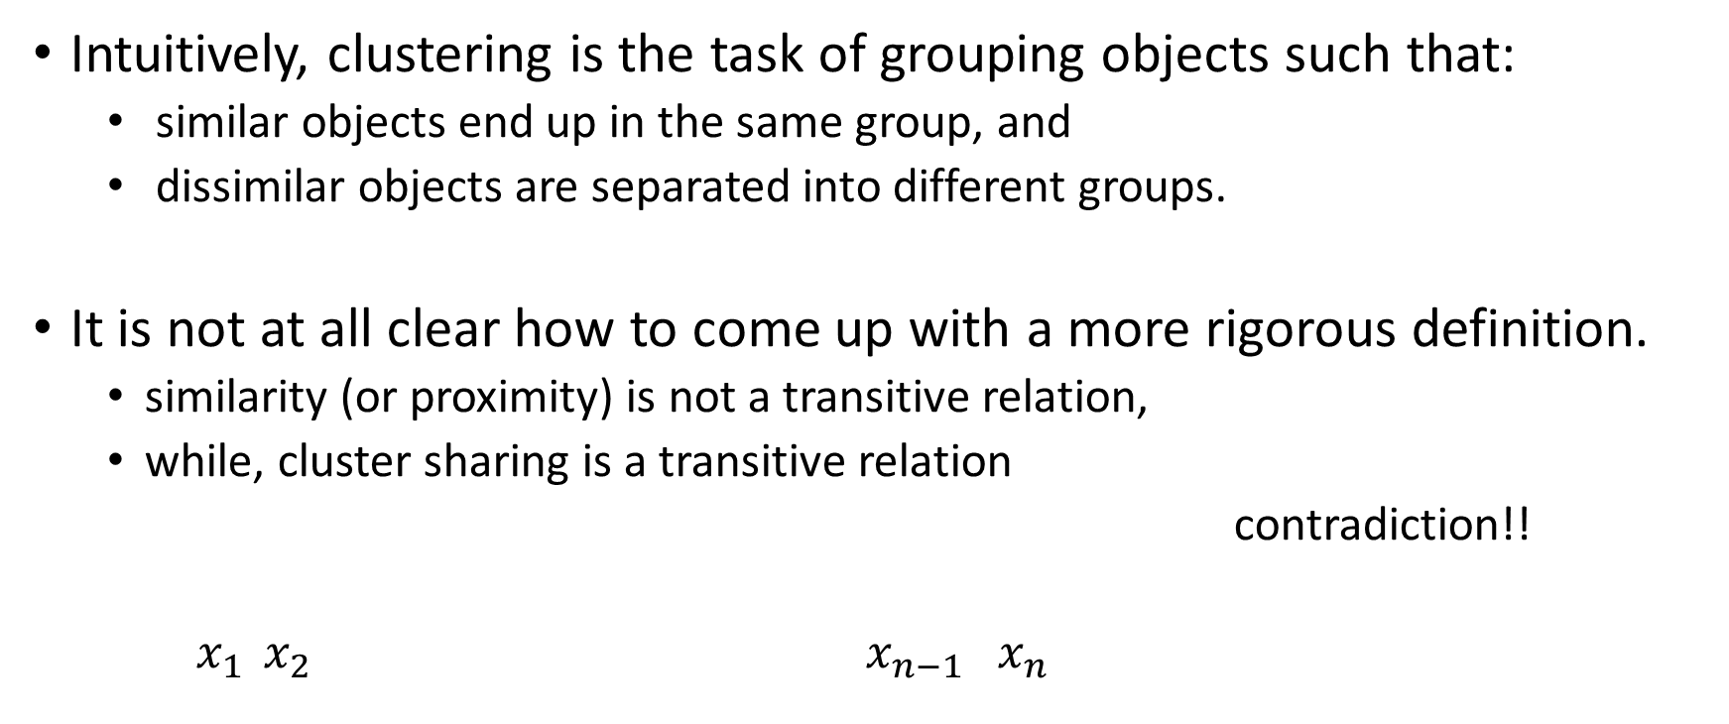
Clustering Definition?
Intuitively, clustering is the task of grouping objects such that:
similar objects end up in the same group, and
dissimilar objects are separated into different groups.
It is not at all clear how to come up with a more rigorous definition.
similarity (or proximity) is not a transitive relation,
while, cluster sharing is a transitive relation
contradiction!!
$x_{1 } x_{2} x_{n−1} x_{n}$

Slide 3
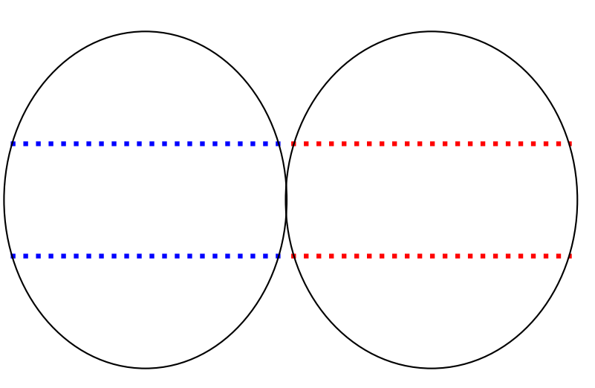
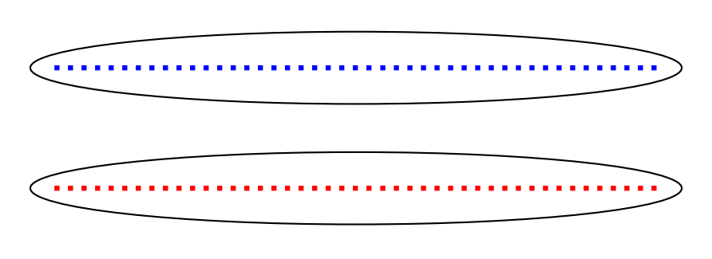
Another Problem: lack of “ground-truth” clustering (there is no absolute success evaluation )
vs
Popular Approach: define a cost function over a parameterized set of possible partition

Slide 4

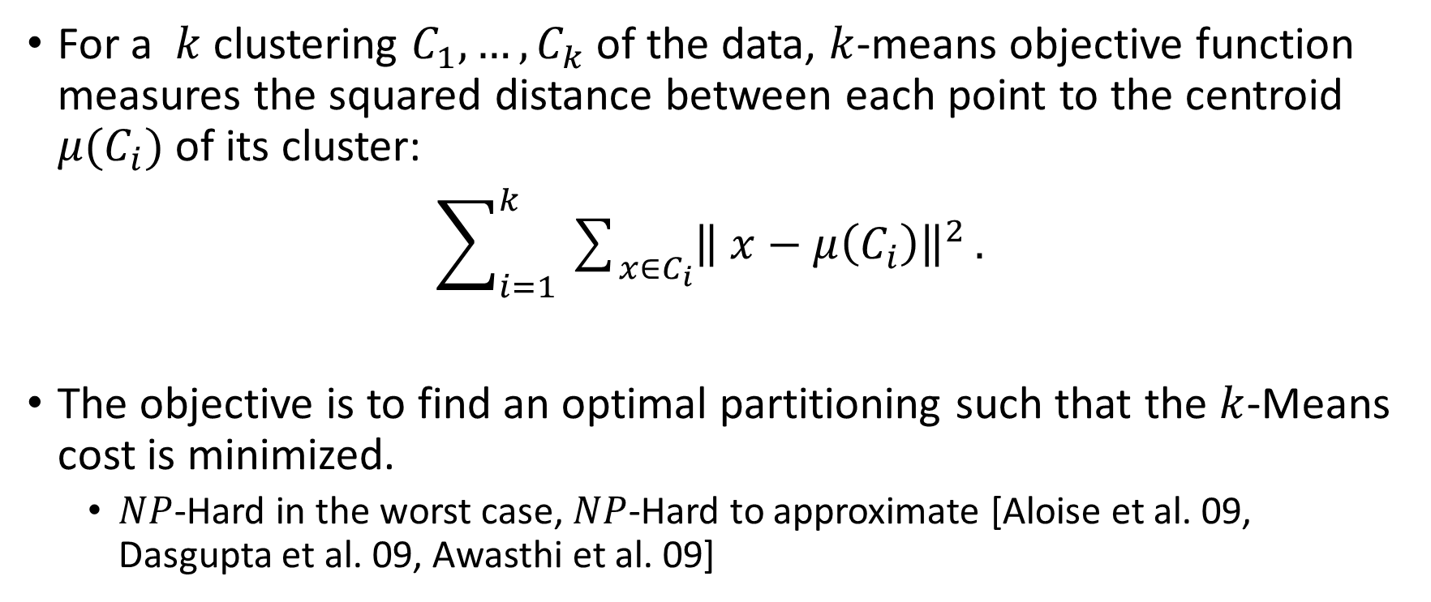
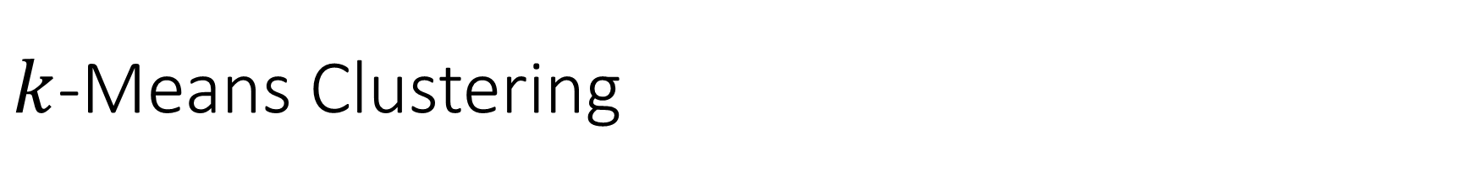
$k$-Means Clustering
For a $k$ clustering $C_{1},…,C_{k}$ of the data, $k$-means objective function measures the squared distance between each point to the centroid $μ(C_{i})$ of its cluster:
$\sum_{i=1}^{k}{\sum_{x∈C_{i}}{{\left\| x−μ\left(C_{i}\right)\right\|}^{2}}}.$
The objective is to find an optimal partitioning such that the $k$-Means cost is minimized.
$NP$-Hard in the worst case, $NP$-Hard to approximate [Aloise et al. 09, Dasgupta et al. 09, Awasthi et al. 09]

Slide 5
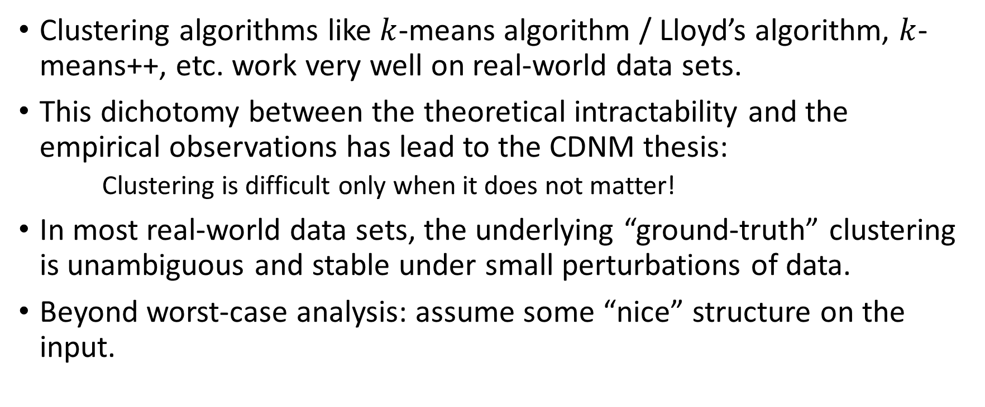
However, in practice…
Clustering algorithms like $k$-means algorithm / Lloyd’s algorithm, $k$-means++, etc. work very well on real-world data sets.
This dichotomy between the theoretical intractability and the empirical observations has lead to the CDNM thesis:
Clustering is difficult only when it does not matter!
In most real-world data sets, the underlying “ground-truth” clustering is unambiguous and stable under small perturbations of data.
Beyond worst-case analysis: assume some “nice” structure on the input.

Slide 6
Intuition: a “nice” structure

Slide 7
Formalizing the Intuition

Slide 8
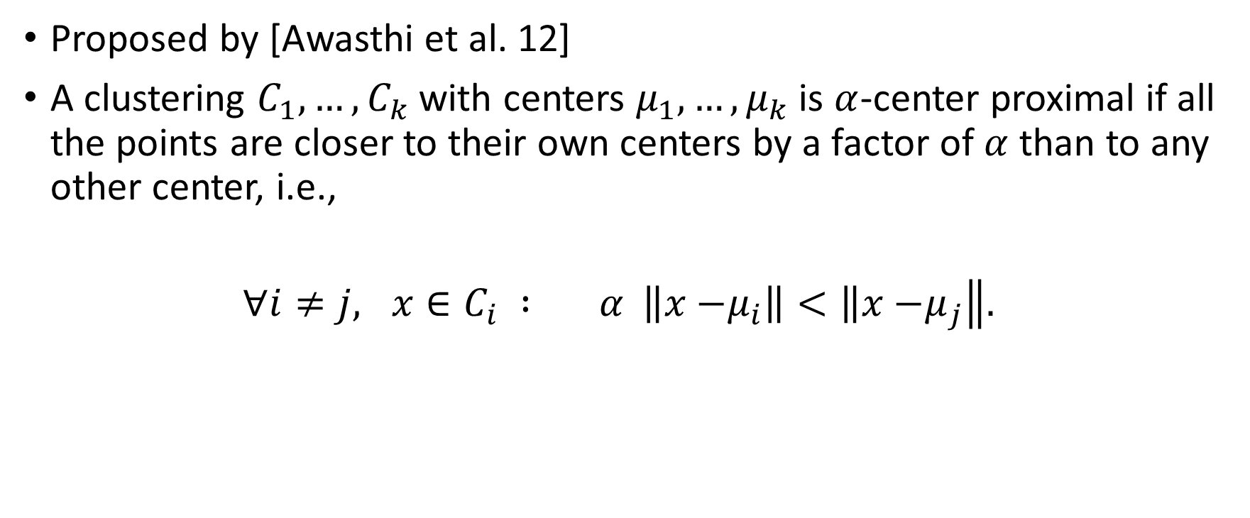
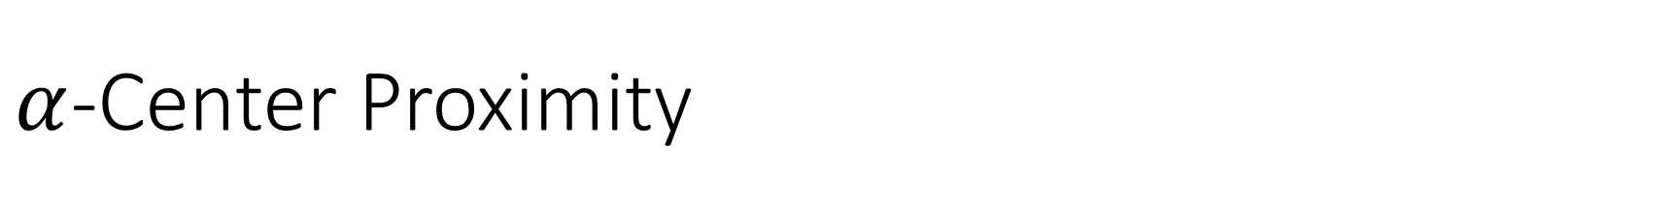
$α$-Center Proximity
Proposed by [Awasthi et al. 12]
A clustering $C_{1},…,C_{k}$ with centers $μ_{1},…,μ_{k}$ is $α$-center proximal if all the points are closer to their own centers by a factor of $α$ than to any other center, i.e.,
$∀i≠j, x∈C_{i} : α \left\|x−\right.\left.μ_{i}\right\|<\left\|x−\right.\left.μ_{j}\right\|.$

Slide 9
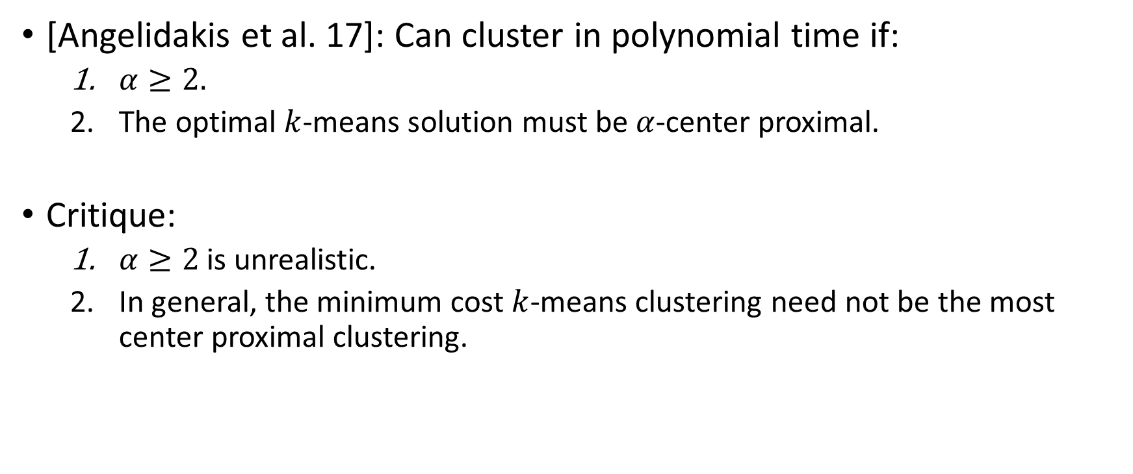
Previous Results
[Angelidakis et al. 17]: Can cluster in polynomial time if:
$α≥2.$
The optimal $k$-means solution must be $α$-center proximal.
Critique:
$α≥2$ is unrealistic.
In general, the minimum cost $k$-means clustering need not be the most center proximal clustering.

Slide 10
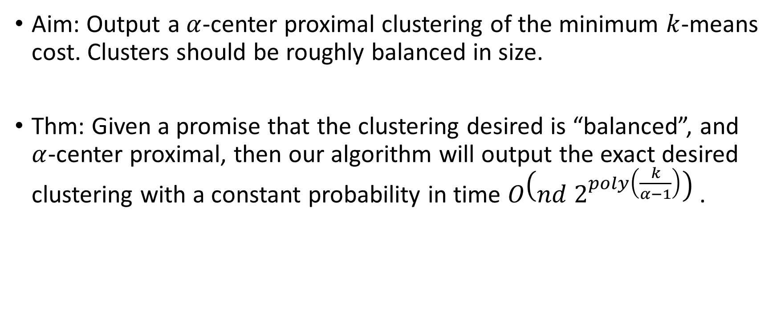
Our Results
Aim: Output a $α$-center proximal clustering of the minimum $k$-means cost. Clusters should be roughly balanced in size.
Thm: Given a promise that the clustering desired is “balanced”, and $α$-center proximal, then our algorithm will output the exact desired clustering with a constant probability in time $O\left(nd 2^{poly\left(\frac{k}{α−1}\right)}\right)$.

Slide 11
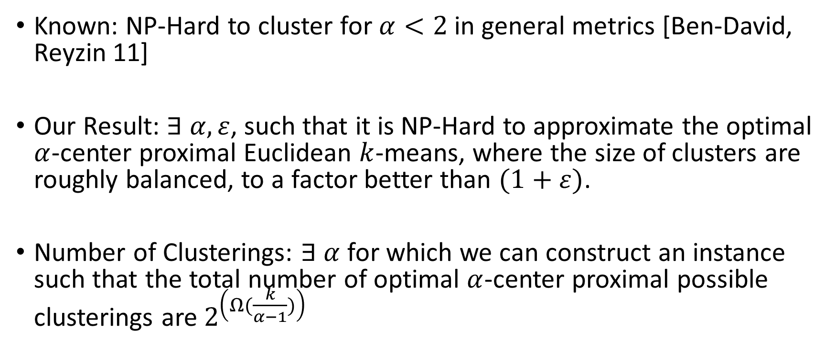
Lower Bounds
Known: NP-Hard to cluster for $α<2$in general metrics [Ben-David, Reyzin 11]
Our Result: $∃ α, ε$, such that it is NP-Hard to approximate the optimal $α$-center proximal Euclidean $k$-means, where the size of clusters are roughly balanced, to a factor better than $(1+ε)$.
Number of Clusterings: $∃ α$ for which we can construct an instance such that the total number of optimal $α$-center proximal possible clusterings are $2^{\left(Ω(\frac{k}{α−1})\right)}$

Slide 12
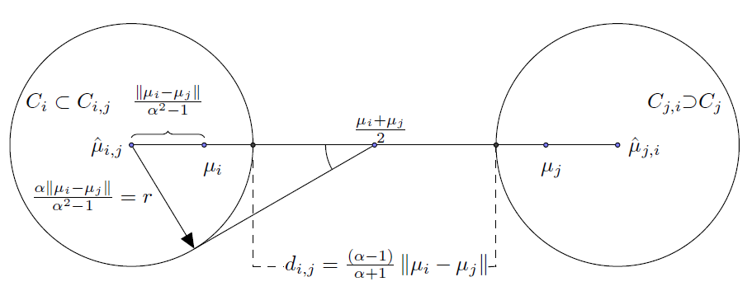
Algorithm Insight 1

Slide 13
Algorithm Insight 2
Approximate Caratheodory Theorem: Sample points uniformly at random from a cluster of bounded radius. Mean of the sample is close to the cluster mean.

Slide 14
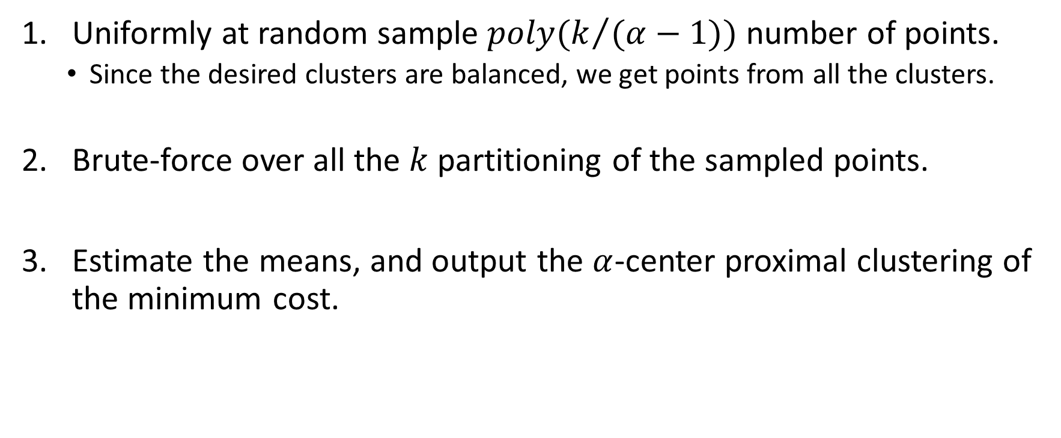
The Algorithm: putting the two together
Uniformly at random sample $poly(k/{(α−1))}$ number of points.
Since the desired clusters are balanced, we get points from all the clusters.
Brute-force over all the $k$ partitioning of the sampled points.
Estimate the means, and output the $α$-center proximal clustering of the minimum cost.

Slide 15
Extensions
Can handle certain class of outliers (see poster)
Result extends to any clustering whose center can be approximated by random samples.

Slide 16
Thank You!

