Slide 1
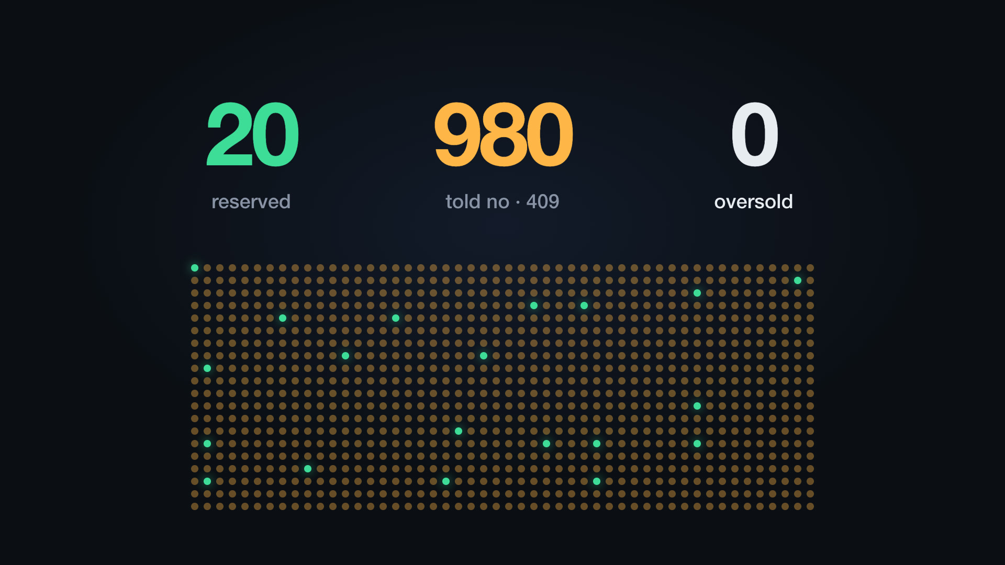
A STORY ABOUT LIMITED STOCK
ReserveCore
20 sneakers, 1,000 shoppers, and a shop that never sells what it doesn't have.
Notes:
This is the story of ReserveCore, told through one small shop's busiest day. No jargon: I'll show a little code only where it helps you see how the idea works.

Slide 2
Meet Maya
Maya runs a small online sneaker shop. On Saturday at 10:00 she releases 20 pairs of a limited sneaker.
More than 1,000 fans are waiting, fingers on the Buy button.
Her nightmare: selling 21 pairs when she only has 20, then emailing a fan to say sorry.
20
1,000
pairs in stock
shoppers waiting
1 second
for most of them to click Buy
Notes:
Meet Maya. She has 20 pairs and more than a thousand fans who will all click Buy within a second of the drop opening. If her shop gets this wrong, she sells shoes she doesn't have, and the people who paid get an apology instead of sneakers.

Slide 3
Four ways drop day can go wrong
The last pair
The double tap
Two shoppers click Buy on the last pair at the same instant. Both see "in stock".
Leo taps Buy as his train enters a tunnel, and his phone sends the request again.
The walk-away
The power cut
Ana puts a pair in her cart, then leaves to cook dinner. The pair sits there, unsold.
A server crashes in the middle of a sale. Was the pair sold or not?
Notes:
Four things go wrong on a day like this. Two people grab the last pair at once. Someone's phone sends the same order twice. Someone walks away mid-checkout and the pair is stuck in their cart. And sometimes a server simply crashes. The rest of the story is how ReserveCore handles each one.

Slide 4
ReserveCore: a careful shop assistant
ReserveCore sits behind Maya's shop and looks after one thing: how many pairs are left.
When a shopper starts checkout, it puts a pair behind the counter for 10 minutes. Pay, and it is sold. Change your mind, and it goes back on the shelf.
On the shelf
Behind the counter
Sold
anyone can take it
held for one shopper
paid for
THE RULE IT NEVER BREAKS
on the shelf + behind the counter + sold = 20, always
Notes:
Think of ReserveCore as a very careful shop assistant. Every pair is in one of three places: on the shelf, behind the counter for one shopper, or sold. The three always add up to 20. The database itself refuses any change that would break that rule, so even a bug in the code can't create a 21st pair.

Slide 5
One checkout, step by step
1
2
3
4
Hold a pair
Shopper pays
Confirm
Or put it back
Shopper starts checkout
Maya's payment provider
Payment went through: sold
Cancel, or the 10 minutes run out
POST /v1/reservations
(not ReserveCore)
POST …/confirm
POST …/cancel
Every step is answered clearly: held, sold, back on the shelf, or "sorry, sold out".
Notes:
Here is one checkout. The shop asks ReserveCore to hold a pair. The shopper pays with Maya's normal payment provider; ReserveCore never touches money. If payment works, the shop confirms and the pair is sold. If the shopper gives up, the shop cancels, and if nobody does anything, the hold simply runs out after 10 minutes. The small grey lines are the actual web addresses the shop calls.

Slide 6
The last pair
CHAPTER 1 · 10:00:00
At 10:00:00, 1,000 requests arrive at once.
ReserveCore lets them line up for the count, one at a time, and asks one question: is there still a pair?
Checking and taking happen in a single move, so two people can never both get the last one.
UNDER THE HOOD
UPDATE inventory
SET available = available - 1
WHERE sku = 'SNKR-10'
AND available >= 1;
Check and take in one step. Everyone after the 20th pair hears "sold out" straight away.
Notes:
Chapter one, ten o'clock. A thousand requests hit at the same moment. The trick is that ReserveCore never asks 'is there a pair?' and then 'take it' as two separate steps, because between those two steps someone else could take it. It does both in one move, inside the database. That one line, available is at least one, is the whole defence against selling a pair twice.

Slide 7
The double tap
CHAPTER 2 · LEO IN A TUNNEL
Leo's order reaches the shop and a pair is held for him, but the reply is lost in the tunnel.
His phone tries again. Without care, that would hold a second pair.
Every order carries a ticket number. ReserveCore remembers each ticket and simply repeats its first answer.
UNDER THE HOOD
POST /v1/reservations
Idempotency-Key: checkout-81723
→ Idempotent-Replayed: true
Same ticket, same answer. Leo gets one pair, not two.
Notes:
Chapter two: Leo on the train. His order worked, but he never saw the answer, so his phone sent it again. Every order carries a ticket number, called an idempotency key. ReserveCore stores the answer under that ticket, so when the same ticket arrives again it just replays the first answer. We tested fifty copies of the same order arriving at once: one pair held, fifty identical answers.

Slide 8
The walk-away
CHAPTER 3 · ANA LEAVES HER CART
Every hold comes with a timer, 10 minutes by default.
When it runs out, a cleaner puts the pair back on the shelf for the next fan. A cleaner runs every second on every server.
Several cleaners can work at once without ever grabbing the same cart.
UNDER THE HOOD
SELECT id FROM reservation
WHERE expires_at <= now()
FOR UPDATE SKIP LOCKED
Each cleaner skips carts another cleaner is already handling.
Notes:
Chapter three: Ana leaves to cook dinner. Her pair shouldn't be stuck for ever, so every hold has a timer. When it runs out, a cleaner returns the pair to the shelf. Because Maya runs more than one server, there are several cleaners, and the words SKIP LOCKED make each one skip carts another cleaner already has in hand. So a pair is never returned twice.

Slide 9
The last second
CHAPTER 4 · SARA, JUST IN TIME?
Sara's payment finishes 10 milliseconds before her hold expires, but her confirmation has to wait a moment in line.
Was she on time? The database's own clock decides, at the very moment of the change, including the time spent waiting.
If she is late, the pair is released right away so someone else can buy it.
UNDER THE HOOD
SET status = 'CONFIRMED'
WHERE clock_timestamp()
< expires_at
Checked after waiting in line, not before. One clock, no arguments.
Notes:
Chapter four is the subtle one. Sara pays just before her deadline, but her confirmation waits a few milliseconds behind other requests. If we checked the time before she queued, we'd let a late order through. So the check uses the database clock at the moment the change is actually made. If she's late, the pair goes straight back on the shelf. We tested this right at the deadline, again and again: every pair ended either sold or released, never both.

Slide 10
The power cut
CHAPTER 5 · EVERY SERVER GOES DOWN
We switched off both servers while 30 shoppers were holding pairs, and waited until every hold had run out.
When the servers came back, all 30 pairs were on the shelf again within a tenth of a second, each exactly once.
Every change happens completely or not at all, so a crash can never leave half a sale behind.
UNDER THE HOOD
BEGIN;
-- take the pair
-- write the hold
-- note it in the history
COMMIT; -- all of it, or none
A crash in the middle undoes the whole step, so nothing is lost or counted twice.
Notes:
Chapter five: the worst case. We cut power to every server while thirty people held pairs, then waited until all their timers had expired. When the servers came back, the cleaners returned all thirty pairs within a tenth of a second, each one exactly once. That works because every change is wrapped up as one all-or-nothing step: either it fully happened, or it never happened.

Slide 11
Drop day, for real
We ran the drop with 1,000 simulated shoppers across two servers.
20
980
0
pairs sold
shoppers told "sold out", politely
pairs oversold
We also broke our own code on purpose, 11 times.
Each time, the automatic tests caught it before it could reach a real shop.
Notes:
So, did it work? We replayed drop day with a thousand simulated shoppers across two servers: exactly twenty pairs sold, nine hundred and eighty people told sold out, and zero oversold. Then we tried to break it ourselves, eleven times, by removing protections one by one. The automatic tests caught every single one.

Slide 12
What we learned along the way
Measure, don't guess
Fail fast
Find the real culprit
A clever speed-up looked great on paper. Careful measurement showed no real gain, so we took it out.
If something gets stuck, a request now gives up after 2 seconds with a clear "try again" instead of blocking everyone.
A few dropped requests turned out to be the laptop's Docker networking, not the shop itself.
503 SERVICE_BUSY · Retry-After: 1
Notes:
Three lessons from reviewing the work like a senior engineer. First, measure instead of guessing: one speed-up sounded clever, but when we measured it properly it made no difference, so it came out. Second, fail fast: if a request gets stuck waiting, it now gives up after two seconds with a clear 'try again', instead of holding up everyone behind it. Third, find the real culprit: a handful of dropped requests under extreme load turned out to be Docker's networking on the laptop, not the shop.

Slide 13
What's next
1
Even faster drops
Make the busiest moment shorter by doing less while a pair is being taken.
2
A page for shop owners
Let Maya add products and keys herself instead of asking a developer.
3
Many drops at once
Measure a whole catalogue of products selling at the same time.
Notes:
What comes next: making the busiest moment even shorter, giving shop owners a simple page to manage their own products, and testing a whole catalogue of drops at the same time.

Slide 14
Maya sleeps well on drop day.
ReserveCore holds stock during checkout and never sells what it doesn't have: not in a rush, not on a double tap, not when carts are abandoned, and not when the power goes out.
Notes:
And that's the story. Maya can open her drop, go to sleep, and know that twenty pairs means twenty pairs. Thank you, happy to take questions.

