Slide 1
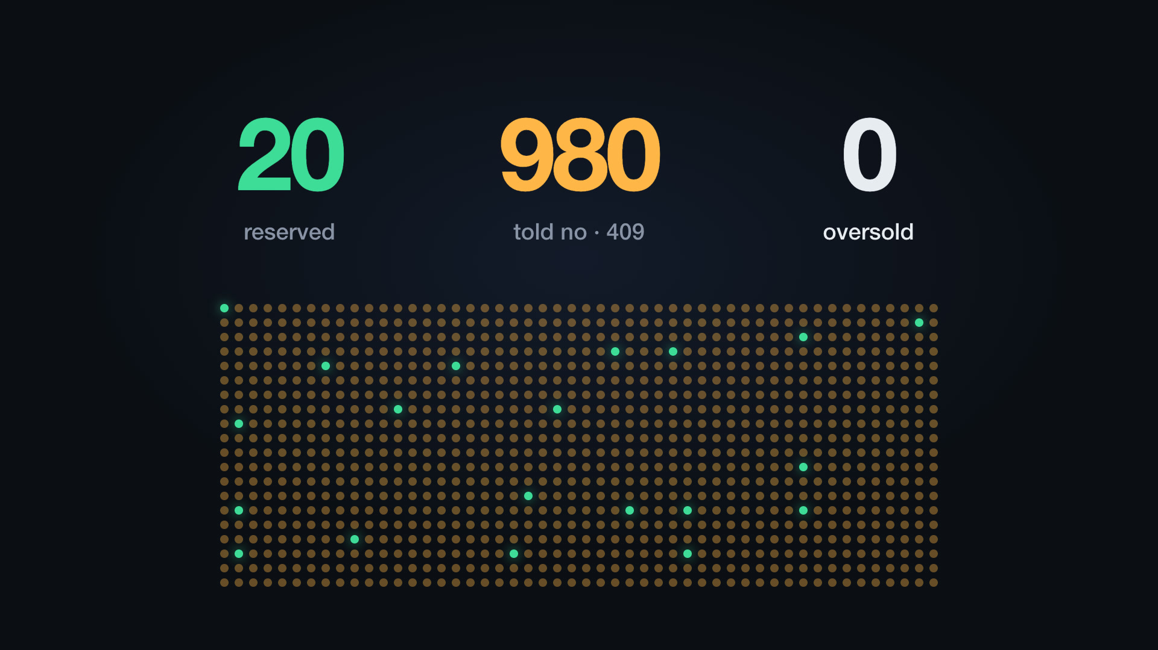
TECHNICAL DEEP DIVE
ReserveCore
Holding limited stock during checkout without overselling, double-applying a request or losing one in a crash.
Spring Boot 4 · Java 25 · PostgreSQL 18
Notes:
ReserveCore is a backend service that online stores call during checkout. It owns one thing: the stock count. In the next few minutes I will show the model, the API, five real failure scenarios and how each is handled, and the proof that it works, all from recorded runs. The image is a frame from the launch video: 1,000 checkout requests for 20 units, exactly 20 reserved, 980 refused, none oversold.

Slide 2
One drop: 20 pairs, 1,000 checkouts in one second
ReserveCore is the HTTP service a storefront calls during checkout. It does not take payments. It owns the stock count, and it has to keep four promises under load.
Never oversell
Apply each request once
Never half-apply
Safe on many servers
At most 20 pairs leave the shelf, however many requests race for them.
A retried or duplicated request never reserves a second pair.
A crash at any moment leaves stock exactly as before or exactly as after.
Any number of app instances share one PostgreSQL database.
In plain terms: the service makes sure a limited item is never sold twice, even when everyone clicks Buy at the same moment.
Notes:
A store sells 20 pairs of a limited sneaker. At 10:00:00 the drop opens and about 1,000 checkout sessions start within a second, spread across two app servers. The naive failure is overselling: two shoppers both see one left and both pay. But there are three more ways this goes wrong in production: retried requests, crashes mid-change, and several servers acting at once. ReserveCore keeps all four promises, and it does it with the database, not with in-memory locks.

Slide 3
Three numbers per SKU, four reservation states
initial = available + held + sold
Enforced on every write by a CHECK constraint; each quantity is also kept at 0 or more.
From | Event | To | Stock change
new | reserve, enough available | ACTIVE | available − q, held + q
ACTIVE | confirm, before expires_at | CONFIRMED | held − q, sold + q
ACTIVE | cancel, before expires_at | CANCELLED | held − q, available + q
ACTIVE | worker, at or after expires_at | EXPIRED | held − q, available + q
CONFIRMED, CANCELLED and EXPIRED are final. Every transition also appends a row to the movement ledger with the quantities after it and the request id that caused it.
In plain terms: every unit is free to reserve, set aside for a checkout, or sold, and the three always add up to the total.
Notes:
Each SKU is one row with three working numbers. Available can be reserved now, held is set aside for an ongoing checkout, sold is confirmed. Their sum always equals the initial stock, and PostgreSQL itself rejects any write that breaks that. A reservation is a small state machine with one way in and three ways out. The ledger means any number on the dashboard can be explained line by line, including which request changed it.

Slide 4
One checkout through the API
REQUEST
RESPONSE
POST /v1/reservations
Authorization: Bearer rcsk_devalice_…
Idempotency-Key: checkout-81723
{"sku": "SNKR-10", "quantity": 1,
"holdSeconds": 600}
HTTP/1.1 201 Created
Location: /v1/reservations/01a12e0c-…
{"id": "01a12e0c-…",
"status": "ACTIVE",
"expiresAt": "2026-10-12T10:10:00Z"}
After payment the storefront calls POST …/confirm; on abandon, POST …/cancel; otherwise the hold expires. Every error has one shape, RFC 9457 problem details with a stable code:
409 {"code": "INSUFFICIENT_STOCK", "detail": "Requested 1 of SKU SNKR-10 but only 0 available.", …}
In plain terms: the shop asks for a hold, then confirms after payment or cancels; every error says exactly what went wrong.
Notes:
This is the whole client contract for one checkout. The storefront authenticates with a merchant API key, and every write carries an Idempotency-Key, here checkout-81723, which comes back in the retry scenario. The response gives the hold and its expiry. Then exactly one of three things happens: confirm, cancel, or expiry. Errors are machine-readable: a stable code such as INSUFFICIENT_STOCK, RESERVATION_EXPIRED or IDEMPOTENCY_KEY_REUSED, plus the request id that also appears in the logs.

Slide 5
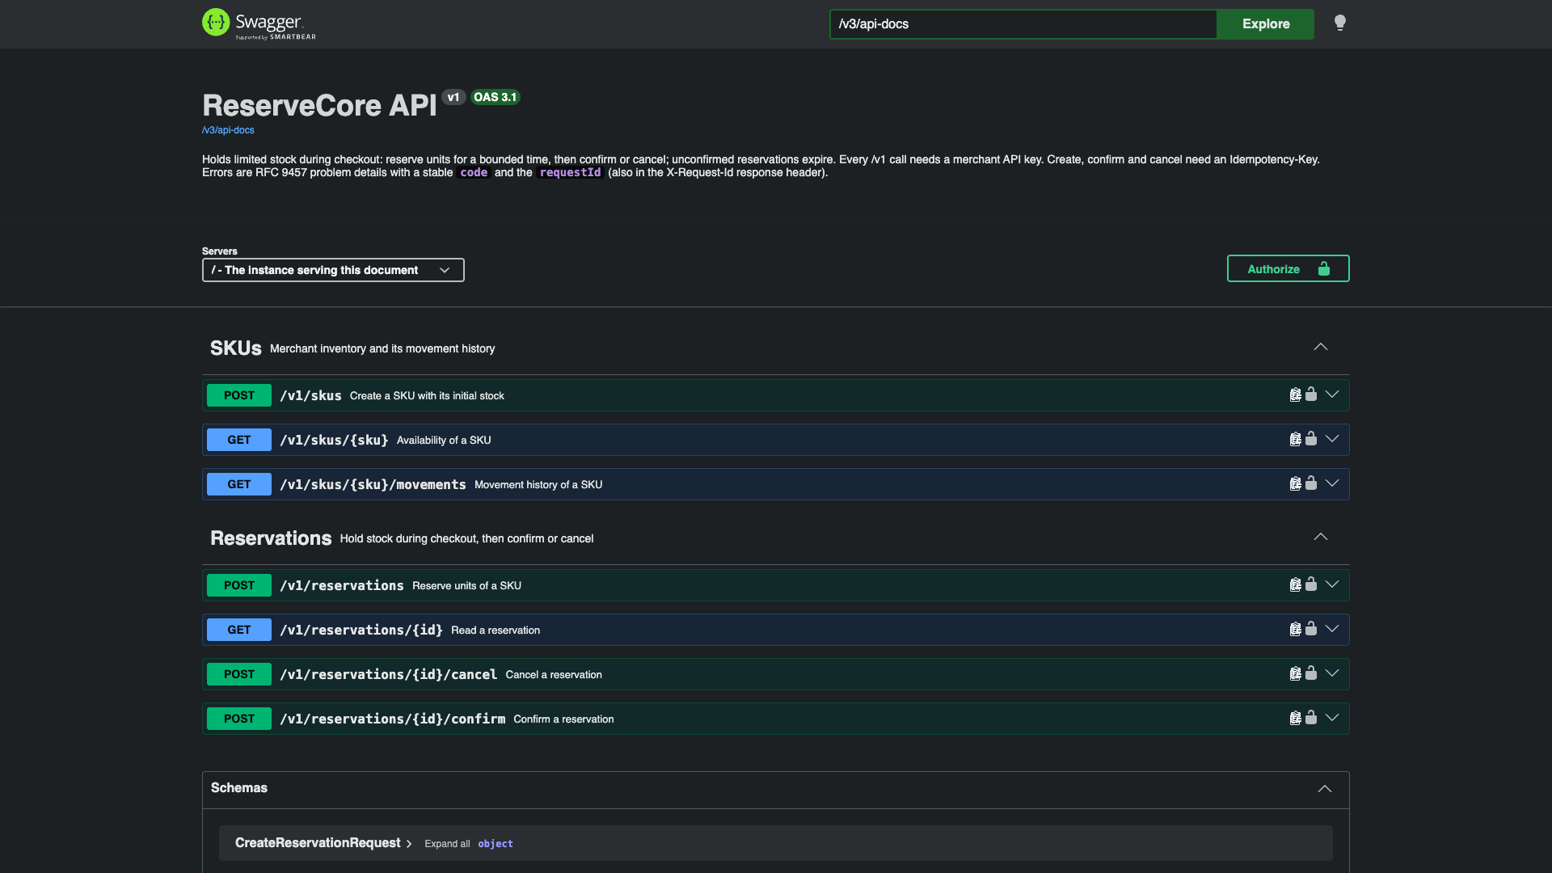
Seven endpoints, documented and drift-checked
SKUs
create, read availability, paged movement history
Reservations
reserve, read, confirm, cancel; writes need an Idempotency-Key
Drift check
the OpenAPI spec is committed, and a test fails the build when the code no longer matches it
In plain terms: seven web addresses do everything, and the build fails if the documentation drifts from the code.
Notes:
This is the real Swagger UI served by a running instance. Three endpoints manage SKUs and their history; four manage reservations. The spec is generated from the code, committed to the repository, and a test compares the two on every build, so the documentation cannot silently go stale. Every call needs a merchant API key, stored only as a SHA-256 hash.

Slide 6
Two shoppers, one last pair
SCENARIO 1 OF 5
Read, then write (naive)
One conditional UPDATE
T1 SELECT available → 1
T2 SELECT available → 1
T1 UPDATE available = 0
T2 UPDATE available = −1 oversold
UPDATE inventory
SET available = available - :q,
held = held + :q
WHERE sku = :sku AND available >= :q
RETURNING available, held, sold;
T2 waits on T1's row lock. PostgreSQL then re-checks the WHERE clause against the committed row, matches nothing, and T2 gets 409 INSUFFICIENT_STOCK. No application locks, so it holds across every server.
In plain terms: the database checks and takes the last unit in one step, so two buyers can never both get it.
Notes:
The classic bug: check, then act. Both transactions read 1, both write, and stock goes negative. ReserveCore makes the check and the deduction one statement. When two requests hit the same row, the second waits for the first's lock; after the first commits, PostgreSQL re-evaluates the WHERE clause on the new row version, so available >= 1 is now false and zero rows match. That becomes a clean 409. I tested the naive version as a deliberate bug: requests got past the check and only the CHECK constraint stopped them, as 500 errors. So the constraint is the safety net, and the conditional UPDATE is the mechanism.

Slide 7
The shopper in a tunnel
SCENARIO 2 OF 5
Situation | Result
Retry after the response was lost | Stored response replayed, header Idempotent-Replayed: true
50 copies at the same moment | Copies wait on the key, then replay: 1 reservation
Same key, different body | 409 IDEMPOTENCY_KEY_REUSED
First attempt failed with 500 | Record rolled back too; the retry runs fresh
First statement of the same transaction
INSERT INTO idempotency_record
(merchant_id, operation,
idempotency_key, request_hash)
VALUES (…)
ON CONFLICT DO NOTHING;
In plain terms: if the same request arrives twice, the second gets the first answer instead of a second reservation.
Notes:
The shopper taps Buy as the train enters a tunnel. The reservation commits, the response is lost, the app retries. Every write carries an Idempotency-Key, and the first statement of the business transaction inserts it. If the key exists with the same SHA-256 request hash, we return the stored response byte for byte. Two copies arriving at once serialize on the primary key: the second waits, then replays. In the demo, 50 simultaneous copies gave 50 identical 201s and one reservation. A different body under the same key is a 409. A 500 is never recorded, because the whole transaction rolled back, so the retry simply runs. Business refusals like out of stock are recorded, so a replay reports what originally happened. Records are kept 24 hours.

Slide 8
Paying at the last millisecond
SCENARIO 3 OF 5
Example: the hold expires at 10:10:00.000. Payment finishes at 10:09:59.990, then the confirm waits 15 ms for a row lock.
SELECT … FROM reservation WHERE id = :id FOR UPDATE; -- wait for the lock
UPDATE reservation SET status = 'CONFIRMED', resolved_at = clock_timestamp()
WHERE id = :id AND clock_timestamp() < expires_at; -- time read after the lock
now(): rejected design
clock_timestamp(): used
Returns the transaction's start time, so the late confirm would be accepted.
Read after the lock, so the 15 ms count: 409 RESERVATION_EXPIRED, and the overdue hold is released on the spot.
Boundary test, 7 runs: 30 holds expiring 30 ms ahead, confirms and workers released together. Every hold ended CONFIRMED or EXPIRED, never both.
In plain terms: the deadline is judged by the database clock at the moment of the change, and a late request releases the hold.
Notes:
This is the subtle one. The timestamps are an illustrative example. The confirm arrived before the deadline but had to wait 15 ms for a lock held by another request. A SELECT FOR UPDATE computes its output before it waits, and now() is the transaction's start time, so either would let a late confirm through. ReserveCore checks expiry in the UPDATE that runs once the lock is held, using clock_timestamp(), so the waiting time counts and the confirm is refused. The worker and a confirm can never both win: both need the row lock and both require status ACTIVE. The boundary test fired confirms and four workers together, right at the expiry, seven times: the results split both ways, and no hold ever ended both confirmed and expired.

Slide 9
Abandoned carts, many workers
SCENARIO 4 OF 5
Runs every second on every instance
Each batch of up to 100 is one transaction
Stock goes back in ascending row id, so two workers never deadlock
No leases and no in-memory timers
WITH due AS (
SELECT id FROM reservation
WHERE status = 'ACTIVE'
AND expires_at <= now()
ORDER BY expires_at LIMIT 100
FOR UPDATE SKIP LOCKED)
UPDATE reservation r
SET status = 'EXPIRED', resolved_at = now()
FROM due WHERE r.id = due.id;
4 workers, 200 due holds: each expired exactly once, split 60 / 40 / 50 / 50.
In plain terms: a cleanup job on every server puts abandoned holds back on the shelf, and two jobs never grab the same hold.
Notes:
Nobody calls cancel for an abandoned cart, so every server runs an expiration pass once a second. The key clause is SKIP LOCKED: two servers running this at the same moment receive disjoint batches instead of blocking or both expiring the same row. A row a confirm is holding is skipped and retried on the next pass. Each batch is one transaction; if a server dies mid-batch, it rolls back and any instance picks the rows up again. In the test, four concurrent workers drained 200 due holds; every hold expired once, with the work split roughly evenly.

Slide 10
Pull the plug on every server
SCENARIO 5 OF 5
30
2 / 2
30 / 30
92 ms
holds active
instances killed with SIGKILL
released, each exactly once
after the restarted servers were ready
The holds expired while nothing was running. On restart the first worker passes reclaimed all 30, with exactly one EXPIRED ledger row each.
Why it is safe: every operation is one transaction, so a kill leaves it fully committed or never started, and one lock order everywhere, idempotency record then reservation then inventory, rules out deadlocks.
In plain terms: even if every server is killed at the worst moment, nothing is lost and nothing is counted twice.
Notes:
The harshest demo. Thirty shoppers hold pairs with five-second holds. Both servers get SIGKILL, so nothing is running, and the holds expire with no worker alive. On restart, within 92 milliseconds of the servers reporting ready, all thirty were back on the shelf, each released once, with one EXPIRED row per reservation in the ledger. The demo also checks that the kill happened before the first hold expired, so the reclamation really happened after the restart.

Slide 11
Rules PostgreSQL enforces, whatever the code does
Stock always balances
Released at most once
Stores stay apart
CHECK (initial_quantity =
available + held + sold)
UNIQUE (reservation_id)
WHERE kind IN ('CONFIRMED',
'CANCELLED', 'EXPIRED')
FOREIGN KEY (merchant_id,
inventory_id) REFERENCES
inventory (merchant_id, id)
and every quantity stays at 0 or more
one resolution row per reservation in the ledger
a reservation cannot point at another store's SKU
API keys look like rcsk_<prefix>_<secret>; only a SHA-256 hash is stored and compared in constant time. Another store's resources answer 404, so the API does not even reveal that they exist.
In plain terms: the database itself refuses any change that would break the rules, even if the code had a bug.
Notes:
Application code can have bugs, so the last line of defense is in the schema. A write that unbalances stock or makes it negative is rejected. A second release of the same reservation violates a partial unique index, which is exactly what stopped the double resolutions when I removed locks on purpose. Composite foreign keys that include the merchant id make cross-store links impossible. And authentication never stores a usable key.

Slide 12
Proof from real runs
Check | Result
Integration tests on real PostgreSQL 18 (Testcontainers), no mocks, no sleeps | 66 service + 4 demo tests passing
Deliberate bugs: row lock, transaction, stock check, replay, SKIP LOCKED, merchant filter, expiry check… | 11 of 11 caught (one after tightening a test)
Demo: 1,000 requests for 20 units, two instances | 20 reserved · 980 × 409 · 0 unexpected
Ledger audit on about 20,500 reservations and a restored backup | 0 discrepancies
One hot SKU on a laptop, 50 to 1,000 concurrent clients | 1,600–3,500 req/s mostly refused; 1,000–1,500 reservations/s
Benchmark: Apple M4, Docker Desktop, two app instances with 10 database connections each; client on the same machine. Raw outputs are kept in docs/benchmark/.
In plain terms: we tried to break it in every way we could think of, and it held.
Notes:
Everything on this slide is measured, nothing estimated. The tests run against a real PostgreSQL container, and races are released together with latches rather than timed with sleeps. To check that the tests can actually fail, I introduced eleven deliberate bugs, one at a time: removing the row lock, the transaction, the stock condition, the idempotency replay, SKIP LOCKED, the merchant filter, the expiry check and more. The suite caught every one; one needed a stricter assertion first. The demo runs every scenario against two live instances, and the audit is a SQL script that reconciles stock, reservations and the ledger.

Slide 13
What a senior review of the code found
Finding | Change | Evidence
Reserve held the hot row lock for four round trips | Stock, reservation and ledger in one SQL statement | Same results; A/B within noise, kept for one atomic write
Lock waits had no limit | 2 s lock timeout, then 503 SERVICE_BUSY | LockTimeoutTest holds a real row lock
Overdue holds read ACTIVE and stayed held | Effective status; expire on first touch | Lifecycle and worker tests
Worker wrote ledger rows one at a time | One batch per product | Worker tests unchanged and green
Outcomes invisible in metrics; probes flooded logs | Outcome counter by error code; probes not logged | ObservabilityTest
Idea: check stock before locking | Tried, measured, removed | PostgreSQL never locks a row that fails the check
In plain terms: every change was proven with a test that fails without it, and one idea was dropped because the numbers said so.
Notes:
I then reviewed my own code the way a senior reviewer would, in order of impact. The reservation held the hot row lock for four database round trips; lock waits had no limit, so one stuck transaction could block every request for that product; expired holds still read as ACTIVE; the worker wrote ledger rows one at a time while holding locks; and the metrics could not tell an out-of-stock from a duplicate-key conflict. Each fix has a test that fails without it. One idea, a lock-free availability check before the update, was tried, measured and removed, and I will show why.

Slide 14
Failing fast, and releasing overdue holds on touch
Bounded lock waits
Overdue holds
SET LOCAL lock_timeout = '2000ms'
{"status": "EXPIRED", "reclaimPending": true}
First statement of every API transaction; Flyway and the worker are unaffected
No lock within 2 s: PostgreSQL error 55P03, the transaction rolls back
Answer: 503 SERVICE_BUSY with Retry-After: 1
Nothing recorded, so a retry with the same key is safe
A hold past its deadline reads EXPIRED, never a stale ACTIVE
The first confirm or cancel that finds it overdue releases the units now: 409 RESERVATION_EXPIRED
The ledger row records which request released it
Same row lock and once-only index: released exactly once
In plain terms: a stuck request gives up after 2 seconds instead of blocking everyone, and an expired hold is freed when touched.
Notes:
Two behaviour changes. First, bounded waits: every API transaction starts with SET LOCAL lock_timeout of two seconds, scoped to that transaction only. If a request cannot get a row lock in time, PostgreSQL raises error 55P03, the transaction rolls back, nothing is recorded for idempotency, and the client gets 503 SERVICE_BUSY with Retry-After one second, so retrying with the same key is safe. The test holds a real row lock from a second connection, so the request genuinely waits; no sleeps. Second, overdue holds: reading one now shows EXPIRED with reclaimPending true, and the first confirm or cancel that finds it overdue releases the units immediately instead of waiting for the worker. The ledger row records which request did it.

Slide 15
Measuring the hot path instead of guessing
A/B, 9 runs each | Before | After | Change
Mostly refused, 200 clients | 2,391 | 2,092 | −13%
Mostly refused, 1,000 clients | 2,015 | 2,162 | +7%
All succeed, 200 clients | 1,196 | 998 | −17%
All succeed, 1,000 clients | 1,230 | 1,413 | +15%
Requests per second, median. Signs flip between rounds and ranges overlap: no difference beyond the ±20% run-to-run noise. A precheck before locking measured worse and was removed.
Next lever: no application round trips while the row is locked (server-only idempotency write).
In plain terms: requests spend most of their time queuing for the one row, so the next speed-up is fewer app round trips while holding it.
Notes:
This is the most important engineering slide. I rewrote reserve, confirm and cancel so each writes stock, reservation and ledger in one SQL statement, which removes two round trips from the time the hot row is locked. Then I measured it properly: two images differing in one file, the load client inside Docker, interleaved rounds, 144 runs. Result: no difference beyond the run-to-run noise of about twenty percent. The lock-free precheck was worse, because PostgreSQL does not lock a row that fails the WHERE clause, so it only added a round trip; I removed it. Sampling the database during load explains the result: 73 percent of session time is queued on the row lock, 13 percent is the lock holder waiting for the application, and disk flushes take only 60 microseconds. So the next speed-up is a server-only transaction for the idempotency record, which I proposed rather than built.

Slide 16
Tracing the lost connections
Step | Result
Reproduce: fresh servers, a 1,000-client burst after a warm-up, client on the host | 2 of 6 runs lost 1 to 11 requests
Hypothesis: Tomcat accept queue too small; raise it from 100 to 1,024 | Still lost 38 in 1 of 6 runs: falsified
Remove Docker Desktop port forwarding: client inside the Docker network | 0 of 6 runs, and 0 in 144 benchmark runs
Did lost requests reach the application? | No: no idempotency record, no log line, so retries are safe
Most likely cause: Docker Desktop networking under connection bursts, not the service. Not proven, because six clean runs could happen by chance, but 144 more clean runs support it.
In plain terms: the few dropped connections happen in Docker Desktop on a laptop, before requests ever reach the service.
Notes:
The open finding from earlier: under bursts of about a thousand new connections, a few requests lost their connection. I treated it like a bug: first a command that reproduces it, which failed two of six runs. The first hypothesis, a too-small Tomcat accept queue, was falsified: a queue of 1,024 still lost requests. Then I removed Docker Desktop port forwarding from the path by running the client inside the Docker network: zero losses in six runs and in all 144 benchmark runs. The lost requests never reached the application, so nothing changed and retries are safe. The most likely cause is Docker Desktop networking on a laptop, not the service; I say most likely because six clean runs is not proof.

Slide 17
Operating it, and what is still open
In place
Known limits
JSON logs with requestId and merchantId; probes are not logged
Prometheus: outcomes by error code, worker lag, time since the last successful pass
Writes wait at most 2 s for a lock, then 503 SERVICE_BUSY
Database outage: requests fail within 5 s, metrics stay up
Runbook with drilled backup, restore and key issuance
One hot SKU is capped by its row lock (73% of database time is spent queuing for it)
Load spread across many SKUs is not benchmarked yet
No admin API: stores and keys are created with SQL
Actuator endpoints need no key; keep them internal
Burst connection drops traced to Docker Desktop networking, not the service
In plain terms: it can be watched, backed up and recovered, and every known weakness is written down.
Notes:
For operations there are structured logs, Prometheus metrics including outcomes by error code, worker lag and the age of the last successful expiration pass, and a readiness check that includes the database. Writes give up after two seconds on a lock with a clear 503. I drilled a database outage: requests fail within five seconds, metrics keep answering, and both instances recover without a restart. The limits are written down: one hot product is capped by its row lock, many-product load is not benchmarked yet, there is no admin API, actuator endpoints must stay internal, and the burst connection drops trace to Docker Desktop networking.

Slide 18
Correctness lives in the database
One conditional UPDATE stops overselling.
A stored idempotency key stops duplicates.
Row locks and database time settle races.
SKIP LOCKED makes cleanup safe on every server.
Notes:
To close: ReserveCore moves correctness into the database. One conditional UPDATE stops overselling, a stored idempotency key stops duplicates, row locks plus database time settle the races, and SKIP LOCKED makes cleanup safe on every server. Then it proves all of that by actually breaking things. Questions.

