Slide 1

Data Analytics + Python
DateTime
Math
Random
Modules and Libraries

Slide 2
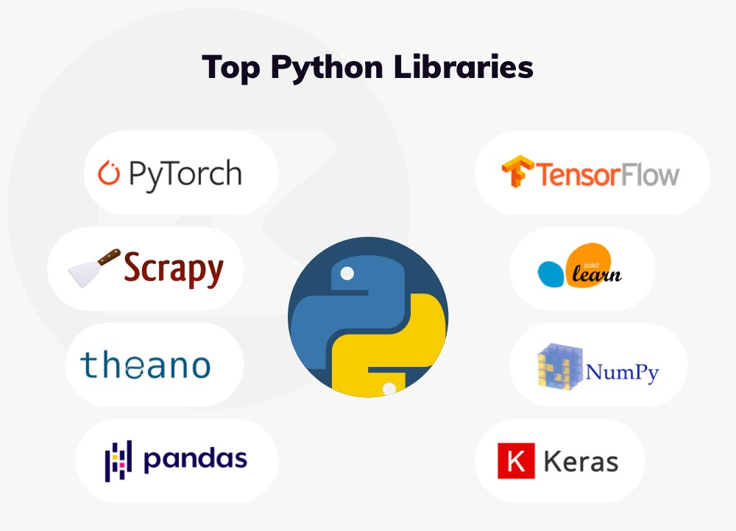
What are Python modules?
LIBRARIES OF PRE-WRITEN CODE THAT ARE WITHIN PYTHON TO ACCOMPLISH DIFFERENT GOALS -- REDUCES HAVING TO REWRITE A LOT OF CODE

Slide 3
There are 137,000 Python Libraries, and growing … !
TensorFlow - NumPy
SciPy - BeautifulSoup
Pandas - Scrapy
Matplotlib - PyTorch
Keras - SciKit-Learn
NetWorkX - Eli5

Slide 4
Python Libraries we’ll use
DateTime = elegantly handle date and time calculations
Math = advanced functions normally found on calculator
Random = random generator of chance and possibilities
Pandas = (Python Data Analysis) used for data analysis and cleaning of data
NumPy = (Numerical Python) use for numerical computation and multi-dimensional arrays
Matplotlib = a graphic plotting library
BeautifulSoup = used for web crawling and data scraping

Slide 5
Anytime you use a module, you will have to IMPORT it into your program to use it.
import {module_name_here}
import datetime

Slide 6
Datetime
Not a data type of its own
We import the module datetime to work with dates and date objects
%a = weekday, abrev.
%A = weekday, full name
%w = weekday, number
%d = day of month
%b = month, abrev.
%B = month, full name
%m = month as a number
%y = year, short
%Y = year, full

Slide 7
Datetime
import datetime
x = datetime.datetime.now()
Y = datetime.datetime(2020, 5, 17) print(x)
print(Y)

Slide 8
Datetime
import datetime x = datetime.datetime.now() print(x.year) print(x.strftime("%A"))
import datetime x = datetime.datetime(2018, 6, 1) print(x.strftime("%B"))

Slide 9
Math Module
Basic Operators
+ = addition
- = subtraction
/ = division
* = multiplication

Slide 10
x = 39
x += 5
print(x)
y = 100
y -= 75
print(y)
print(math.pi)
Import math

Slide 11
Random Module
Allows you to use random numbers when needed
import random
prob = random.random()
print(prob)
diceThrow=random.randrange(1,10)
Print(diceThrow)

