Slide 1

Data Analytics Intro to Python

Slide 2


What is a programmer?
What is an analyst?
A creator
A problem solver
A thinker
A creator
A problem solver
A thinker
That is why they fit together so well!

Slide 3
What will you learn along the way?
To think methodically
Solve Problems
Create small programs to practice your coding skills

Slide 4
Algorithms
What is an algorithm?
Programming is the skill that allows a computer scientist to take an algorithm and represent that solution in a program that can be followed by a computer!
Programs are written in programming languages such as Python, html, JavaScript etc.
Series of steps to solve the problem at hand
What is an program?
Series of instructions telling a computer how to solve a problem

Slide 5
Python Learning Materials
Python For Everyone -- PY4E
This program was created by Dr. Charles Severance (a.k.a. Dr. Chuck).
He’s a Clinical Professor at the University of Michigan School of Information Technology.
https://www.py4e.com/

Slide 6

PYTHON
Python is considered a high-level language
Easier to use a high-level language
Programs must be processed before they can run
The lowest level languages are known as Machine Languages.
Machine Languages encode instructions in binary that is easily executed by computers
More like natural language
Takes less time to write
Shorter and easier to read
More likely to be correct
High-level languages need to be “translate” into machine language for computers to understand.

Slide 7
Two “ways” to Process Code
Interpreter
Compiler
Reads a high-level program and executes it, meaning it does what the program says.
Processes a little at a time, reading lines and performing computations
Reads the program and translates it completely before starting to run it.

Slide 8
Python is an Interpreted language
The source code of a Python program is converted into bytecode that is then executed by the Python virtual machine.
Python is different from major compiled languages, such as Java, C and C + +; Python code is not required to be built and linked like code for these languages.

Slide 9


Two Ways to use Python
Shell
Files

Slide 10

You’ve chosen to learn another language! Be patient, and keep practicing!

Slide 11
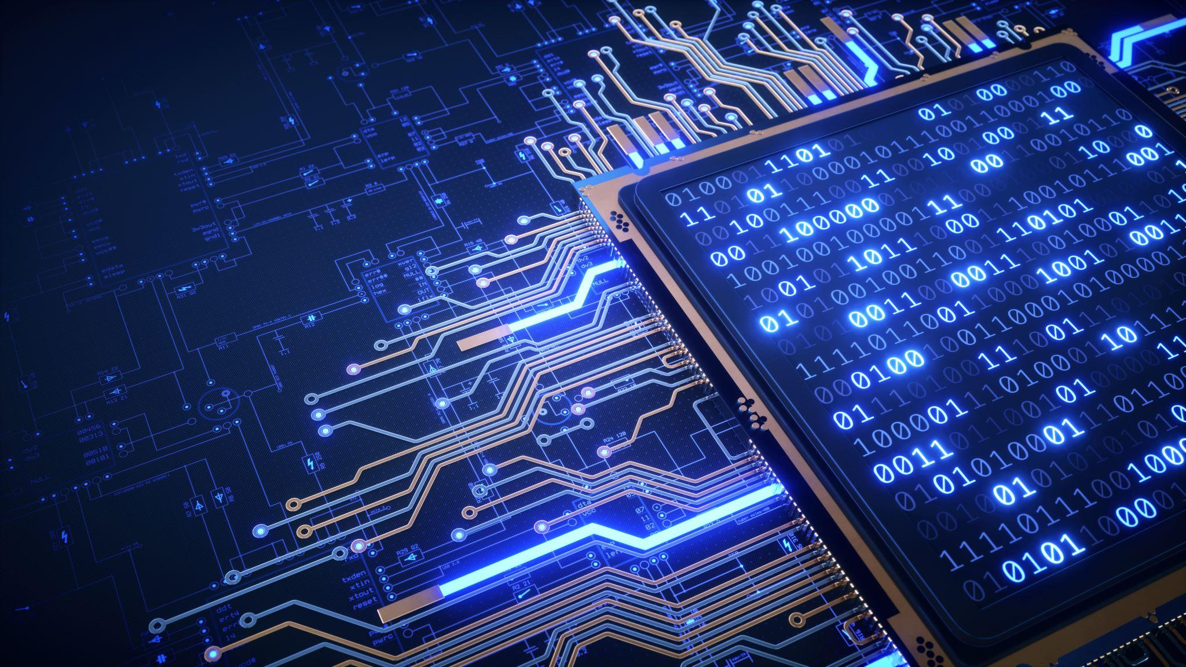
Types of Languages
Natural
Formal
Form on their own
Spoken languages
Slang - great example
Are designed by people!
Programming languages fall under this
There are rules about grammar, syntax, and punctuation

Slide 12
Common Vocabulary in Python
VALUE – a number or string etc. that can be stored in a variable or computed in an expression.
VARIABLE – a name that refers to a value
VARIABLE NAME - A name given to a variable. Variable names consist of a sequence of letters and digits that begin with a letter.
“In best programming practice, variable names should describe their use in a program, making the program self documenting.”

Slide 13
Str = a Python data type that holds a string of characters
Operators = special symbols that represent a simple computation
Data Type = a set of values
Comment = information in a program that is meant for other programmers (used with ## infront)
Input = a command in a program that prompts the user to put in an answer
Output = the result of a program

Slide 14
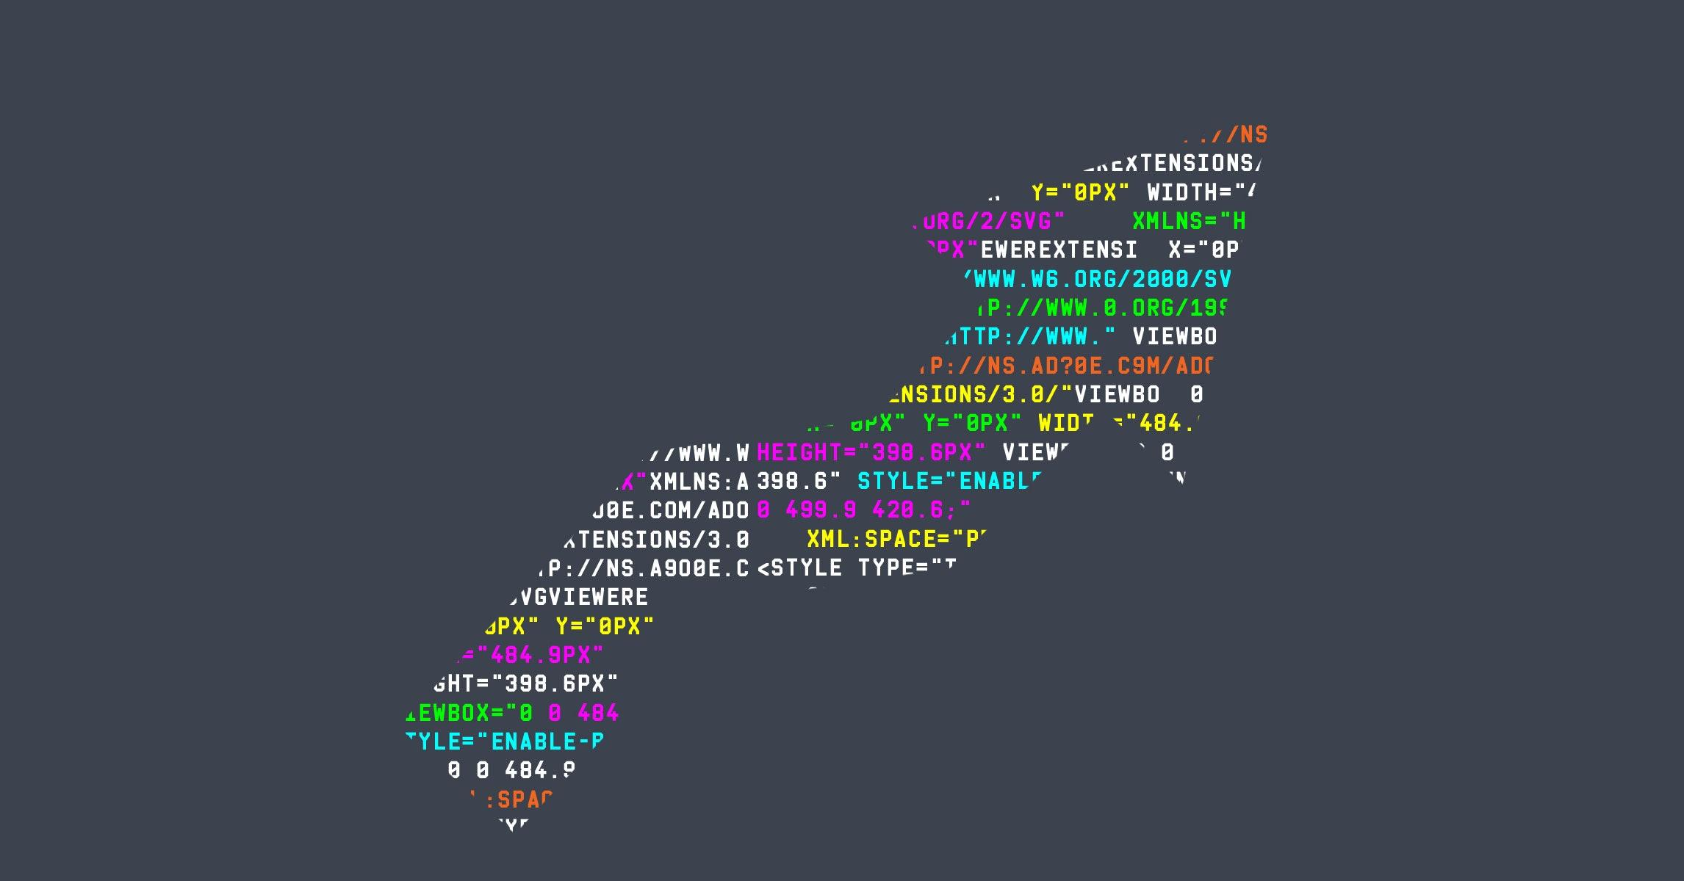
Let’s write our First Program!

Slide 15
print(“Hello, World!”
print(Hello, World!”)
(“Hello, World!”)

Slide 16
Input(What is your name?”)
inputHow you?)
input(“What you names?”)

Slide 17
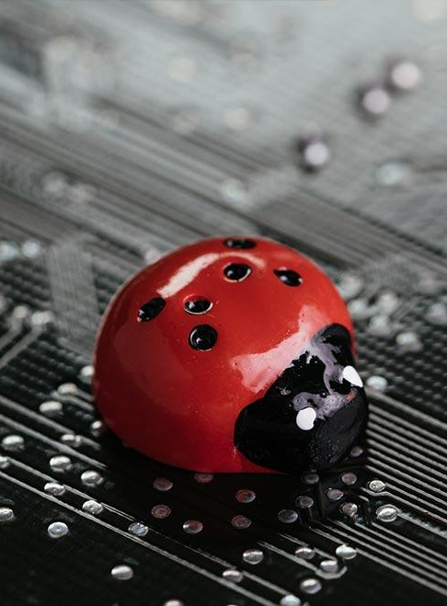
Debugging
The process of detecting and removing existing and potential errors
(aka 'bugs’)
from software code.
Errors could cause code to behave unexpectedly or crash.

Slide 18
Examples of Error Types
SYNTAX – mistakes in the code like spelling, punctuation, spacing, incorrect labels, etc. Won’t run.
RUNTIME – occurs at the time of running or executing a program; program may hang or crash.
SEMANTIC – code is grammatically correct but doesn't make any sense.
LOGICAL –when instructions given do not accomplish the intended goal. EG: wrong calculations

Slide 19

Debugging is a VERY useful skill in programming!
It’s a science and an art
Think of yourself as a detective looking for the clues as to what went wrong
Consider all evidence
Sometimes issues are minor and are quick, but others can take a while to find / fix.
#1 Rule: Complexity is the enemy of efficiency

Slide 20
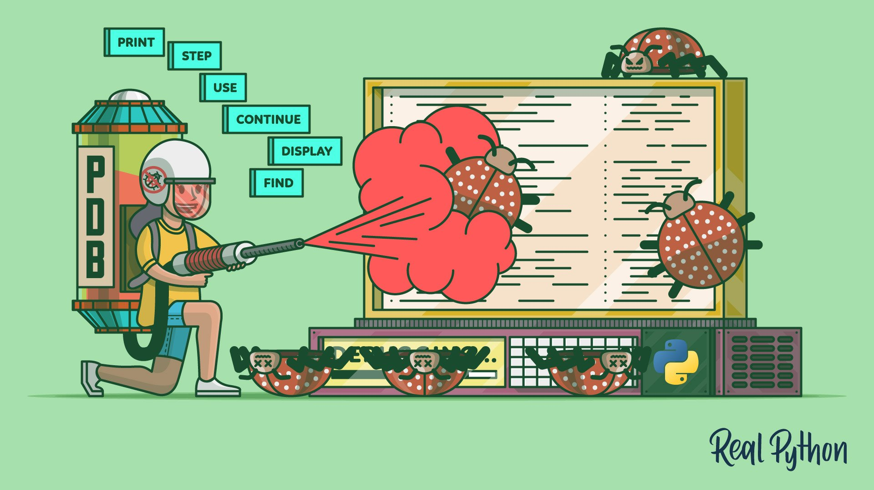
Helpful debugging tips
Regularly test and review code as you are writing it
Chunk code into smaller sections
Explain your code aloud to yourself
Work backward to try finding the issue
Take an break and come back to it
Ask someone to help you look at it

Slide 21
Review
What kind of language is Python considered?
What’s a natural language?
What are Algorithms?
What is the program we use to write Python in?
What’s the file extension of a Python file?
What is the area called where we put in our commands?
What is the #1 rule of coding / debugging?

