Slide 1

Jupyter Notebook

Slide 2
What is Jupyter Notebook?
Jupyter Notebook - an open source web application used to create and share documents that contain ~ live code ~ equations ~ visualizations ~ text
The Notebook extends the console-based approach to interactive computing
It’s a web-based application for the whole computation process:- developing, documenting, executing code, and communicating the results
It’s a spin-off from the IPython project, and is maintained by the open-source community at Project Jupyter -- http://jupyter.org/

Slide 3
What is the value of using Jupyter Notebook?
A Web Application: a browser-based tool for interactive authoring of documents - combineding text, mathematics, code, computations and rich media output.
Notebook Documents: a representation of all content visible in the web application, including inputs and outputs of computations, explanatory text, mathematics, images, and rich media representations of objects.
We’ll also install Jupyter Notebook in VS Code, to use directly inside the IDE, to have a single place to work from as we go.

Slide 4
Install Jupyter Notebook
In your terminal, type
pip install jupyter notebook

Slide 5
Install Jupyter Notebook in VS Code
Make sure you’re in the correct directory Open VS Code
Add the following Extensions by Microsoft: -
Jupyter, Jupyter Keymap, Jupyter Notebook Renderer, Jupyter Slide Show, and Jupyter Cell Tags

Slide 6
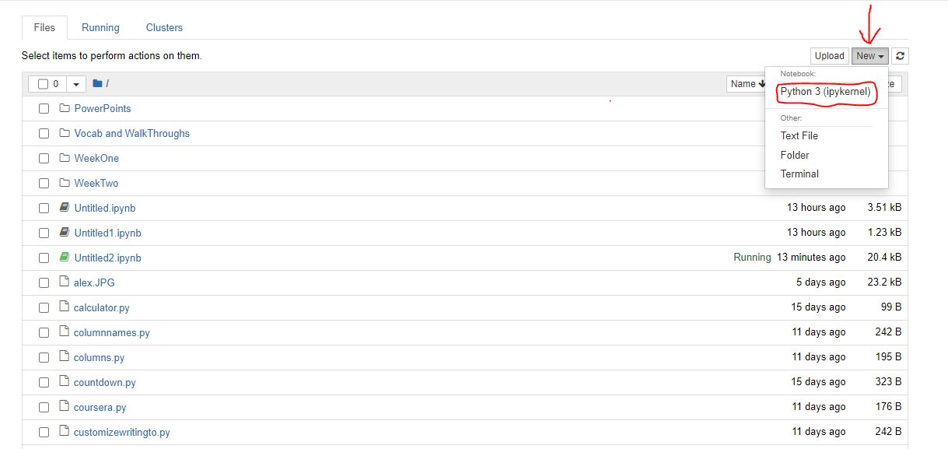
How to start the Jupyter Notebook Server
Type `jupyter notebook` in your terminal and press enter

Slide 7
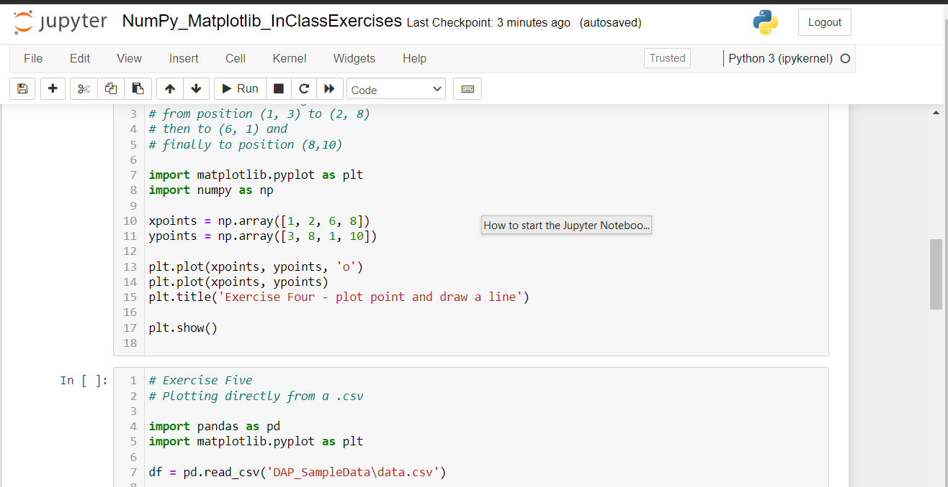
Starting an existing Notebook should open a screen like this:

Slide 8
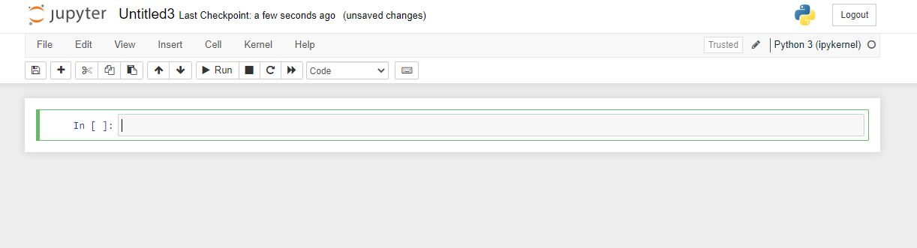
Starting a new kernel should open a screen like this:

Slide 9
Make sure you’re in the correct directory in the Terminal Open VS Code (code .) Either Initialize Jupyter Notebook from the console; This will open the web interface (type jupyter notebook) -- or – Or to use Jupyter Notebook inside VS Code, create a new file with the `.ipynb` extension
Using Jupyter Notebook inside VS Code

Slide 10
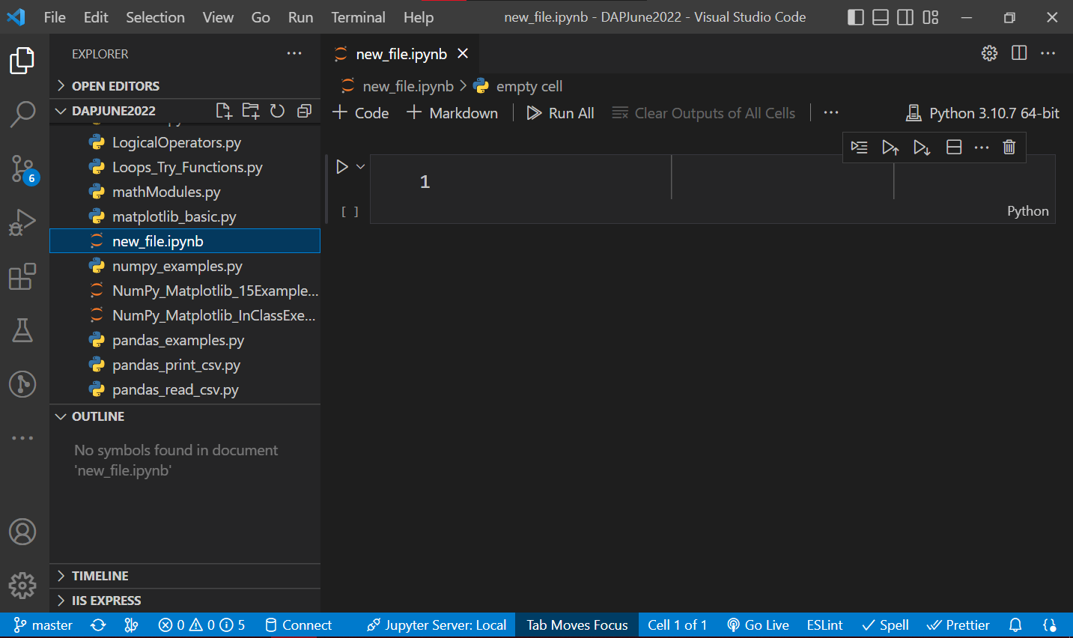

Slide 11
The Jupyter Notebooks Project https://jupyter.org Jupyter Notebook Quick Start Guide -- https://jupyter-notebook-beginner-guide.readthedocs.io/en/latest/index.html How to Use Jupyter Notebook: A Beginner’s Tutorial – https://www.dataquest.io/blog/jupyter-notebook-tutorial Excellent Article on beautifying Jupyter Notebooks https://towardsdatascience.com/enrich-your-jupyter-notebook-with-these-tips-55c8ead25255
Read more about Jupyter Notebook

