Slide 1

Jupyter Notebook

Slide 2
What is Jupyter Notebook?
Jupyter Notebook is an open source web application that you can use to create and share documents that contain live code, equations, visualizations, and text.
The notebook extends the console-based approach to interactive computing in a qualitatively new direction.
It provides a web-based application suitable for capturing the whole computation process:- developing, documenting, and executing code, as well as communicating the results.
Jupyter Notebook is a spin-off project from the IPython project, and is maintained by the people at Project Jupyter -- http://jupyter.org/

Slide 3
What is the value of using Jupyter Notebook?
The Jupyter Notebook combines two components:
A Web Application: a browser-based tool for interactive authoring of documents which combine explanatory text, mathematics, computations and their rich media output.
Notebook Documents: a representation of all content visible in the web application, including inputs and outputs of the computations, explanatory text, mathematics, images, and rich media representations of objects.
We’ll also install Jupyter Notebook in VS Code, to use directly inside the IDE, to have a single place to work from as we go.

Slide 4
Install Jupyter Notebook
In your terminal, type
pip install jupyter notebook

Slide 5
Install Jupyter Notebook in VS Code
Make sure you’re in the correct directory Open VS Code
Add the following Extensions by Microsoft: -
Jupyter, Jupyter Keymap, Jupyter Notebook Renderer, Jupyter Slide Show, and Jupyter Cell Tags

Slide 6
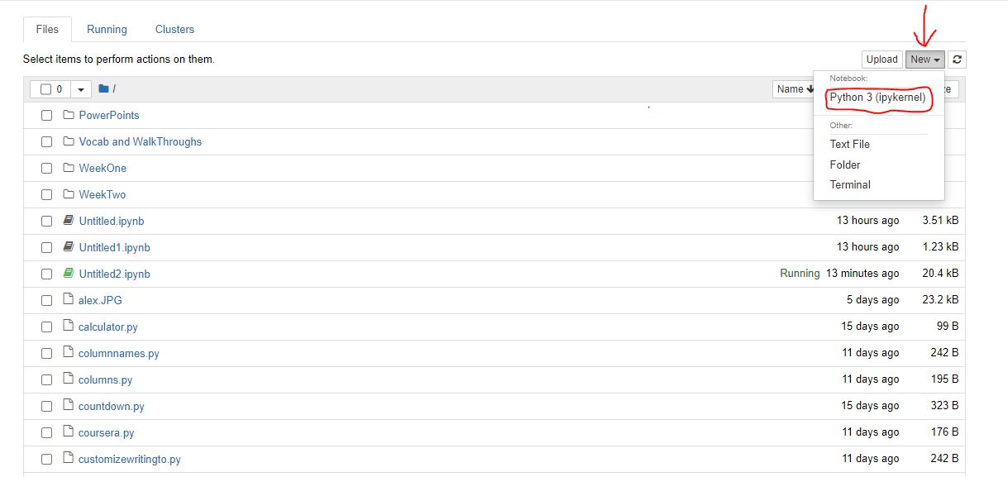
How to start the Jupyter Notebook Server
Type jupyter notebook in your terminal and press enter

Slide 7
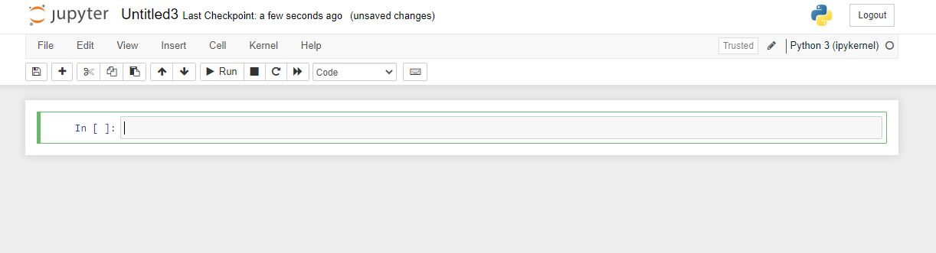

Slide 8
Make sure you’re in the correct directory in the Terminal Open VS Code (code .) Either Initialize Jupyter Notebook from the console; This will open the web interface (type jupyter notebook) -- or – Or to use Jupyter Notebook inside VS Code, create a new file with the `.ipynb` extension
Using Jupyter Notebook inside VS Code

Slide 9
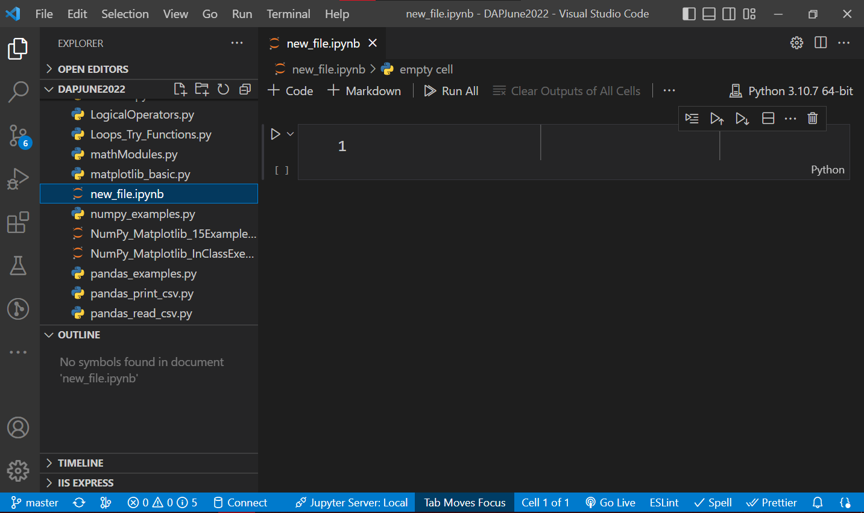

Slide 10
The Jupyter Notebooks Project https://jupyter.org Jupyter Notebook Quick Start Guide -- https://jupyter-notebook-beginner-guide.readthedocs.io/en/latest/index.html How to Use Jupyter Notebook: A Beginner’s Tutorial – https://www.dataquest.io/blog/jupyter-notebook-tutorial
Read more about Jupyter Notebook

