Slide 1
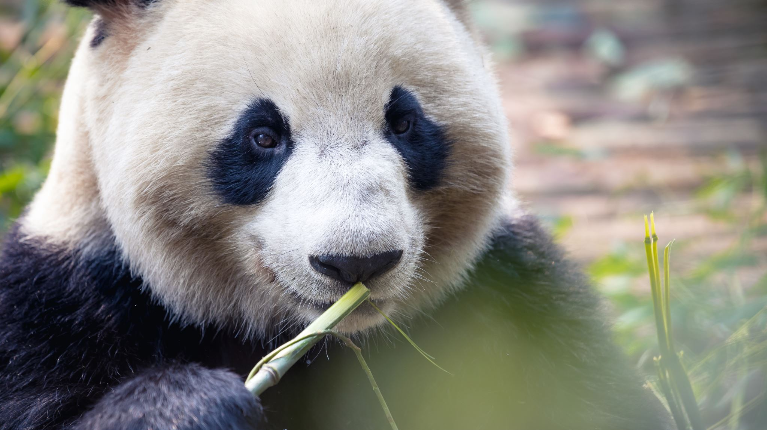
Python and Pandas

Slide 2
What is Pandas
An open-source Python package that is most widely used for data science/data analysis and machine learning tasks.
Built on top of NumPy which provides support for multi-dimensional arrays.
References both “Panel Data” and “Python Data Analysis”
Created by Wes McKinney in 2008

Slide 3
Pandas vs NumPy
NumPy provides objects for multi-dimensional arrays
Pandas is capable of offering an in-memory 2d table object called a DataFrame.
NumPy consumes less memory compared to Pandas

Slide 4
What can Pandas do?
Data Cleansing
Data normalization
Data visualization
Data inspection
Data fill
Merges and joins
Statistical analysis
Loading and saving data

Slide 5
Remember: Pandas is a Module
You have to install it first:
pip install pandas
You have to import it at the beginning of every code file:
import pandas as pd

Slide 6
DataFrames & Series
DataFrames
Series
2-dimensional data structure
2-dimensional array
Table with rows & columns
Column within a table
1 dimensional array holding data of any types.

Slide 7

DataFrame Example (create a new Python file)
import pandas as pd
Report = {"Classes": ["Math", "Science", "Spanish", "History", "Health"],
"Grades": [75, 80, 95, 60, 100]}
results = pd.DataFrame(Report)
print(results)

Slide 8
You should have
Classes Grades
0 Math 75
1 Science 80
2 Spanish 95
3 History 60
4 Health 100

Slide 9
Finding the location
import pandas as pd
Report = {"Classes": ["Math", "Science", "Spanish", "History", "Health"],
"Grades": [75, 80, 95, 60, 100]}
results = pd.DataFrame(Report)
print(results.loc[3])

Slide 10
You should have
Classes History
Grades 60
Name: 3, dtype: object

Slide 11
Location of More than 1 line
import pandas as pd
Report = {"Classes": ["Math", "Science", "Spanish", "History", "Health"],
"Grades": [75, 80, 95, 60, 100]}
results = pd.DataFrame(Report)
print(results.loc[[2, 3]])

Slide 12
You should have
Classes Grades
2 Spanish 95
3 History 60

Slide 13
Naming the Rows
import pandas as pd
Report = {"Classes": ["Math", "Science", "Spanish", "History", "Health"],
"Grades": [75, 80, 95, 60, 100]}
results = pd.DataFrame(Report, index = ["week1", "week2", "week3", "week4", "week5"])
print(results)

Slide 14
You should have
Classes Grades
week1 Math 75
week2 Science 80
week3 Spanish 95
week4 History 60
week5 Health 100

Slide 15
Locating a specific row
import pandas as pd
Report = {"Classes": ["Math", "Science", "Spanish", "History", "Health"],
"Grades": [75, 80, 95, 60, 100]}
results = pd.DataFrame(Report, index = ["week1", "week2", "week3", "week4", "week5"])
print(results.loc[“week3”])

Slide 16
You should have
Classes Spanish
Grades 95
Name: week3, dtype: object

Slide 17
Series Examples (create a new Python file)
import pandas as pd
age = [20, 40, 60]
years = pd.Series(age)
print(years)

Slide 18
Finding the location
import pandas as pd
age = [20, 40, 60]
years = pd.Series(age)
print(age[0])

Slide 19
You should have
20

Slide 20
Naming the Rows
import pandas as pd
age = [20, 40, 60]
years = pd.Series(age, index = ["Me", "My Brother", "My Sister"])
print(years)

Slide 21
You should have
Me 20
My Brother 40
My Sister 60
dtype: int64

Slide 22
Locating a specific row
import pandas as pd
age = [20, 40, 60]
years = pd.Series(age, index = ["Me", "My Brother", "My Sister"])
print(years["My Sister"])

Slide 23
You should have
60

Slide 24
Now, let’s try working in Jupyter Notebook

Slide 25
Sorting dataframes
df.sort_values(by=[‘x’], inplace=True)
df.sort_values(by=[‘x’], inplace=True, ascending=False)
df.sort_values(by=[‘first column’, ‘second column’,…], inplace=True)

Slide 26
Reading & Working with .csv files in Pandas

Slide 27
What is a .CSV file???
A file that contains plain text, with values that are commas separated
CSV == “Commas Separated Values”
Common file extension for data sets
You can open it in Notepad but the format will be off; Use VS Code instead

Slide 28
Pandas -- reading data from files (create a new Python file)
import pandas as pd
df = pd.read_csv(‘data.csv’)
print(df.to_string())
With this print statement, you get the WHOLE dataframe

Slide 29
Print Summary of a DataFrame
import pandas as pd
df = pd.read_csv(‘data.csv’)
print(df)
With this print statement,
you get the first 5 lines & the last 5 lines
With the row & column count

Slide 30
max_rows command
import pandas as pd
df = pd.read_csv(‘data.csv’)
print(pd.options.display.max_rows)
You will get the max rows set on your system

Slide 31
Setting max_rows
import pandas as pd
pd.options.display.max_rows = 9999
df = pd.read_csv(‘data.csv’)
print(df)
With this setting, you should get the whole dataframe

Slide 32
Viewing the FIRST 10 rows
import pandas as pd
df = pd.read_csv(‘data.csv’)
print(df.head(10))
If you have an empty head command,
you get the first 5

Slide 33
Viewing the LAST 10 rows
import pandas as pd
df = pd.read_csv(‘data.csv’)
print(df.tail(10))
If you have an empty tail command,
you get the last 5

Slide 34
Information about the DataFrame
import pandas as pd
df = pd.read_csv(‘data.csv’)
print(df.info())
If you print an empty info command,
you get the DataFrame Summary

Slide 35
<class 'pandas.core.frame.DataFrame'>
RangeIndex: 169 entries, 0 to 168
Data columns (total 4 columns):
# Column Non-Null Count Dtype
--- ------ -------------- -----
0 Duration 169 non-null int64
1 Pulse 169 non-null int64
2 Maxpulse 169 non-null int64
3 Calories 164 non-null float64
dtypes: float64(1), int64(3)
memory usage: 5.4 KB
Explanation of type of object
How many rows
and columns
Name of each column
with data type
Total number of data types
Memory used for the data frame

Slide 36
A closer look at the data …
# Column Non-Null Count Dtype
--- ------ -------------- -----
0 Duration 169 non-null int64
1 Pulse 169 non-null int64
2 Maxpulse 169 non-null int64
3 Calories 164 non-null float64
There are 5 rows in the Calories column without data.
Nulls are bad!
Nulls = the wrong result when you analyze data

Slide 37
Let’s find the Nulls
import pandas as pd
df = pd.read_csv(‘data.csv’)
print(df.to_string())
Output: 17 27 91 118 141

Slide 38
Dropping the nulls #1
import pandas as pd
df = pd.read_csv(‘data.csv’)
new_df = df.dropna()
print(new_df.to_string())
This DOES NOT change the
original dataframe
BECAUSE
we are using new_df

Slide 39
Dropping the nulls #2
import pandas as pd
df = pd.read_csv(‘data.csv’)
df = df.dropna(inplace = True)
print(df.to_string())
This changes
the ORIGINAL

Slide 40
Replacing Nulls -- fillna
import pandas as pd
df = pd.read_csv(‘data.csv’)
df = df.fillna(130, inplace = True)
print(df.to_string())
Replace NULL with 130

Slide 41
Replacing Nulls in Specific Columns
import pandas as pd
df = pd.read_csv(‘data.csv’)
df[“Calories”].fillna(130, inplace = True)
print(df.to_string())
Replace NULL in Calories

Slide 42
Replace the Nulls using mean, median, mode
Mean = the average value
Median = the value in the middle, after you have sorted all the values ascending
Mode = the value that appears most frequently

Slide 43
Replace NULLS with MEAN
import pandas as pd df = pd.read_csv('data.csv') x = df["Calories"].mean() df["Calories"].fillna(x, inplace = True)
Print(df.to_string())

Slide 44
Replace NULLS with MEDIAN
import pandas as pd df = pd.read_csv('data.csv') x = df["Calories"].median() df["Calories"].fillna(x, inplace = True)
Print(df.to_string())

Slide 45
Replace NULLS with MODE
import pandas as pd df = pd.read_csv('data.csv') x = df["Calories"].mode()[0] df["Calories"].fillna(x, inplace = True)
print(df.to_string())

Slide 46
Fixing dates
import pandas as pd df = pd.read_csv('data1.csv') print(df.to_string())
df[‘Date’] = pd.to_datetime(df[‘Date’])
df.dropna(subset=[‘Date’], inplace = True)
print(df.to_string())

Slide 47
Fixing wrong info
import pandas as pd df = pd.read_csv('data1.csv')
print(df.to_string())
df.loc[9, ‘Duration’] = 45
We want to change line 9 Duration to be 45

Slide 48
Fixing wrong info in LARGE sets
import pandas as pd
df = pd.read_csv('data.csv')
for x in df.index:
if df.loc[x, "Duration"] > 120:
df.loc[x, "Duration"] = 120
print(df.to_string())

Slide 49
Removing rows in LARGE sets
import pandas as pd
df = pd.read_csv('data.csv')
for x in df.index:
if df.loc[x, "Duration"] > 120:
df.drop(x, inplace = True)
print(df.to_string())

Slide 50
Finding all Duplicates
import pandas as pd
df = pd.read_csv('data1.csv')
print(df.duplicated())

Slide 51

Removing all Duplicates
import pandas as pd
df = pd.read_csv('data1.csv’)
df.drop_duplicates(inplace = True)
print(df.duplicated())

Slide 52
Plotting & Practice with Pandas, and .csv files

Slide 53
Plotting directly from a .csv
import pandas as pd
import matplotlib.pyplot as plt
df = pd.read_csv(“data.csv”)
df.plot()
plt.show()

Slide 54
Creating a scatter plot
import pandas as pd
import matplotlib.pyplot as plt
df = pd.read_csv(‘data.csv’)
df.plot(kind = “scatter”, x = “Duration”, y = “Calories”)
plt.show()

Slide 55
Creating a Histogram plot
import pandas as pd
import matplotlib.pyplot as plt
df = pd.read_csv("data.csv")
df["Duration"].plot(kind ='hist')
plt.show()

Slide 56
Practice with .csv files
First, we need to gather our data
import pandas as pd
titanic_data = pd.read_csv(“titanic.csv”)
print(titanic_data.head())

Slide 57
Practice with .csv files
If you wanted to use the data straight from the web
import pandas as pd
titanic_data = pd.read_csv(“https://raw.githubusercontent.com/datasciencedojo/datasets/master/titanic.csv”)
print(titanic_data.head())

Slide 58
Customizing Headers
import pandas as pd
col_names = ["Id", "Survived",
"Passenger Class", "Full Name",
"Gender", "Age", "SibSp", "Parch",
"Ticket Number", "Price", "Cabin", "Station"]
titanic_data = pd.read_csv(r"C:\Users\User\Desktop\DAP2022\titanic.csv", names = col_names)
print(titanic_data.head())

Slide 59
Skipping Rows
import pandas as pd
col_names = ["Id", "Survived",
"Passenger Class", "Full Name",
"Gender", "Age", "SibSp", "Parch",
"Ticket Number", "Price", "Cabin", "Station"]
titanic_data = pd.read_csv(r"C:\Users\User\Desktop\DAP2022\titanic.csv", names=col_names, skiprows=[0])
print(titanic_data.head())

Slide 60
Saving to a new .csv file
import pandas as pd
col_names = ["Id", "Survived",
"Passenger Class", "Full Name",
"Gender", "Age", "SibSp",
"Parch", "Ticket Number", "Price",
"Cabin", "Station"]
titanic_data = pd.read_csv(r"C:\Users\User\Desktop\DAP2022\titanic.csv", names=col_names, skiprows=[0])
titanic_data.to_csv('use_titanic.csv', index=False)

Slide 61
Creating a .csv from scratch
import pandas as pd
cities = pd.DataFrame([["St. Louis", "Missouri"], ["Atlanta", "Georgia"]], columns=["City", "State"])
cities.to_csv('cities.csv')

Slide 62
Viewing the .csv file
import pandas as pd
df = pd.read_csv('cities.csv’)
print(df)

Slide 63
Saving the file without indexes
import pandas as pd
cities = pd.DataFrame([["St. Louis", "Missouri"], ["Atlanta", "Georgia"]], columns=["City", "State"])
cities.to_csv('cities.csv’, index=False)
df = pd.read_csv('cities.csv')
print(df)

Slide 64
Individual Practice
Create your own .csv file with data and save it
Make a change to the file and save a copy with a different name.
Send both these files to your assigned TA in a Slack message

