Slide 1
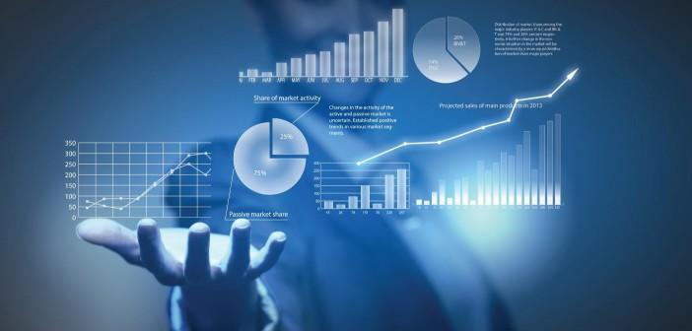
Data Analytics

Slide 2
DAP is HOT right now!
Effectively make decisions
Develop new revenue
Companies are looking for people who can maintain their data and analyze it to:
Decrease Operational costs

Slide 3
Who are Data Analysts?
Take data from their organizations
Use that data to answer questions
Communicate the results
Some Titles
Business Analyst; Operations Analyst
Business Intelligence Analyst
Marketing Analyst; Database Analyst

Slide 4
Python Learning Materials
Python For Everyone -- PY4E
This program was created by Dr. Charles Severance (a.k.a. Dr. Chuck).
He’s a Clinical Professor at the University of Michigan School of Information Technology.
https://www.py4e.com/

Slide 5
The end project: Your Capstone
Showcases what you have covered over this 12-week period
15 – 20 minutes in length
You need to come up with a topic
Clean and analyze data to get an answer
Create and present your story!
Create a question with that topic
Locate raw data sets on that topic

Slide 6
Data Wrangling
The process of cleaning and unifying messy and complex data sets for easy access and analysis.
Organizing and processing data
Data professionals spend as much as 80% of their time in the data wrangling process.

Slide 7
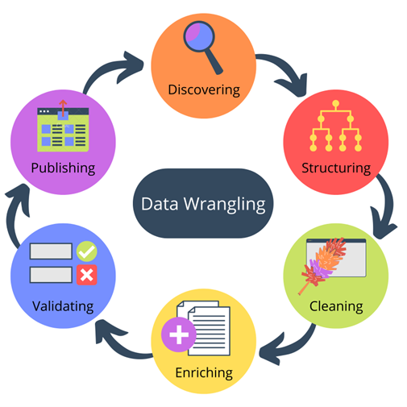
Data Wrangling
Step #1 – Discovery
Step #2 – Structuring
Step #3 – Cleaning
Step #4 – Enriching
Step #5 – Validating
Step #6 – Publishing

Slide 8
Examples of Wrangling
Joining together multiple data sets into one
Finding gaps in data and filling/deleting them
Getting rid of data that is unnecessary
Identifying extreme outliers and either explaining them or getting rid of them

Slide 9
Step #1 - Discovery
Find data that addresses your question
Become familiar with your data so that you know how you will end up using it.
Identify trends, patterns and some data cells / sections that might cause issues in analysis.

Slide 10
Step #2 - Structuring
Take your raw data and transform it to what you can work with
Unstructured data is often text-heavy and contains things such as Dates, Numbers, ID codes, etc.
Example: - When using info scrapped from a website, you might parse HTML code, pull out what you need, and discard the rest.

Slide 11
Step #3 - Cleaning
Removes outliers that can potentially skew your results when analyzing the data
Changes any null values and standardizes the data format to improve quality and consistency
Identifies duplicate values, standardizes systems of measurements, fixes structural errors and typos, and validates the data to make it easier to handle

Slide 12
Step #4 - Enriching
Deciding if you need to add to the data by combining raw data with additional data from other sources.
Example: - Combining two or more databases of customer information to fill in gaps in the data
Enriching the data is an optional step that you only need to take if your current data doesn’t meet your requirements.

Slide 13
Step #5 - Validating
Making sure that the data that you have is of the quality necessary to complete your project.
The rules of data validation require repetitive programming processes that help to verify the – Quality, Consistency, Accuracy, Security, and Authenticity of data

Slide 14
Step #6 - Publishing
Creating your analysis and presenting it to the public.
You can deposit the data into a new architecture or database.
We will display our data story using Tableau.

Slide 15
Goals of Efficient Data Wrangling
Show "deeper intelligence" by gathering data from several different sources
Provide accurate, actionable data to clients, on time
Reduces time spent collecting and organizing raw data
Allow data scientists and analysts to focus on the analysis
Provide intelligence for better decision-making by leaders

Slide 16
What’s the Difference?
DATA WRANGLING
DATA CLEANING
Changes the data’s format by making the raw data into something more useable.
** Prepares data’s structure for modeling **
Removing data that will not help in analysis because it contains errors or misinformation.
** Enhances data’s accuracy and integrity **

Slide 17
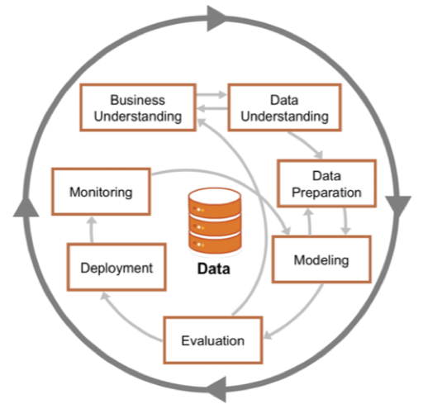
Crisp-DM
CRoss
Industry
Standard
Process for
Data Mining
A process model with six phases that naturally describes the data science life cycle.

Slide 18
What is Crisp-DM?
The CRoss Industry Standard Process for Data Mining (CRISP-DM) is a model that serves as the base for a data science process.
Published in 1999 to standardize data mining processes across industries, it is the most common methodology for data mining, analytics, and data science projects.
Data science teams that combine a loose implementation of CRISP-DM with overarching team-based Agile project management approaches will likely see the best results.
https://www.datascience-pm.com/crisp-dm-2/

Slide 19
Data Science Life Cycle
Business Understanding What does the business need?
Data Understanding What data do we have / need? Is it clean?
Data preparation How do we organize the data for modeling?
Modeling
What modeling techniques should we apply?
Evaluation
Which model best meets the business objectives?
Deployment
How do stakeholders access the results?

Slide 20
The end project: Your Capstone
Showcases what you have covered over this 12-week period
15 – 20 minutes in length
You need to come up with a topic
Clean and analyze data to get an answer
Create and present your story!
Create a question with that topic
Locate raw data sets on that topic

Slide 21
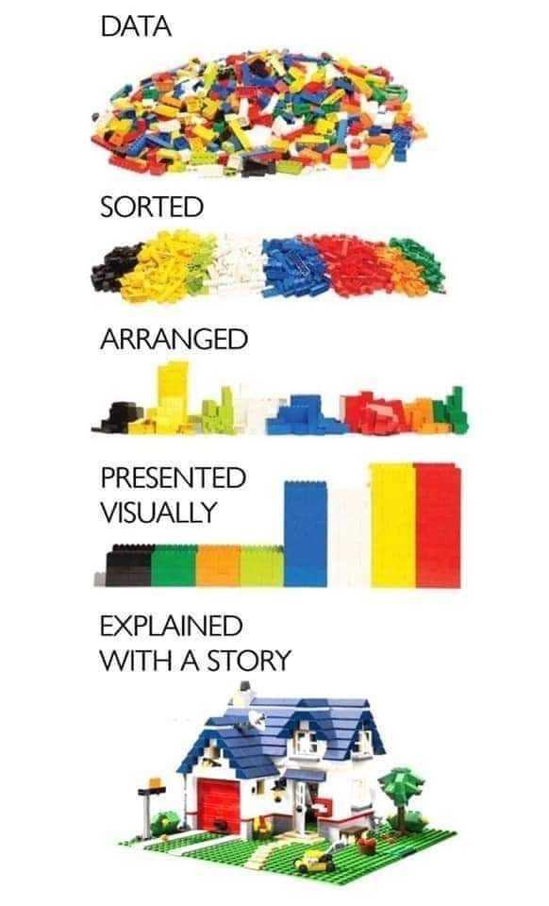
“Data are just summaries of thousands of stories – tell a few of those stories to help make the data meaningful.”
Quote by Chip and Dan Heat, authors of five best selling books, among them -- “Making Numbers Count: The Art and Science of Communicating Numbers”, and “The Power of Moments: Why Certain Experiences Have Extraordinary Impact”,.

