Slide 1

Excel & Data Analytics

Slide 2
Remember Data Wrangling?
The process of cleaning and unifying messy and complex data sets for easy access and analysis.
Organizing and processing data

Slide 3
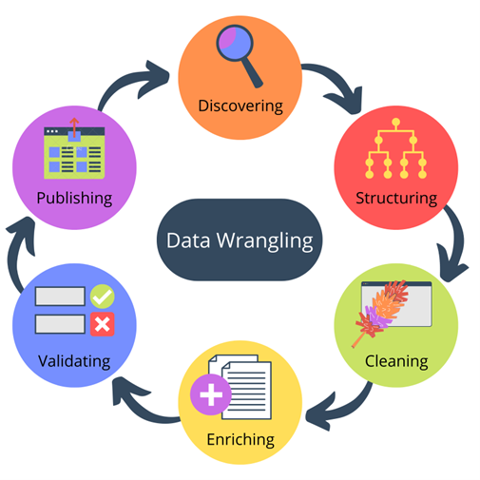
Data Wrangling
Step #1 – Discovery
Step #2 – Structuring
Step #3 – Cleaning
Step #4 – Enriching
Step #5 – Validating
Step #6 – Publishing

Slide 4
What is Excel?
A program by Microsoft that is used for recording, analyzing and visualizing data in the form of a spreadsheet.

Slide 5
Why Excel?
- Performs various math functions on large data sets
- You can search, sort, filter; makes it easier to clean
- Beautify data and present with charts & tables
- Reporting, accounting & analysis is easier
- Provides security through locking cells, and passwords

Slide 6
Excel is HUGE
If you don’t have Excel installed, and you don’t have a Microsoft account, here is a site to signup for …
Free Microsoft Office Online | Word, Excel, PowerPoint
https://www.microsoft.com/en-za/microsoft-365/free-office-online-for-the-web

Slide 7
Lets play with Excel!
We will use the following spreadsheet together to learn more about Excel.
Excel_Practice_Student.xlsx
Note: This spreadsheet has 3 tabs at the bottom of the screen and is wide so scroll to the right to see all the content

Slide 8
Functions
AND
AND USING IF
=AND([logical1], [logical2], ...)
If a number is greater than or smaller than another number or is equal to something.
Produces “True” or “False”
=IF(AND(logical_test, logical_test), [“value_if_true”], [“value_if_false”])
Produces whatever outcome you need it to read if you don’t want “True” or “False” …
Like “Black” and “White”

Slide 9
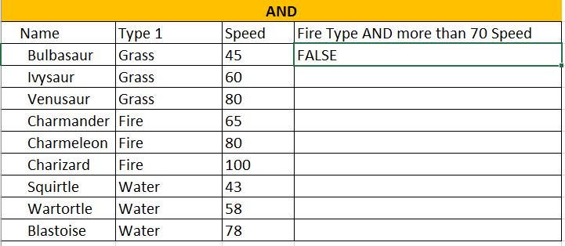
Reading a function in Excel
=AND(B3=“Fire”,C3>70)

Slide 10
=AVERAGEIFS(C27:C38, B27:B38, F28, D27:D38,G28)
AVERAGEIF
AVERAGEIFS
Combine averages from different cells
=AVERAGEIF(range, criteria, [average_range])
Calculates the average of a range based on one or more true/false conditions
=AVERAGEIFS(average_range, criteria_range1, criteria1, ...)

Slide 11
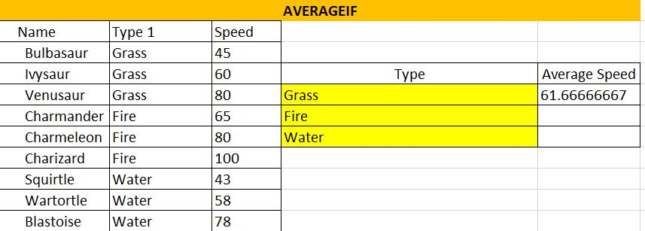
Reading a function in Excel
=AVERAGEIF(B15:B23,D17,C15:C23)

Slide 12
Functions
COUNT
COUNTA
Calculates number of cells used within a range that have numbers
=COUNT(value1:value2)
Calculates number of cells used within a range that have either numbers or letters
=COUNTA(value1:value2)

Slide 13
Functions
COUNTBLANK
COUNTIF
Calculates number of cells used within a range that are blank
=COUNTBLANK(value1:value2)
Calculates number of cells as specified
Have to use a $ for absolute values to be counted
=COUNTA($value$1:$value$2,criteria)

Slide 14
Functions
COUNTIFS
Counts cells in a range based on one or more true or false conditions
=COUNTIFS(criteria_range1, criteria1, [criteria_range2, criteria2], ...)

Slide 15
Functions
IF (EQUAL TO)
Returns values based on a true or false condition
Click on D105
=IF(B105="Grass", "Yes", "No")

Slide 16
Functions
IF (GREATER THAN)
IFS
Counts cells in a range based on one or more true or false conditions
I105
=IF(H105>500, "Yes", "No")
Returns values based on one or more true/false conditions
D117
=IFS(C117>90,"Fast", C117>50,
"Normal", C117<=50,"Slow")

Slide 17
Functions
MEDIAN
MODE
Returns the middle value in the data
=MEDIAN(F117:K117)
Used to find the number seen most times.
=MODE.SNGL(B129:E134)

Slide 18
Functions
OR WITH IF
OR
Let's you check multiple conditions for the if function
=IF(OR(H140="water",C140>60),"Yes","No")
Returns true/false based on two or more conditions.
=OR(B140="Water",C140>60)

Slide 19
Functions
STDEV.P
STDEV.S
Calculates the Standard Deviation for the entire population
=STDEV.P(D152:D173)
Measures how far a ‘typical’ observations is from the average of the data.
*Ignores cells with text and logic
Calculates the Standard Deviation for a sample
=STDEV.S(L152:L171)

Slide 20
Functions
SUMIF
SUMIFS
Calculates the sum of values in a range based on true/false conditions.
=SUMIF(C177:C185,F178,D177:D185)
Calculate the sum of a range based on one or more true/false condition
=SUMIFS($D$189:$D$201,$C$189:$C$201,G189,$E$189:$E$201,H189)

Slide 21
Functions
VLOOKUP
XOR
Allows searches across columns
=VLOOKUP(G207,A205:E226,2,1)
lookup_value (required) in 1st column,
table_array (required) lookup range,
col_index_num (required) of lookup_value,
Approximate - 1/TRUE or Exact - 0/FALSE
Returns true/false based on two or more conditions
=XOR(B231="fire",C231<60)

Slide 22
Excel Part 2 – Charts & Pivot Tables

Slide 23
Windows Keyboard Shortcuts
CTRL + Z undo
CTRL + W close
CTRL + A Select all
ALT + TAB Switch apps
ALT + F4 Close apps
WIN + D Show/Hide Desktop
CTRL + X Cut
CTRL + C Copy
CTRL + V Paste
WIN + L/R Arrow compare windows
WIN + up/down arrow
WIN + double up/down
ESC
WIN + PrtScn save screenshot
Shift + arrows highlight text
CTRL + B/I/U customize font

Slide 24
macOS Keyboard Shortcuts
Command + C = Copy
Command + X = cut
Command + V = paste
Control + Command + F = Fullscreen
Command + Mission Control = desktop

Slide 25
Inserting Charts
Visually Compare information inside of your data
Once your data is filled out…
- highlight the information use
- Highlight B1:C5
- Click Insert in the ribbon
- Bring up chart options
- Pick the ones you want
Go to the Loans Tab on Excel Spreadsheet

Slide 26
Pivot Tables
A summary of a large dataset that usually includes the total figures, average, minimum, maximum, etc.
Once you bring up your spreadsheet
- Click on pivot table
- dataset should already be selected
- Select “new worksheet”
- Choose the values that you want
- Analyze your data
Open Up Sales Spreadsheet

Slide 27
Sales Exercise
- Select Insert
- Select PivotChart
- Table/Range should be picked already
- Select: CompanyName, ProductName, UnitPrice, Quantity and SubTotal
- Select the Row Labels drop down, remove the “select all” tick, select Ana Trujiullo, press ok

Slide 28
Sales Exercise continued
- Go back to Insert and choose pivot table
- Make sure table is selected
- Choose FirstName
- Choose CompanyName
- Choose SubTotal and drag to values
- Select recommended Charts

