Slide 1




IoT-Based Temperature and Humidity Monitoring System
Presented By:
Grp 31
Shaganti Samhitha(21CSB0A52)
Yashsvini Katare(21CSB0A67)
Savvy Jain(21CSB0F15)

Slide 2
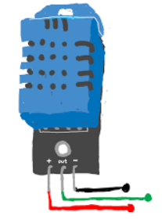

OBJECTIVE
Use a DHT22 sensor to continuously track environmental conditions
Upload real-time sensor readings to ThingSpeak for cloud-based monitoring
Detect when temperature exceeds 25°C or humidity goes beyond 45%
Send an alert email using Google Apps Script when thresholds are exceeded
Activate a buzzer and LED indicators when conditions become unsafe.

Slide 3

APPROACH
Connect ESP32 to DHT22 sensor, buzzer, and LED indicators
Establish a WiFi connection for data transmission.
Read temperature & humidity at fixed intervals and compare readings against preset threshold values
Send sensor data to ThingSpeak for visualization and analysis.
If temperature or humidity exceeds the threshold:
Turn ON Red LED & Buzzer for local alert.
Trigger an email alert via Google Apps Script.
Else Turn ON Green LED
Repeat the process every few seconds to ensure real-time monitoring

Slide 4
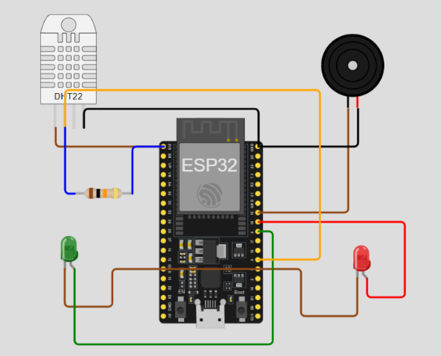
DESIGN
COMPONENTS USED:
Temperature and humidity sensor (DHT22)
Microcontroller (ESP32)
Cloud platform: ThingSpeak for real-time data logging and alert generation
Open-source simulators: Wokwi
Additional components: LEDs, buzzer
Resistor: 10kΩ
Jumper Wires: For circuit connections.

Slide 5
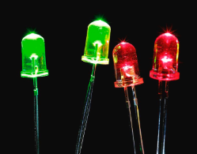


The circuit is implemented using Wokwii
ThingSpeak API is used for real-time data logging.
A circuit is designed to integrate the DHT22 sensor with the microcontroller. The sensor reads temperature and humidity values, which are then sent to the cloud. (Connections are mentioned in Report)
WiFi Connection
ESP32 connects to the Wokwi-GUEST WiFi network
Data is sent to ThingSpeak cloud

Slide 6
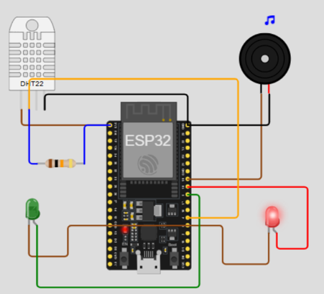
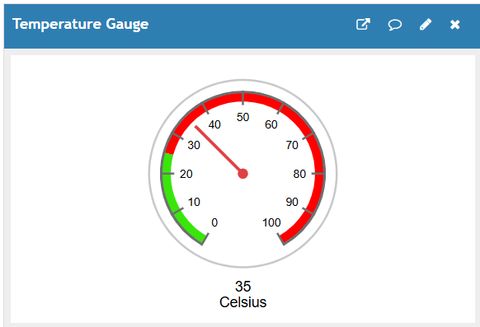
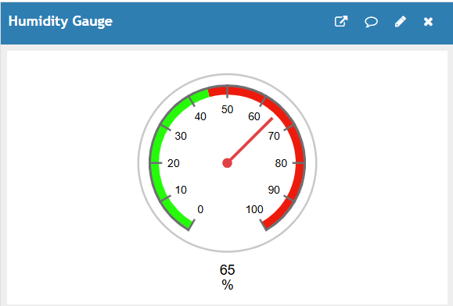
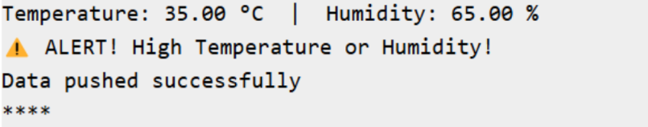
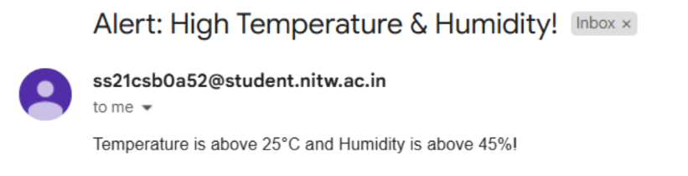
RESULTS(Explicitly mentioned in Report)
Wokwi
ThingSpeak
Buzzer and Red LED ON
Email

Slide 7
THANK YOU!

