Slide 1


ATLIQ
HOSPITALITY ANALYSIS
DESIGNED & PRESENTED BY -
SAVYA SREE
Notes:
Hello everyone! I’m Savya. I am here to present to you the project that I have completed as part of my Data Analytics Bootcamp in Codebasics using PowerBI. This project is going to be about AtliQ Hotels, which is going to be in the hospitality domain. Before going to the dashboard, first, let's understand what Atliq Hotels is.

Slide 2

ATLIQ
HYDERABAD
MUMBAI
DELHI
BANGALORE
Atliq Grands
Atliq Grands
Atliq Grands
Atliq Grands
Atliq Exotica
Atliq Exotica
Atliq Bay
Atliq Exotica
Atliq Bay
Atliq Bay
Atliq Blu
Atliq Bay
Atliq Blu
Atliq Blu
Atliq City
Atliq Blu
Atliq City
Atliq City
Atliq Palace
Atliq City
Atliq Palace
Atliq Palace
Atliq Palace
Atliq Seasons
Notes:
AtliQ owns five-star hotels across 4 cities in India, i.e., Hyderabad, Mumbai, Delhi, and Bangalore. They have been in this industry for 20 years now. Due to the market strategies of competitors, AtliQ was losing its market share and revenue. So they wanted to incorporate a Data Analytics team to boost their performance and strengthen their position in the market. I am acting as a Data Analyst here to provide insights to their team.
So these are all the different properties owned by Atliq in different cities. All these in white go under the luxury category and yellow belong to the business category.

Slide 3


DATASET
Provided excel files containing 3 months of booking details:
dim_date
dim_hotels
dim_rooms
fact_aggregated_bookings
fact_bookings
Mock dashboard and metrics list

Slide 4
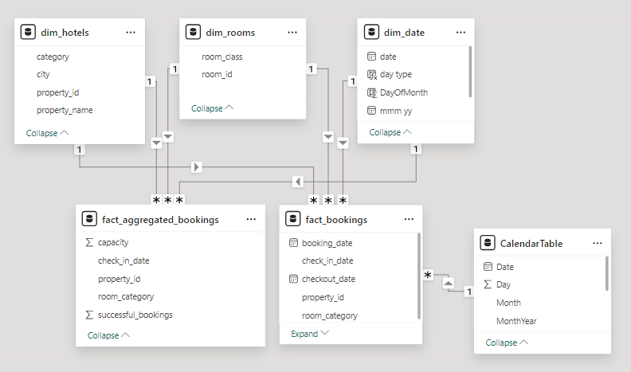
DATA MODEL

Slide 5
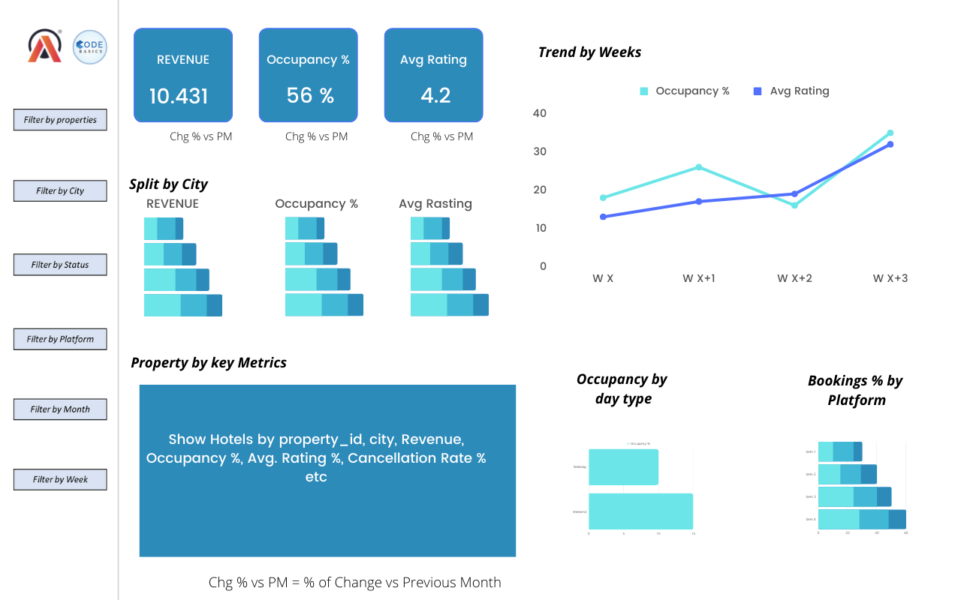
MOCK-UP DASHBOARD

Slide 6

KEY INSIGHTS
Mumbai leads the revenue generation with 669M, while Delhi records the lowest at 105M.
Delhi boasts the highest occupancy rate at 61%, compared to Bangalore’s lowest occupancy at 56%.
Among the room types, Elite Rooms achieve the highest number of bookings, whereas Presidential Rooms record the lowest.
Atliq Blu and Atliq Exotica feature the longest average stay duration of 2.8 days, while Atliq City has the shortest at 1.8 days.

Slide 7
AND MORE.......
Mumbai incurred a revenue loss of 116M due to cancellations.
Presidential Rooms in Mumbai generate the highest Average Revenue per Day at 19K.
Revenue peaked during Week 29, reaching 139.7M, while Week 26 recorded the lowest at 114.2M

Slide 8
NEXT STEPS.......
Implement dynamic pricing strategies to boost weekday occupancy.
Identify reasons or patterns for high cancellation percentages.
Enhance cancellation policies to minimize revenue loss.
Invest in room upgrades for properties with lower ratings.

Slide 9



THANK
YOU

