Slide 1


ATLIQ
HOSPITALITY ANALYSIS
DESIGNED & PRESENTED BY -
SAVYA SREE

Slide 2

ATLIQ
HYDERABAD
MUMBAI
DELHI
BANGALORE
Atliq Grands
Atliq Grands
Atliq Grands
Atliq Grands
Atliq Exotica
Atliq Exotica
Atliq Bay
Atliq Exotica
Atliq Bay
Atliq Bay
Atliq Blu
Atliq Bay
Atliq Blu
Atliq Blu
Atliq City
Atliq Blu
Atliq City
Atliq City
Atliq Palace
Atliq City
Atliq Palace
Atliq Palace
Atliq Palace
Atliq Seasons

Slide 3


DATASET
Provided excel files containing 3 months of booking details:
dim_date
dim_hotels
dim_rooms
fact_aggregated_bookings
fact_bookings
Mock dashboard and metrics list

Slide 4
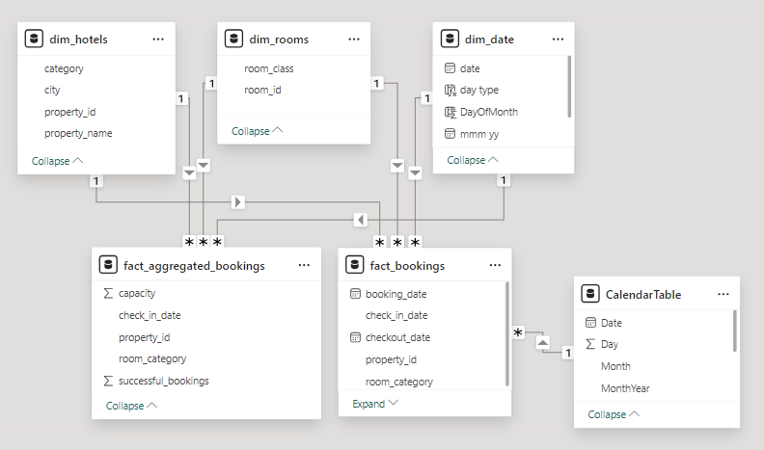
DATA MODEL

Slide 5
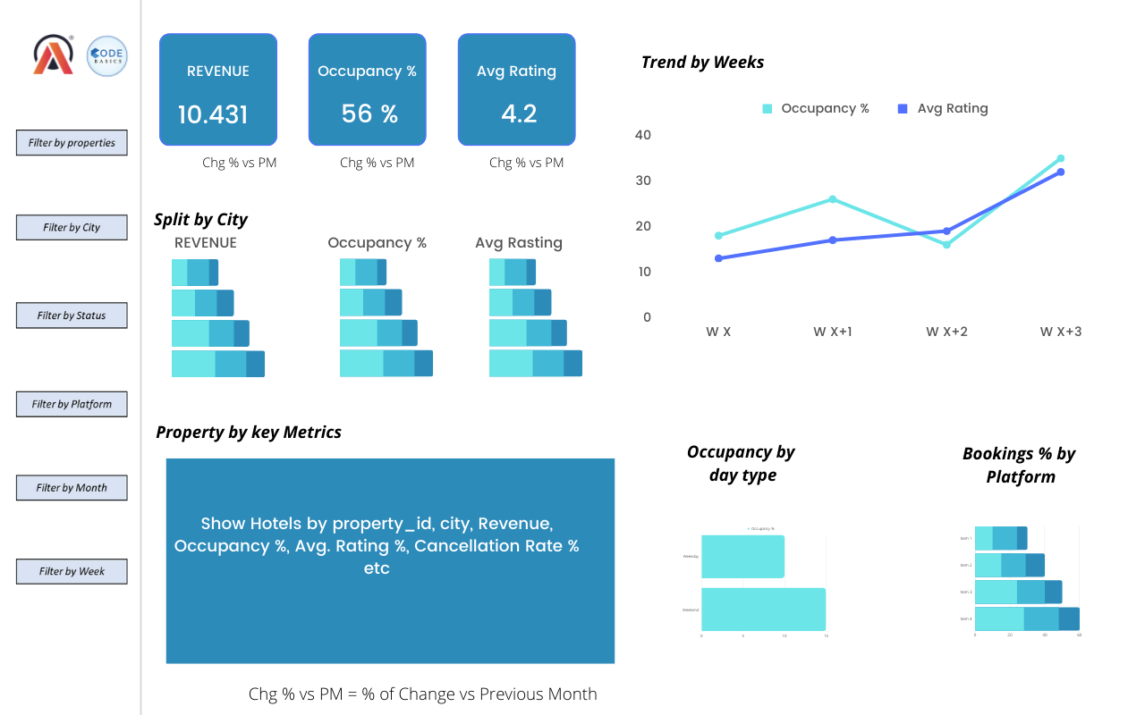
MOCK-UP DASHBOARD

Slide 6

KEY INSIGHTS
Mumbai leads the revenue generation with 669M, while Delhi records the lowest at 105M.
Delhi boasts the highest occupancy rate at 61%, compared to Bangalore’s lowest occupancy at 56%.
Among the room types, Elite Rooms achieve the highest number of bookings, whereas Presidential Rooms record the lowest.
Atliq Blu and Atliq Exotica feature the longest average stay duration of 2.8 days, while Atliq City has the shortest at 1.8 days.

Slide 7
AND MORE.......
Mumbai incurred a revenue loss of 116M due to cancellations.
Presidential Rooms in Mumbai generate the highest Average Revenue per Day at 19K.
Revenue peaked during Week 29, reaching 139.7M, while Week 26 recorded the lowest at 114.2M

Slide 8
NEXT STEPS.......
Implement dynamic pricing strategies to boost weekday occupancy.
Identify reasons or patterns for high cancellation percentages.
Enhance cancellation policies to minimize revenue loss.
Invest in room upgrades for properties with lower ratings.

Slide 9



THANK
YOU

