Slide 1
Chisel and Posits
Sam Waddell

Slide 2
Overview
Intro to Posits
Posit Multiply
Chisel Pros
Current Results and Future Work

Slide 3
What are Posits?
“Floating Point is dead…” and Posits are an alternative.
Specify with a bit width n, and max number of exponent bits es
Real Number = (-1)^{sign} × 2^{integer power} × (1 + binary fraction)
Determined by exponent and regime…

Slide 4
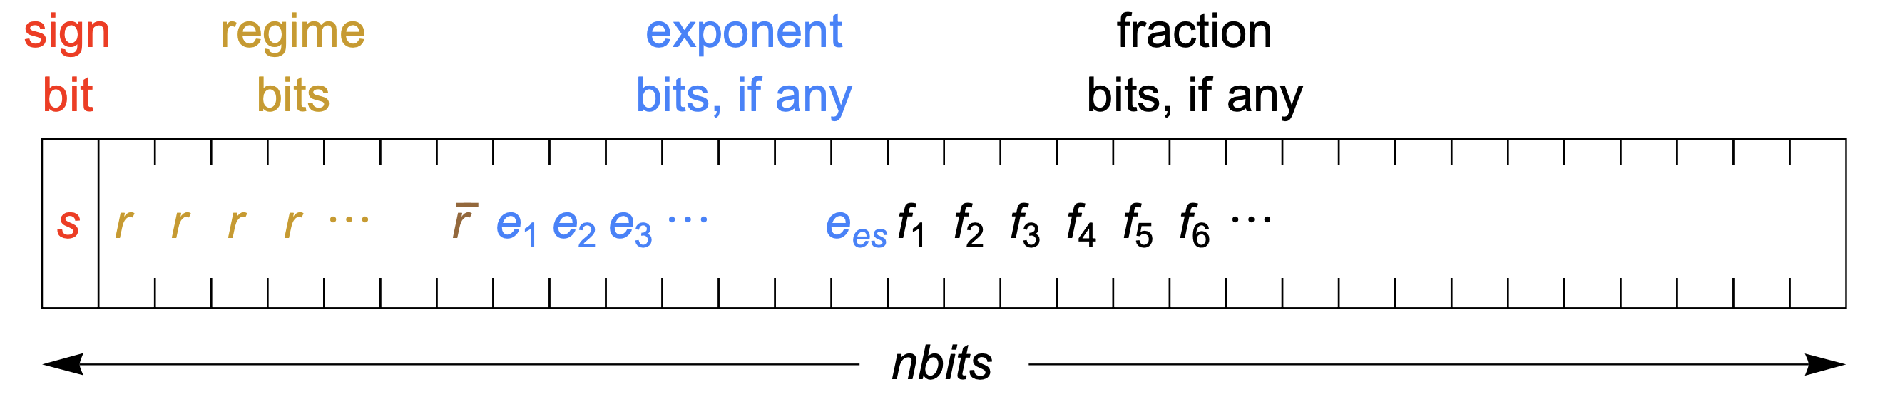
What are Posits?
The regime comes after the sign bit, in any length
The exponent takes up to es bits, but could be less
Any remaining bits are the fraction

Slide 5

What are Posits?
$$k=\left\{\begin{aligned}−m if regime has m 0s \\ m−1 if regime has m 1s\end{aligned}\right. useed=2^{2^{es}}$$
$$real number={−1}^{sign}∗{useed}^{k}∗2^{exponent}∗(1.fraction)$$

Slide 6
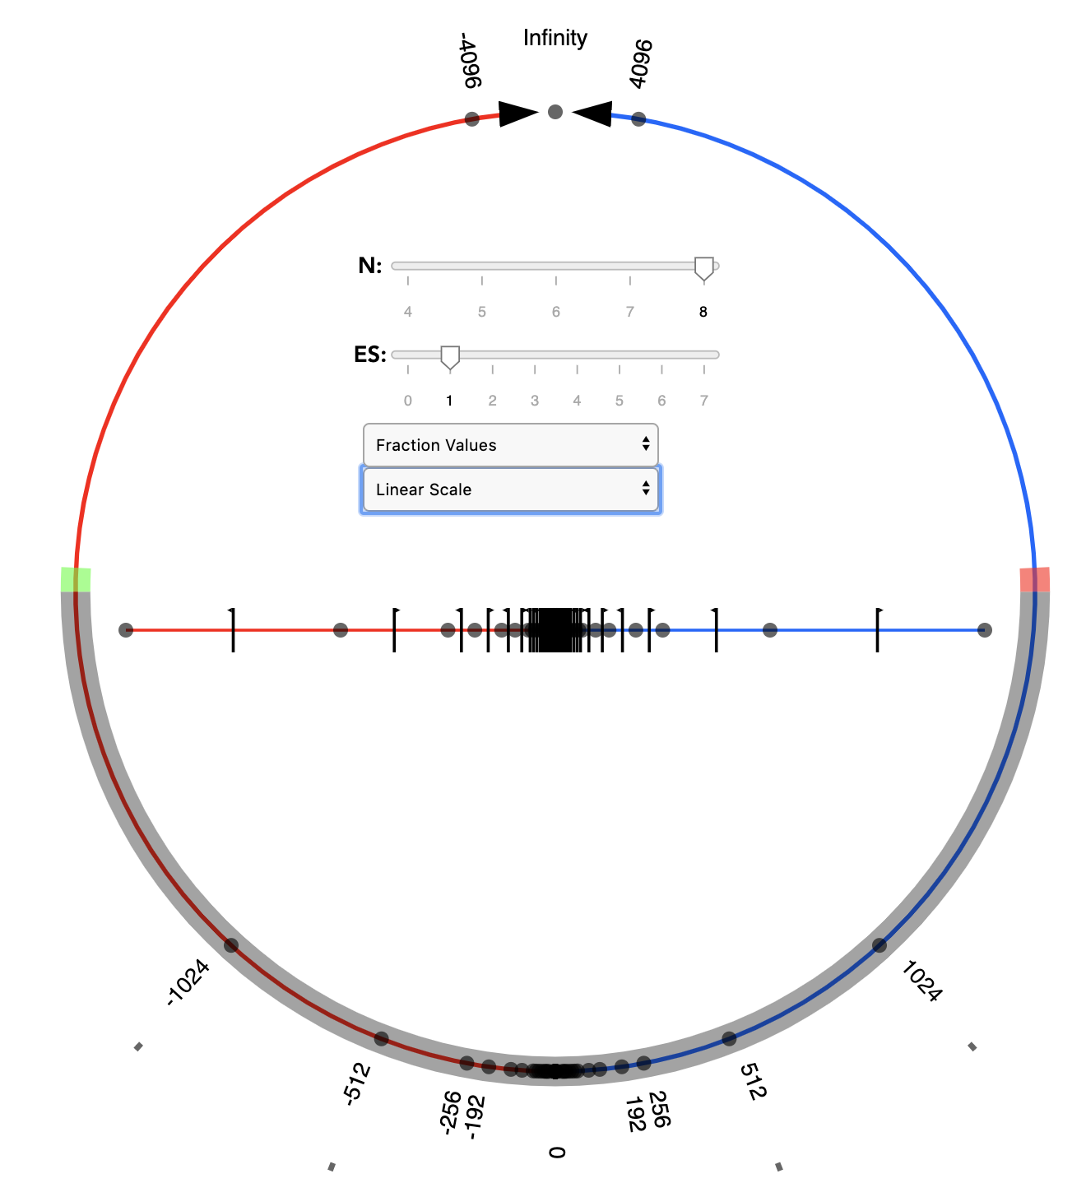
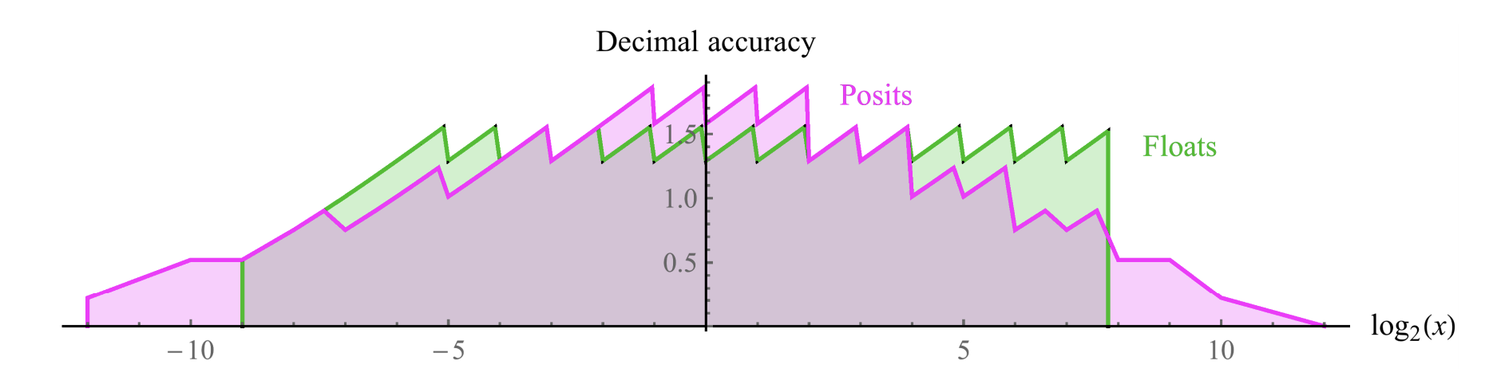

Posits vs Floats
The regime provides tapered accuracy (more accurate with lower exponents)
Symmetric around 1 (from 0 to $∞$)

Slide 7

Posits vs Floats
Other Posit advantages:
No redundant patterns – only one representation for 0, and $±∞$/NaN, every possibility specifies a unique number
No overflow to infinity or underflow to 0
Use of quire allows for reproducible results (rounding is deferred)

Slide 8
Posits vs Floats
Overall, Posits require simpler hardware for operations, and provide parameterizable accuracy and range.
Possible to get the same accuracy as floating point with fewer bits, or better accuracy without more bits.

Slide 9
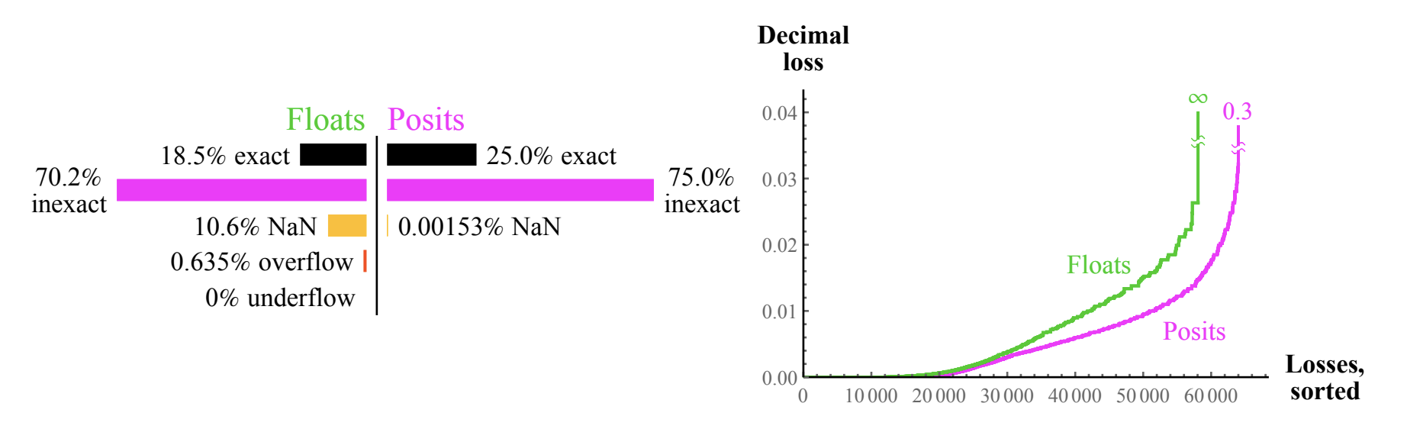
Posits vs Floats: Some Examples
8-bit add

Slide 10
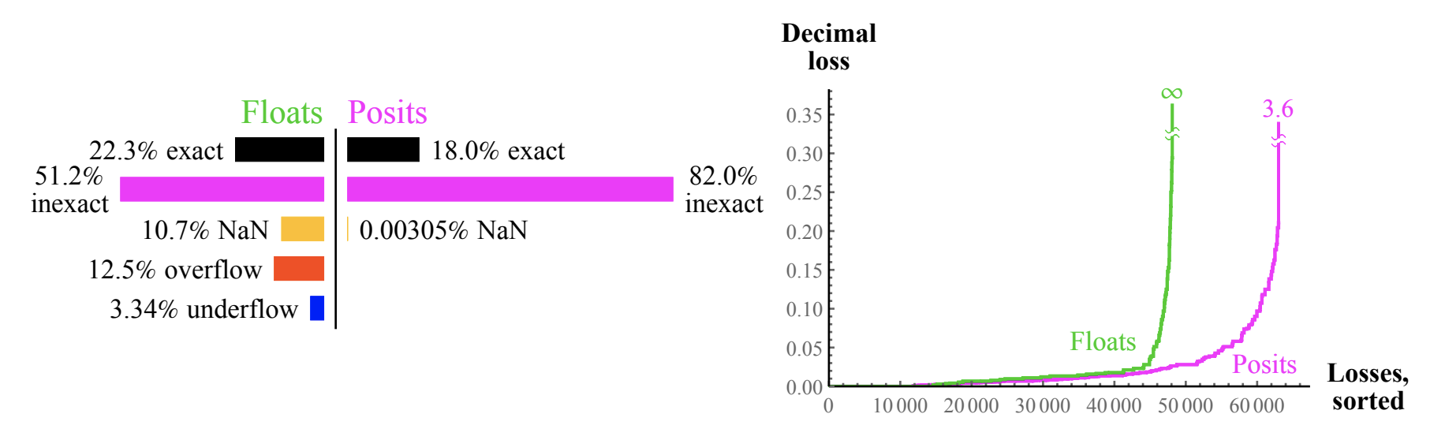
Posits vs Floats: Some Examples
8-bit multiply

Slide 11
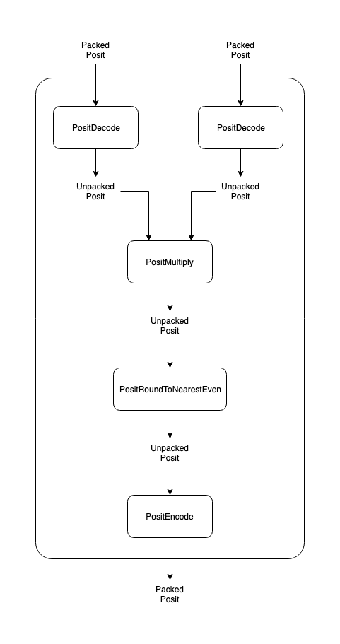
Posit Multiply
I focused on implementing a Posit Multiplier in Chisel, based off of existing Verilog
Major Components:
The Multiplication
Round to Nearest Even
Converting between packed and unpacked posits

Slide 12
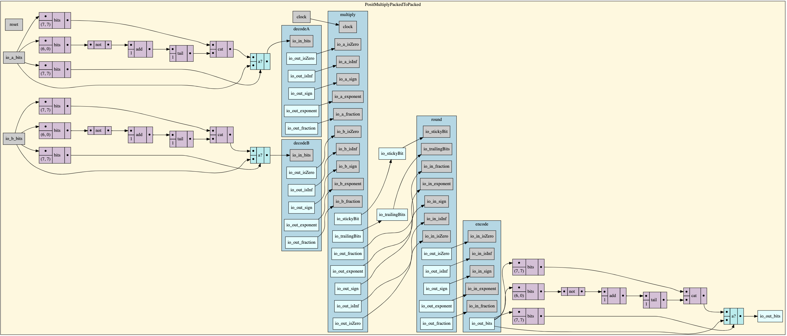
Posit Multiply

Slide 13
Chisel
I learned a new Scala-based hardware construction language to make this multiplier. It’s a Java-like way of writing (synthesizable) Verilog.
At first my Chisel code was a fairly direct translation of the Verilog, but since then I’ve been learning that Chisel has a lot more power than that.

Slide 14
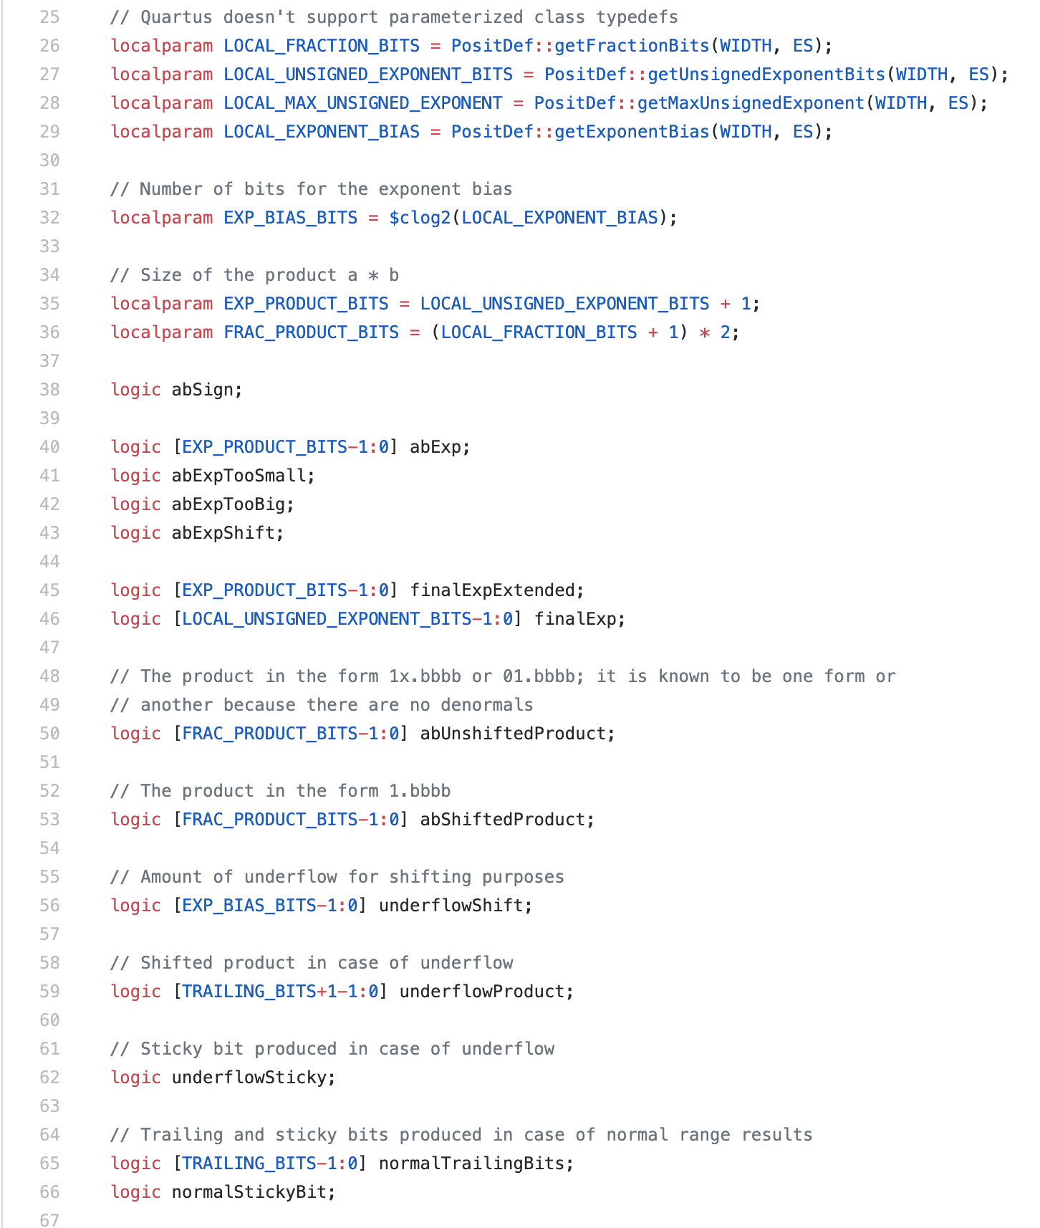
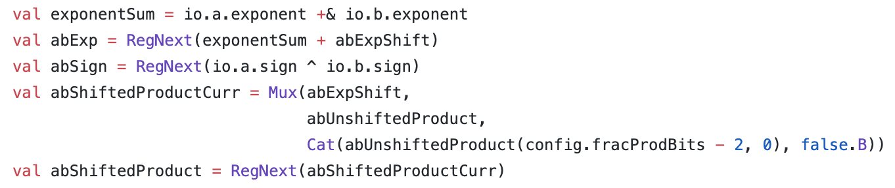



Chisel
Implicit Parameters: set params in 1 class and pass them into all others implicitly
Type inference: declare and assign wires, logic, etc. in 1 line

Slide 15
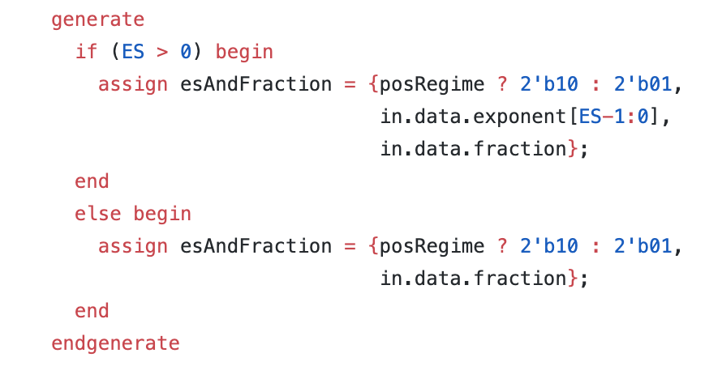
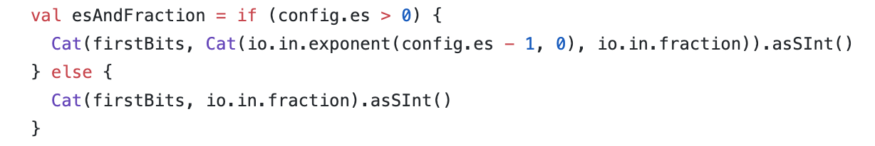
Chisel
More simplification…

Slide 16
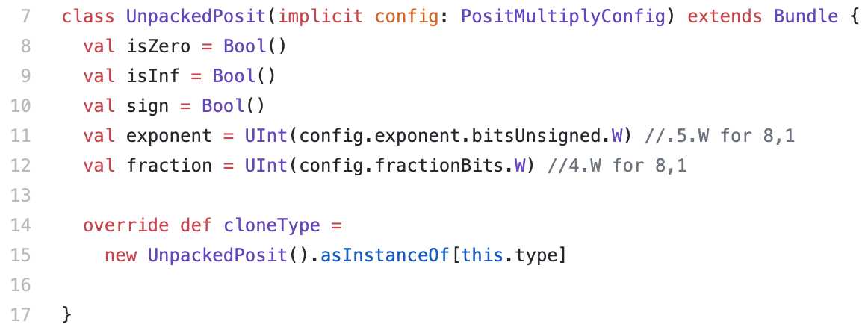
Chisel
Bundles help organize/carry data
Type casting makes it easy to assign to bundles and other structures

Slide 17
Chisel
With Chisel it’s easier to make complex, highly parameterized designs: both circuits and circuit generators
e.g., FIR Filter

Slide 18
Current Results
Have the full Packed to Packed multiplication working like the Verilog version
Have a unittest, written in chisel, for major cases and random multiplications, based off map of all 256 numbers represented by 8-bit Posit
Only tested (8,1) Posits

Slide 19
Current Results
With 3-stage pipeline (manual pipelining), multiplier runs up to ~ 133 MHz
Can run 8 multipliers in parallel on a PYNQ board at this frequency ( less resources than floating point multiplication)
Good news for using posits for training, etc., but…

Slide 20
Future Work
Training will require PositAdd, which still needs to be implemented and tested
Posit operations can be deterministic, but this requires using the quire with add, which makes it more complex than the multiplier I implemented
Also:
Extensively test other sized Posits for comparison
Need to implement better testing outside of chisel to handle rounding

Slide 21
Questions?

Slide 22
Resources
Posit Arithmetic: https://posithub.org/docs/Posits4.pdf
Beating Floating Point at its Own Game: Posit Arithmetic: http://www.johngustafson.net/pdfs/BeatingFloatingPoint.pdf

