Slide 1
Hotel Booking Demand EDA And Cancellation Prediction

Slide 2
Problem Statement
Manage Guest Data And Booking behavior Patterns To Device a Strategy For Hotels Revenue Management , Using Data Science And Machine Learning

Slide 3
Where to get the Data
* The Data is Originally From the article Hotel Booking Demand Dataset, Written by Nuno Antonio,Ana Almeida, and Luis Nunes For Data In brief,Volume22,february 2019
Data Source:
* Available On Kaggle

Slide 4
Types Of Given DataPoints
Market Segment
Offline And Online Source From Where The Booking is Generated And Related Variables
Hotel Revenue
City Or Resort Hotel, Adr Etc.
Customer Related
Variables Describing the data types of customer based on stay,whether returning,accompanied by how many etc.
Cancellation History
Has their Been Cancellation Made Earkier? etc

Slide 5
Data Description
1.hotel (str) - Hotel (H1 = Resort Hotel or H2 = City Hotel)
2.lead_time (int) - Number of days that elapsed between the entering date of the booking into the PMS and the arrival date 3.arrival_date_year (int) - Year of arrival date
4.arrival_date_month (str) - Month of arrival date
5.arrival_date_week_number (int) - Week number of year for arrival date
6.arrival_date_day_of_month (int) - Day of arrival date
7.stays_in_weekend_nights (int) - Number of weekend nights (Saturday or Sunday) the guest stayed or booked to stay at the hotel
8.stays_in_week_nights (int) - Number of week nights (Monday to Friday) the guest stayed or booked to stay at the hotel 9.adults (int) - Number of adults
10.children (float) - Number of children
11.babies (int) - Number of babies
12.meal (str) - Type of meal booked. Categories are presented in standard hospitality meal packages: (Undefined/SC = no meal package, BB = Bed & Breakfast, HB = Half board – breakfast and one other meal - usually dinner, FB = Full board – breakfast, lunch and dinner)
13.country (str) - Country of origin. Categories are represented in the ISO 3155–3:2013 format
14.market_segment (str) - Market segment designation (TA = Travel Agents, TO = Tour Operators)
15.distribution_channel (str) - Booking distribution channel (TA = Travel Agents, TO = Tour Operators)

Slide 6
Data Description
16.is_repeated_guest (int) - Value indicating if the booking name was from a repeated guest (1) or not (0)
17.previous_cancellations (int) - Number of previous bookings that were cancelled by the customer prior to the current booking
18.previous_bookings_not_canceled (int) - Number of previous bookings not cancelled by the customer prior to the current booking
19.reserved_room_type (str) - Code of room type reserved. Code is presented instead of designation for anonymity reasons 20.assigned_room_type (str) - Code for the type of room assigned to the booking. Sometimes the assigned room type differs from the reserved room type due to hotel operation reasons (e.g. overbooking) or by customer request. Code is presented instead of designation for anonnymity reasons
21.booking_changes (int) - Number of changes/amendments made to the booking from the moment the booking was entered on the PMS until the moment of check-in or cancellation
22.deposit_type (str) - Indication on if the customer made a deposit to guarantee the booking. This variable can assume three categories: (No Deposit = no deposit was made, Non Refund = a deposit was made in the value of the total stay cost, Refundable = a deposit was made with a value under the total cost of stay)
23.agent (float) - ID of the travel agency that made the booking
24.company (float) - ID of the company/entity that made the booking or responsible for paying the booking. ID is presented instead of designation for anonymity reasons

Slide 7
Business Questions
Lets see cancellation split between type of hotels.
Favourites meal of guests
Maximum no of previous bookings not canceled according to the hotel
Maximum no cancellation according to the market segement
Maximum cancellation in which month?
Maximum cancellation of total of special requests?
How many guest arrived in each hotel month per year in each hotel?
Maximum people arrived date in the month
Maximum no guests coming from which country?
Maximum cancellation in which month?
Maximum cancellation in which year?
Market segment by country

Slide 8
EDA On Variables
Explore the patterns formed by the variables and try to draw insights from their variables relationship.Listed below are some key ideas that can be explored as a part of EDA.
Examples
Do Cancellation differ by type of Hotel ?
Do Cancellation Rates have a Time Trend ?
Where Do The Cancellation Originate From ? How Do They Diffe By Different Market Segments ?
How Does Lead Time And Average Daily Rate Differ?
What Is Relationship Between Lead Time And Cancellation Rate Related To Each other ?

Slide 9
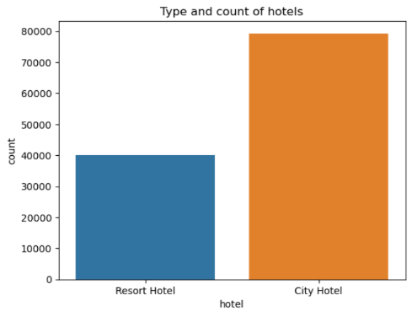
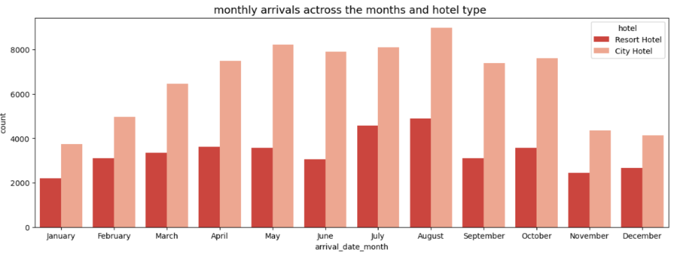
EDA – Part
Taking a Look at overall Cancellations And Arrival Date Patterns
City Hotels Have More cancellations Than A Resort Hotel
Cancellations Typically reduces in the beginning of the month
The Absolute number of cancellations are increasing .
We may want to study the profile of cancellations from a source perspective

Slide 10
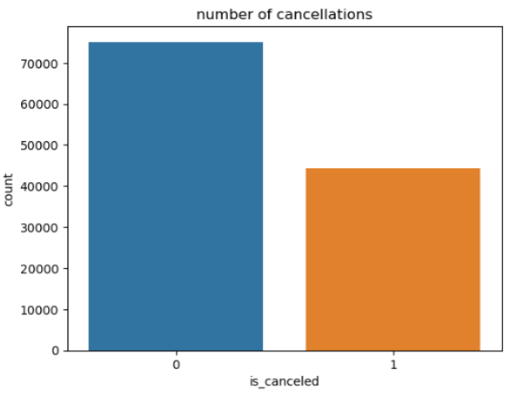
EDA Part -
Plotting the cancellation rate over time to uncover relationship between arrival Time And Likelihood To Cancel
Base line Cancellation Likelihood For City Hotels is More
Base line Cancellation Likelihood For Resort Hotels is Less

Slide 11
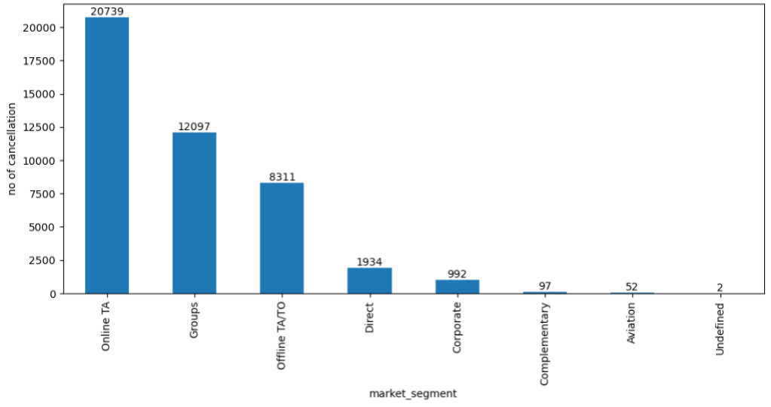
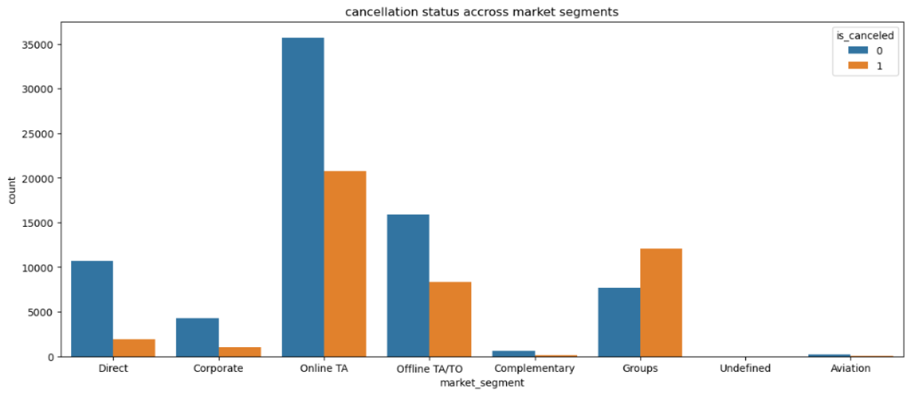
EDA Part
Understanding Cancellation By Market Segments
Cancellation Rates by Market Segment
Cancellation Rate by market Segment And Hotel Type
Online , Offline TA Ad Groups Lead The Cancellations Rate
The Hotel Type Affects The Cancellation Rates

Slide 12
Data Pre – Processing - Part
Dependent Variable – The Cancellation Of Booking Will Be The Dependent variable In our Project
Modeling Hypothesis
We Shall Try to Build Separate Models For Resort Hotel And City Hotel.
Build Indicator or One _ Hot Encoded Variables That Maximize The discrimination.
Explore Bi-Variant Relationship to Check If Specific Pockets Can Be Identified Where Likelihood Capture Maximize
For Example – returning Customers Who Belong to Transient Party Category
Treat The Company Variable and Create Some Bins Out of It..Interact The Bins With The Customers Type And Check For Possibilities As Described Above.
Build And Engagement Index Of The Booking To asses Hoe deeply Is The Customer Likely To Embed In The Hotel’s Service.

Slide 13
Data Pre – Processing - Part
Pre – Processing Is Divided Into Two Steps – Derived Features Creation And Fundamental Data Cleaning
Bivariate Rank Analysis
Variables Cleaning And Selection
Generate a Percentile Distribution Of Variable.
Collect Extreme Value Lying Beyond The(P1 to P99) Range And Create an Outlier File.
Divide The Remaining Values In Deciles.
Analyse The Inactivity Rate Deciles.
Calculate Missing Value Percentage . Discard If Feature Has More Than 25% Missing Value.
Calculate Mean And Standard – Deviation Of Numerical Variables – Discard If Standard Deviation is 0.
Discard The Variables That Do Not Show Any Discrimination Across The Cancellation Rate.

Slide 14
Classification Methodologies To Consider
Bi – Directional Approach : Strong Classifier algorithms(Parametric And Non-Parametric) Can Be tested And Results Compared For Final deployment.
Statistical approach
Tree Based ML Learning
Logistic Regression
This Model Will have Weights Or Coefficients For Individual Features.
Flexibility To Create Custom target Segment based On Predicted Probability Of Each Client .
Decision Tree And Random Forest And GBM
Generates A set Of Rules That Can Be Visually interpreted And Radially Deployed For Decision Making.
Captures Interactions and Non-Linearity In the Data As Predictors Relate Themselves To The Dependent Variable.

Slide 15
ML – Actionable Strategy
Outcome Of The Project Is Best Conveyed With Business Context And Impact.
An Example Of Strategy
Low Engagement
High Engagement
High Cancel Prob
Encourage To Cancel Son
Lower Days To cancel
Low Cancel Prob
No Action
Lower ADR

