Slide 1

Page Object Model
Page Object Model – is a design pattern used in test automation to organize source code, improve maintainability and reusability of the code.
NOTE: There is no industry implemented standard
Core concept – every page of the web application has own “class” with a methods/functions responsible for operations on this page.

Slide 2
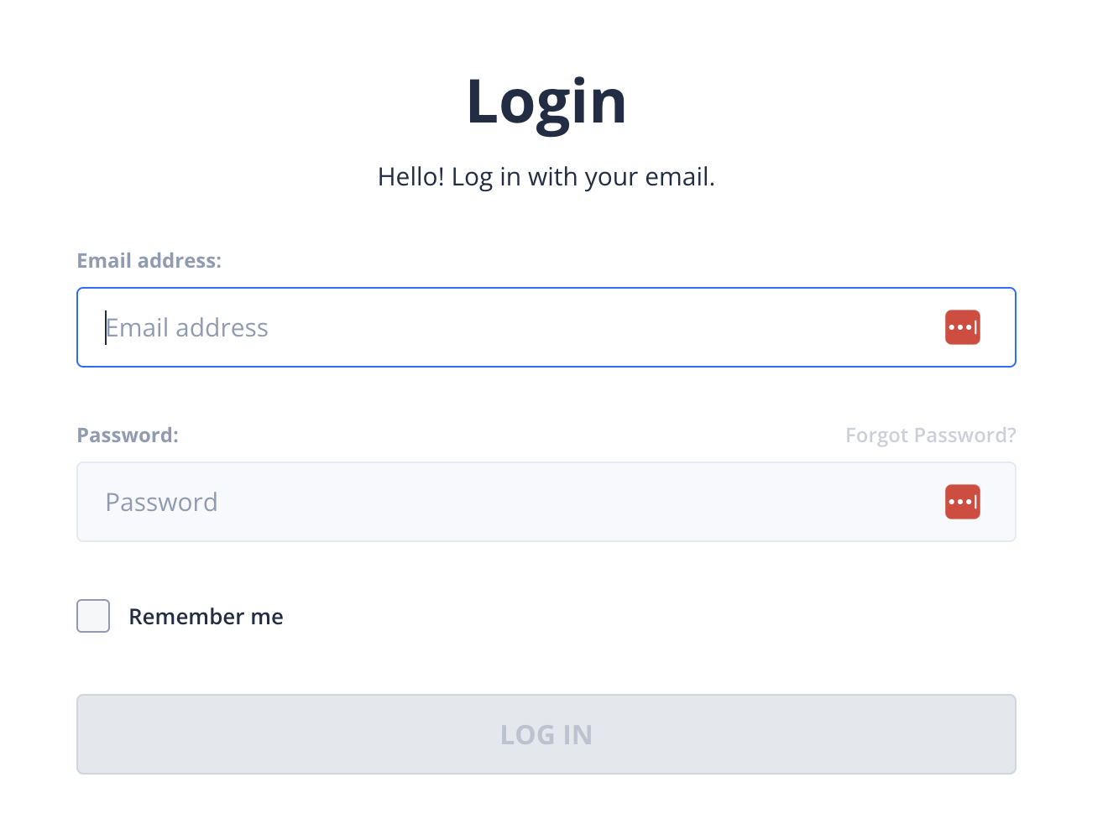
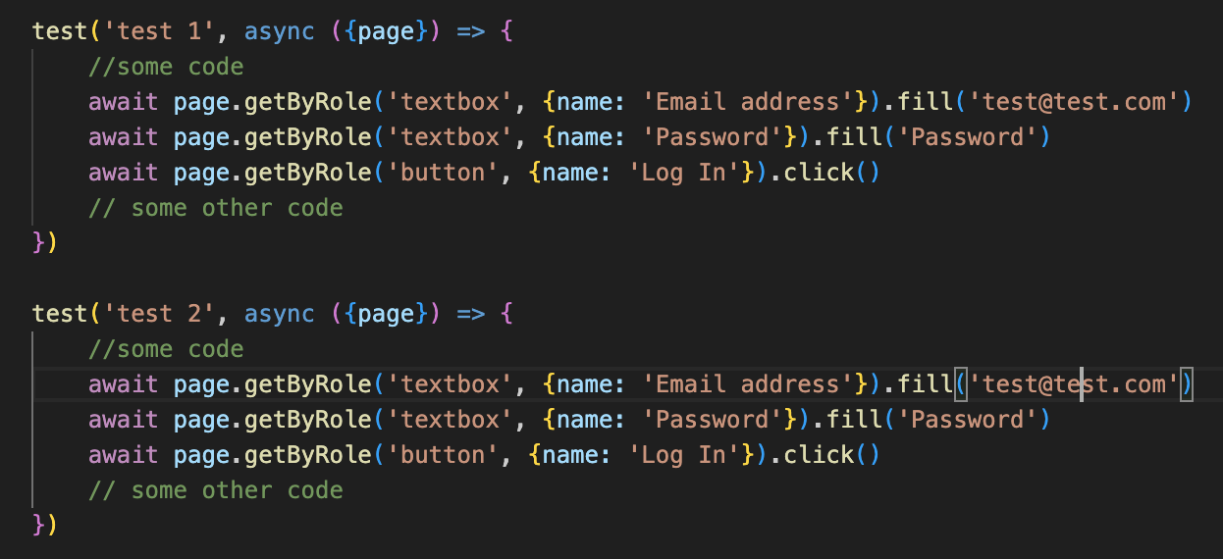
Page Object Model

Slide 3
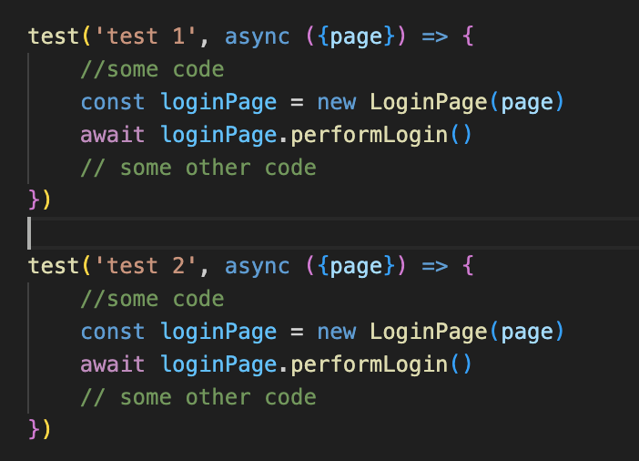
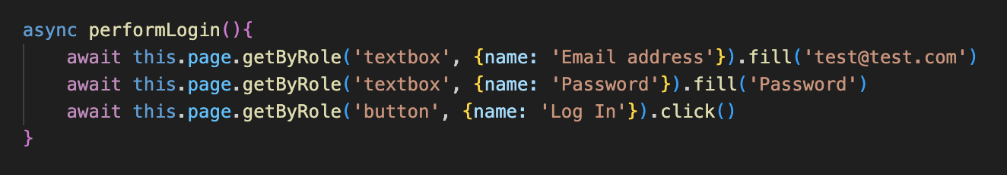
Page Object Model

Slide 4
Page Object Model
Two important principles
DRY – Don’t Repeat Yourself
KISS – Keep It Simple Stupid

Slide 5
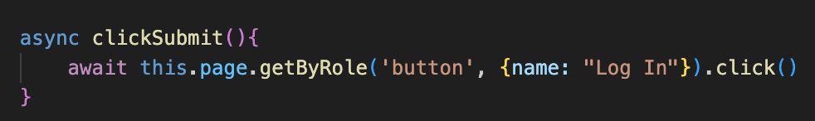
Page Object Model
Two useful practices
Descriptive naming
Avoid tiny methods

