Slide 1
LDAP

Slide 2
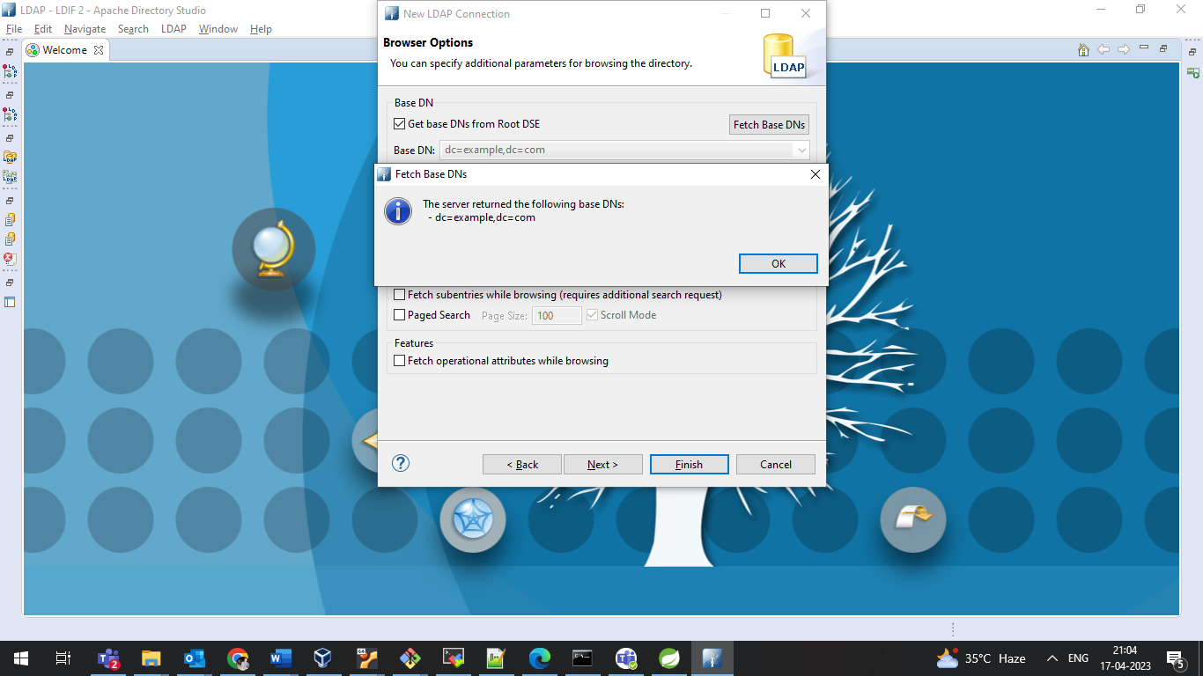

Slide 3
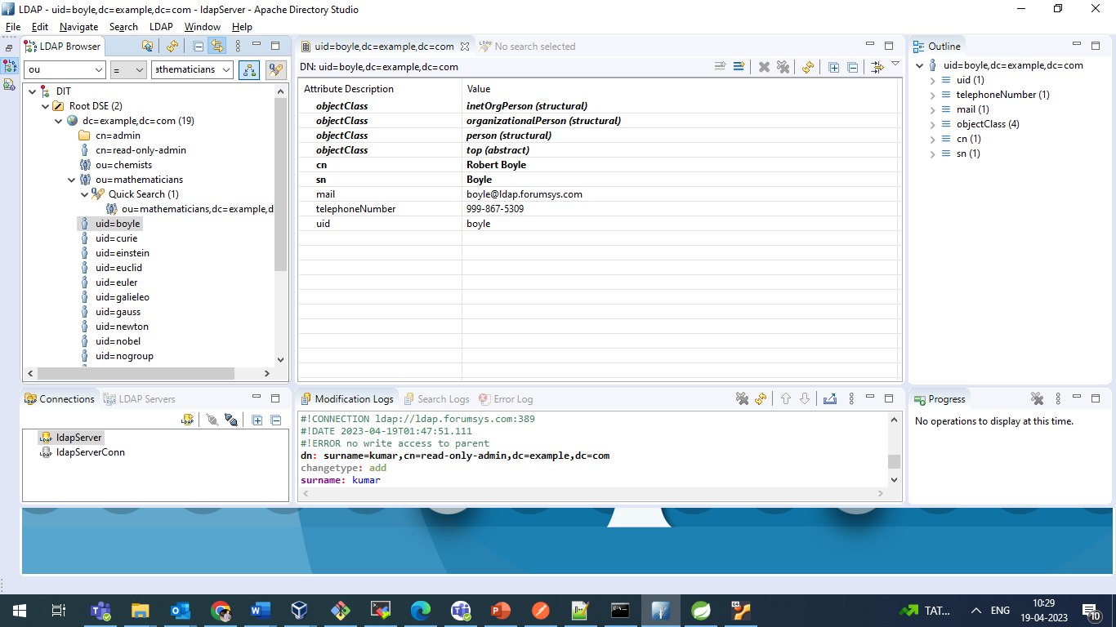

Slide 4
ldap://ldap.forumsys.com:389/ou=mathematicians,dc=example,dc=com
https://camel.netlify.app/components/latest/spring-ldap-component.html
http://www.masterspringboot.com/security/authentication/securing-spring-boot-applications-with-ldap/
madhavi modali9:53 AM
https://docs.spring.io/spring-ldap/docs/current/reference/
madhavi modali9:54 AM
https://memorynotfound.com/spring-boot-spring-ldap-advanced-ldap-queries-example/

Slide 5
Object class is the grouping of objects that can be described in terms of the attributes its members have in common

Slide 6
// TODO Auto-generated method stub
//.getIn().setBody("(ou=mathematicians)");
//exchange.getIn().setBody("(objectClass=*)"); //all users from all group
//(&(objectClass=groupOfUniqueNames)(objectClass=top)(cn=Mathematicians)(uniqueMember=uid=euclid,dc=example,dc=com)(uniqueMember=uid=euler,dc=example,dc=com)(uniqueMember=uid=gauss,dc=example,dc=com)(uniqueMember=uid=riemann,dc=example,dc=com)(uniqueMember=uid=test,dc=example,dc=com)(ou=mathematicians))
//exchange.getIn().setBody("(ou=Mathematicians+Chemists)");
//
//exchange.getIn().setBody("(&(cn=Mathematicians)(&(member=*)))");
//exchange.getIn().setBody("(ou=Mathematicians)(&(member=*))");
//exchange.getIn().setBody("(objectClass=groupOfUniqueNames)");
//exchange.getIn().setBody("(objectCategory=Chemists)(memberOf=cn=Chemists)");
//(objectClass=groupOfUniqueNames)&(cn=*)
//exchange.getIn().setBody("(objectClass=person)");
//exchange.getIn().setBody("(&(objectClass=groupOfUniqueNames)(ou=mathematicians))"); //working
//exchange.getIn().setBody("(&(objectCategory=*)(memberOf=cn=Mathematicians))");
//exchange.getIn().setBody("(&(objectClass=groupOfUniqueNames)(cn=Mathematicians)(member=cn=admin,dc=com,dc=com))"); //working
exchange.getIn().setBody("(ou=scientists)"); //working
//exchange.getIn().setBody("uid=euclid");
//exchange.getIn().setBody("(objectClass=inetOrgPerson)");

Slide 7
https://www.ibm.com/docs/en/sdse/6.4.0?topic=categories-ldap-error

