Slide 1

sawankarn/factory-design-pattern-code-ppt (github.com)
Design Pattern

Slide 2
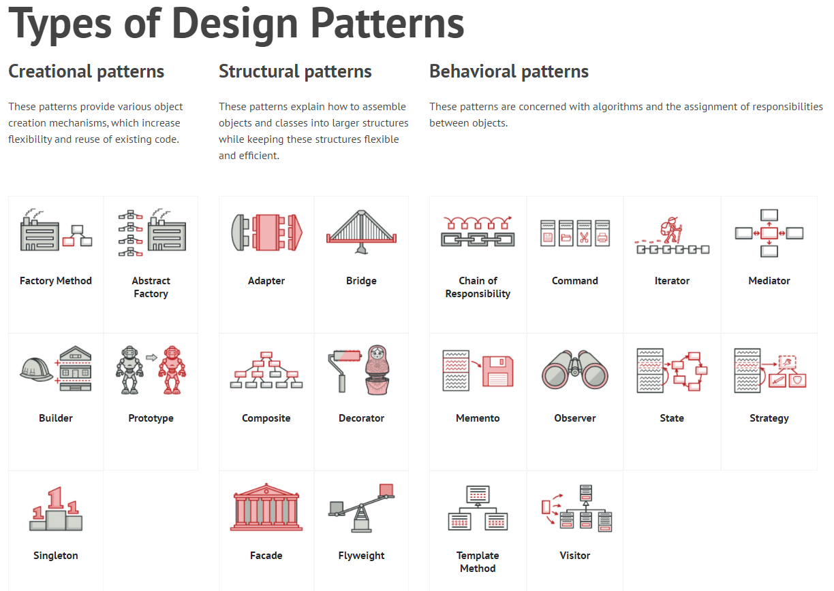
sawankarn/factory-design-pattern-code-ppt (github.com)

Slide 3
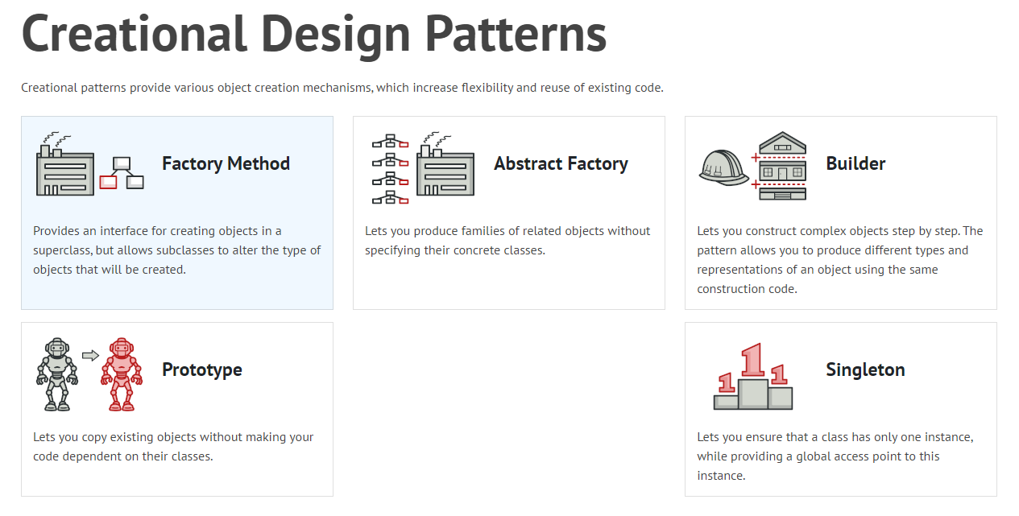
sawankarn/factory-design-pattern-code-ppt (github.com)

Slide 4
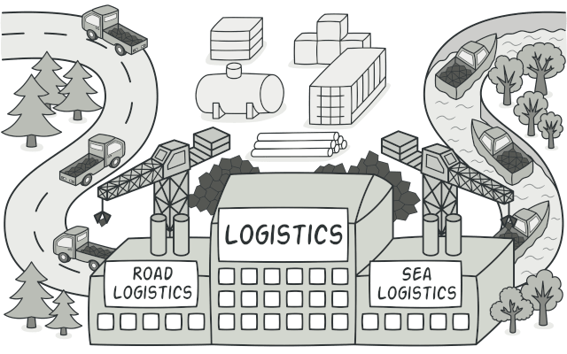
sawankarn/factory-design-pattern-code-ppt (github.com)
Imagine that we are working on logistic management application. And in the first version of application can handle transportation by trucks only.
All code based logic written only for Truck.

Slide 5

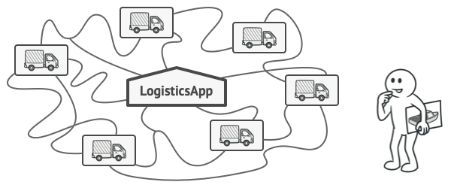
sawankarn/factory-design-pattern-code-ppt (github.com)
?
As we are using Agile methodology and client want to add Ship transportation also in the application. Adding Ships into the app would require making changes to the entire codebase.

Slide 6

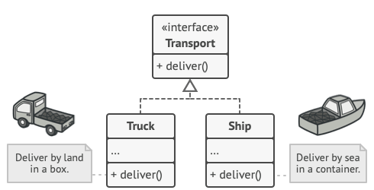
sawankarn/factory-design-pattern-code-ppt (github.com)
Here Factory design pattern comes in the role. Both Truck and Ship classes should implement the Transport interface, which declares a method called deliver.
Each class implements this method differently: deliver by truck, deliver by ship.

Slide 7
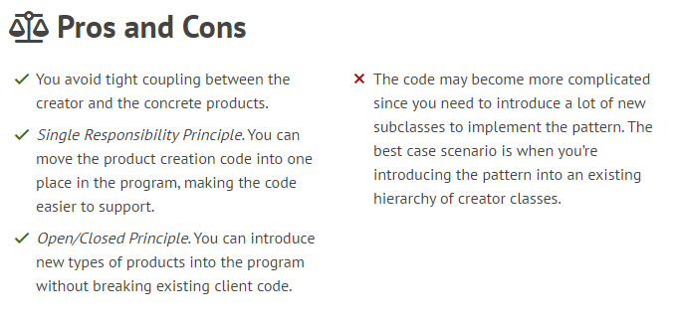
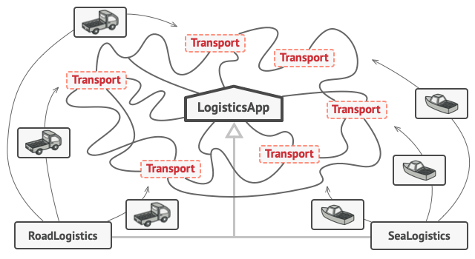
sawankarn/factory-design-pattern-code-ppt (github.com)

