Slide 1
Eye Monitored Wheel Chair

Slide 2
Outline Of Work
IMAGE PROCESSING AND CONTROL
This includes the algorithm to track the eye and generation of signal according to a perticular position of eye.
CIRCUIT ASSEMBLY AND MICROCONTROLLER
Assemblying the microcontroller and interfacing it with the motors and MATLAB.
HARDWARE ASSEMBLY
Making the prototype and combining all the parts together in a signal unit.

Slide 3
IMAGE PROCESSING AND CONTROL
1

Slide 4
Processing the image captured from the webcam in order to find the position of eye and then generate a specific signal to control the motor.

Slide 5
IMAGE PROCESSING AND CONTROL
Methods used
Morphological Image Processing
Template Matching
Concentration Shift
We worked on all the 3 method but the best results are obtained in the last method that is CONCENTRATION SHIFT

Slide 6

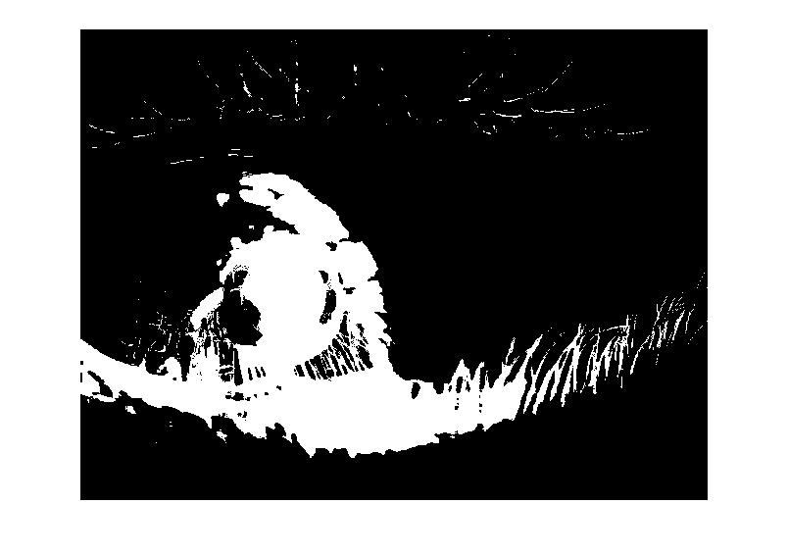
Concentration Shift
Pupil is the major part of eye.
Darker than other parts.
On thresholding we get a black and white image.
Most of the parts in that image is due to pupil.

Slide 7
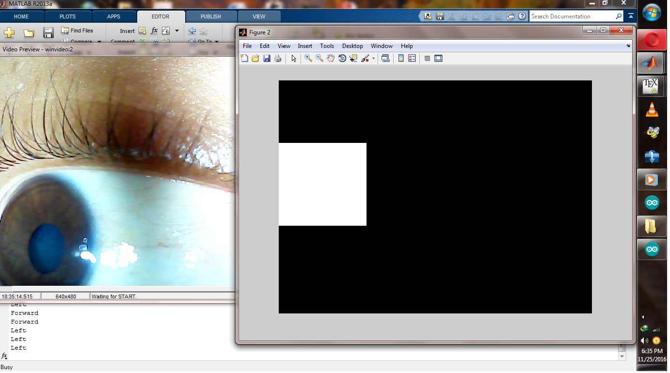
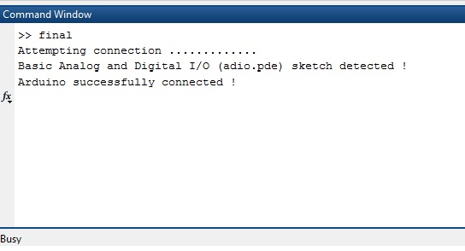
What after we get the binary image?
Can be divided into 2 parts:-
Processing
Detecting Shift
Detecting Region
Control
Initializing Arduino
Sending specific signal

Slide 8
CIRCUIT ASSEMBLY AND MICROCONTROLLER
2

Slide 9
Connection of every component with the Arduino.

Slide 10
CIRCUIT ASSEMBLY AND MICROCONTROLLER
Motor connected to port 10,11,12,13 digital pins of Arduino Uno R3 board.
Two ports are used to drive one motor because the output of digital pins are only 20mA.
USBASP is used to connect the Arduino with laptop.
Two LED’s are connected for better visualization.

Slide 11
HARDWARE ASSEMBLY
3

Slide 12
All the small parts, circuit and system will be assembled in a signal unit.

Slide 13
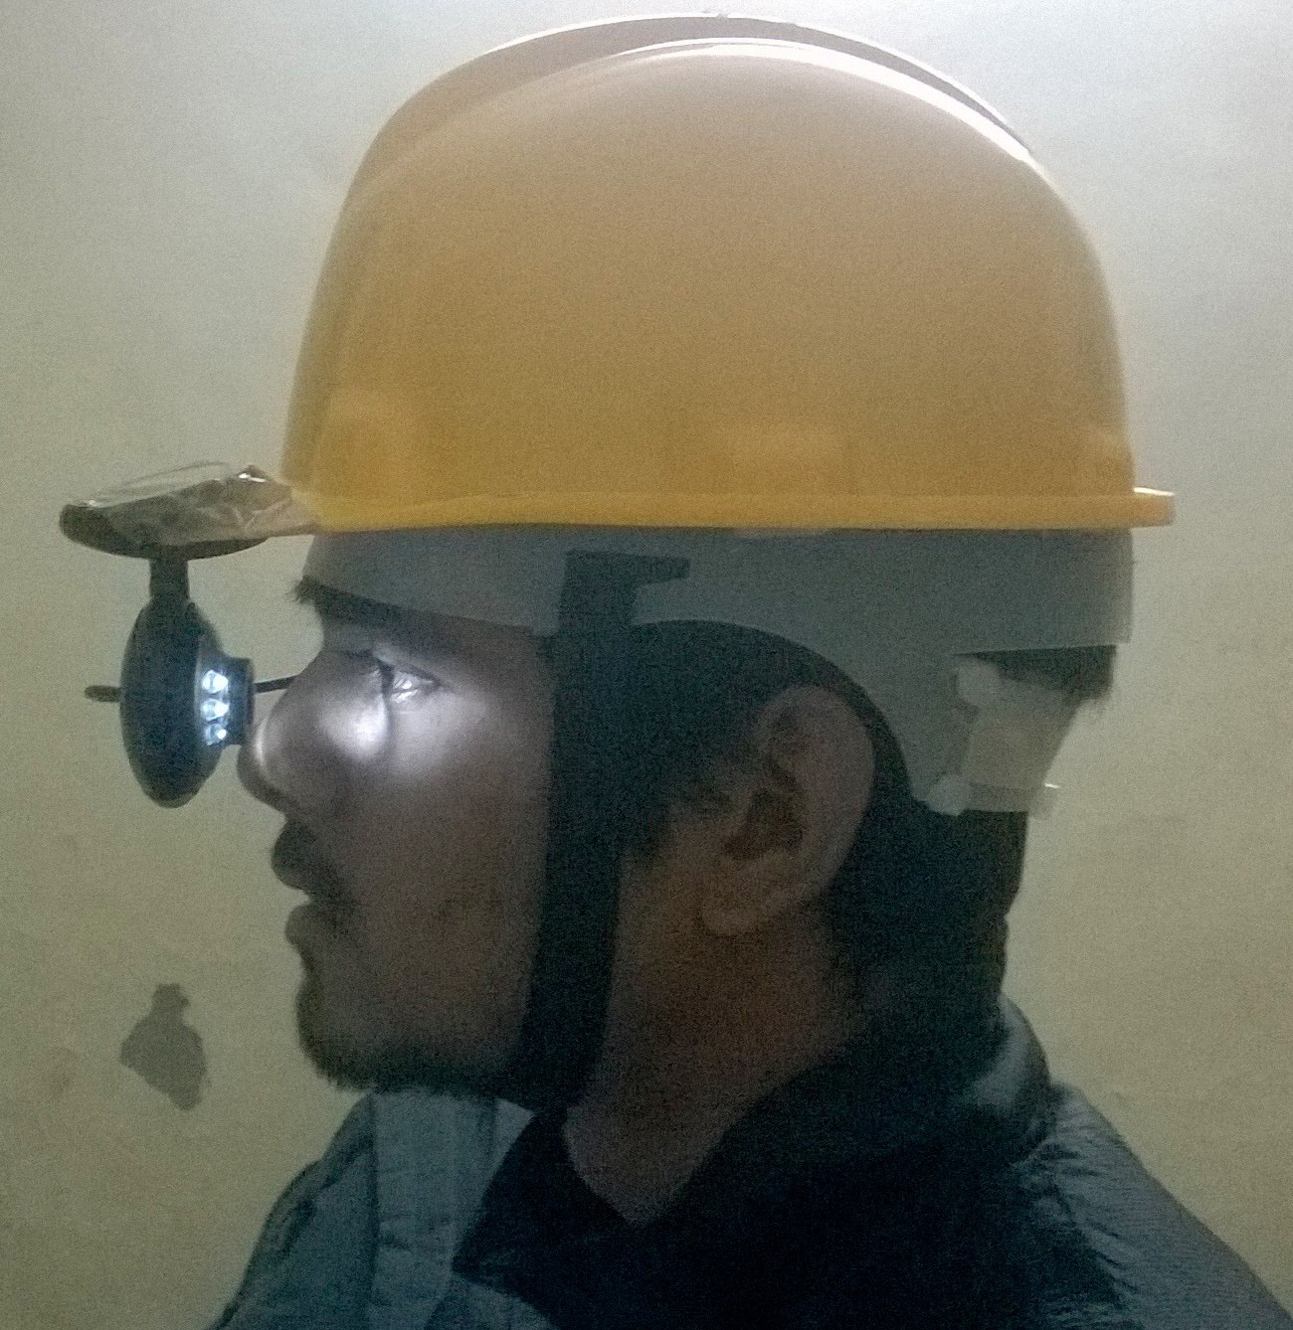
HARDWARE ASSEMBLY
Can be divided into 2 parts:-
Helmet Assembly
Mounting Webcam
Wheel Chair Prototype Assembly
Motor Assembly.
Component Assembly.
Arranging real wheel chair with motors, if possible.

Slide 14
Worked Completed.
Adjustable Webcam Assembly On Helmet.
Image Processing.
Tracking Eye.
Generating Control Signal.
Driving Motors Through Arduino.

Slide 15
Work To Be Completed In Next Semesters
Wheel Chair Assembly.
Driving High Power Motors Through Arduino Using Relays.
To Introduce Safety Features, If Possible.

Slide 16
Thank You!
Sawan Singh
Raj Gaurav Tiwari
Akriti Gupta
Shivam Chaubey

