Slide 1
MULTIUSER CHAT APPLICATION
Submitted to : PRESENTED BY:-
Dr. Namita Mittal SANWAT RAM JAT(2015UCP1317)
DEEPAK CHOUDHARY(2015UCP1437)
HIMANSHU VERMA(2015UCP1155)

Slide 2
contents
INTRODUCTION
MODULE AND DESCRIPTION
FRONT END AND BACK END
SCREEN SHOTS THAT SHOW WORK FLOW OF THE PROJECT

Slide 3
introduction
Our project is an example of chat application which basically based on private chatting
It is made of two application
Client application which runs on user’s PC
Server application which runs on any PC on the network
To start chatting client should get connected to server

Slide 4
MoDULe AND DESCRIPTION
Server Modules:
A server is a specially equipped computer connected to the internet that allows users with chat clients to converse with one another via typed messages in real time.
Client Module:
A client is a software program that allows users to connect to chat servers and communicate with other users via a chat room.

Slide 5
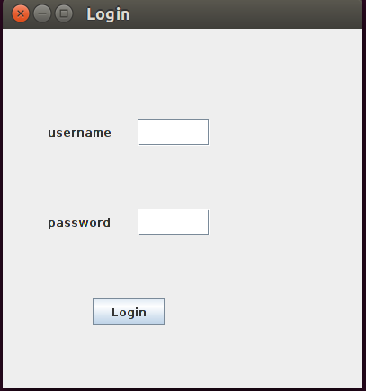
Login Front End

Slide 6
Login
Once a User logged in,will redirect to that User List.

Slide 7
User List
In this list the user will able to see that other user’s that are conected to the Server so all user will show as Online in this list.
From this List for User will select the other client for chating and by compressing on that will redirect it to that client message window.

Slide 8
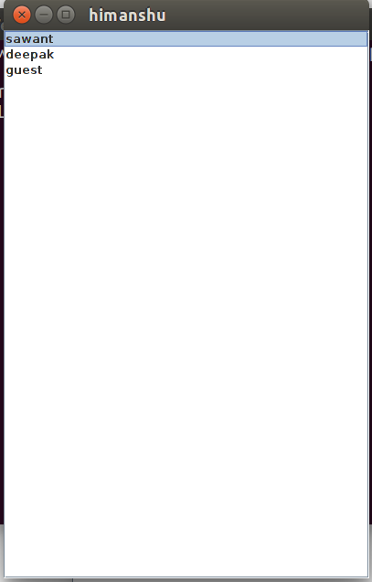
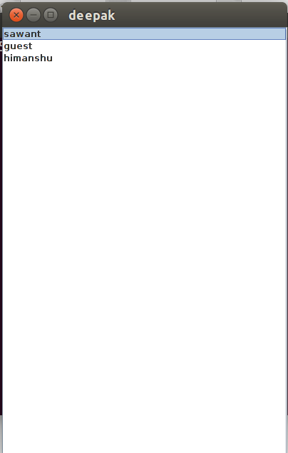
User List

Slide 9
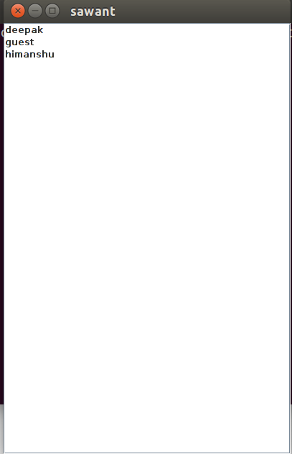
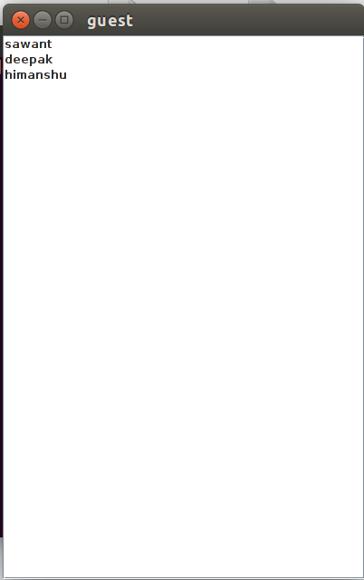
User list

Slide 10
Message window
Once a user double click on one of online client he will redirect here and client that he selected to chat should also open this window for user.
Once both side window is open,they can send messages to each other.
One user can chat with multiple user at a time.

Slide 11
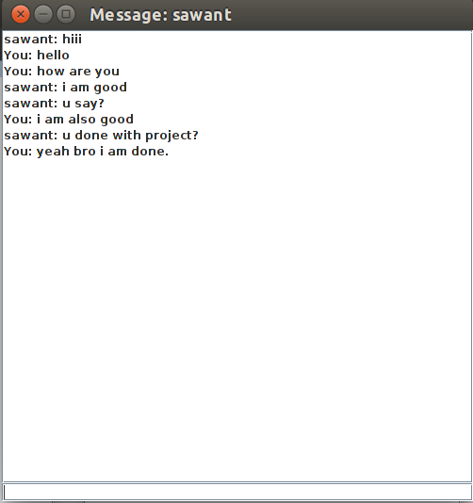
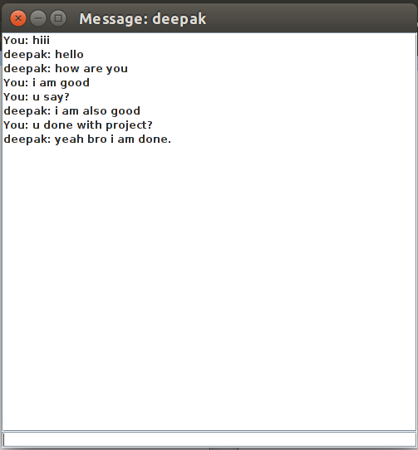
Message window

Slide 12


